Slide 1
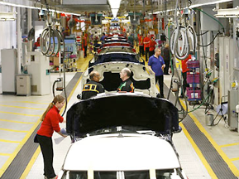
Decision Making
Session 4
Stephen Gilbert
https://youtu.be/Cv6tuzHUuuk?t=8s

Slide 2
What explains how people make decisions?

Slide 3
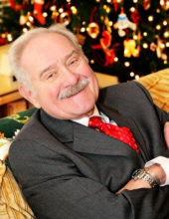
Dr. Ray Gilbert
“People do things that make sense to them at the time.”

Slide 4
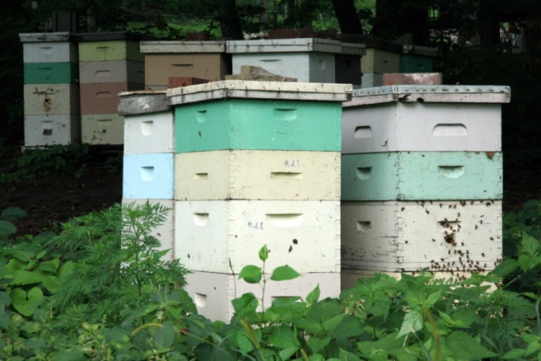
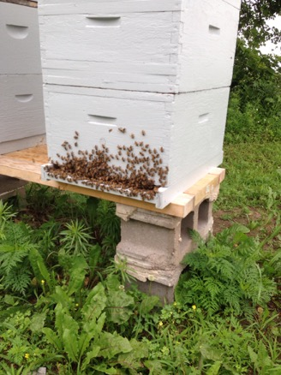
The Nature of Truth: Epistemology
“Bearding”

Slide 5
Philosophical Frameworks
Paradigms/Epistemologies, Theoretical Perspectives, and Methodology
Slides by Dr. Joanne Marshall

Slide 6
Research Framework Derived from Crotty, 1998
Notes:
You’ll get to read Crotty for 1/25. It is dense.

Slide 7
Philosophy first

Slide 8
Philosophy informs paradigms

Slide 9
Philosophical frameworks
“Paradigms shape research at its most basic level; worldviews frame the type of questions asked and what the answers might look like.”
--Brodio & Manning (2002), p. 435

Slide 10
Philosophical frameworks
“Paradigm shift”
Positivism vs. Postmodernism (philosophical paradigm)
Objectivism vs. Constructionism (Epistemology)

Slide 11
Positivism
Auguste Comte (19th c.)
System of philosophical and religious doctrines
Scientific inquiry must rely on observable data

Slide 12
Postmodernism
Artistic, philosophical, and cultural movement
Resists universals and encourages fractured, fluid and multiple perspectives.

Slide 13
Philosophy of Positivism  Objectivist Paradigm
World exists in objectively knowable, singular, natural law-abiding reality
Goal of science is to predict & control -- applies across contexts

Slide 14
Philosophy of Postmodernism  Constructionist Paradigm
= Naturalistic, Hermeneutic, Interpretive
People interact with each other and the world in complicated, context-specific ways to construct knowledge
Knowledge / reality is social

Slide 15
Philosophical frameworks
Positivism | Postmodernism
Objectivism | Constructionism
Objectivity | Subjectivity
Absolutism | Relativism
Control | Context
Quantitative | Qualitative
Vygotsky
&
Situated Action by Lucy Suchman

Slide 16
Why is this HCI?
We build tools to help people act on the world, which involves making decisions.

Slide 17
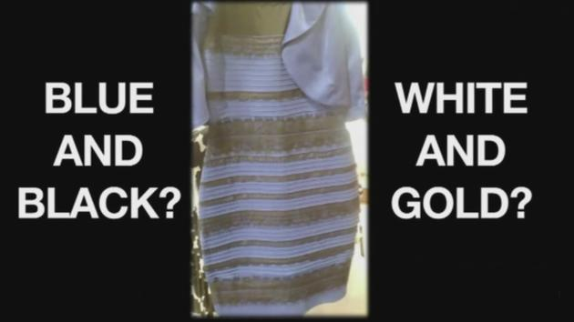
Decision Making Steps
Perception
Judgment
Choice
Decision
Action

Slide 18
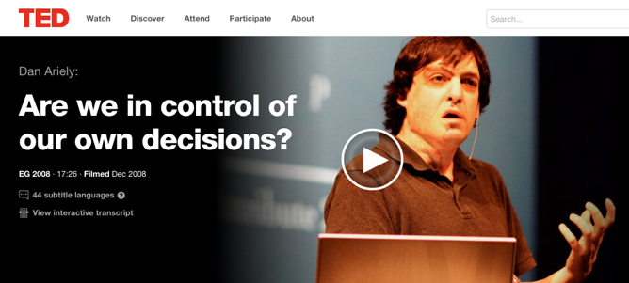
Dan Ariely

Slide 19
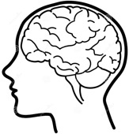
The Nature of Truth: Epistemology
Hammond, 2007
Katsikopoulos, 2009
Correspondence
Accuracy
Empirical
Environment focus
“Does it match the world?”
Plato, Aristotle
One Truth
Reading flight gauges
Weather prediction
Childbed fever (after germs)
Newtonian physics
Coherence
Goodness of Process
Consistency
Rationality
“Does it match our model?”
Kant
More than one truth
Prepping for landing
Playing chess
Childbed fever (before germs)
Quantum physics
Relationship to ethics (http://www.justiceharvard.org/)

Slide 20
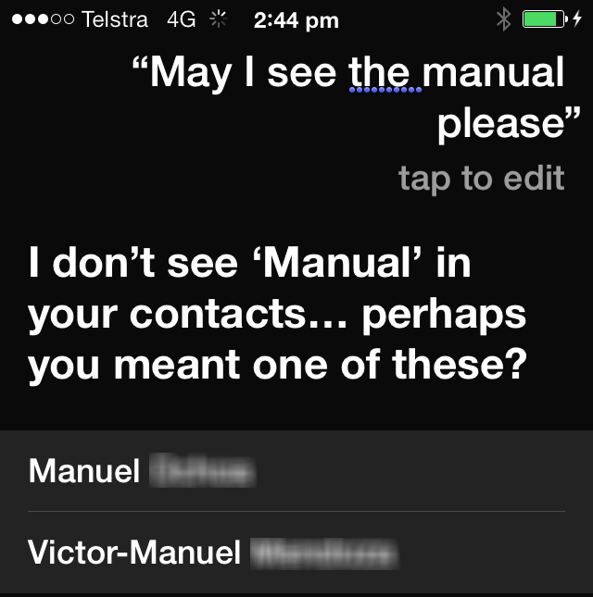
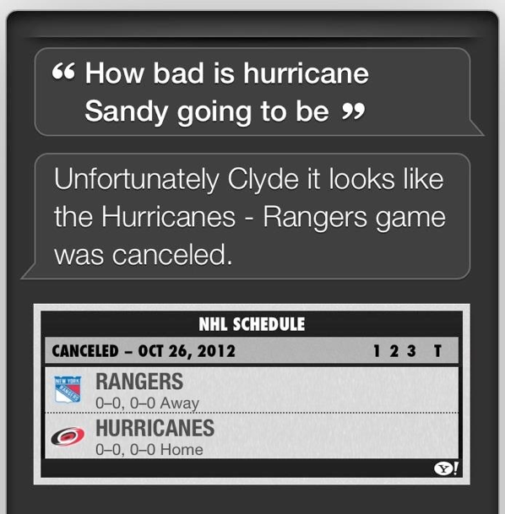
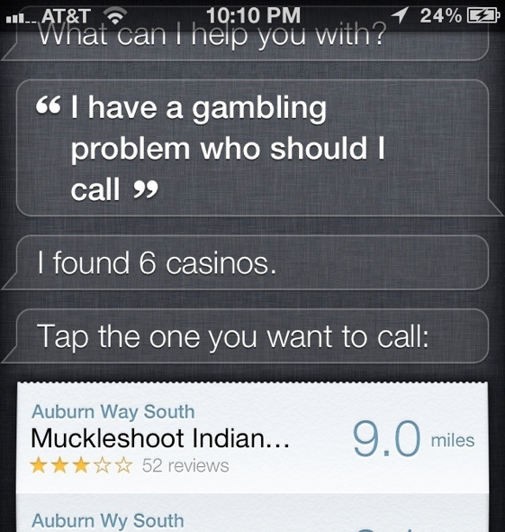
Kathleen Mosier – Hybrid Ecology
Natural
Probabilistic info
Ambiguity
Correspondence
Intuitive
Electronic
Data
Reliability
Coherence
Analytical

Slide 21
Decision Making on the Fly
Signs in the Corner Activity

Slide 22
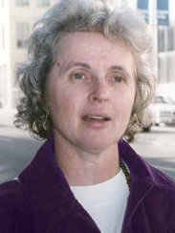
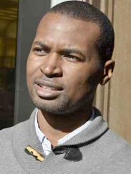
Brunswik’s Lens Model
Correspondence
It’s a vase.
It’s two faces.
the individual matters

Slide 23
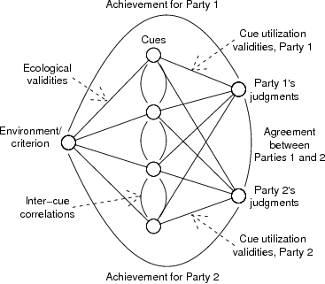
Brunswik’s Lens Model
Correspondence

Slide 24
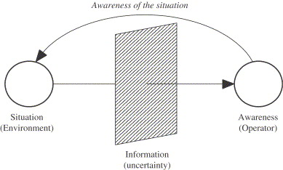
Correspondence
user
interface
Are operator’s judgments correlated with actual states?
Alex Kirlik

Slide 25
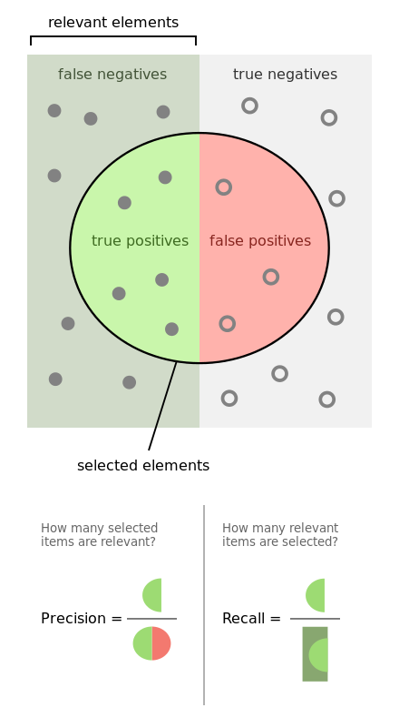
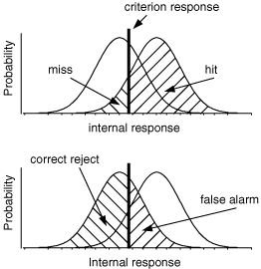
Signal Detection Theory
Correspondence

Slide 26
Naturalistic Decision Making
Correspondence
Gary Klein
Poorly structured problems
Expertise:
knowledge
cue processing differs for novices & experts
experience
All about judgment of the situation.
Notes:
Museum 2.0 analogy – museums have changed so much…just like NDM is evolved dramatically from analytical models

Slide 27
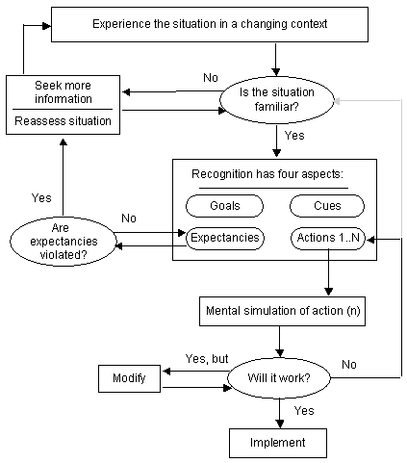
NDM
Correspondence
Hybrid environment can mess with this.

Slide 28
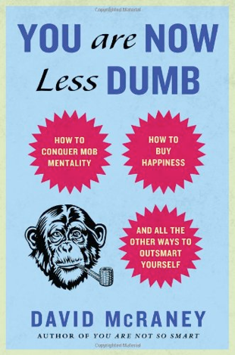
Heuristics & Biases
Coherence
Kahneman & Tversky
Attempts to model human judgment, even though it violates Bayesian thinking.
Availability – What can I remember?
Representativeness – How typical is it?
Framing – What’s the story?
Automation as a heuristic (can violate coherence)

Slide 29
More Heuristics
Coherence
Recognition – If you recognize it, it’s better/bigger/more known.
Do what everyone else does
Default – Don’t change a default
Take-the-best & Tallying – validity of cues
Fast & Frugal Trees – Q&A, one outcome per Q
When do these work well vs. badly?

Slide 30
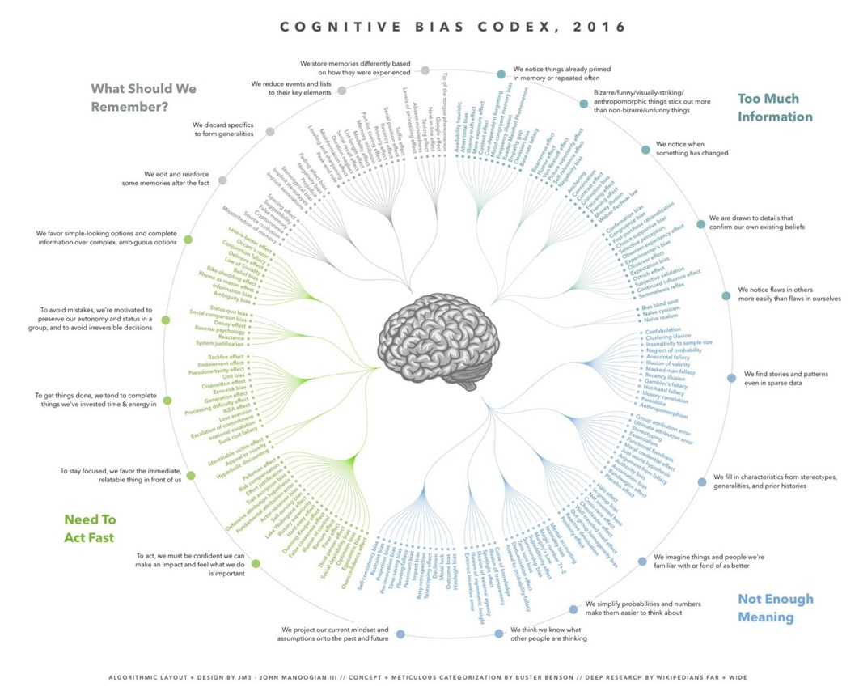

Slide 31
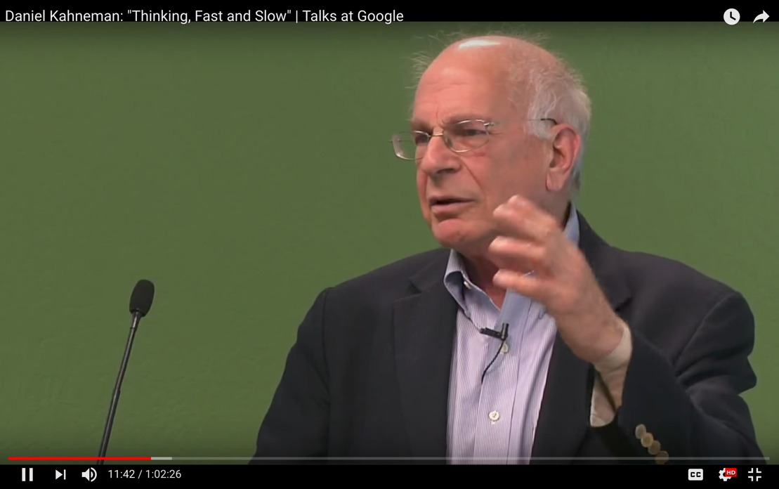

Slide 32
Summary
Decision making is hard to predict.
It probably requires both mental models and data from the world.
We haven’t solved it yet.

