Slide 1
Introduction to Unity3D
Kate Wang and Rhoda Asamoah

Slide 2
Game Engines
Game engines are designed for the creation and development of 2D/3D games
Components
Renderer
Physics Engine
Sound
Scripting
Animation
Artificial Intelligence
Networking
Scene Graph

Slide 3
Unity3D
Free game engine
Provides all the components of any modern game engine
Cross Platform (PC, Xbox, Tablet, Phone, etc.)
http://unity3d.com

Slide 5
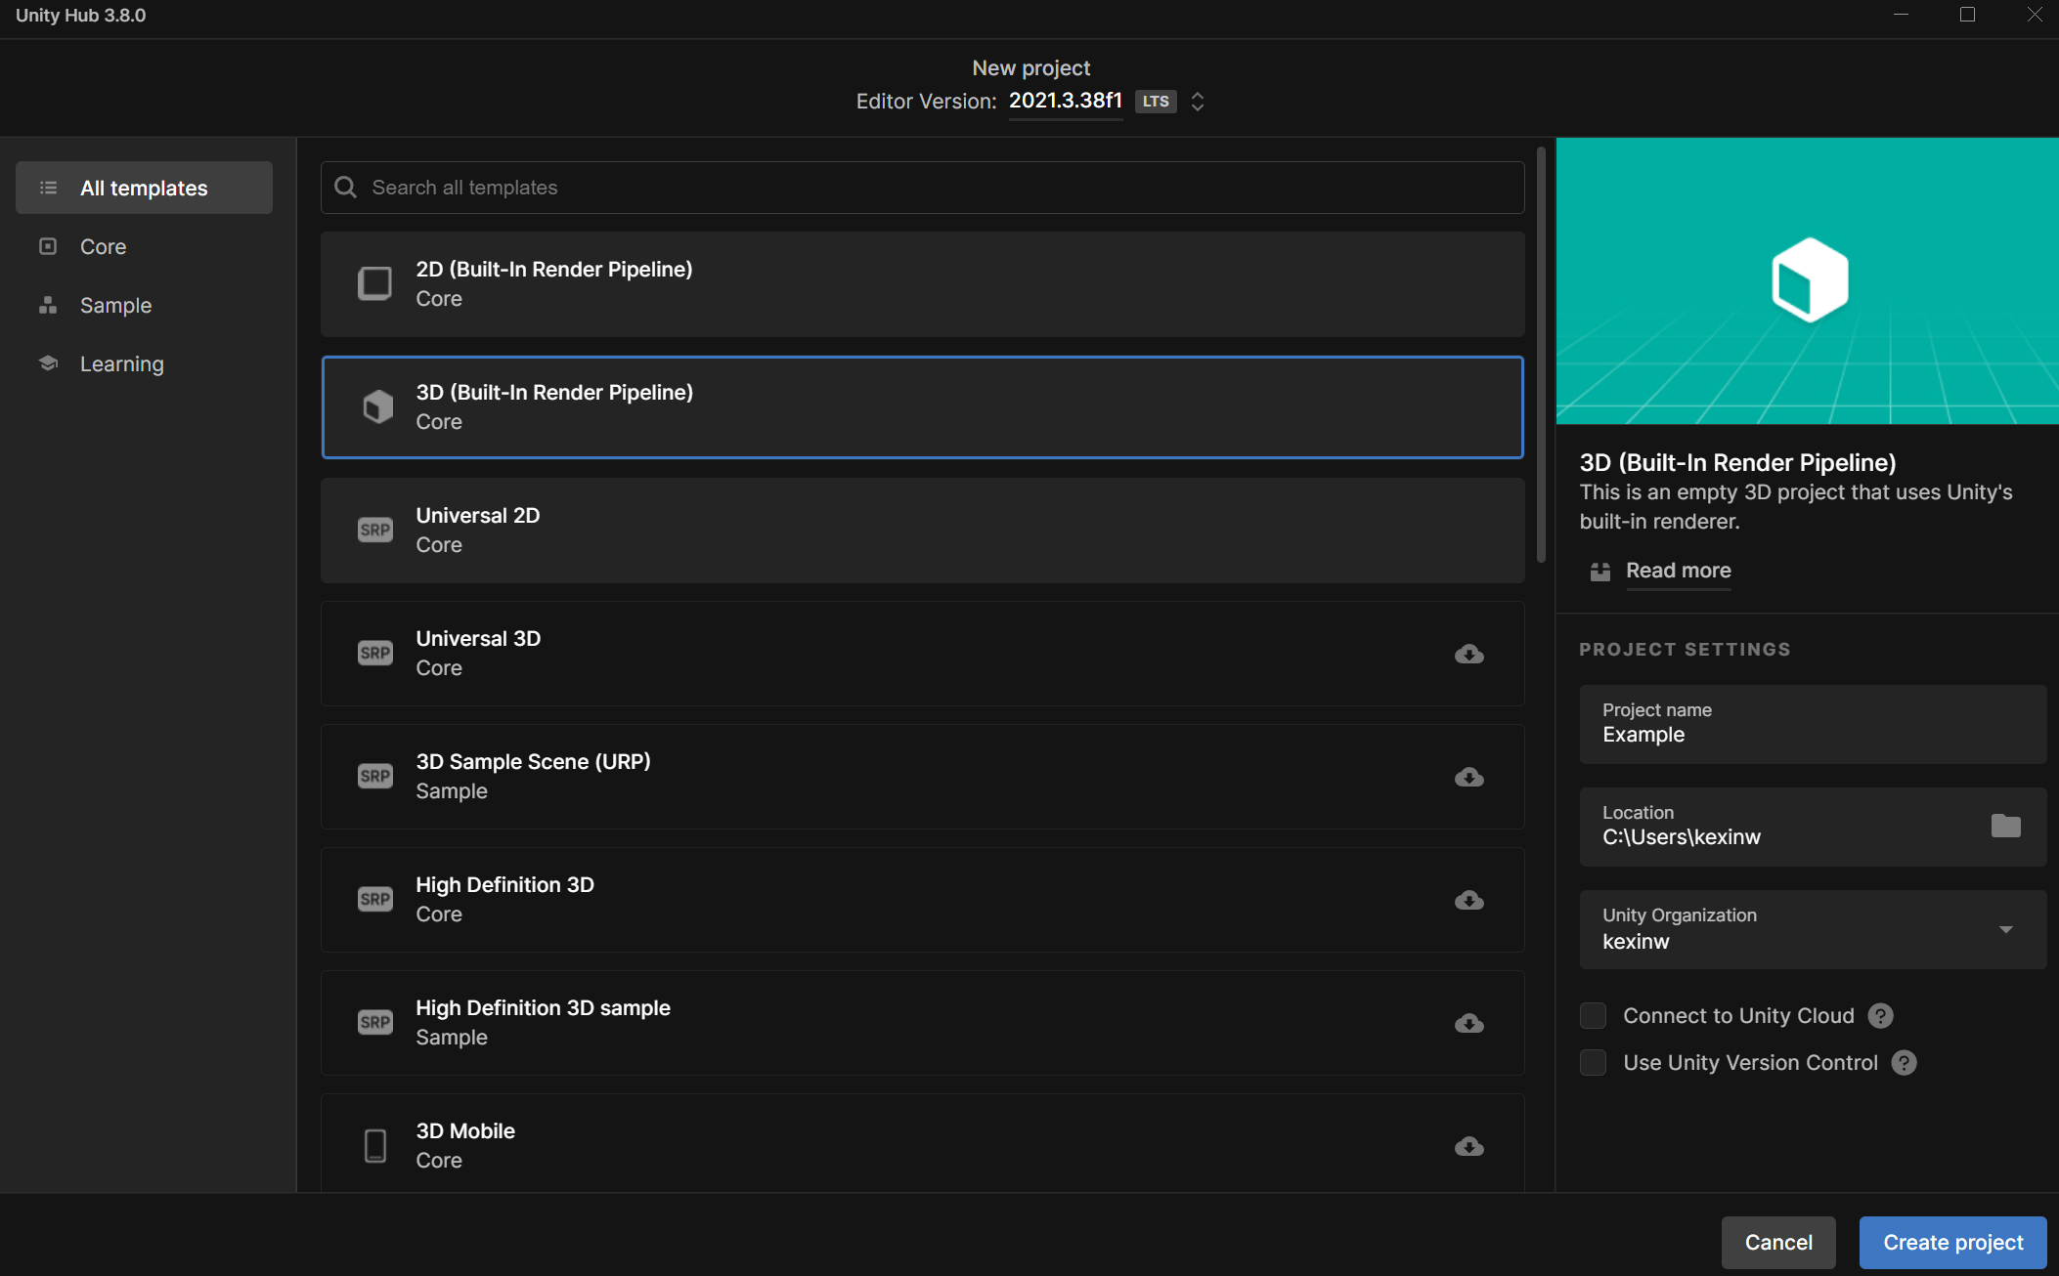
Activity
Sign in with Google using your @iastate email
Create a new Unity Project
Version: Unity 2022.3.62f1
Notes:
Mentioned about versions

Slide 6
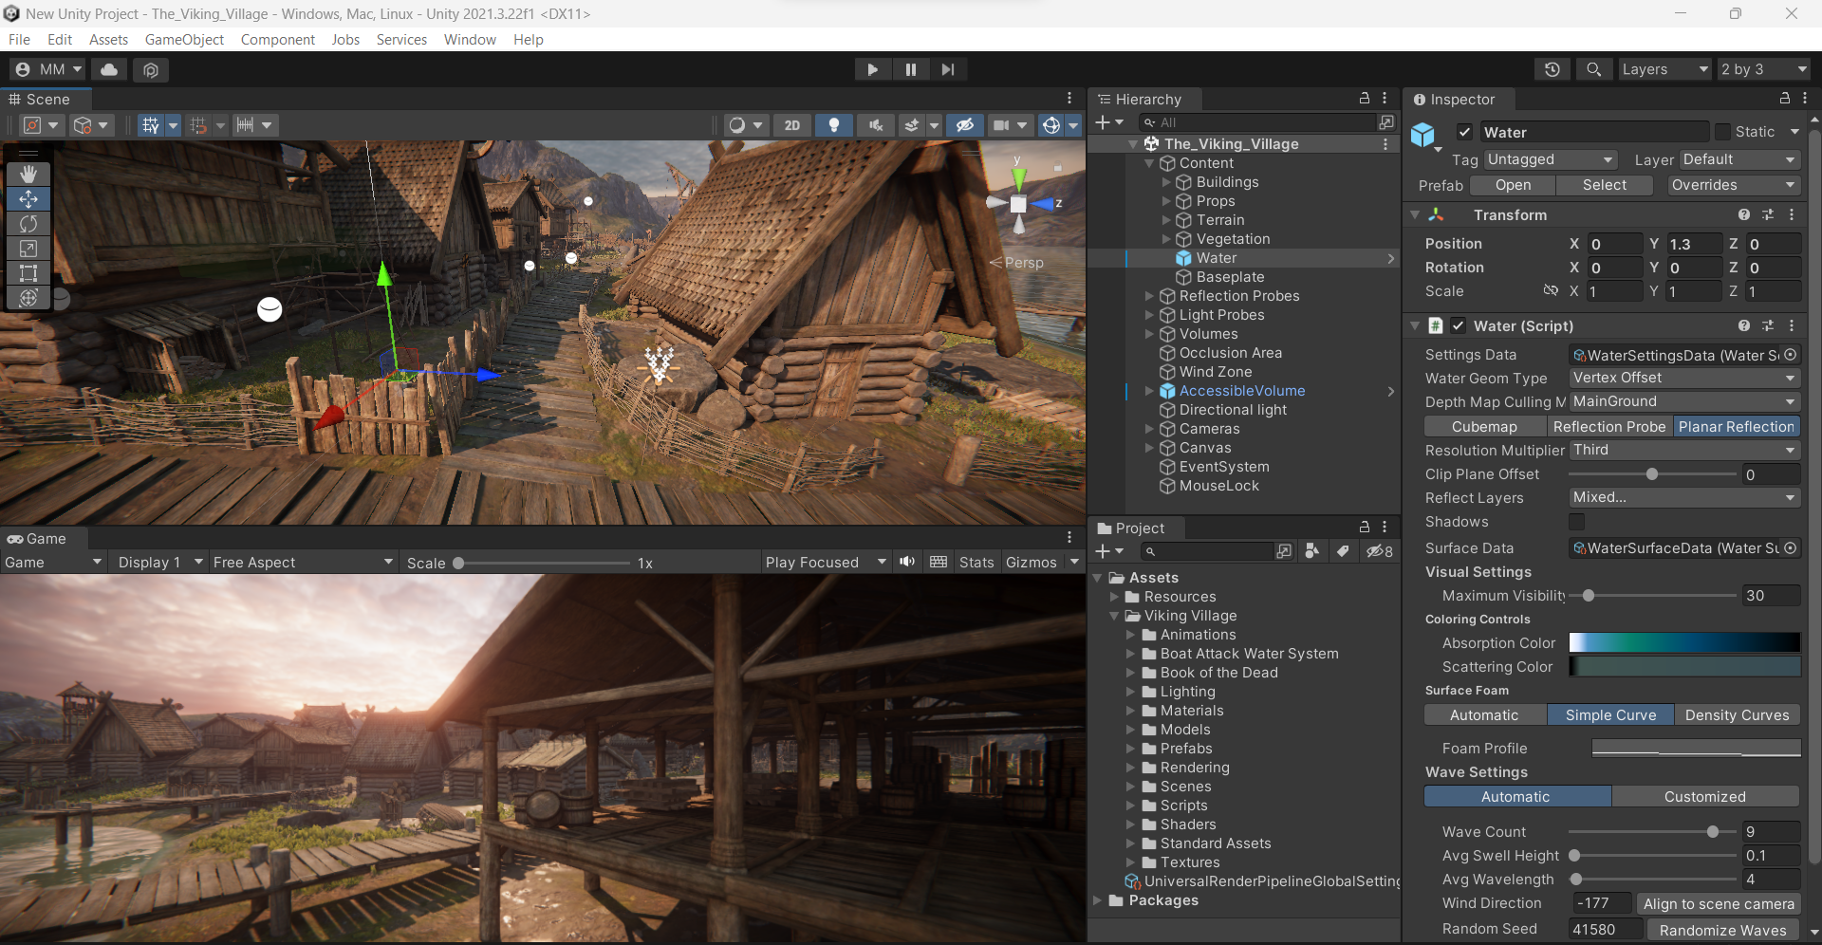

Slide 7
Scene View

Slide 8
Game View

Slide 9
Hierarchy
View

Slide 10
Project
View

Slide 11
Inspector
View

Slide 12
Play Controls

Slide 13
Unity Help Pages
Scripting Documentation - https://docs.unity3d.com/Manual/index.html
Tutorials - https://learn.unity.com/
User Forums - https://forum.unity.com/

Slide 14
Basic Unity Concepts
Game Objects & Components
Prefabs
Tags
Layers

Slide 15
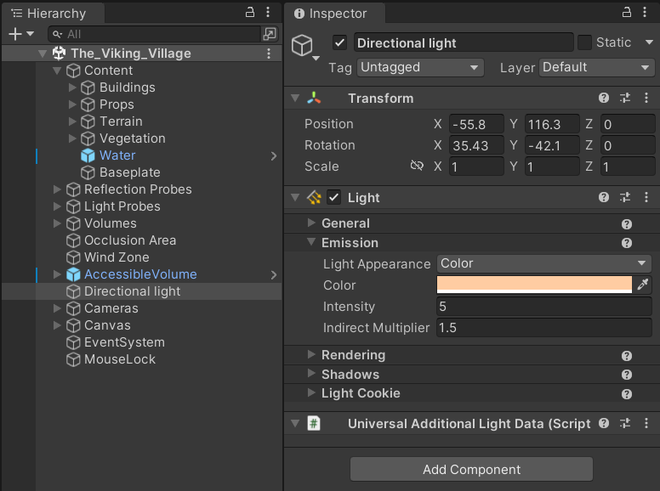
Game Objects & Components
Game Object: Any object within your Unity scene (Hierarchy)
Component: Every Game Object is made up of Components (e.g., Transform)

Slide 16
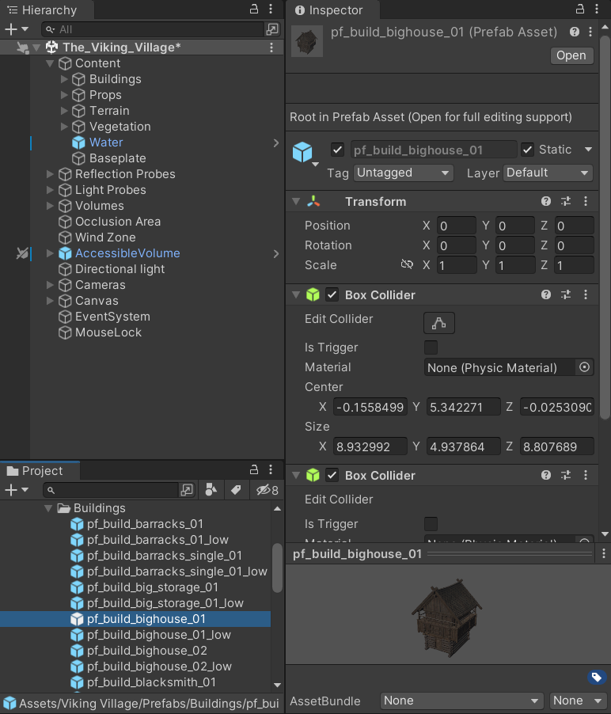
Prefabs
Prefab = Preconfigured Game Object
Prefabs are something you wish to use over and over again with minor tweaks, such as buildings, characters, levels, cameras, etc.
Making changes to a Prefab Game Object allows you to push those changes to all other Game Objects of that type if desired

Slide 17
Tags
Allows you to group Game Objects together (e.g., enemy)
Allows you to search for objects in code

Slide 18
Layers
Another way of grouping things
You can show or hide layers in the Scene View
Often used to control rendering objects differently

Slide 19
Navigating Unity
Pan: Left Mouse Button
Zoom: Right Mouse Button + Alt / Scroll Wheel
Rotate: Left Mouse Button + Alt / Right Mouse
Move: Right Mouse Button + WASD Keys

Slide 20
Unity Camera
Used to render the scene
Must have one camera but can have more
Every camera has a View Frustum shown by the pyramid
Orthographic/Perspective Projection

Slide 21
Unity Lighting
Unity models how light behaves in the real world
You can add as many lights as you want
Directional/Area/Spot
Realtime/Baked lighting

Slide 22
Activity
Create a cube and an empty GameObject
Make the cube as a child of the empty GameObject
Turn the entire GameObject into a prefab
Familiarize yourself with Unity's interface and functionalities

Slide 23
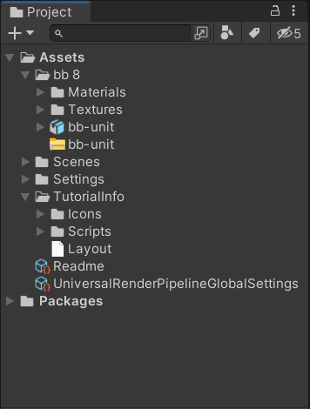
Importing Models
Unity can read
.fbx, .dae (collada), .dxf, .obj, and .skp files
Drag and drop model files into Assets folder
Make sure the geometry, materials, textures are dragged and dropped together into Unity project
{

Slide 24
Importing Models
Proprietary application support
3D Studio Max, Maya, Blender, Cinema4D, etc
Unity converts proprietary files into .fbx during import
User exported .fbx preferred
https://docs.unity3d.com/Manual/3D-formats.html
{

Slide 25
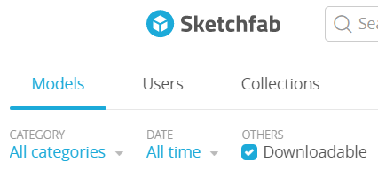
Places to Find Models
Sketchfab.com
turbosquid.com
www.cgtrader.com
https://3dwarehouse.sketchup.com
Dozens of others

Slide 26
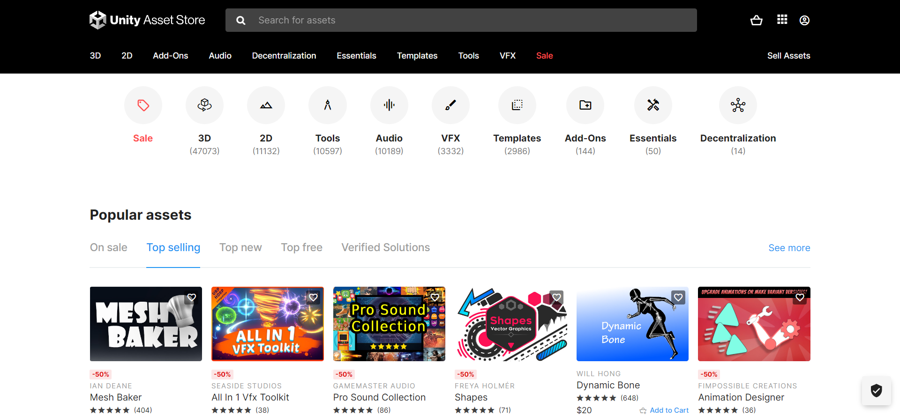
Unity Asset Store
Models
Prefabs
Scripts
Textures
Projects
https://assetstore.unity.com/

Slide 27
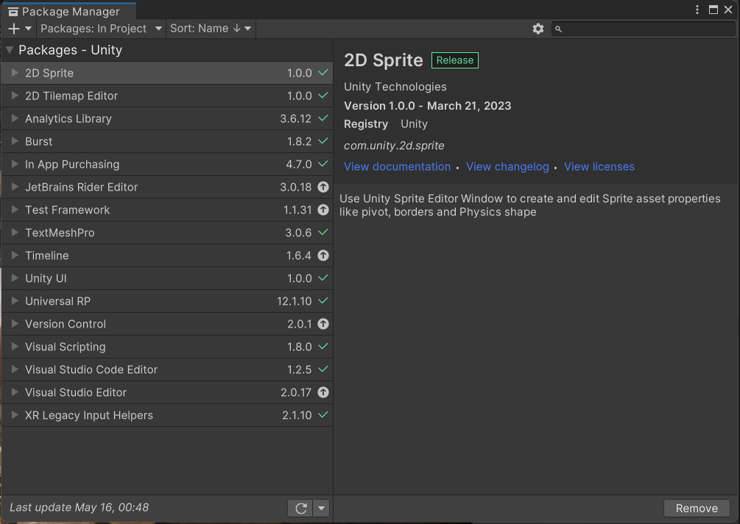
View Unity Store Assets
3.
1.
2.

Slide 28
In-class Assignment
Add solidworks / blender models to your project
Have fun and explore!
Add new models
Add new functionality
Break things
etc.

