Slide 1
Scripting Basics
Kate Wang and Rhoda Asamoah

Slide 2
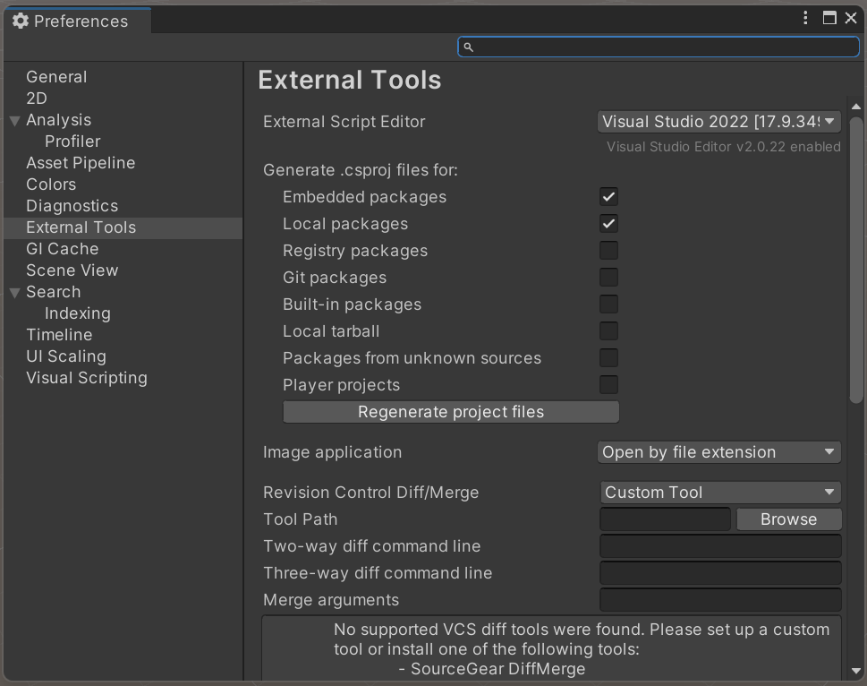
Scripting in Unity
Set Visual Studio as External Script Editor
1
2
3
Notes:
Reemphasize what a component is

Slide 3
Scripting in Unity
Scripting allows developers to extend functionality
Unity uses C#
C# syntax is almost identical to what you learned in C++
Typically scripts apply to a game object
Notes:
Reemphasize what a component is

Slide 4
Scripts as Behavior Components
Scripts can be added to objects as components
Scripts are used to create behavior
Change size or color
Apply intelligence to an object

Slide 5
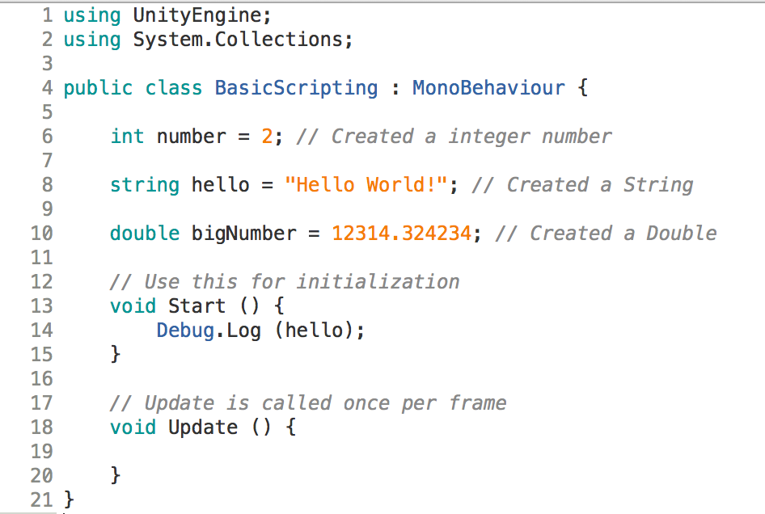
Variables
{type} variableName = {value};

Slide 6
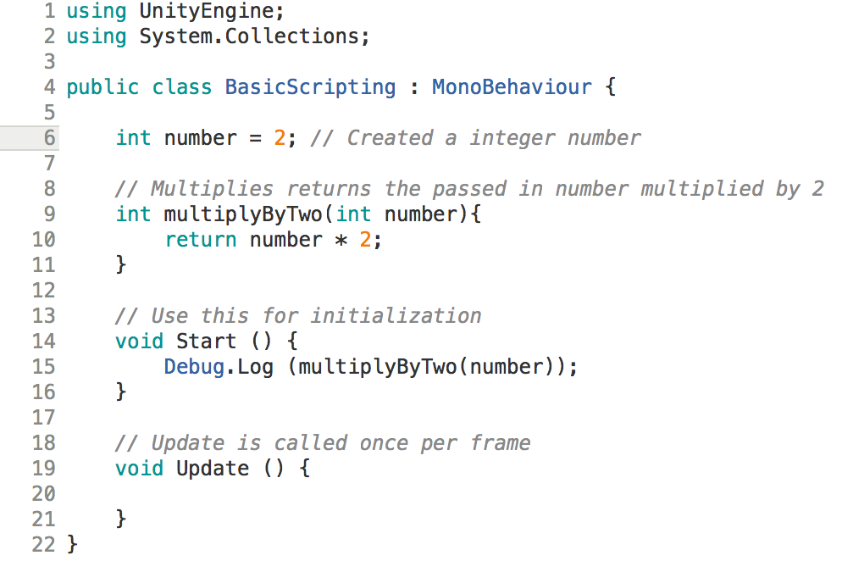
Functions
{type} functionName({type} inputVariable){ Do Something }

Slide 7
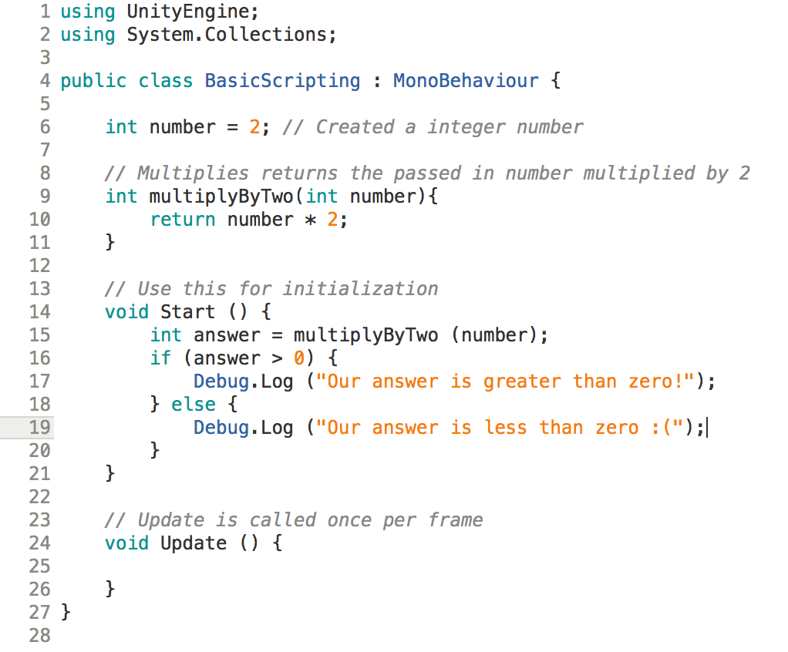
Conditionals

Slide 8
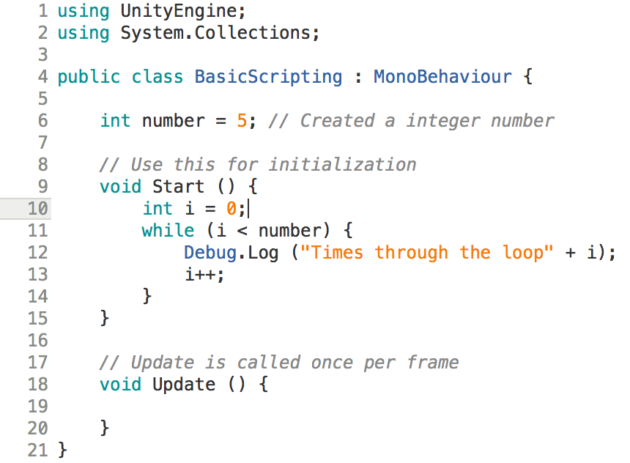
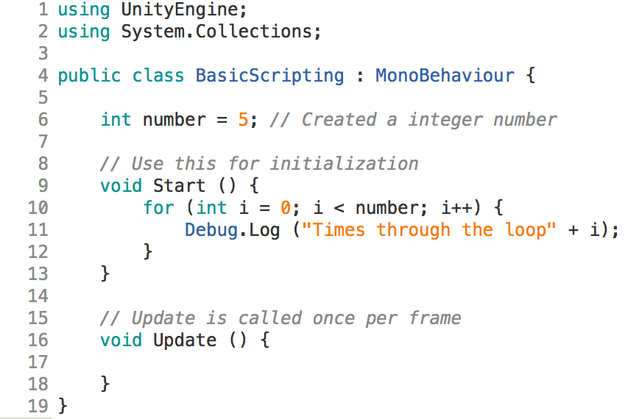
Loops
Supports for, while, and do-while loops

Slide 9
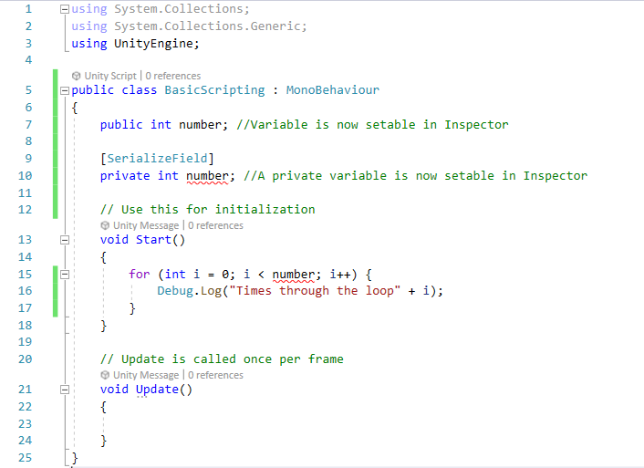
Passing in Values Through Inspector
Set a variable to public
Or
Set a variable as SerializeField

Slide 10
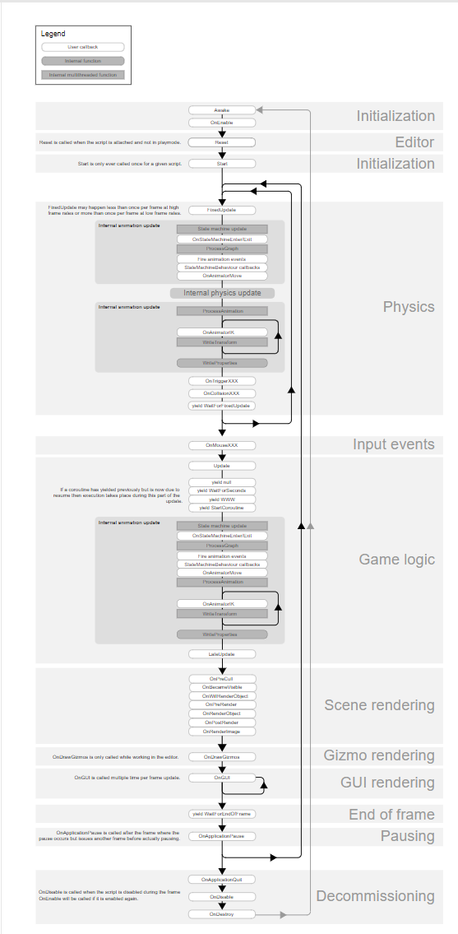
Built in Unity Functions
Awake()
Start()
Update()
Other functions (https://docs.unity3d.com/Manual/ExecutionOrder.html)
Notes:
Go to the website page to explain other functions

Slide 11
Awake Function
A default function in Unity objects
Should be treated like a class constructor
Called once, only once, upon initialization
Notes:
It would be helpful to explain using an example when/why you would do something in Awake but not Start after this slide

Slide 12
Start Function
Called after Awake() upon the first frame if and only if the object is enabled
Called once and only once
Called before Update()

Slide 13
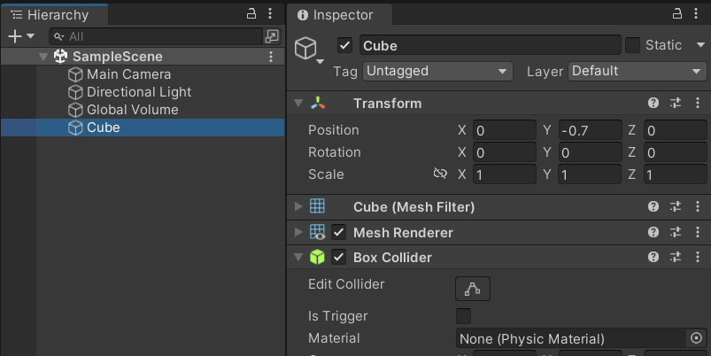
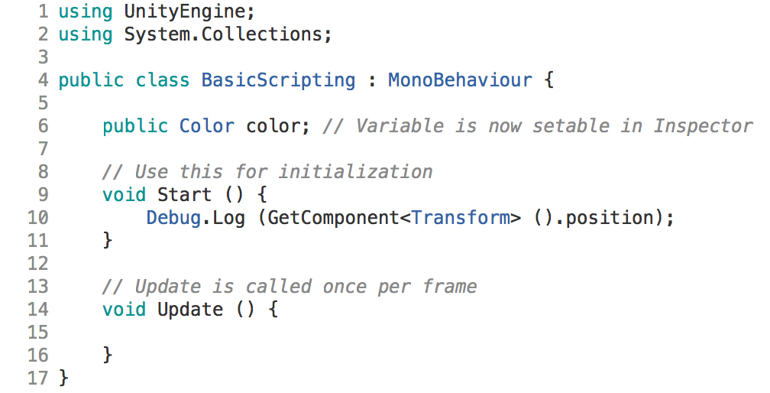
Getting a Component

Slide 14
Update Function
Update() is called every frame when the object is enabled
This is the most used function in Unity
Time.deltaTime gives you the amount of time since Update() was called last / the amount of time between two frame.
Notes:
why it it might be bad to do things here?

Slide 15
Translate and Rotate Objects
The Transform Component of an object holds its Position, Rotation, and Scale
Use GetComponent<>() to change these values

Slide 16
In Class Activity
Create a first-person view “Player” for your farm
Implement a script so that WASD keys control your player to move forward & backward and rotate left & right
Bonus: Enable mouse control for smooth player rotation
Be creative!

