Slide 1
Scripting and UI
Kate Wang and Rhoda Asamoah

Slide 2
Day 1 Review
Game Engines
Unity Interface
Cameras, Lights, and Objects
Scripting in C#

Slide 3
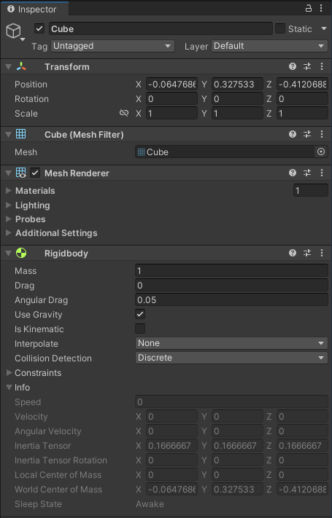
Rigidbody
Control game object’s motion using Unity’s physics engine
Ability to apply gravity to the game objects
FixedUpdate() is recommended when applying force or controlling Rigidbody settings in a script

Slide 4
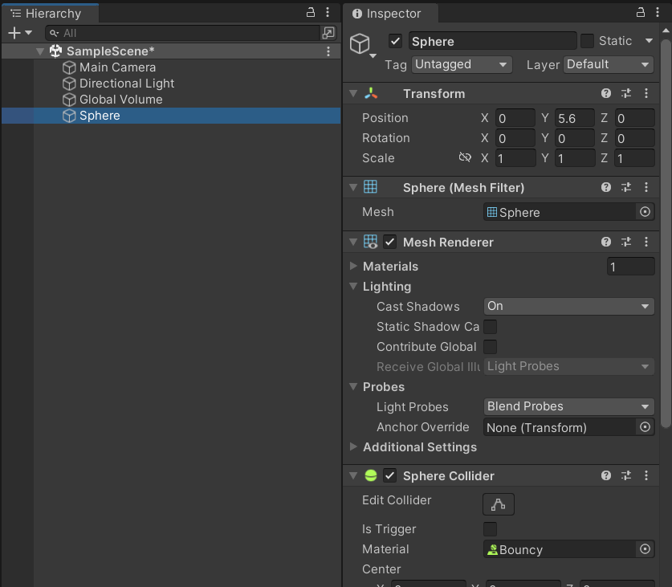
Colliders
Allows physical interaction between objects
Rigidbody must attached to at least one game object
Colliders react with other colliders
Can also be used for selecting objects
Notes:
Create cubes with collider, add rigid body to the player

Slide 5
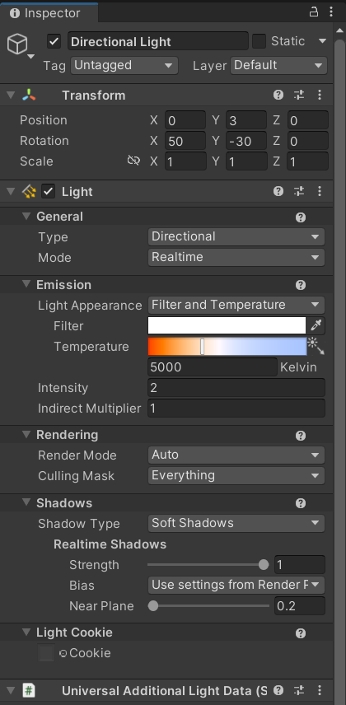
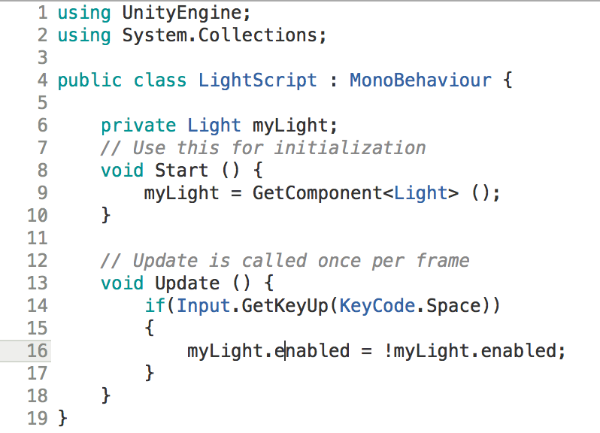
Enabling and Disabling Components

Slide 6
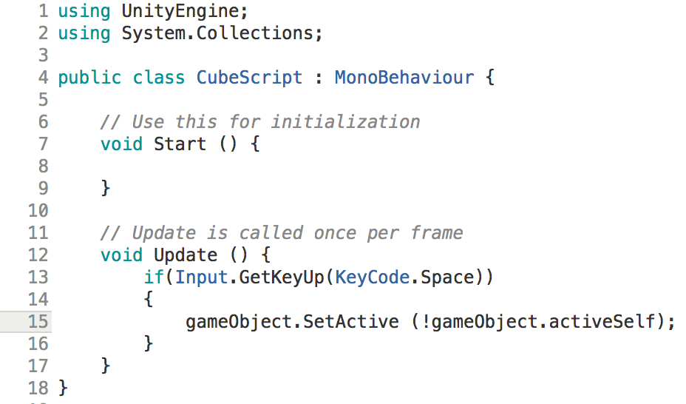
Activating Game Objects
Making a GameObject inactive will disable every component and turn off any attached renderers, colliders, rigid bodies, scripts, etc...
Any scripts that you have attached to the GameObject will no longer have Update() called
Notes:
Write script so that when player enter the cube (a good place to explain on collision enter or on trigger enter) the cube disappear

Slide 7
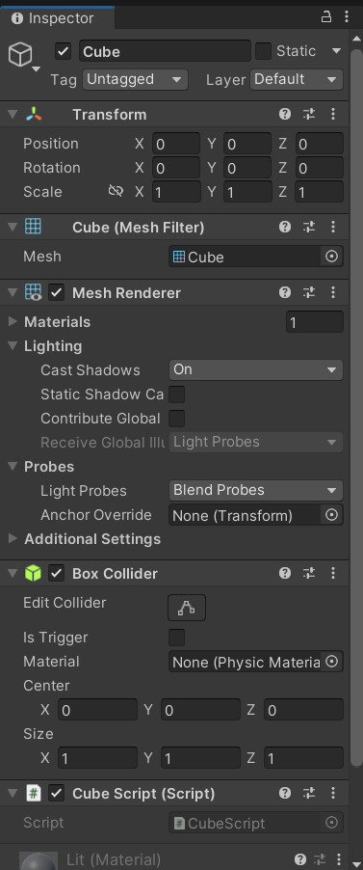
Getting a Component
GetComponent<Type>()
Allows you access to any Component in the object
You can access Parent and Children too

Slide 8
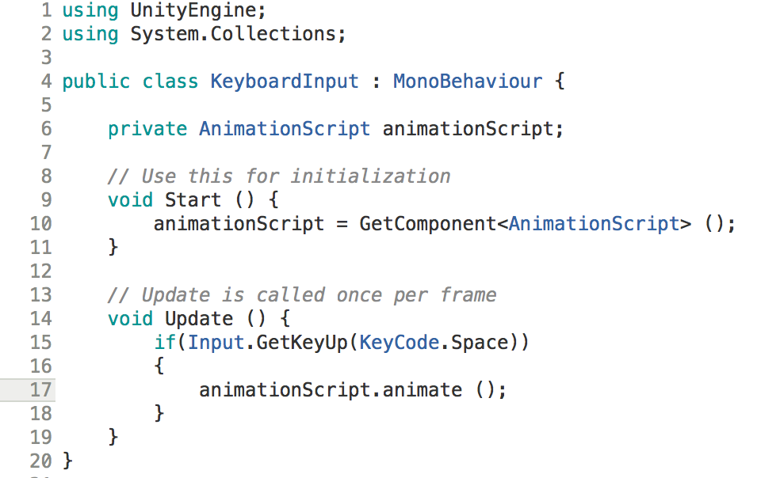
Calling Other Scripts
Scripts are GameComponents, so you can use GetComponent<Type>()or FindObjectOfType<Type>() to obtain a reference to other scripts
Notes:
Write a game manager script to record how many cube player eat

Slide 9
Activity
Implement a feature allowing the player to "eat" cubes

Slide 10
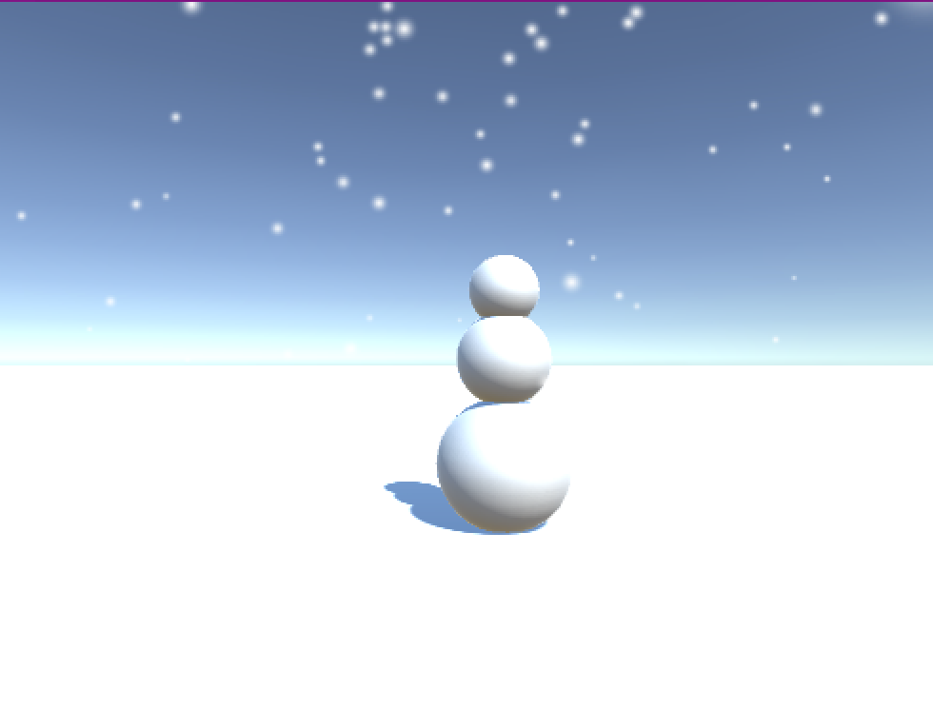
Particle Systems
Uses a large number of small objects to mimic “fuzzy” phenomena
Fire, Smoke, Rain, Snow, Clouds, etc.

Slide 11
Unity User Interfaces

Slide 12
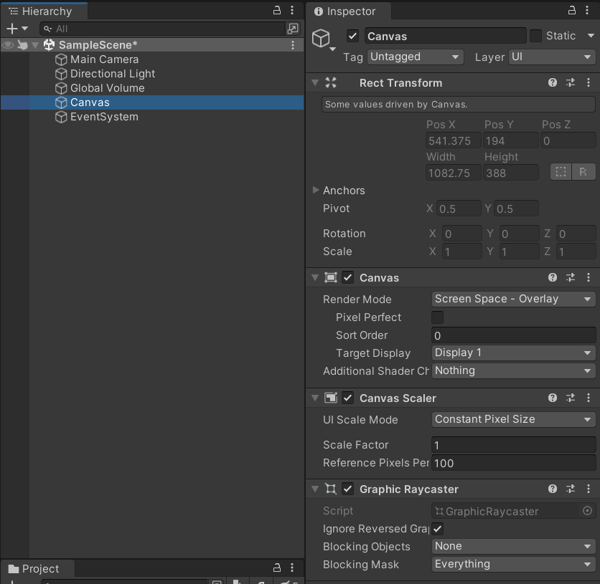
UI Canvas
Everything UI starts with the Canvas
Canvas is a GameObject
All UI elements must be children of a canvas
Notes:
I would discuss canvas size and how it relates to the display’s dimensions.

Slide 13
UI Text
Use textmeshpro whenever you need text
Right-click hierarchy -> UI -> Text-Textmeshpro
Text properties can be set in the Inspector
Can be changed during runtime through scripting
Notes:
Write a script to display player’s score on the UI

Slide 14
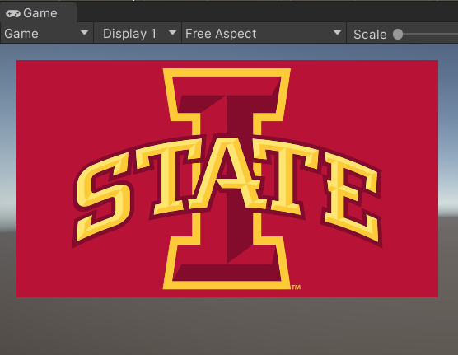
UI Image
Can be used for almost anything, button, slider, etc.
When importing an image, you must define what type of texture it is (Normal Map, Light Map, Sprite)
For UI, we want a Sprite

Slide 15
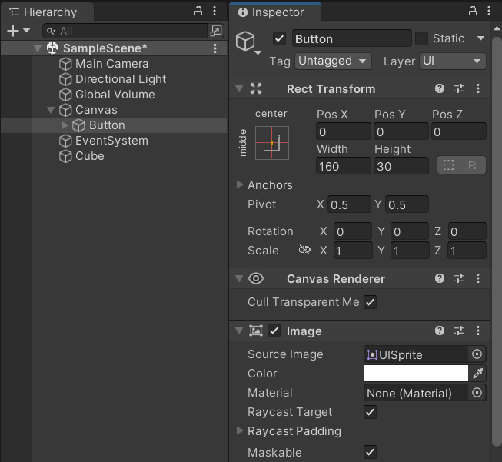
UI Button
Button is a GameObject that must be a child of a canvas
Many different options for styling
Notes:
various options for anchors and pivots

Slide 16
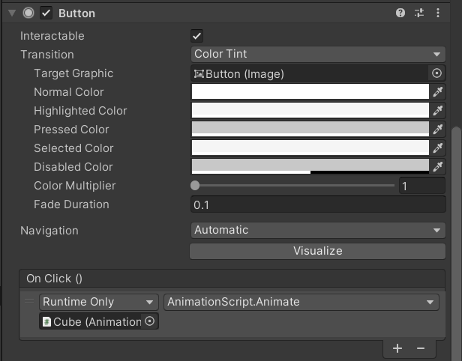
On Click()
You can hook up a button to an action through the Inspector
Chose your GameObject
Choose your Component
Choose your Method
Notes:
Implement a restart button

Slide 17
Activity
Finish your game with following features:
Control the player's movement using the ASWD keys
Implement a feature allowing the player to "eat" cubes within the farm
Display the number of cubes eaten by the player
Include a "restart" button to allow the player to restart the game
Bonus Features:
Enable smooth rotation of the player using mouse input
Replace the cube model with a customized model of your choice
Show the elapsed time since the player started the game
Implement a time limit for the player's gameplay session
Notes:
Will leave 10 minutes to build out the app

Slide 18
Creating an Executable
What if I want to create a standalone app?
Let’s make an executable

Slide 19
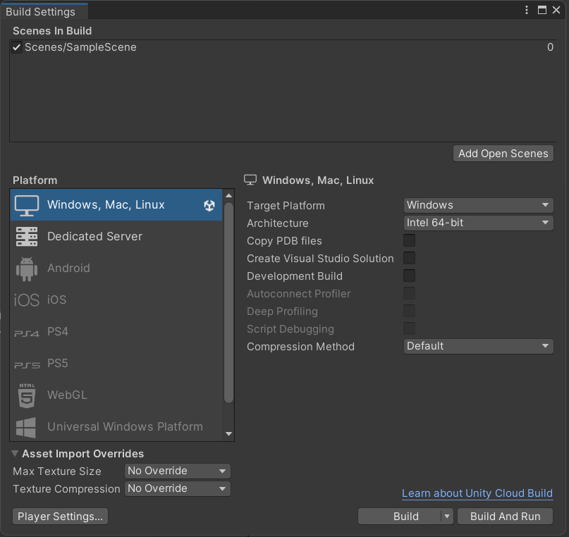
Creating an Executable
Add the desired scene
Select your platform
Build and Run!

