Slide 1
The Craft of Research
Image by storyset on freepik
Week 1: Introduction to Research Problems
Eliot Winer

Slide 2
Outline
Why Craft of Research?
Research overview
Activity
Upcoming

Slide 3
Why Craft of Research?
Covers fundamental research principles
What are some of these principles?
Image by storyset on Freepik

Slide 4
Why Craft of Research?
Increases your comfort and awareness in research writing, reading, and presentations
Why is this important?
Image by rawpixel.com on Freepik

Slide 5
Why Craft of Research?
Provides resources and tools to successfully accomplish your goals and milestones this summer
Such as?
Image by pch.vector on Freepik

Slide 6
What are your expectations for this course?
What would you like to learn?
Course Takeaways
Research skills you would like to develop
Questions
Notes:
Activity: students write their expectations /questions on three sticky notes and we briefly share and discuss (5 minutes)

Slide 7
Research
“A systematic investigation, including research development, testing, and evaluation designed to develop or contribute to generalizable knowledge.”
(https://www.hhs.gov/ohrp/regulations-and-policy/regulations/45-cfr-46/index.html#46.102)
“We do research whenever we gather information to answer a question that solves a problem.”

Slide 8
Systematic investigation
A systematic investigation means that a careful plan is followed to gather information.
Systematic observations are obtained under clearly specified, and, where possible, controlled conditions that can be measured and evaluated.
Specific procedures, techniques and tools to gather information
Notes:
New slide elaborating on systematic investigation

Slide 9
Benefits of Research: Reading
Helps you understand what you read
Supports you in critically evaluating and analyzing ideas
Provides you with inspiration, sparking new ideas, questions and research directions
Image by freepik

Slide 10
Benefits of Research: Discovery
Discovery of how…
New knowledge depends on what questions you do and don’t ask
Research shapes the questions you ask and how you answer them
Knowledge we rely on depends on the quality of the research

Slide 11
Benefits of Research: Writing
Research writing to remember more accurately, understand better, and evaluate more objectively
Communicating ideas and findings effectively for your audience
Documenting the process and contributing to the field
Image by freepik

Slide 12
Who is involved?
Researchers
Professional scientists/researchers
Faculty and educators
Post-docs
Graduate students
Undergraduate students
Who Pays
Government
Corporate institutions
Foundations/non-profits
Universities

Slide 13
Why do we Create and Consume Research?
Researchers
I’ve found new and interesting information
I’ve found a solution to an important practical problem
I’ve found an answer to an important question
Consumers
Entertain me
Help me solve my practical problem
Help me understand something better

Slide 14
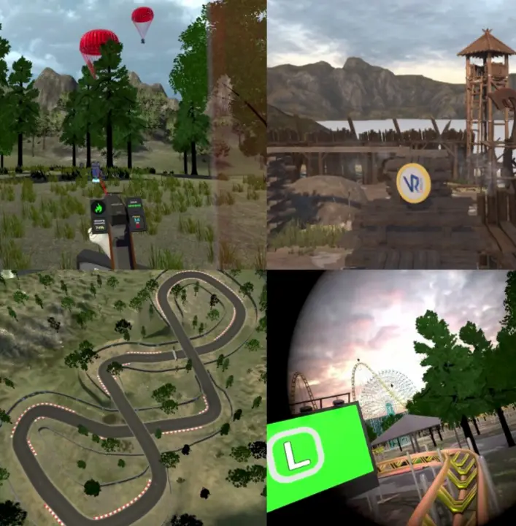
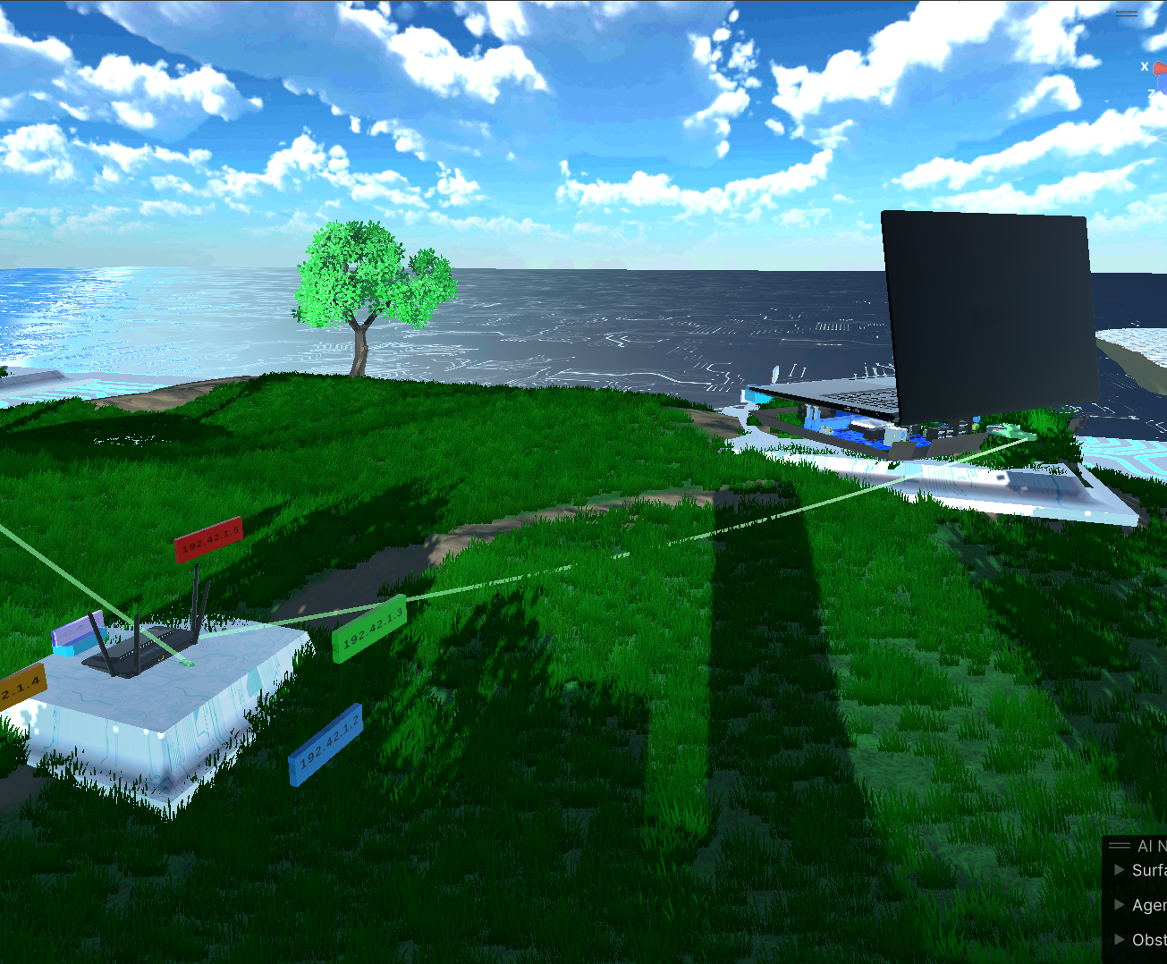
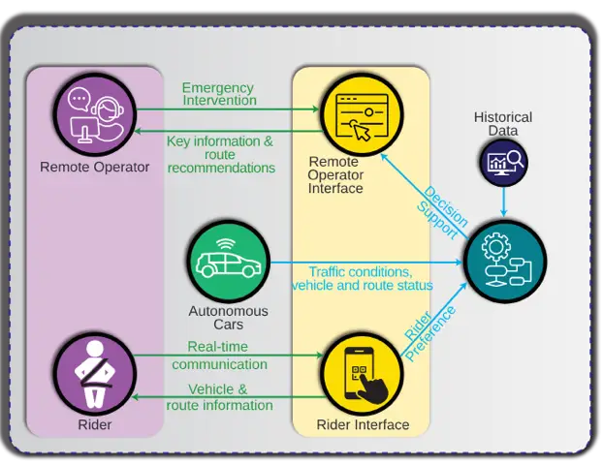
Activity 1: Understanding Your Readers
CyberScore
EchoXR
NAVI
Look at your project overviews
Based on the information you have, let’s discuss
Notes:
Same activity as previous years.
New: Slide has the titles of the three projects of 2024

Slide 15
Who will read my report?
Academic professionals?
Well-informed general readers?
General readers who know little about the topic?

Slide 16
What do my readers expect me to do?
Entertain them?
Provide factual knowledge?
Help them understand something better?
Help them do something to solve a practical problem in the world?

Slide 17
How much can I expect them to know already?
What do they know about my specific topic?
Do they recognize the problem?
Will I need to convince them the problem matters?

Slide 18
How will readers respond to the solution and or answer in my claim?
Will it contradict what they already believe? How?
Will they make standard arguments against my solution?
Will they want to the steps that led me to the solution?

Slide 19
For next session
Please read the PDF up to the section “Process” sent to you in Slack.

