Slide 1
HCI History & Conferences
Adam Kohl

Slide 2
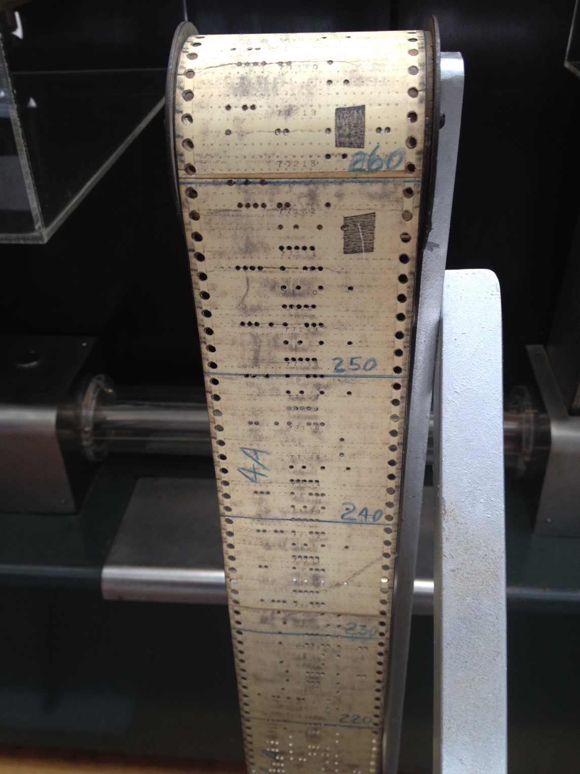
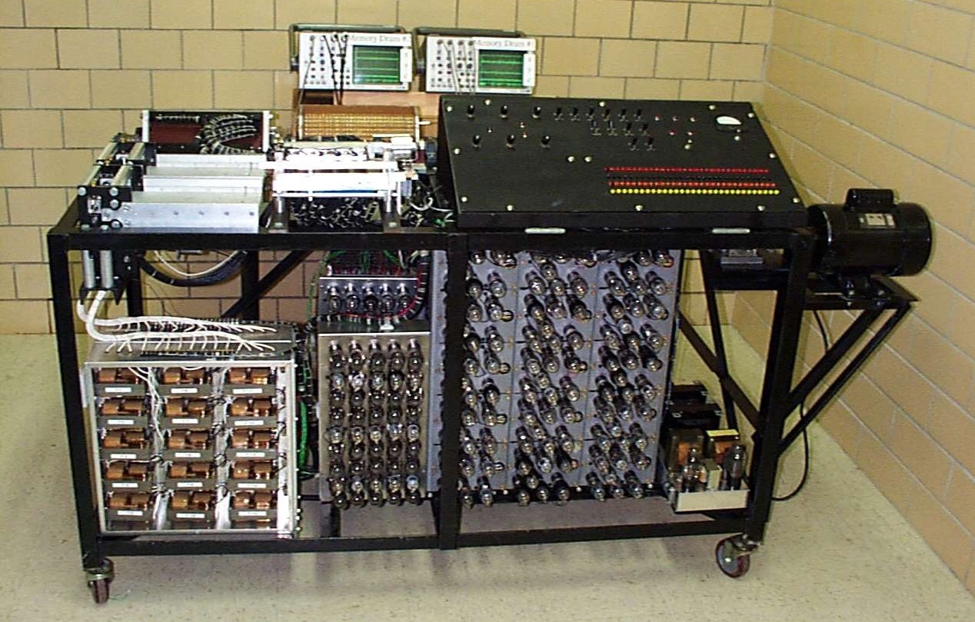
Some Computer History
Atanasoff-Berry Computer (1941)
First electronic digital computing device
At Iowa State!
Harvard Mark I (1944)
Paper tape readers with physical patches

Slide 3
Programming Languages
Moving beyond punch cards
FORTRAN, 1957 from IBM
Dorothy Vaughan
COBOL, 1960
Grace Hopper, “Mother of COBOL”
Still “Batch Processing” – no interaction

Slide 4
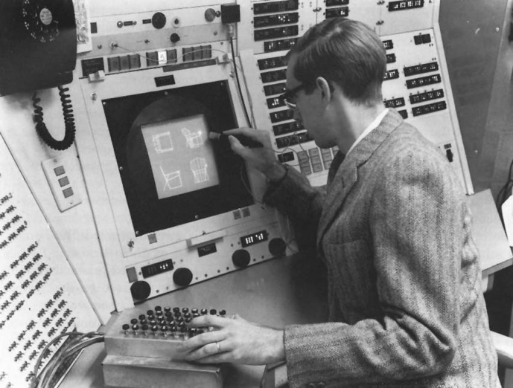
Ivan Sutherland
MIT Ph.D. thesis: Sketchpad, 1963
Light pen
Hierarchy
pictures & subpictures
Icons
Copying
3D rotation

Slide 5
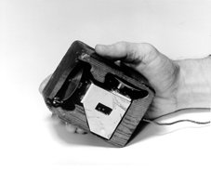
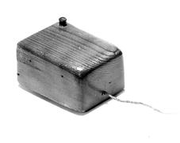
Douglas Englebart
NLS: oNLine System
“Mother of all demos” at 1968 conference
Hypertext
Windows
Audio + video conferencing
File version control
Mouse & control box
Note: no Unix, no ARPAnet/Internet yet

Slide 6
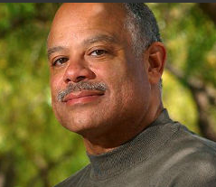
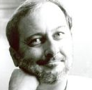
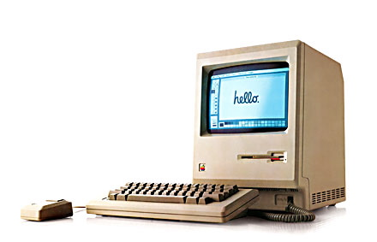
Personal Computers
IBM XT/AT (1981)
Command line & sold many units
Xerox Star (1981)
WIMP GUI
Windows, Icons, Menus, Pointers
Commercial failure
Apple Lisa (1983)
Based on Xerox Star & failed
Apple Macintosh (1984)

Slide 7
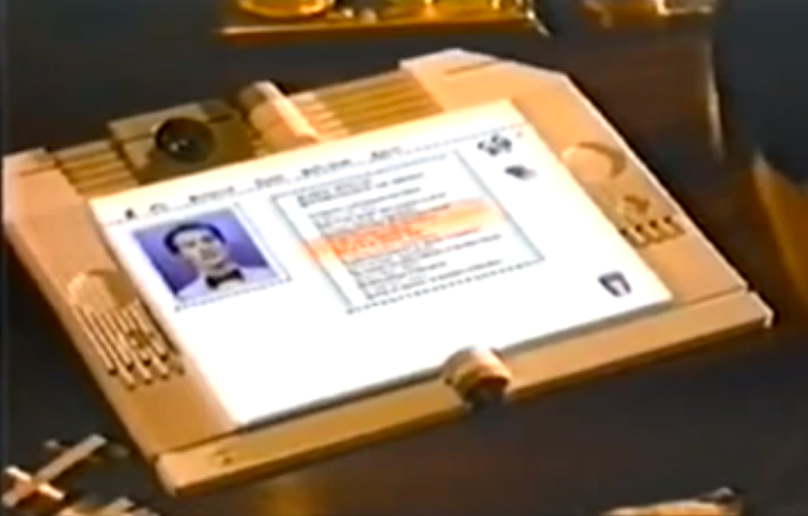
1987: Apple’s Knowledge Navigator vision
Takes place in 2011
What does it get right?
What’s wrong?
What do we still need to do?
Notes:
iPhone 2007
iPad 2010
Siri 2011

Slide 8
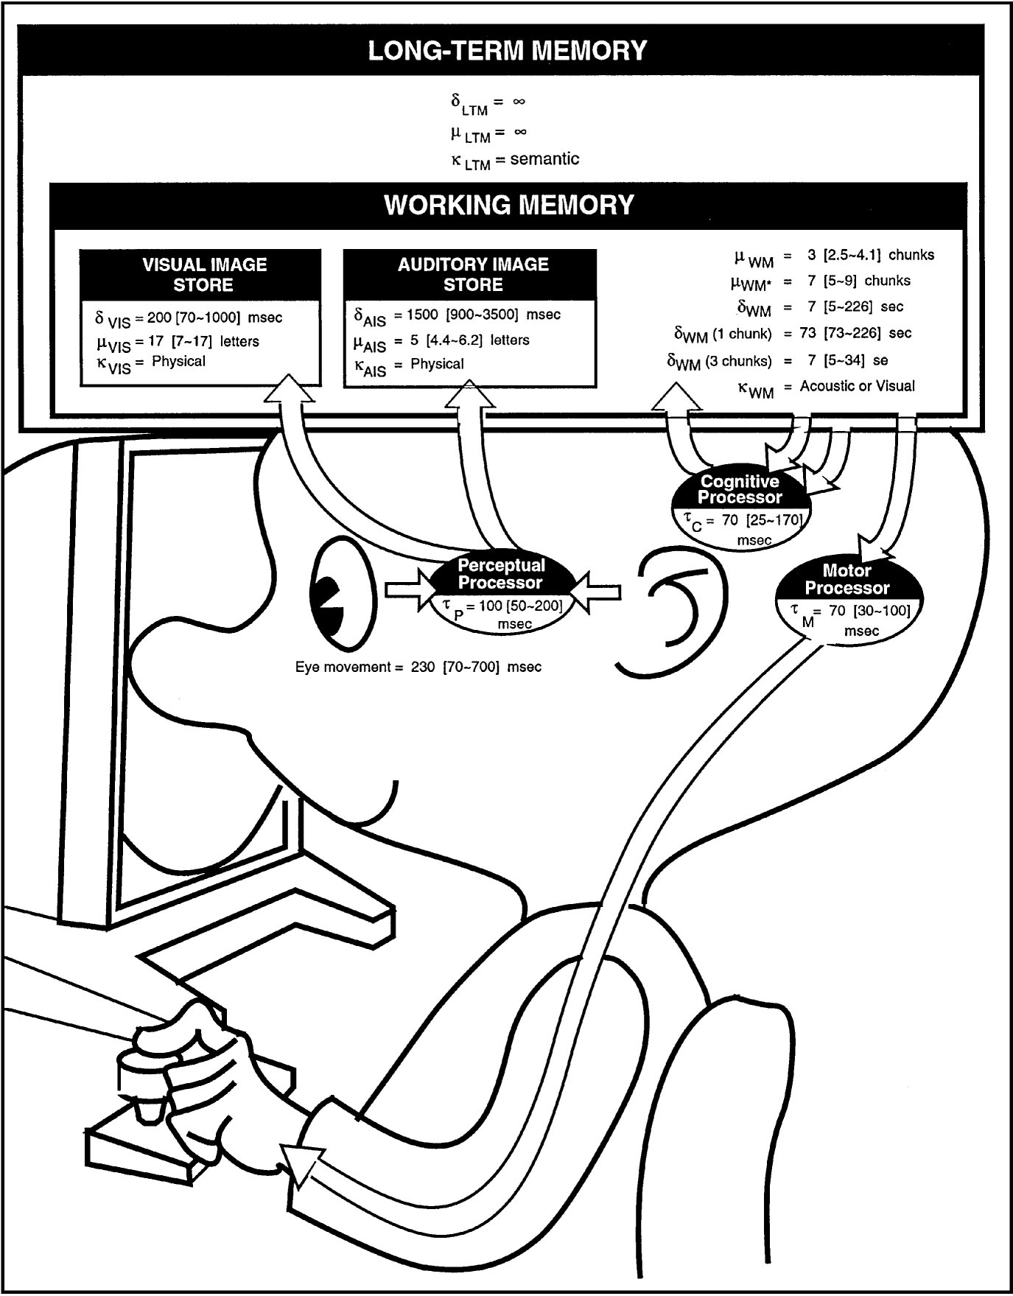
First Wave
Treat human like a machine
What can it do?
Cognitive Science
Psychophysics
Human Factors
People at desks at work

Slide 9
Info Processing Model
Card, Moran & Newell

Slide 10
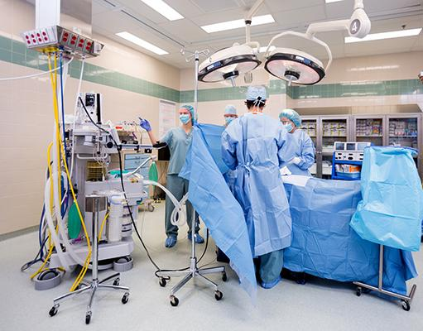
Second Wave
The whole human
Groups of Humans
Situated action / intent
CSCW
Participatory Design
Workplace groups
Technology is separate

Slide 11
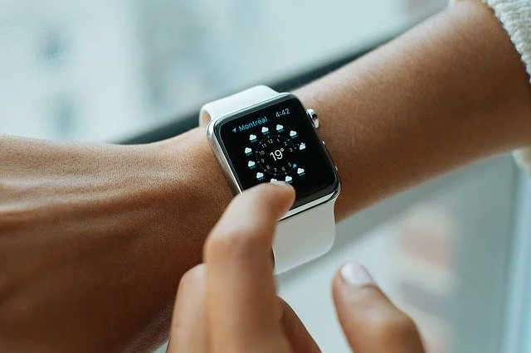
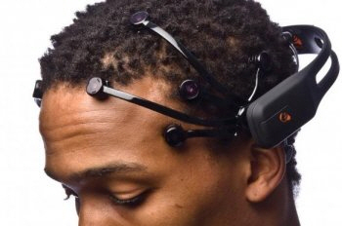
Third Wave
Social dynamics
Culture
Emotion
Affective computing
Human-Agent Teaming
Non–work activities

Slide 12
Conferences
What is a conference?
Conference activities
Why are conferences important?
HCI & XR conferences?
Funding to attend conferences
Activity: browse IITSEC program

Slide 13
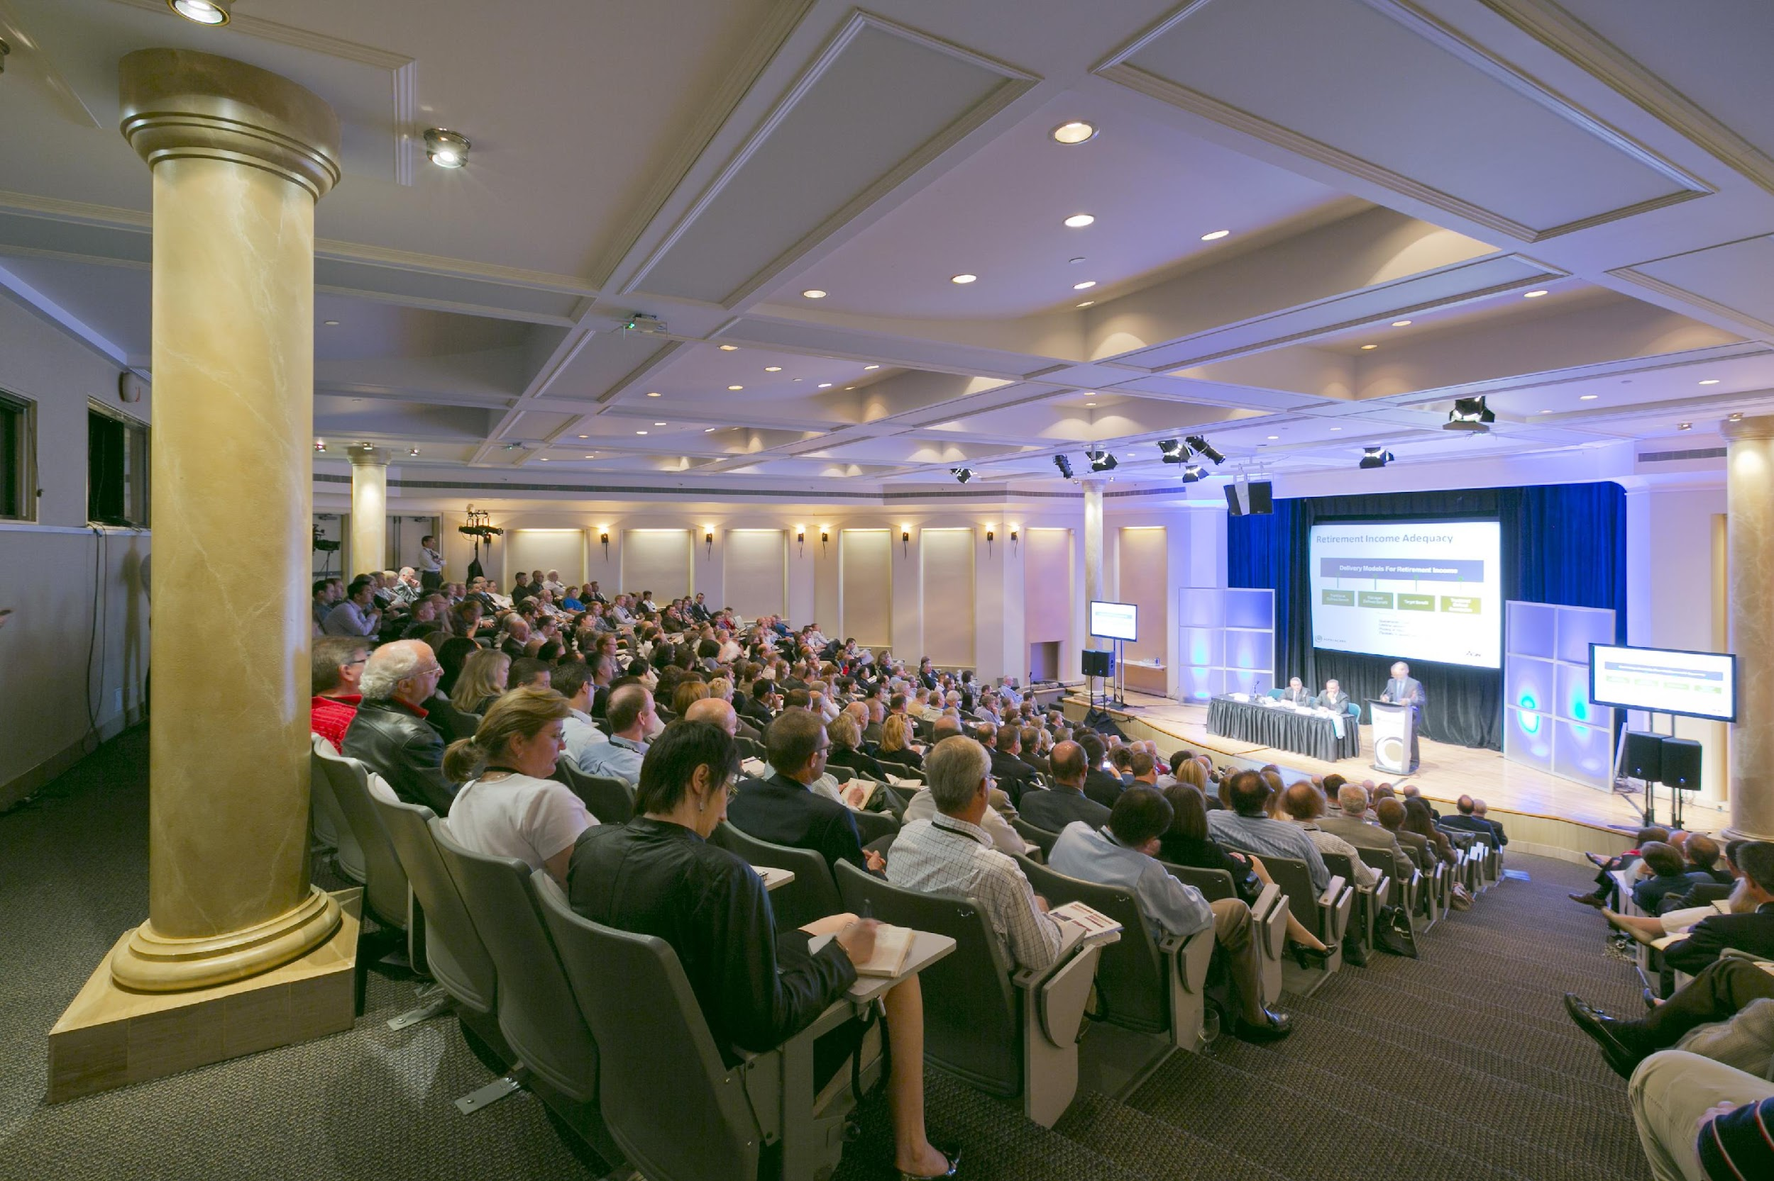
What is an Academic Conference?
A multi-day event in which researchers present their work
An opportunity to network with other experts in your field
More research-focused than industry conferences such as CES

Slide 14
Conference Activities
Papers
Posters
Workshops
Courses/Tutorials
Keynote/Plenary Speakers
Panels
Demos
Competitions
Networking Activities

Slide 15
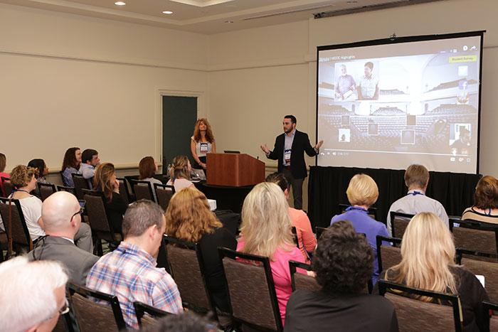
Papers & Posters
Conference papers
Published in conference proceedings
15–30-minute talk at the conference
Sometimes a journal route
Posters
Create a poster and talk with people who come by

Slide 16
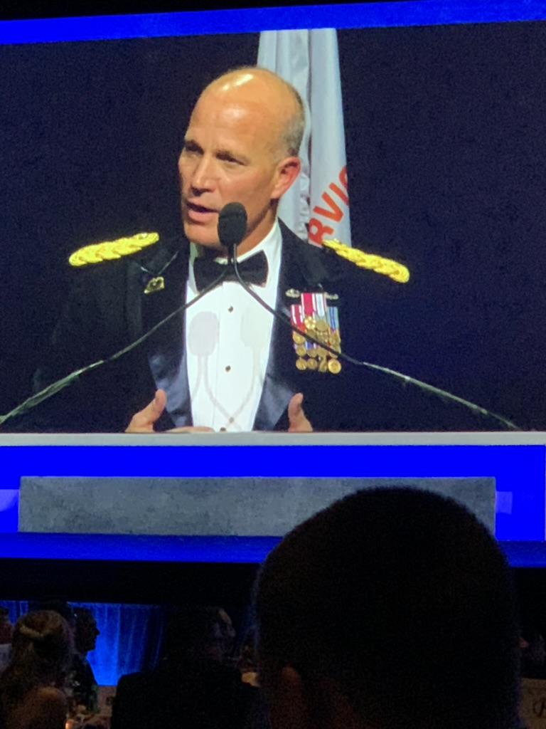
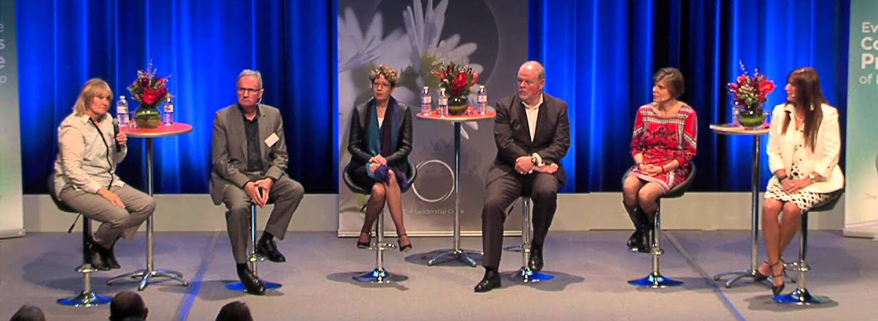
Keynote Speakers & Panels
Top researchers in academia and industry
Keynote speakers give a brief lecture
Panels are Q&A sessions with experts

Slide 17
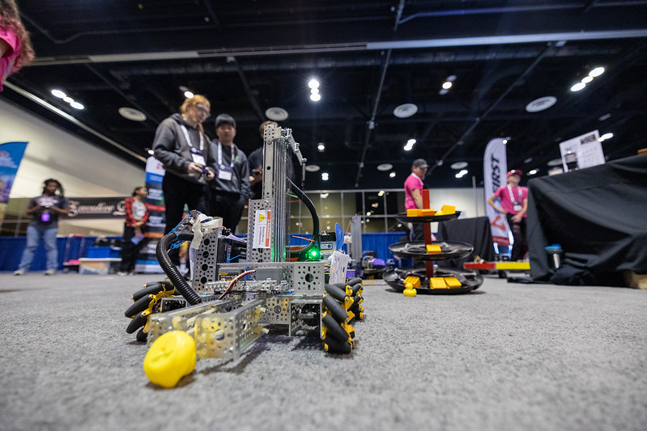
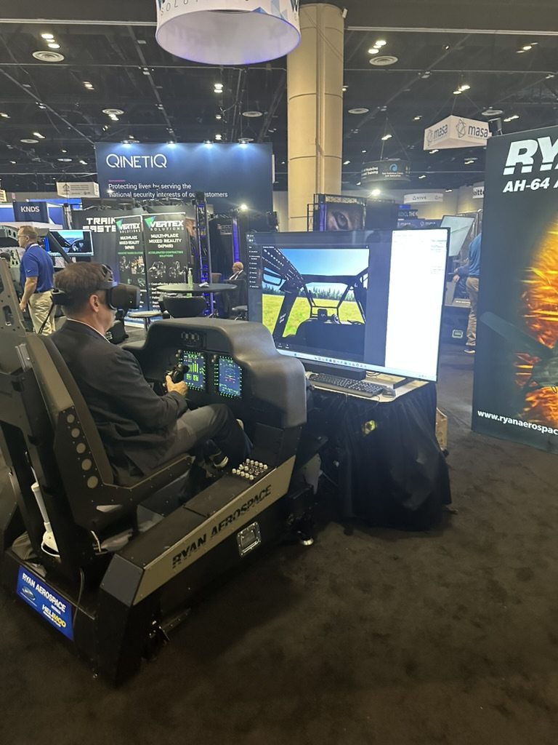
Demos & Competitions
Conferences often have an exhibit hall with demos
Academia and industry
Some conferences have competitions for students

Slide 18
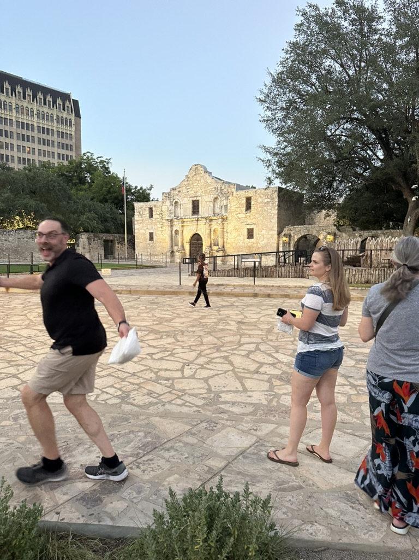
Networking Activities
Numerous official / unofficial networking opportunities
Conference sponsored events
Meet and greets
Happy hours
Birds of a Feather sessions
Company sponsored events
Unofficial meetups with friends and colleagues

Slide 19
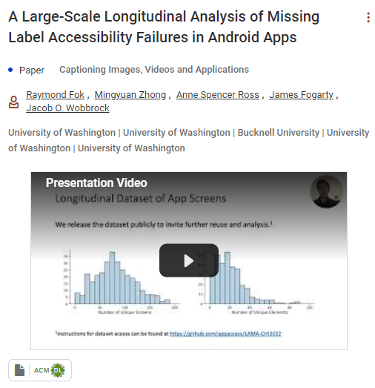
ACM SIG CHI
Conference on Human Factors in Computing Systems
One of the premier HCI conferences
Excellent outlet for UX research
Best paper awards
Industry & Academia
Many videos

Slide 20
HFES
Human Factors and Ergonomics Society
Ergonomics focused conference
Overlap with UX, MR, & other topics
Conferences sometimes referred to as “annual meetings”

Slide 21
IEEE VR
Institute of Electrical and Electronics Engineering Virtual Reality
One of the premier XR focused conferences
Alternates between US and International locations
Virtual or hybrid
Annual 3DUI competition
VRAC runner-up in 2019

Slide 22
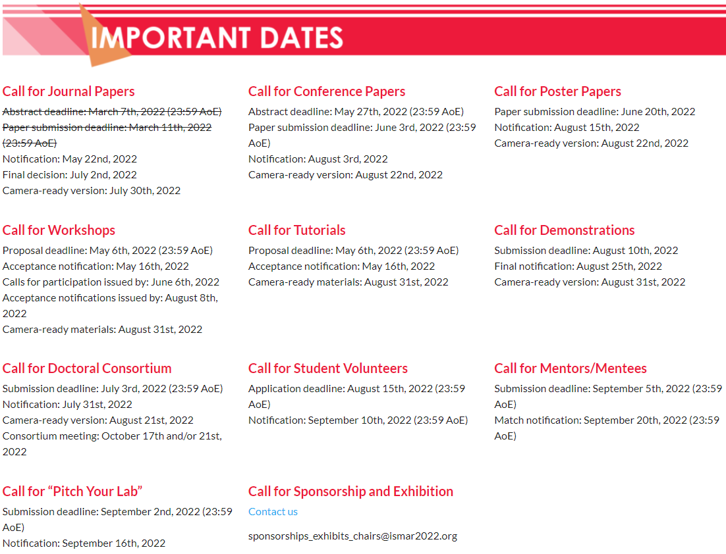
IEEE ISMAR
International Symposium on Mixed and Augmented Reality
The premier conference for AR
Extremely competitive papers
On par with many journals

Slide 23
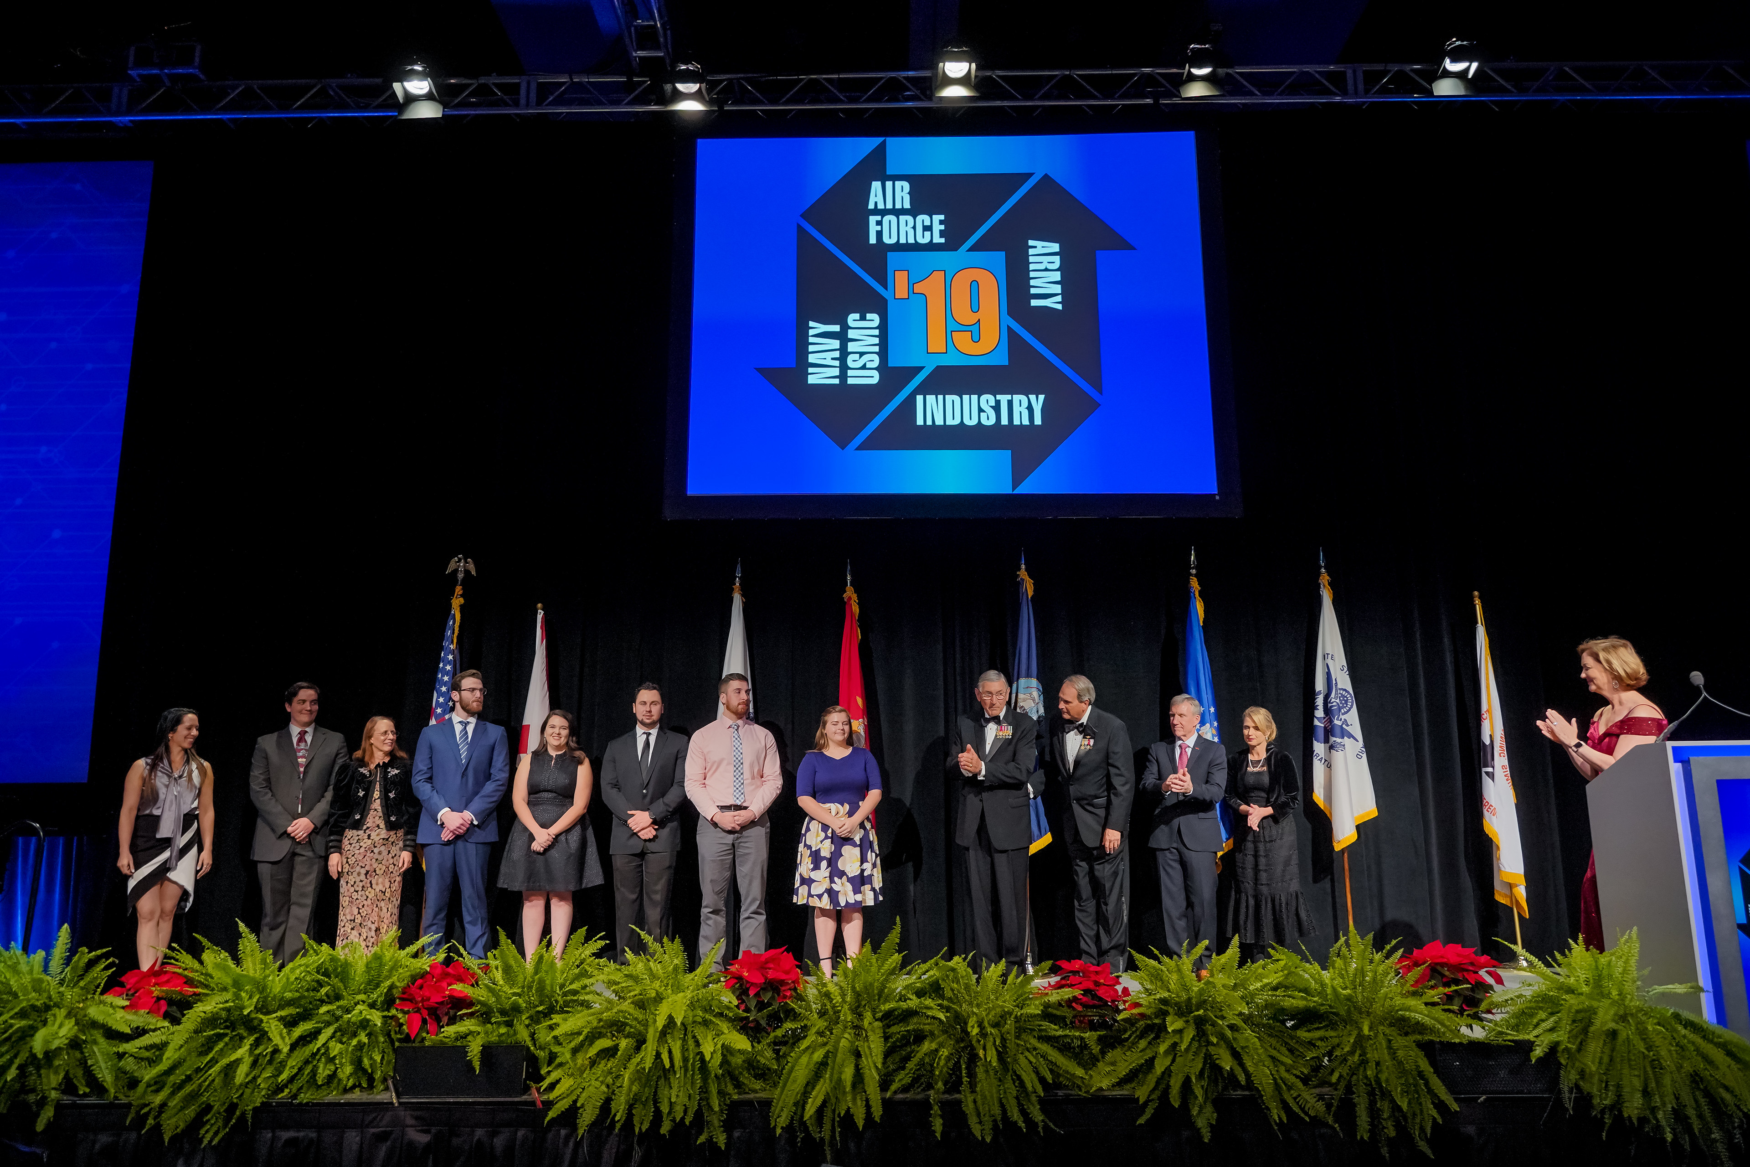
I/ITSEC
Interservice/Industry Training, Simulation, and Education Conference
Unique blend of military, industry, and academia
Immense exhibit show floor
Strong ties to ISU via Eliot
2023 Conference Chair
28 publications
7 scholarship winners
5 subcommittee members
Dr. Stacy MacAllister | Top 10 under 40

Slide 24
Funding to Attend Conferences
Expenses
Registration $300
Flight $600
Lodging x 4: $1000
Per diem x 4: $240
University conference funding programs
Department-specific funding
Professor or Advisor funding

Slide 25
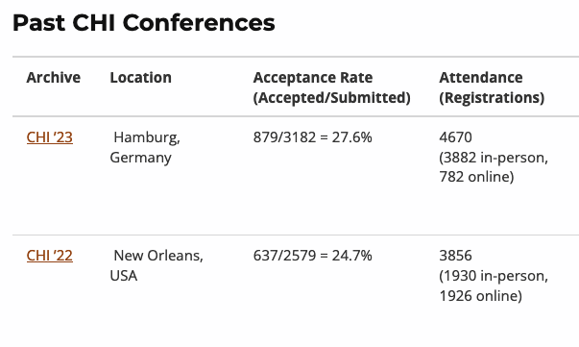
What makes a conference good?
Acceptance Rate
Lower rates $\text{α}$ greater the prestige
ACM & IEEE conferences

Slide 26
I/ITSEC Program Browsing
5 min by yourself
Browse I/ITSEC program
Choose 2 talks you’d want to see
Think of 2 questions you have about HCI.
5 min in pairs – Tell each other your 2 talks and 2 questions.
Group – Tell everyone 1 talk and 1 question.
Let me show you how to browse it…

Slide 27
Homework: Bad Usability Scavenger Hunt
Find 2 interfaces that are frustrating for the user (websites or physical items: Doors, Chairs, Game Controllers, etc.) and capture them (photo or screenshot) by end of Sunday.
Describe:
The user’s task and context
What is working/not working
What could make it better
Blog them: start post title with “HCI:”
Due by end of Sunday

