Slide 1
REU Modeling Course - Part I Blender Program Introduction

Slide 2
Workshop Workflow
Compare/Introduce CAD Programs and Purposes
Blender Interface
Creating/Experimenting With Polygonal Models
Today’s Mini Creation

Slide 3
VRAC Computer Aided Design (CAD) “Flavors”
Digital Product Design (DPD)
Concept Design
Marketing
Engineering
Manufacturing
Free-Form Modeling
Design and Modeling
Rendering and Animation
VRAC
Other Visualization Format
Exchange/Conversion
Post Processing

Slide 4
Free-Form Design & Modeling CAD
Design and Modeling
Direct modeling
Scene Rendering and Animation
Examples:
Cinema 4D
3DS Max
Blender
Rhinoceros 3D
Free-Form Modeling

Slide 5
“Other” Free-Form Modeling
Other Visualization Format
Conceptual Design: ASDS, SpaceClaim
Visualization: OpenSceneGraph, Unity, Unreal Engine
Mesh Edit/Repair: Autodesk Meshmixer, Mesh lab

Slide 7
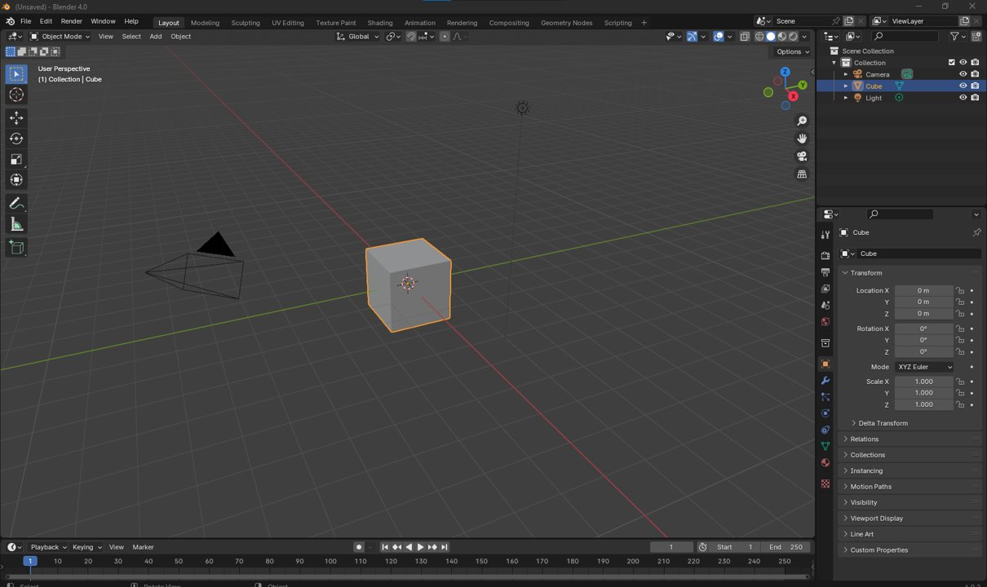
Notes:
When you first open unity, this is the window that will appear. We are going to quickly go over what each section is. Don’t worry too much about remembering all of this. Most will just come with time as you get more familiar with Blender.

Slide 8
Topbar

Slide 9
Topbar
Workspaces:
Predefined window views for different editing modes

Slide 10
Topbar
File Menu:
All things related to making/saving files
Create New Scene
Save Current Scene
Copy Scene
Edit Menu:
All things related to editing files
Undo/Redo History
Preferences
Render Window:
Not important now, but will come back to this in session 3

Slide 11
Areas

Slide 12
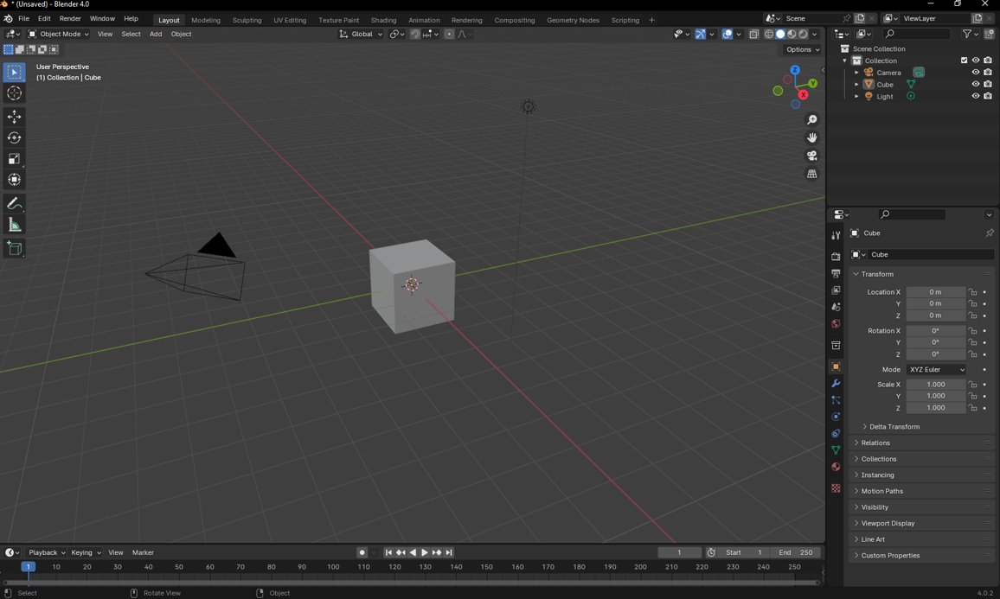
Status Bar

Slide 13
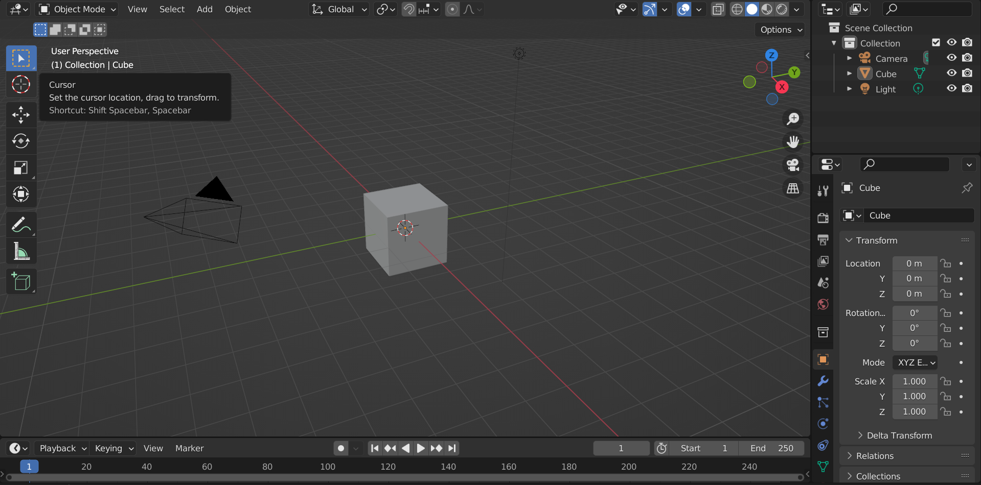
Areas

Slide 14
Areas
ViewPort:
Scene
Notes:
This is where you can see your scene that you are editing/creating

Slide 15
Areas
Hierarchy Tree:
Objects
Cameras
Lights
Notes:
Somewhat similar to Solidworks feature tree, this is where you can see all of the parts, lights, cameras etc in your scene

Slide 16
Areas
Properties:
Size
Position
Rotation
Notes:
Every object will have properties (length, height, width etc). This panel is where you can see/modify those properties.

Slide 17
Areas
Modifiers:
Move
Rotate
Scale
etc
Notes:
These tools will help you move, scale, rotate objects in the scene

Slide 18
Areas
Editing Mode:
Object Mode
Edit Mode (Vertex)
Notes:
This drop down will allow you to select how you want to edit your objects

Slide 19
Blender Viewports
A new panel can be opened by clicking and dragging from this corner

Slide 20
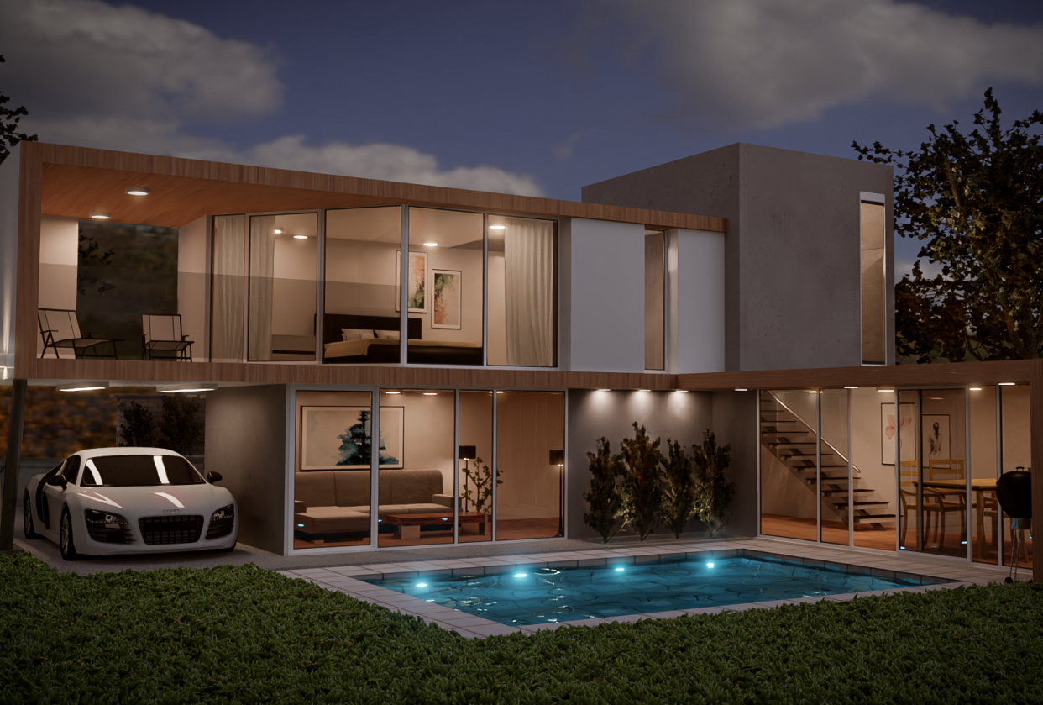
Break Time!

Slide 21
Moving Around in Blender
(Almost identical to Solidworks)
Orbit: Middle mouse click and drag
Traverse: Shift + Middle mouse click and drag
Zoom In/Out: Scroll middle mouse wheel
Select: Left mouse click and drag

Slide 22
What is a Mesh?
Most geometry in blender are meshes
A mesh is a “net” of vertices
Notes:
You can see that this torus (donut) is made up of a series of points and straight lines. This is what a mesh is.

Slide 23
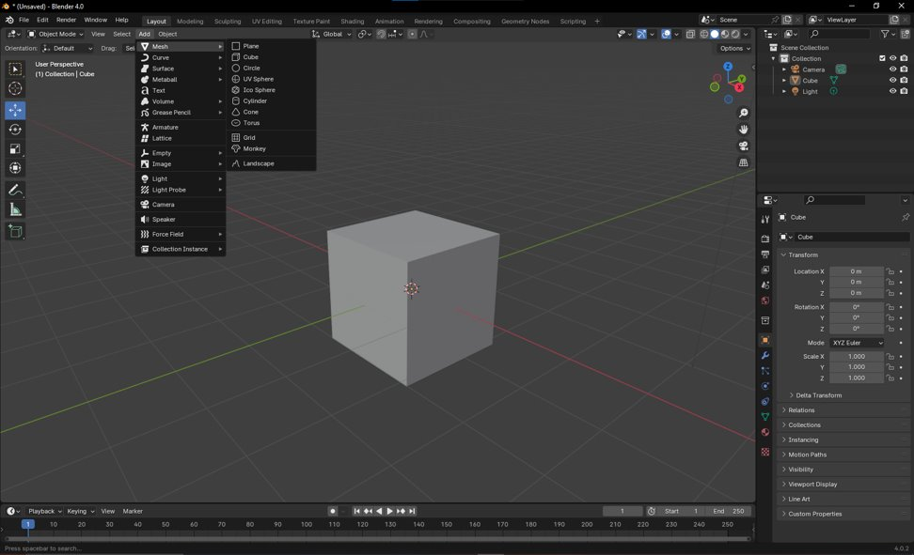
Creating Your First Mesh
Open the Add Menu
Notes:
Click the add button to open the add menu. From there, go to mesh, and select the mesh that you want to add.

Slide 24
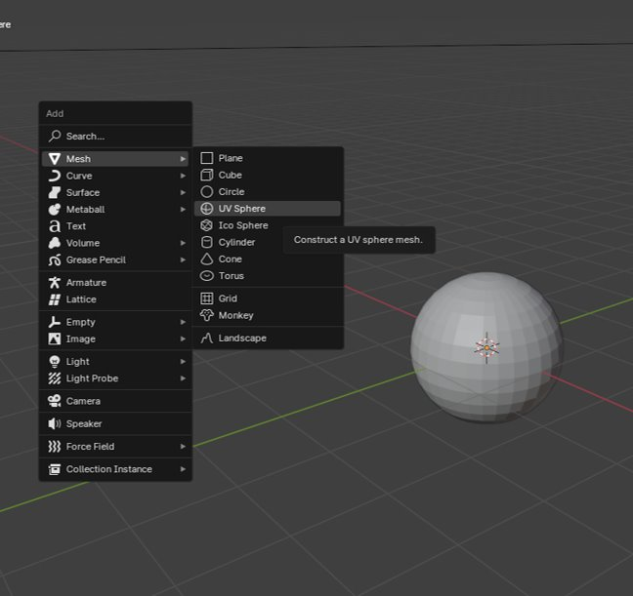
Creating Your First Mesh
The “Add Menu” can also be opened with hot keys
Hotkey: Shift + A
Add Menu > Mesh > UV Sphere

Slide 25
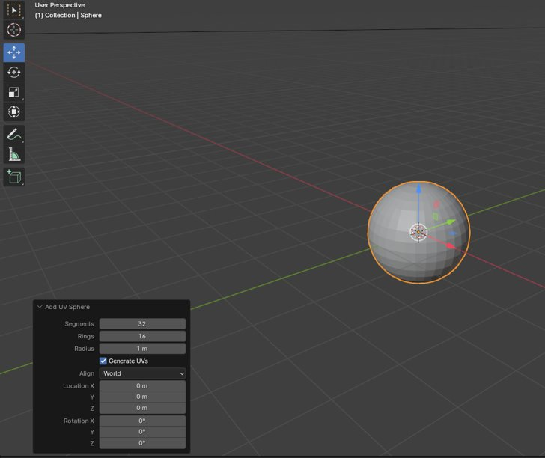
Creating Your First Mesh
Modification menu opens
Notes:
Once the mesh has been created, the modification menu will appear. This will be the only time that this menu appears. Once you click away from the object, the menu disappears.

Slide 26
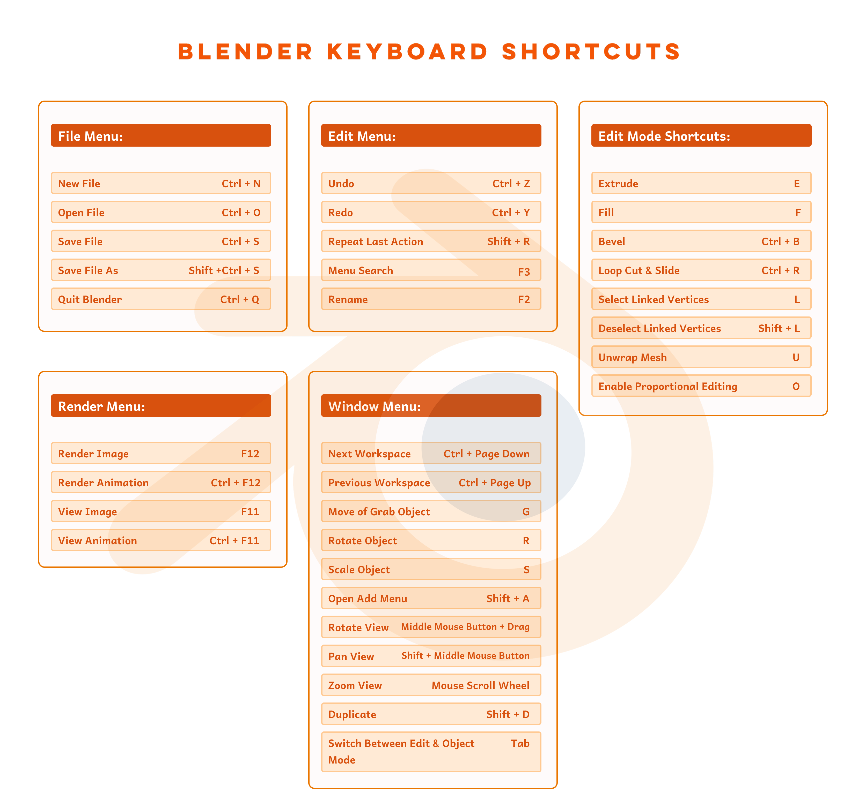
Cheat Sheet

Slide 27
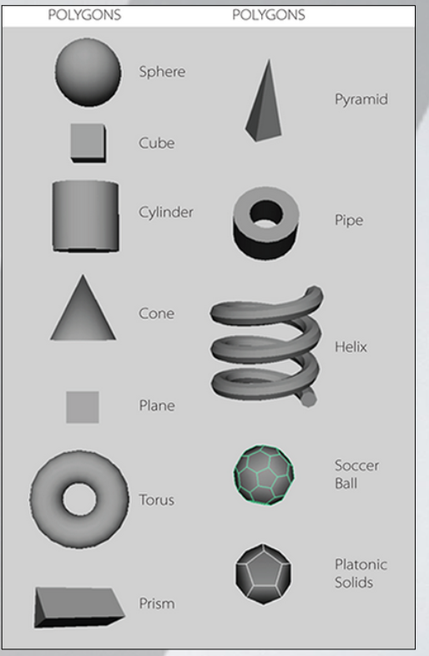
Polygon Models: Primitive Types
Polygon Primitives Include: Sphere, cube, cylinder, cone, plane, torus (dontu), prism, pyramide, pipe, helix, sphere, platonic solids.
Hotkey: Shift + A (opens the add menu)

Slide 28
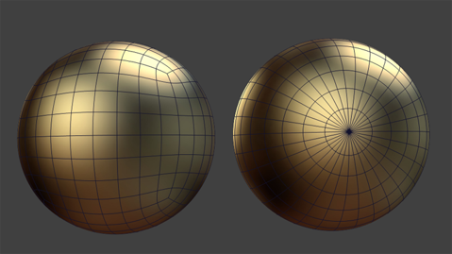
Difference between NURBS & Polygons
NURBS (Non-Uniform Rational B-Spline Surface)
Less details for the same amount of curvature
Composed of curves rather than straight lines
Less flexible when it comes to modeling
Polygons
This course deals almost entirely with Polygons
Used more frequently than NURBS
“Curves” are composed of many small straight lines.

Slide 29
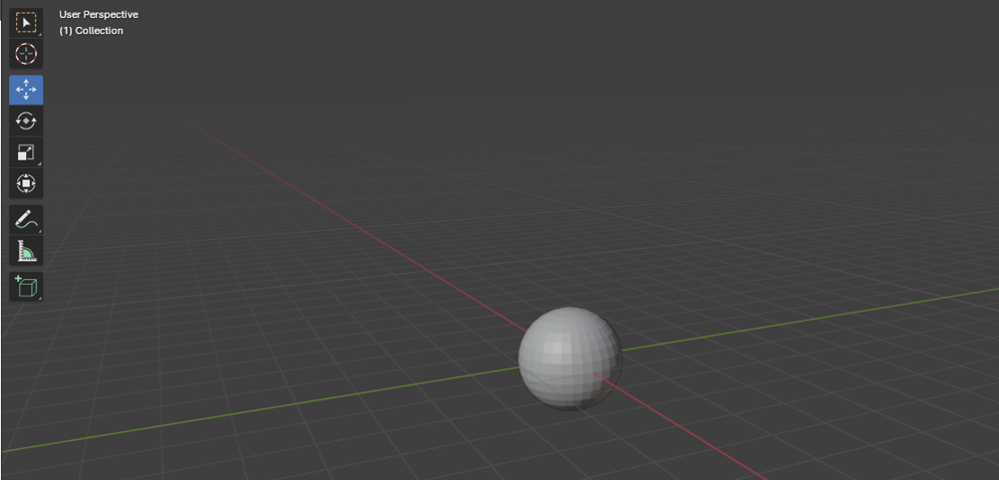
Areas
Modifiers:
These tools will help you move, scale, rotate objects in the scene

Slide 30
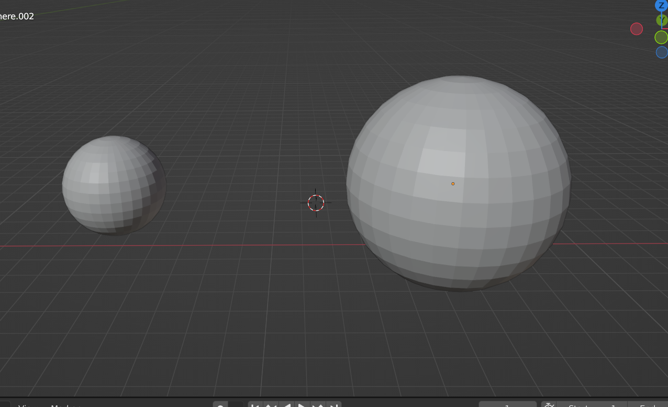
Modifying Your Mesh
Move:
Hotkey: G
Scale:
Hotkey: S
Rotate:
Hotkey: R
Duplicate:
Hotkey: Shift + D
Restrict Modification:
To move, scale, etc along specific axis:
Modifier followed by x/y/z (depending on axis you want to modify)
Scaling Example:

Slide 31
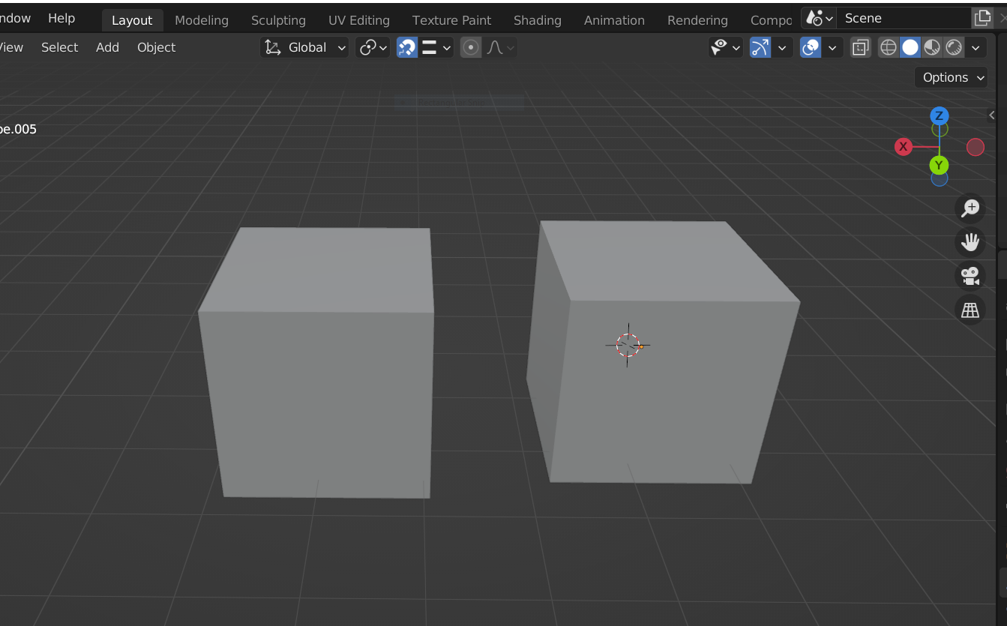
Snapping
The magnet icon at the top of the screen provides different snapping settings.

Slide 32
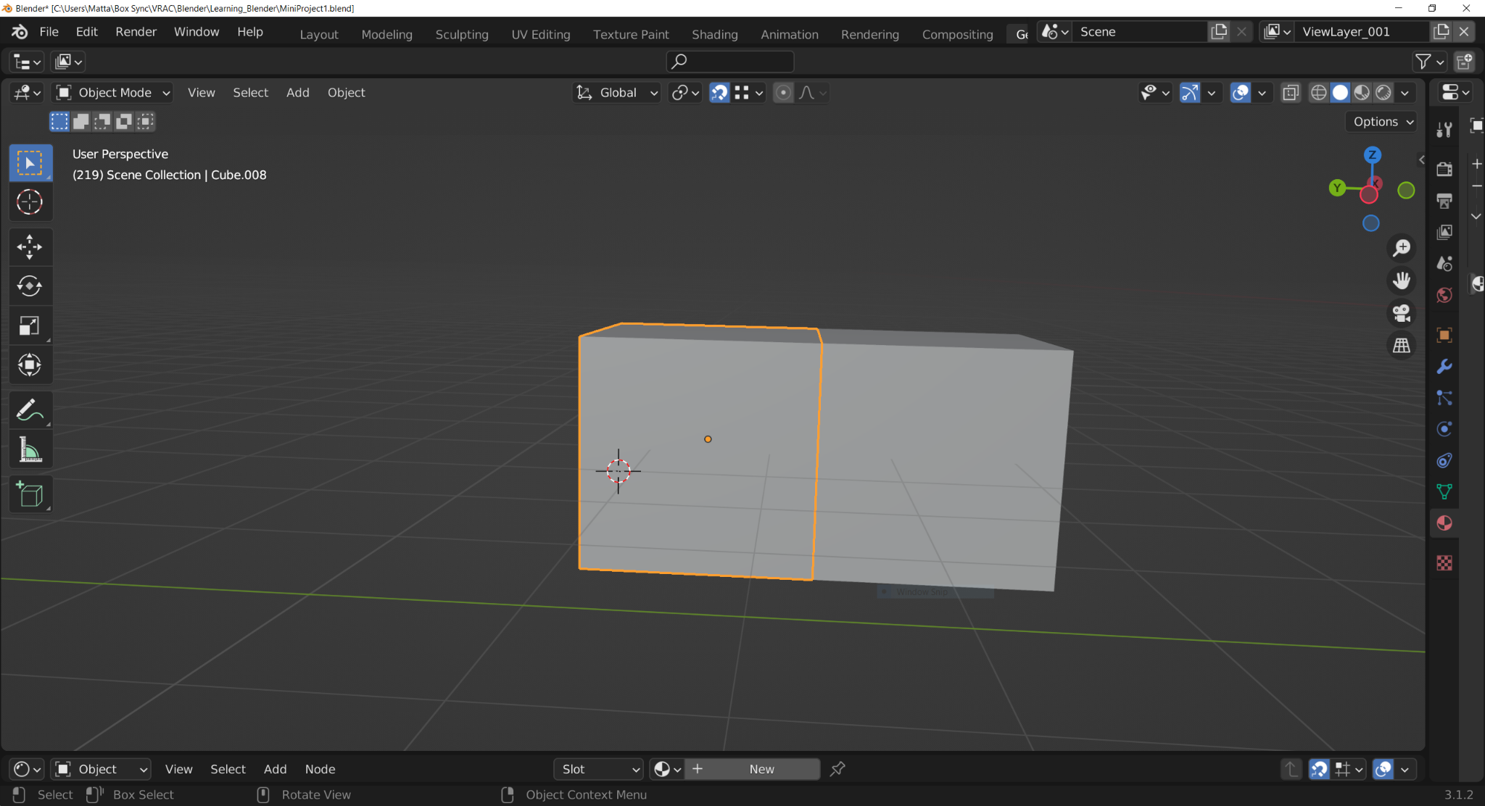
Snapping
Snapping helps line objects up

Slide 33
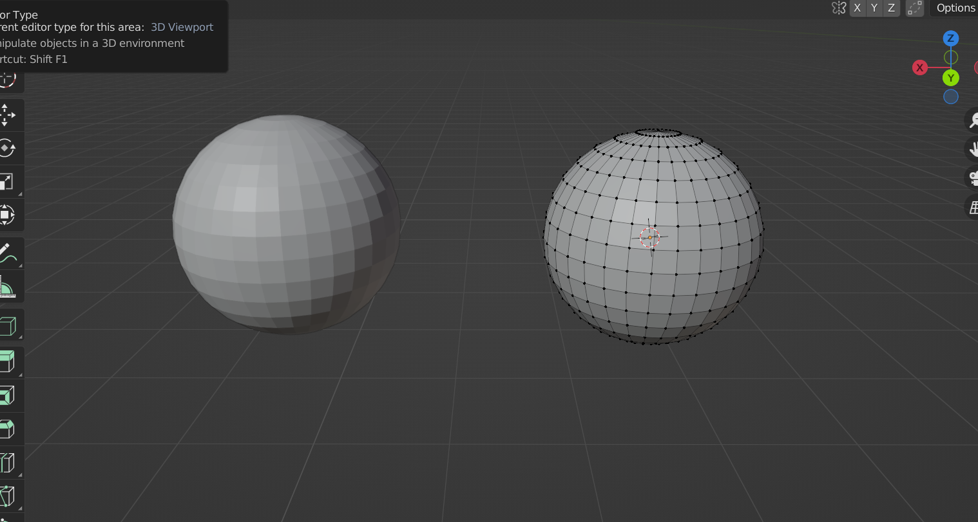
Modifying Vertices
A sphere is really just a collection of straight lines and squares. The points in the corners of these squares are called vertices and we can push and pull them to make our sphere look different.

Slide 34
Modifying Vertices
A sphere is really just a collection of straight lines and squares. The points of these squares are called vertices and we can push and pull them to make our sphere look different.

Slide 35
Vertex Editing:
Select the object you want to edit.
Change “Object mode” to “Edit Mode”
Edit those vertices!
Tip: ‘Tab’ can be used to quickly swap editing modes

Slide 36
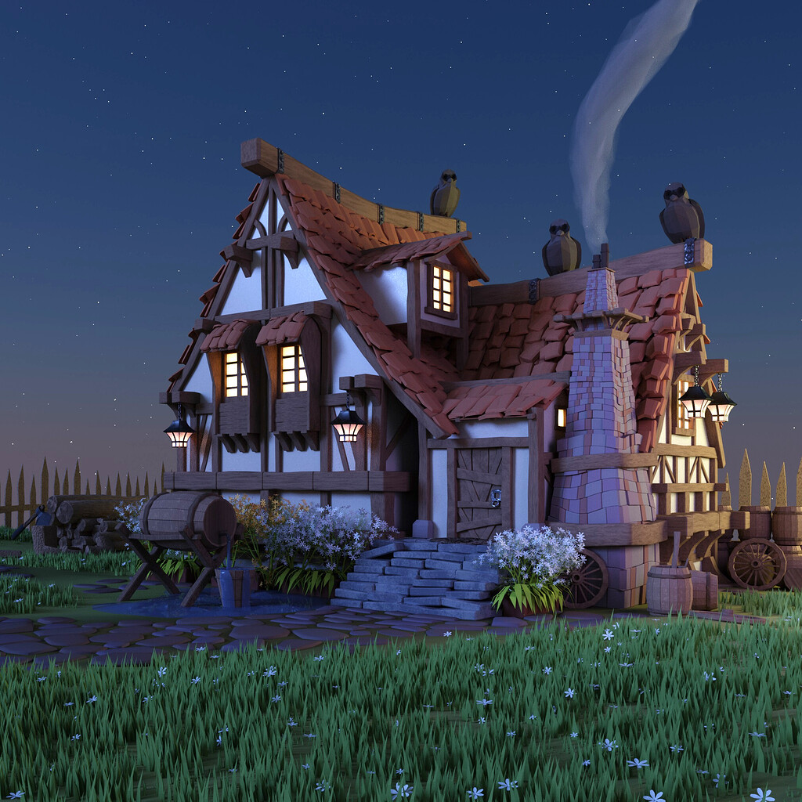
Break Time!

Slide 37
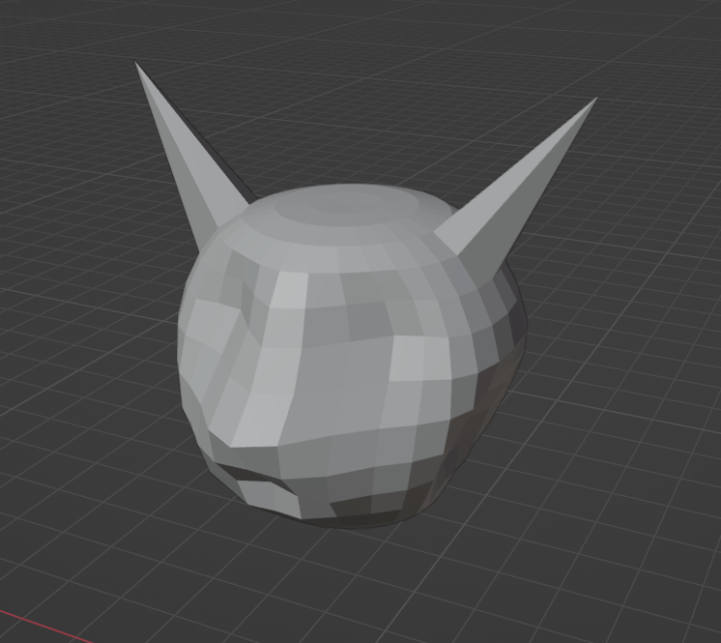
Vertex Mini Activity
Mini Activity
This cat face started out as just a sphere
Edit a standard mesh shape into something fun
Questions:
What happens if a vertex is deleted?
Can you add a vertex back once it is deleted?
What if you want more vertices?

Slide 38
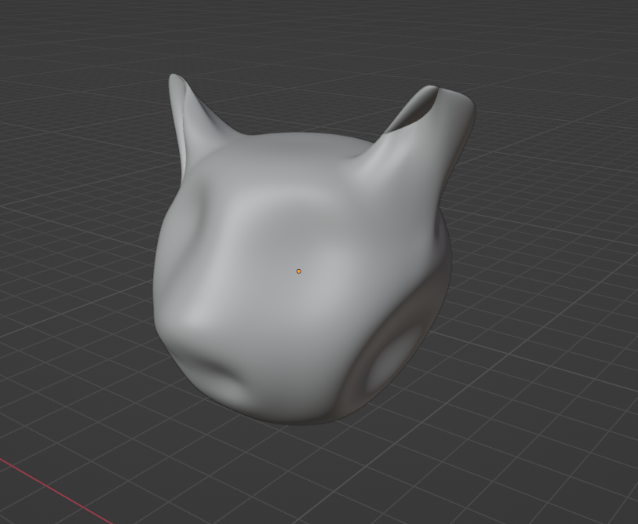
Vertex Mini Activity (Bonus)
What if you wanted to smooth out your shape? How would you do that?

Slide 39
Today’s Mini Creation
Stage 1: Design
Make a quick sketch using the materials provided to design an environment with the objects below.
Confirm design with instructor before modeling
Stage II: 3 Objects
Create a building
House
Shed
Landscape/ground
Yard feature
Wagon
Tree/bush
Stage III: 2 Objects
Landscaping feature
Rocks
Walking path
Details to building:
Door
Roof
Stage IV: 2 Objects
More details
Cow
Water well
Details to building:
Windows
Chimney

Slide 40
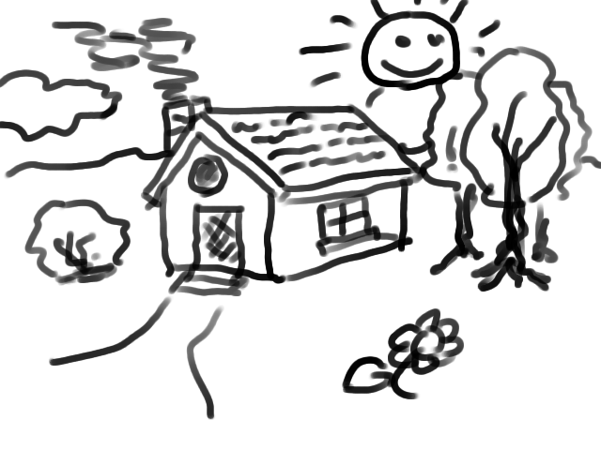
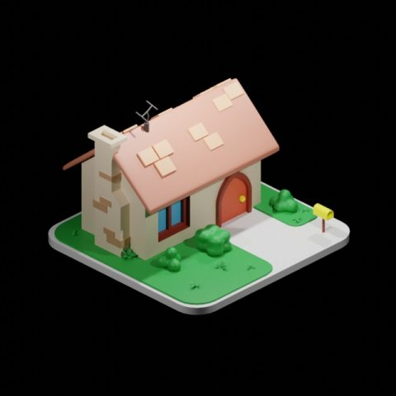

Slide 41
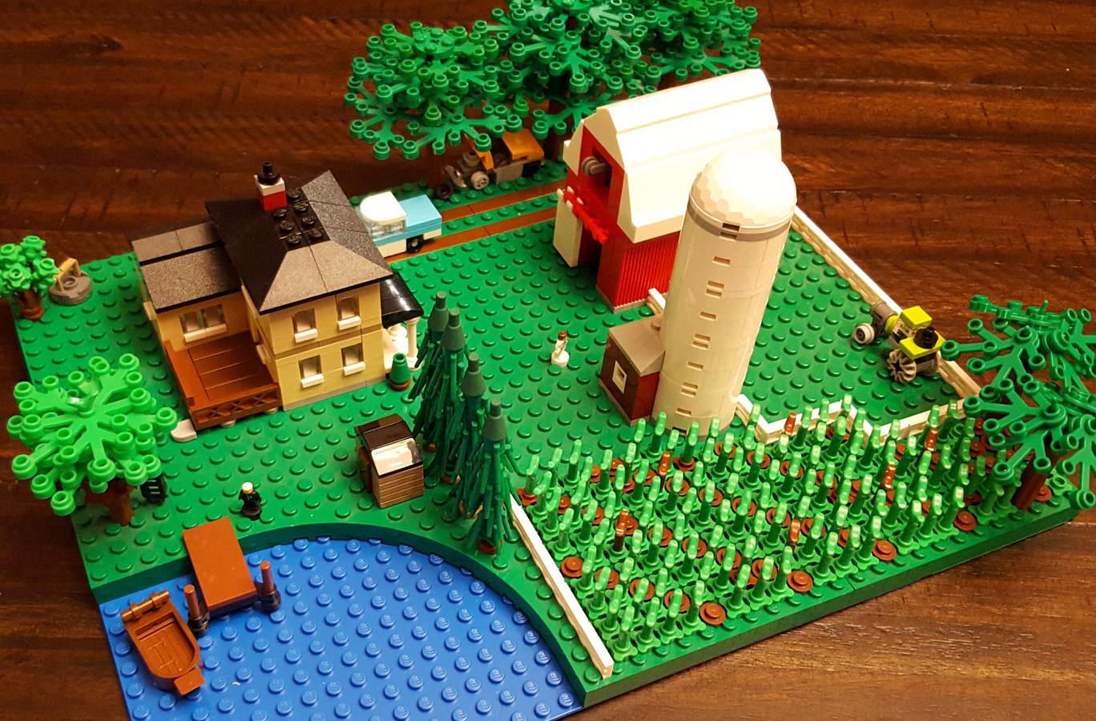
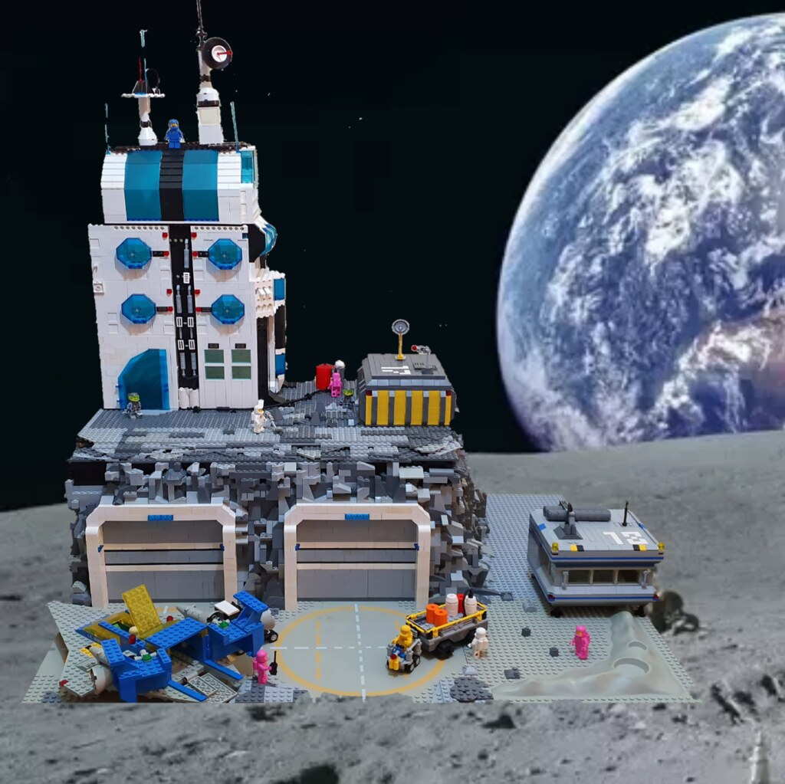
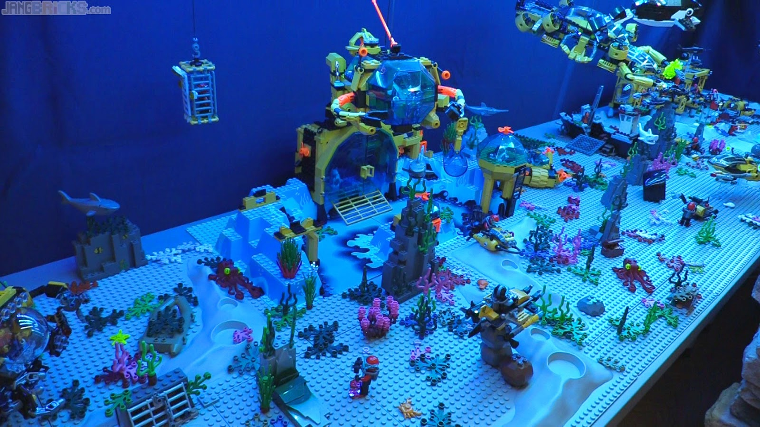
Today’s Mini Creation Inspiration
Notes:
Here are some different ideas for what your farm yard could look like. Be creative and have some fun with it. Maybe it doesn’t have to be on earth at all. What about a space, or underwater farm?

