Slide 1
REU Modeling Course - Part 2
Blender
More Modeling

Slide 2
Workshop Workflow
Workshop Workflow
Review Previous Session
More Modeling Operations
Organizing Scenes/Objects in Blender
Today’s Mini Creation
Review Previous Session
More Modeling Operations
Organizing Scenes/Objects in Blender
Today’s Mini Creation

Slide 3
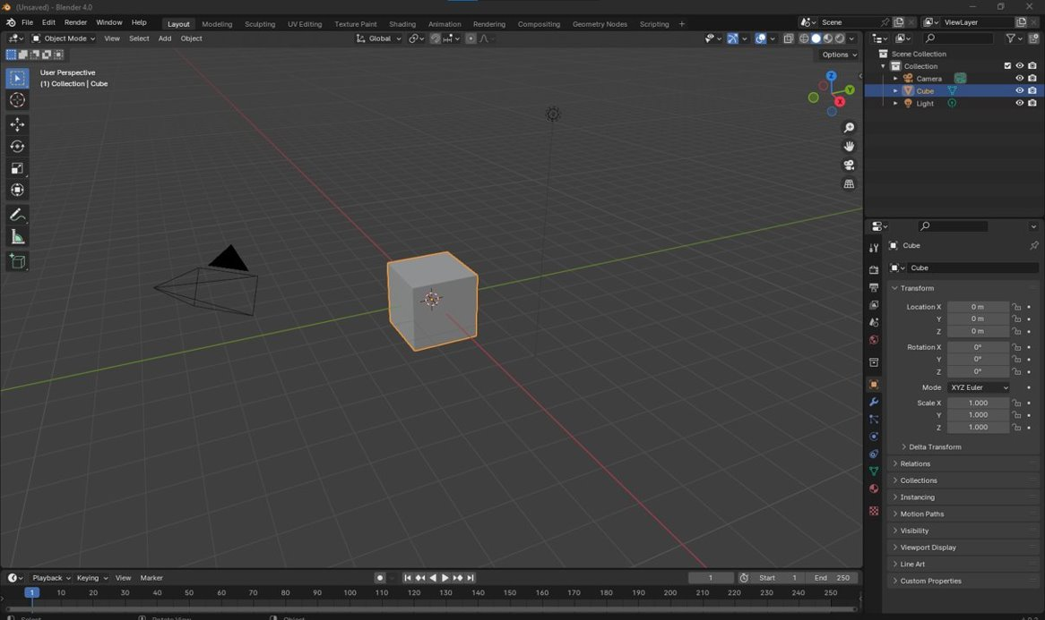
Review
What is this window?

Slide 4
Review
ViewPort:
This is where you can see your scene that you are editing/creating

Slide 5
Review
What is this panel?

Slide 6
Review
Hierarchy Tree:
Somewhat similar to Solidworks feature tree, this is where you can see all of the parts, lights, cameras etc in your scene

Slide 7
Review
What is this panel?

Slide 8
Review
What is this panel?

Slide 9
Review
Modifiers:
These tools will help you move, scale, rotate objects in the scene

Slide 10
Areas
What is this panel?

Slide 11
Review
Editing Mode:
This drop down will allow you to select how you want to edit your objects

Slide 12
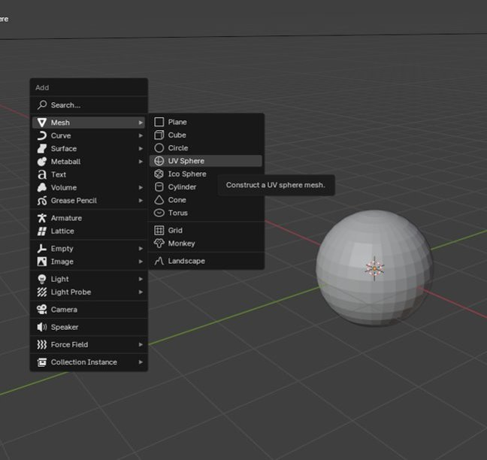
Review
Shift + A is a crucial hotkey!
(Open Add Menu) Shift + A
Add Menu > Mesh > UV Sphere
Hotkey Review:
Move: G
Scale: S
Rotate: R
Switch Editing Mode: Tab

Slide 13
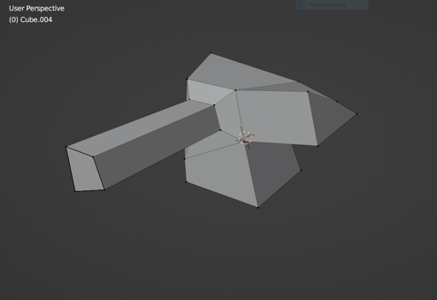
More Vertex Operations
The following tools were used to make this shape from a simple cube:
Extrude
Bevel
Edge Slide

Slide 14
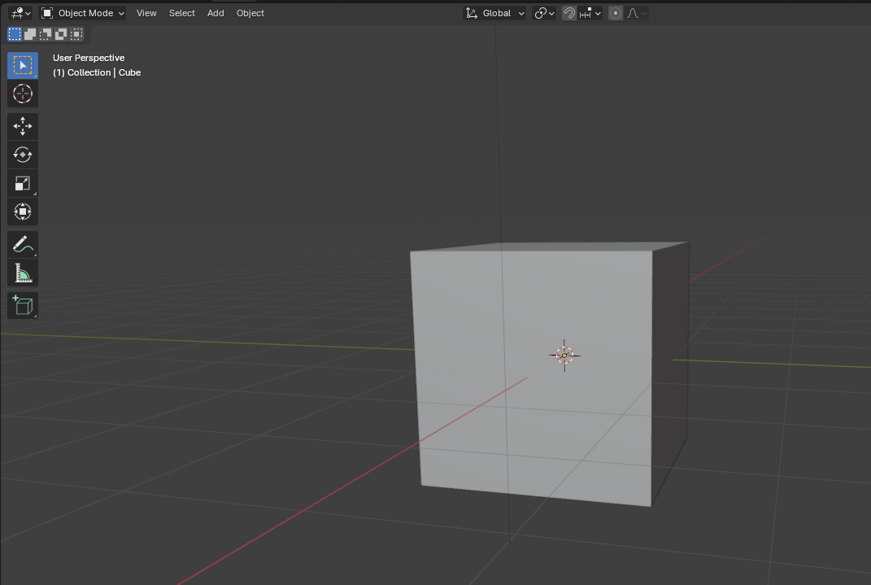
Vertices: Extrude
Add a cube to scene
Enter “Edit Mode”

Slide 15
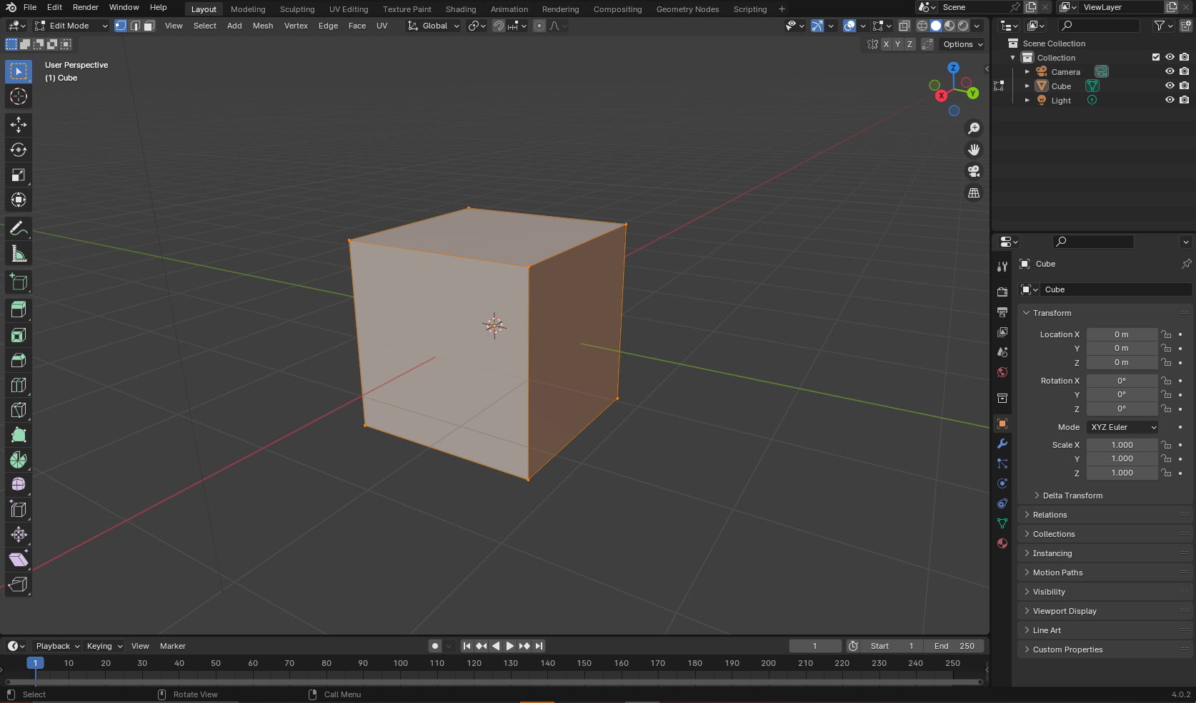
Vertices: Extrude
Notice that a new menu has popped up on the left
Extrude (E)
Bevel (Ctrl+B)
Tip: Clicking and dragging is the best way to select vertices

Slide 16
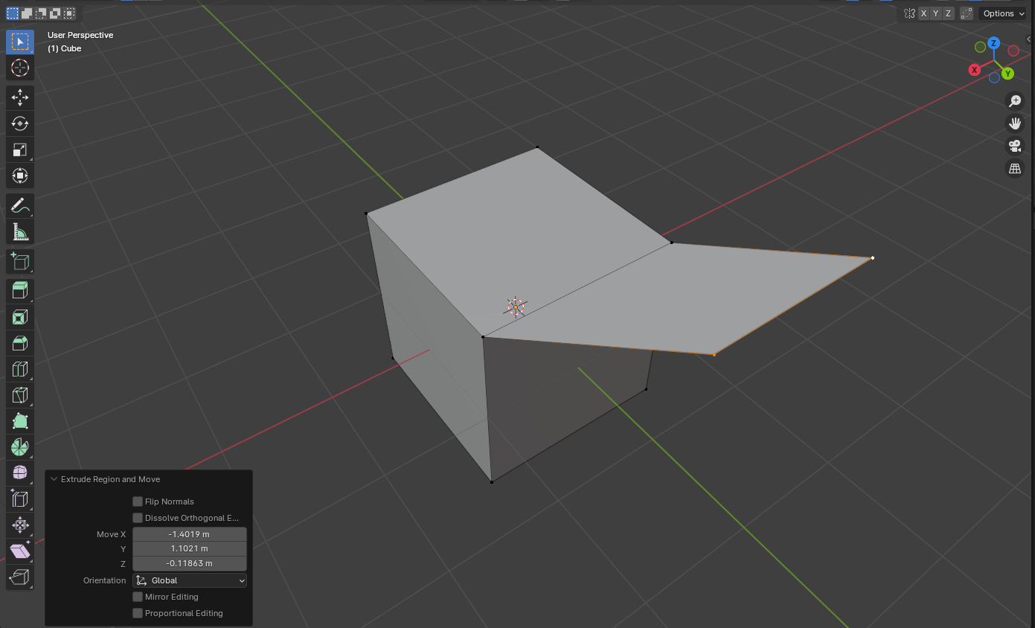
Vertices: Extrude
Extrude (E)
Bevel (Ctrl+B)
Select the point(s) to edit
Press E for extrude
Move mouse to extrude points
Now try to add a bevel

Slide 17
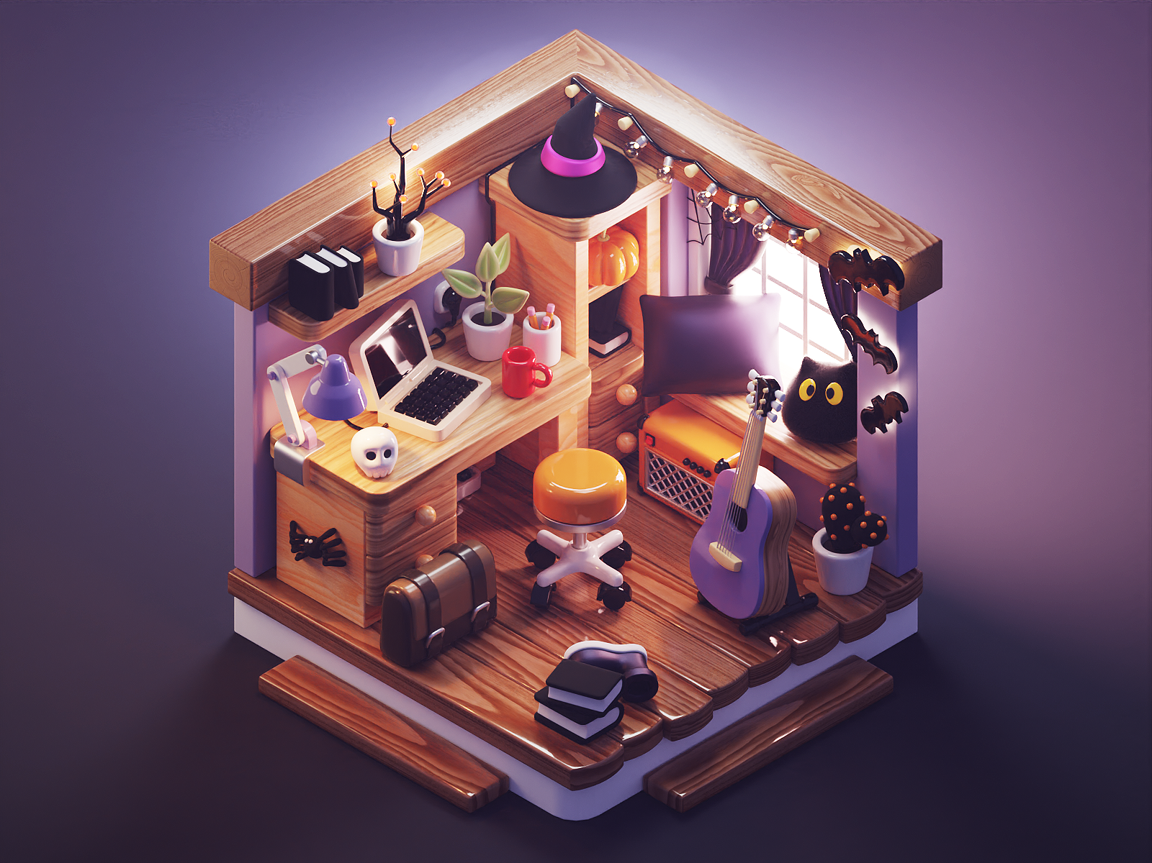
Break Time!

Slide 18
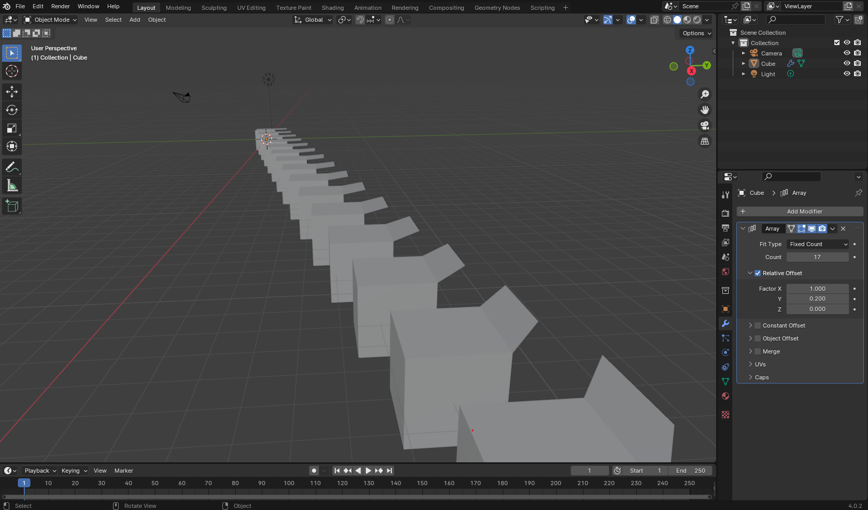
Modifiers!

Slide 19
Modifiers: Menu Introduction
Click the blue wrench

Slide 20
Modifiers: Menu Introduction
List of modifiers will appear here

Slide 21
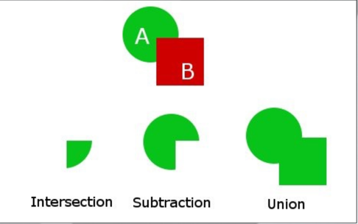
Boolean Modifiers
Boolean Modifiers
Booleans let you subtract, add or intersect an object’s geometry onto another object (merging)
Usually used for objects that will not be deformed (mechanical)
Drawbacks:
Geometry cannot be deformed

Slide 22
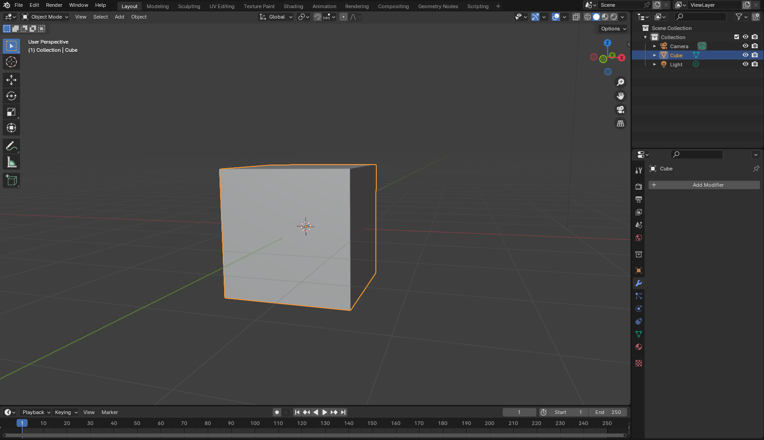
Modifiers: Boolean Difference
Create Cube

Slide 23
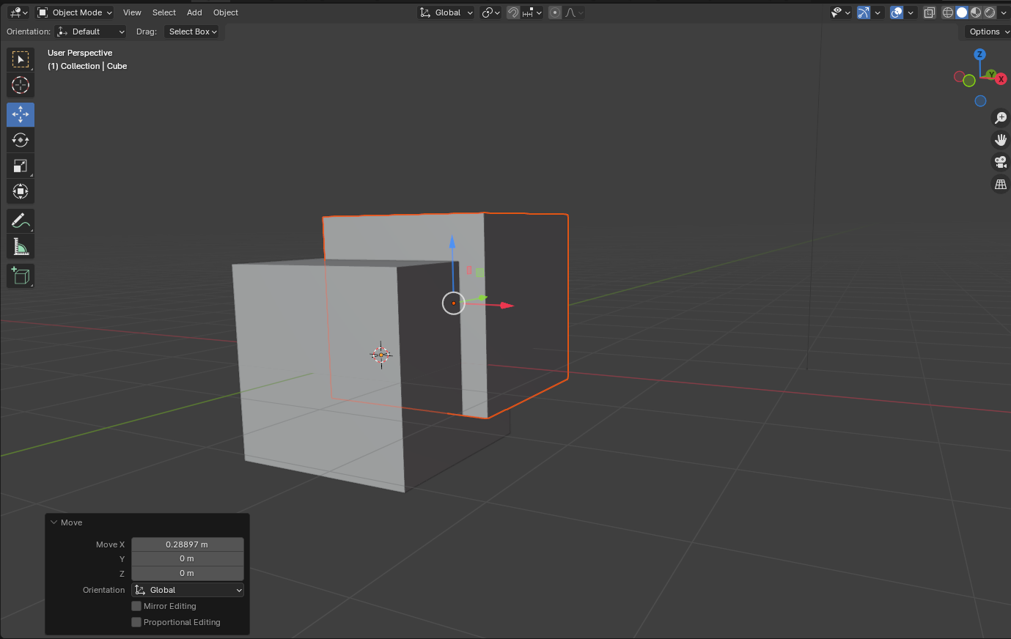
Modifiers: Boolean Difference
Create Second Cube
Make sure cubes intersect

Slide 24
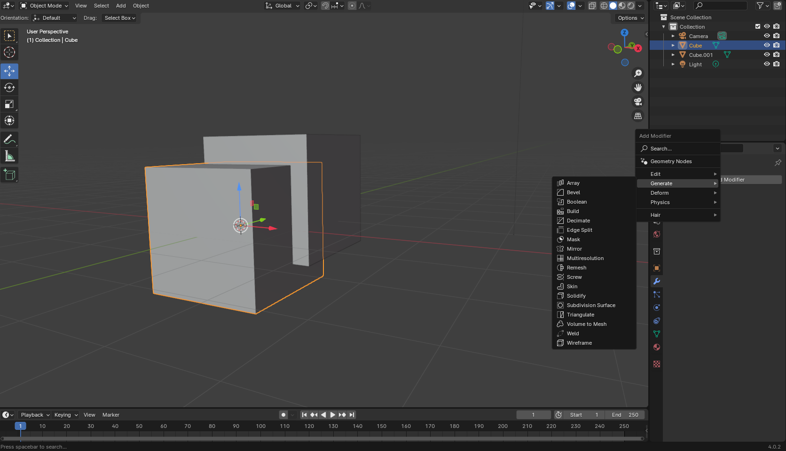
Modifiers: Boolean Difference
Select first cube
Click “Add Modifier”
Click “Boolean”

Slide 25
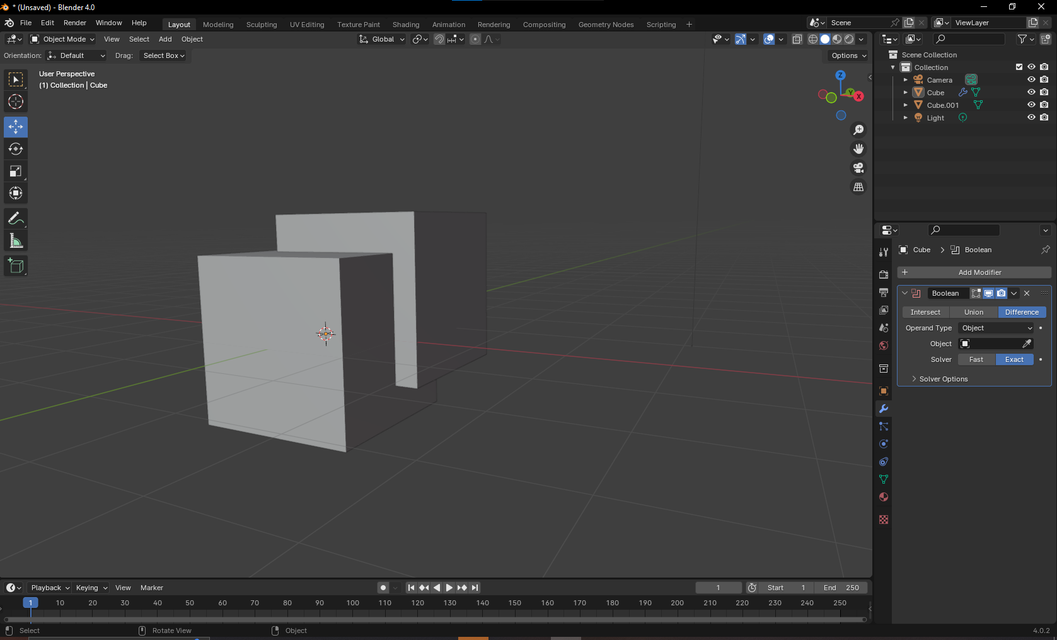
Modifiers: Boolean Difference
To make a cutout, use the “Difference” setting
Select the eyedropper, and click the second cube

Slide 26
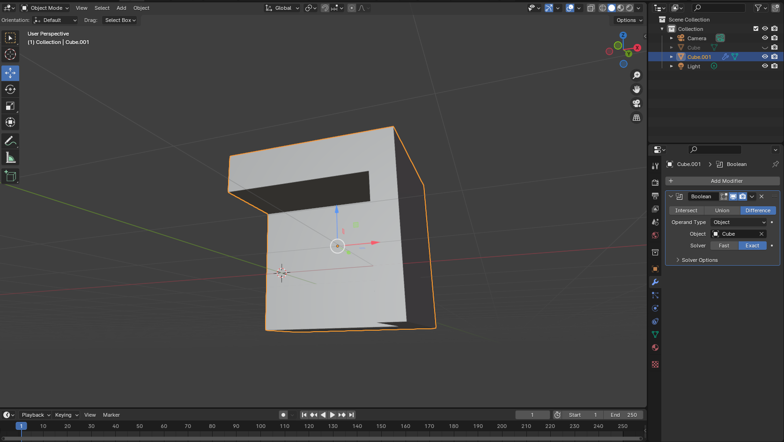
Modifiers: Boolean Difference
Select the second cube and press the hotkey for hide: “H”
Tip: alt+H shows hidden objects in scene

Slide 27
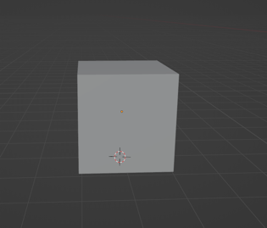
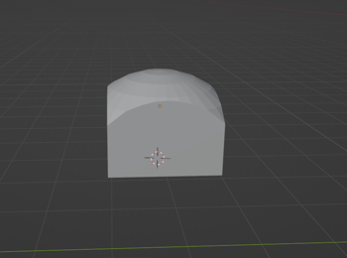
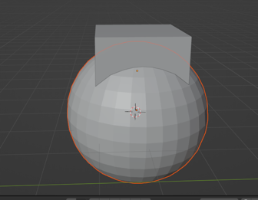
Boolean Modifiers: Intersect Example
Add a mesh cube
3. Apply the bool modifier to cube
2. Add a mesh sphere

Slide 28
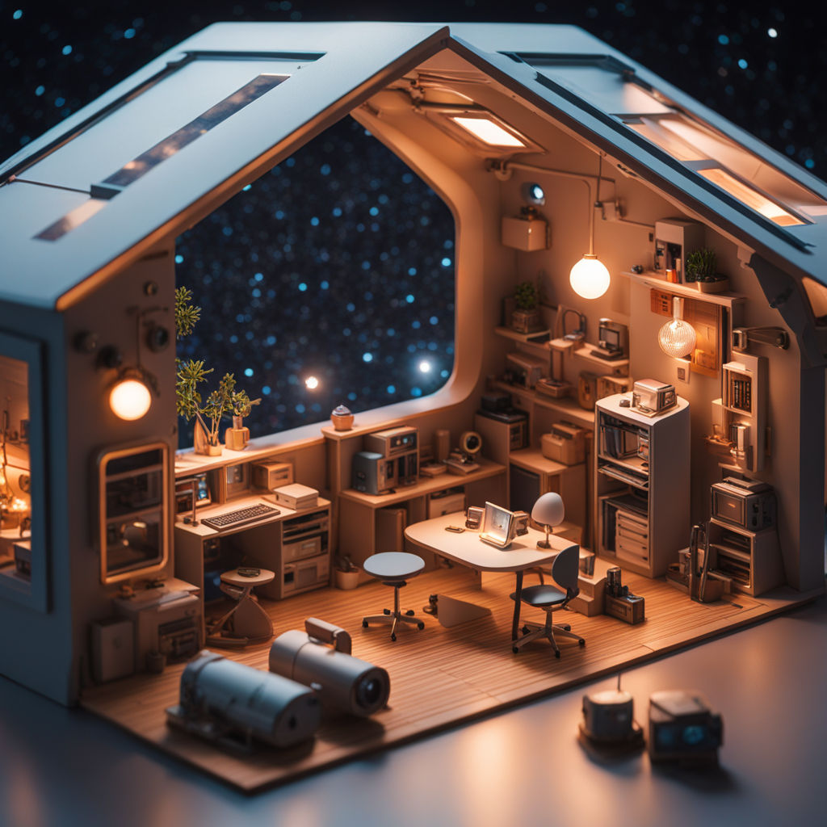
Break Time!

Slide 29
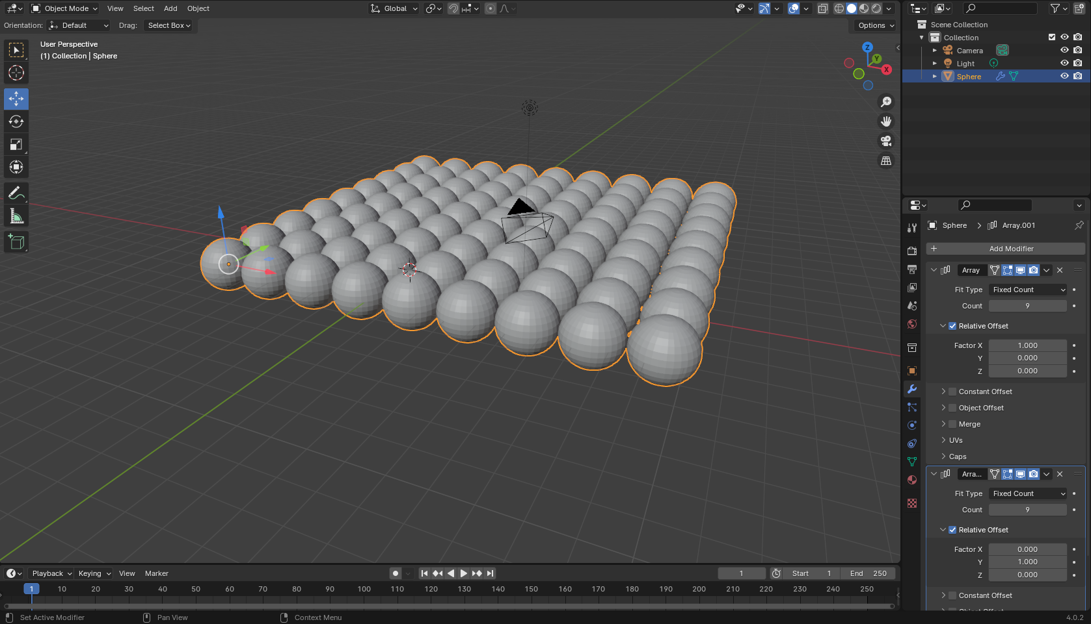
Modifiers: Array
What if we wanted a lot of these spheres in a grid like this?

Slide 30
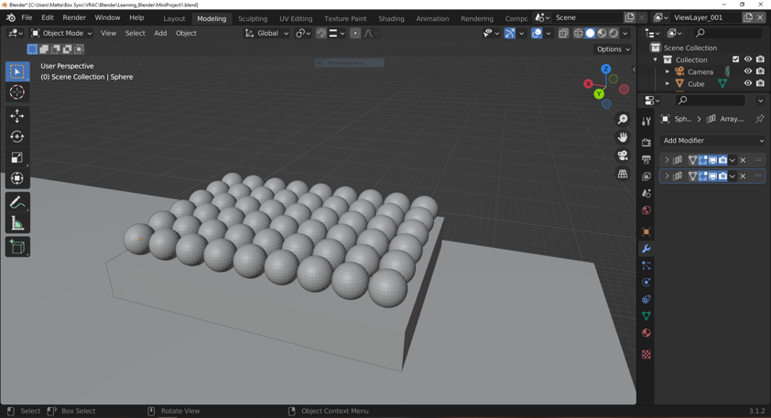
Modifiers: Array
What if we wanted a lot of these spheres in a grid like this?

Slide 31
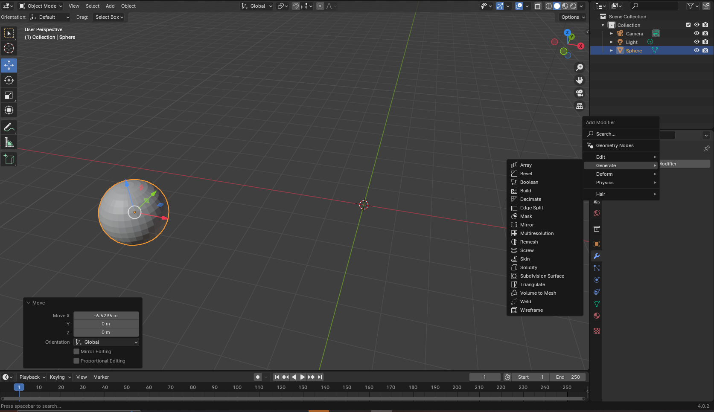
Modifiers: Array
We can use the array modifier in two ways.

Slide 32
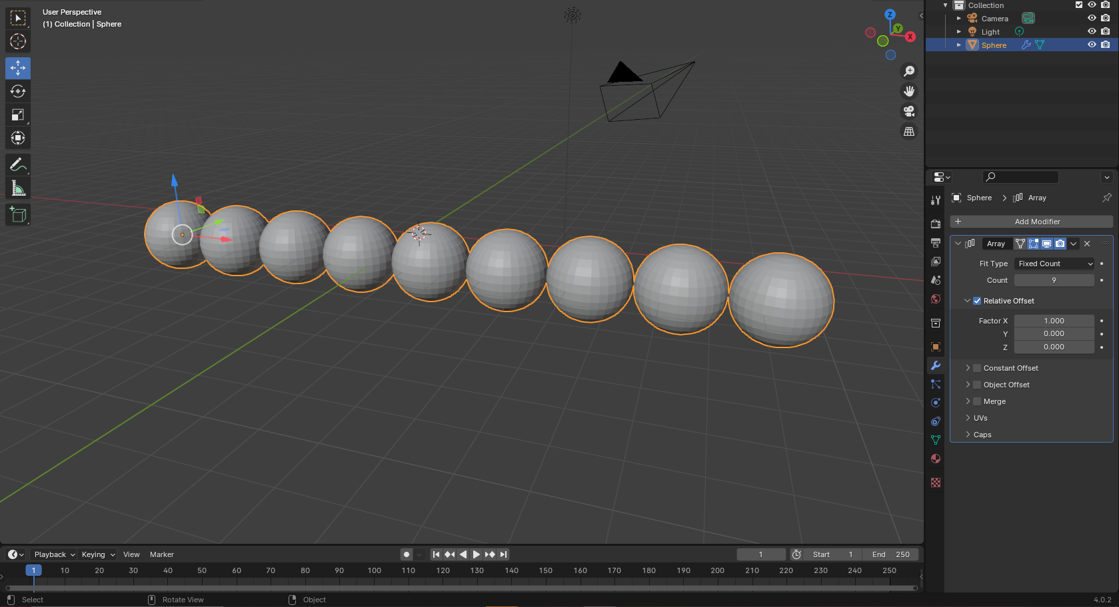
Modifiers: Array
The first array makes copies along the x axis

Slide 33
Modifiers: Array
The second array copies along the Y axis

Slide 34
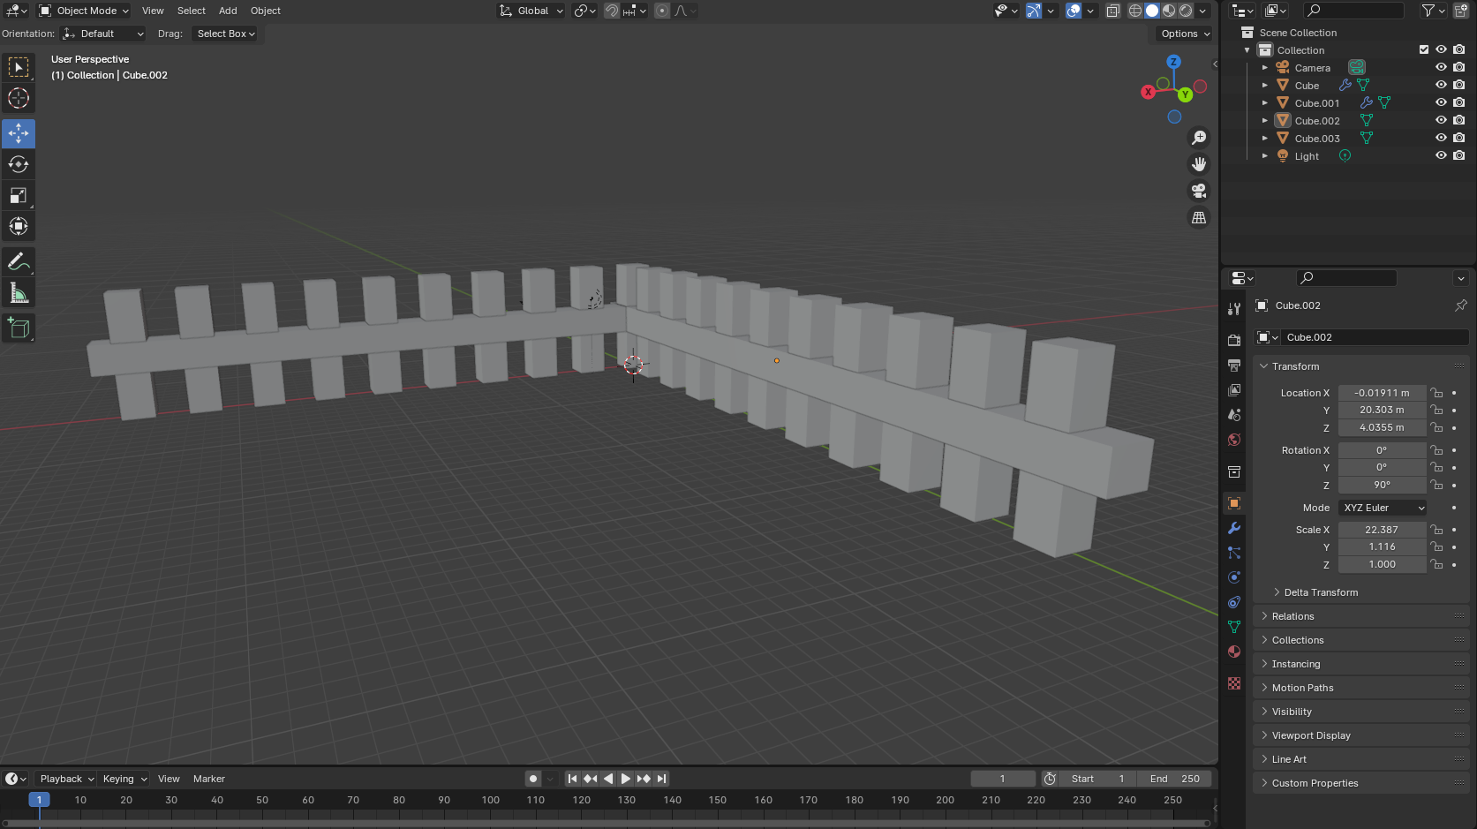
Creating Collections
Collections are useful for organizing a scene
What if I wanted to be able to hide or show all of the fence posts with a single click?
Put all the fence posts in a collection.

Slide 35
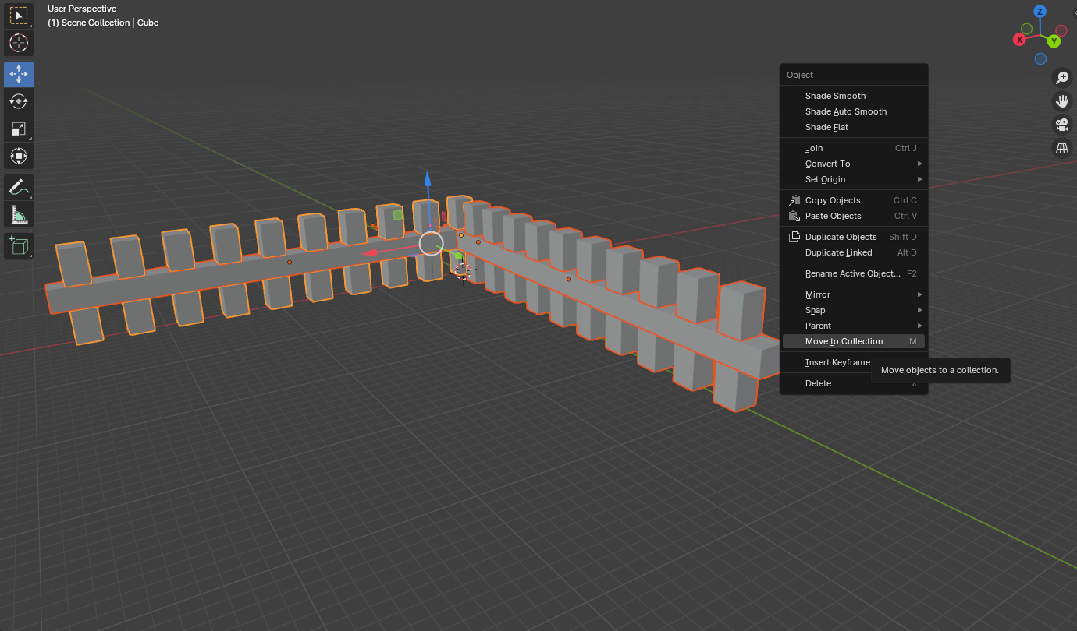
Creating Collections
Select fence objects
Press M (or) right-click & select 'Move to Collection'
“New Collection”
Label the collection

Slide 36
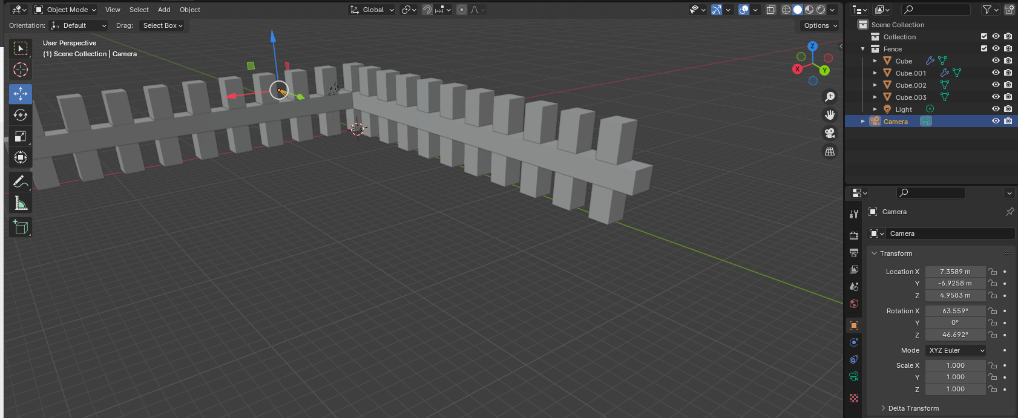
Creating Collections
All fence posts are now collected in this collection in the hierarchy

Slide 37
Mini Creation
Keep working on your creation from Session 1. Add more details, or try new techniques from what we talked about today. Try new modifiers, and play around to see what you can create. Use collections to organize your scene
Stage 1: Design
Make a quick sketch using the materials provided to design and environment with the objects below.
Confirm design with instructor before modeling
Stage 1I: 3 Objects
Create a building
House
Shed
Landscape/ground
Yard feature
Wagon
Tree/bush
Stage III: 2 Objects
Landscaping feature
Rocks
Walking path
Details to building:
Door
Roof
Stage IV: 2 Objects
More details
Cow
Water well
Details to building:
Windows
Chimney

Slide 38
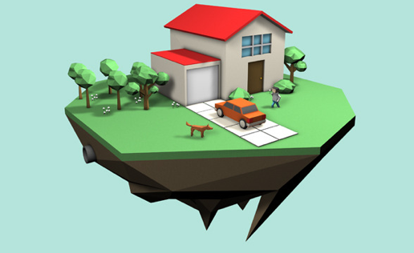
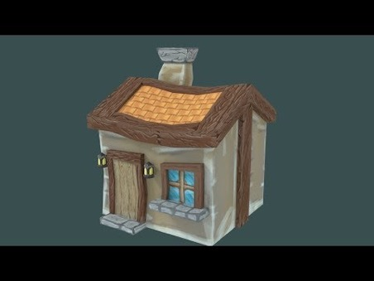
Mini Creation Inspiration

Slide 39
Mini Creation Bonus
Try animating something in your scene (eg: smoke from chimney, swaying tree)
Use animation toolset to make the camera fly through your scene
Try adding colors to the objects in your scene

