Slide 1
REU Modeling Course - Part 3
Blender
More Modeling

Slide 2
Workshop Workflow
Review
Creating & Applying Materials
Rendering
Mini Creation

Slide 3
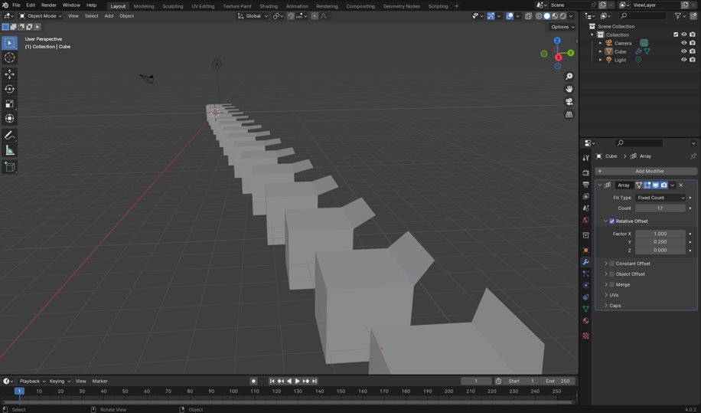
Review
What are modifiers?
How do you add modifiers?

Slide 4
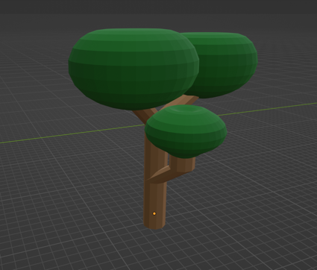
Review
How would you create this:

Slide 5
Basic Lighting Types:
The light on objects in a scene is made up of a combination of these light types.
“Basic Lighting.” LearnOpenGL, https://learnopengl.com/Lighting/Basic-Lighting.

Slide 6
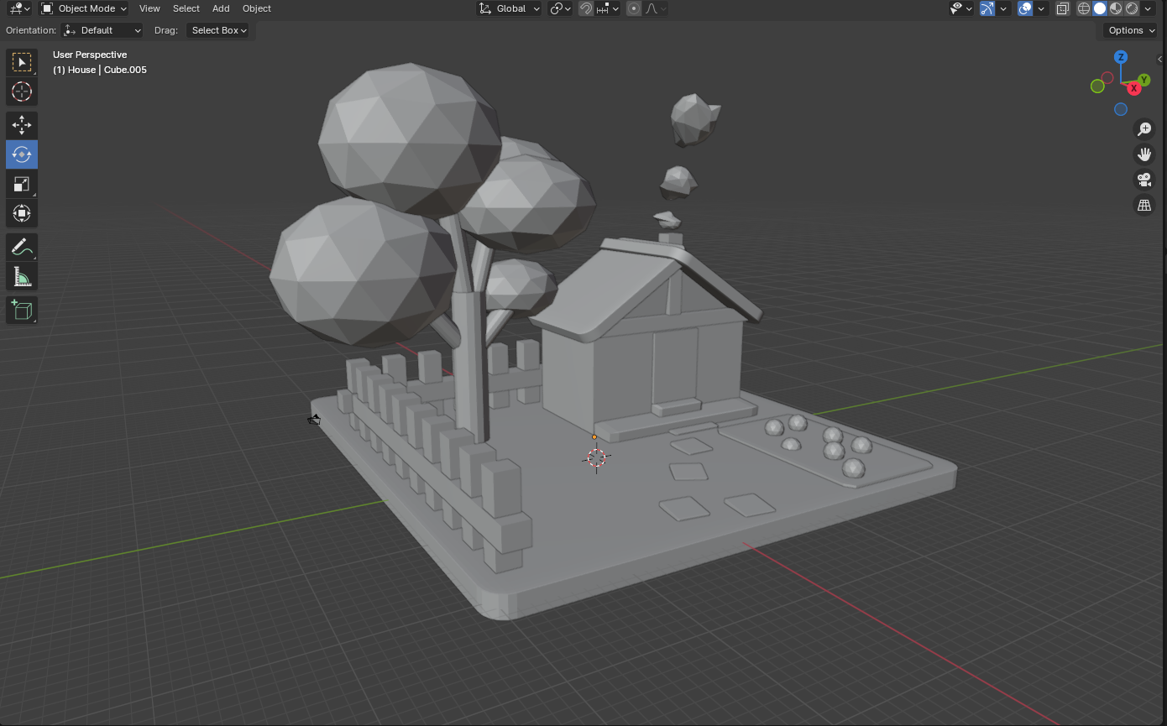
Shaders/Materials
No materials applied

Slide 7
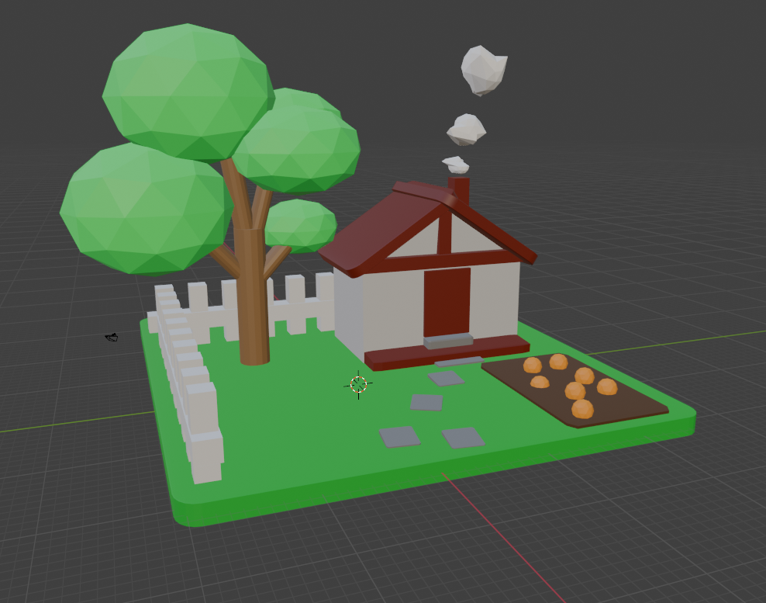
Shaders/Materials
Materials applied

Slide 8
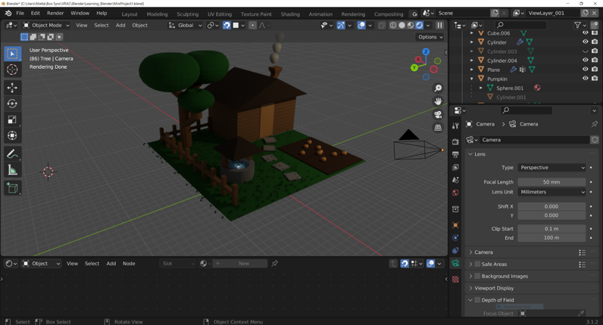
Shaders/Materials Preview

Slide 9
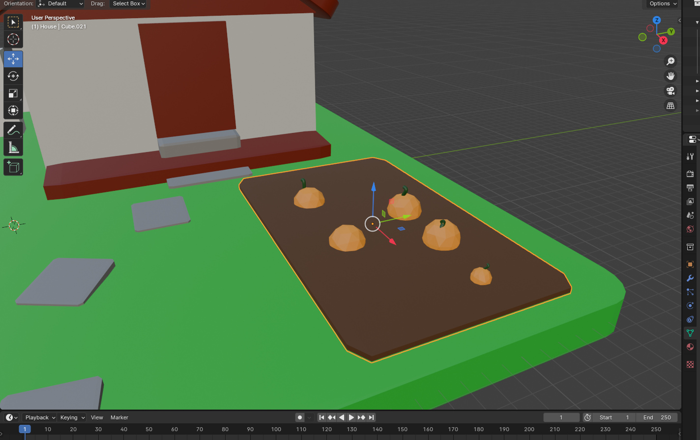
Adding Basic Materials
We want to make the dirt look like dirt
This button opens the materials tab

Slide 10
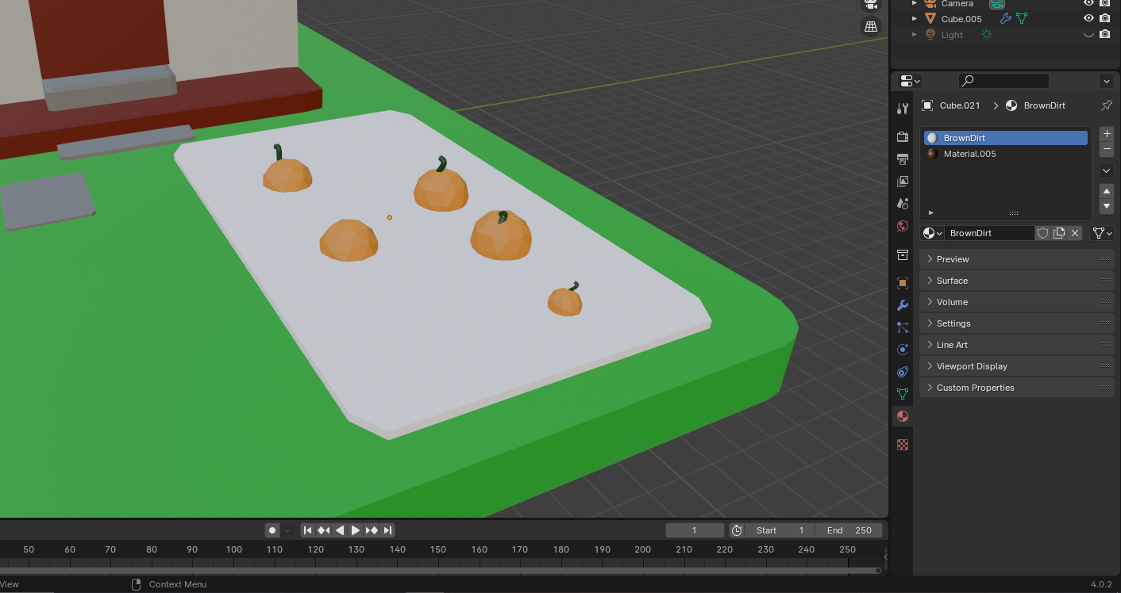
Adding Basic Materials
We want to make the dirt look like dirt
This panel shows the material properties

Slide 11
Adding Basic Materials
We want to make the dirt look like dirt
Click “New”

Slide 12
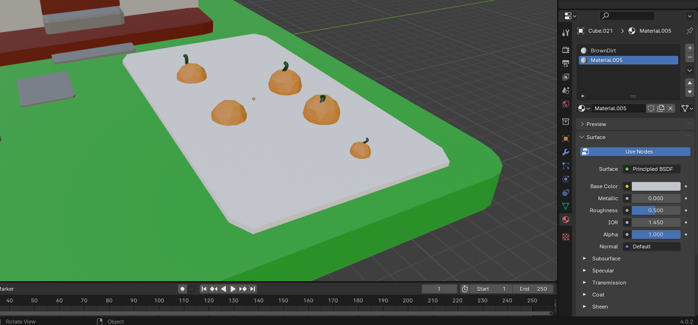
Adding Basic Materials
We want to make the dirt look like dirt
Change Base Color

Slide 13
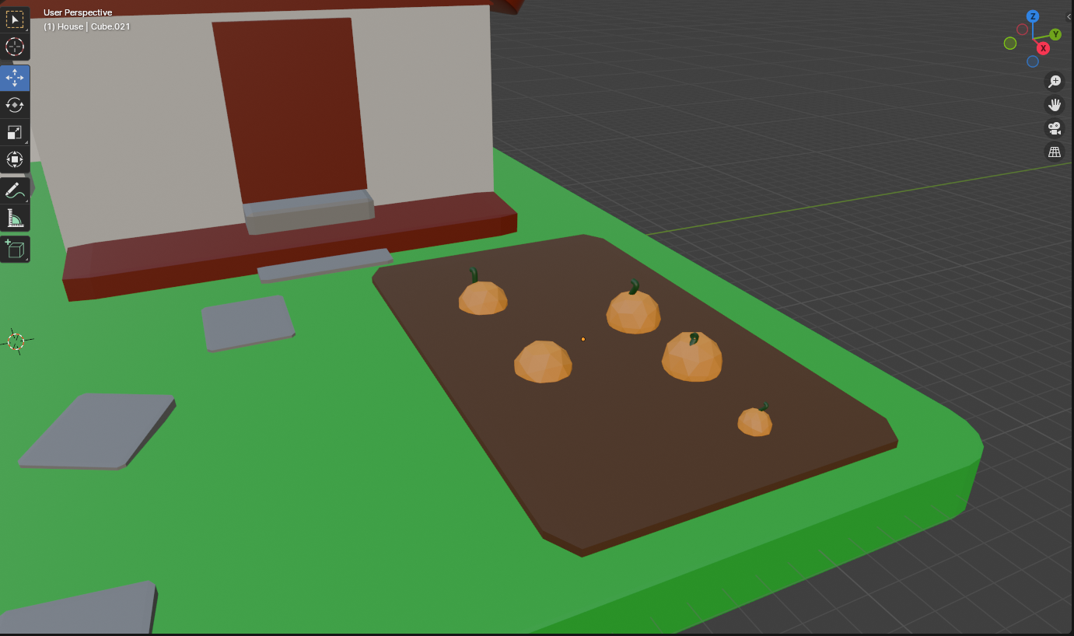
Adding Basic Materials
This is a good start!

Slide 14
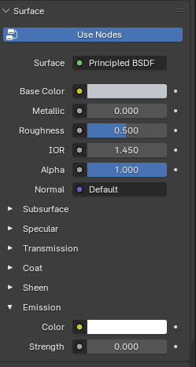
More Material Properties
Metallic:
As the name implies, makes objects look like metal
Roughness:
Less rough = glassy looking
More rough = matte
Normal:
(More on this later)
Emission:
High value = glowing

Slide 15
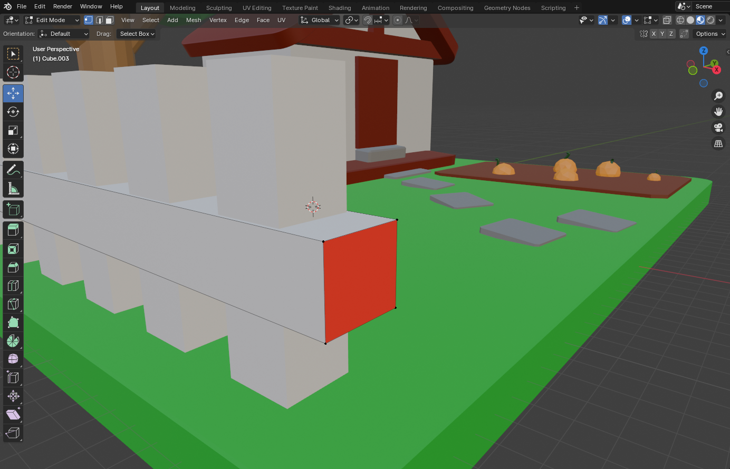
Multiple Materials
An object can have multiple materials

Slide 16
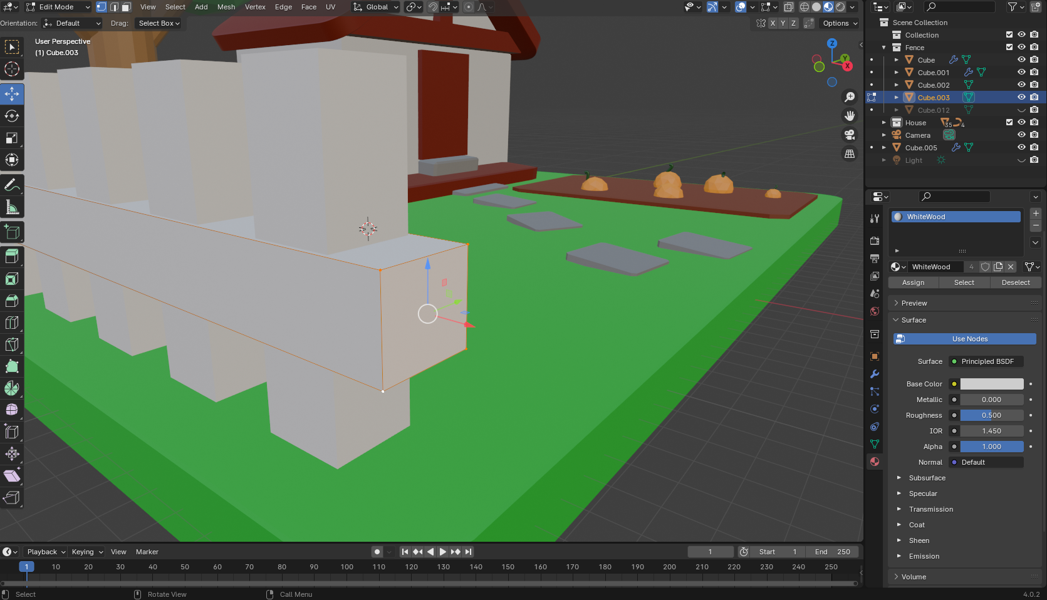
Multiple Materials
Enter “Edit Mode” (Tab)
Select vertices of desired face

Slide 17
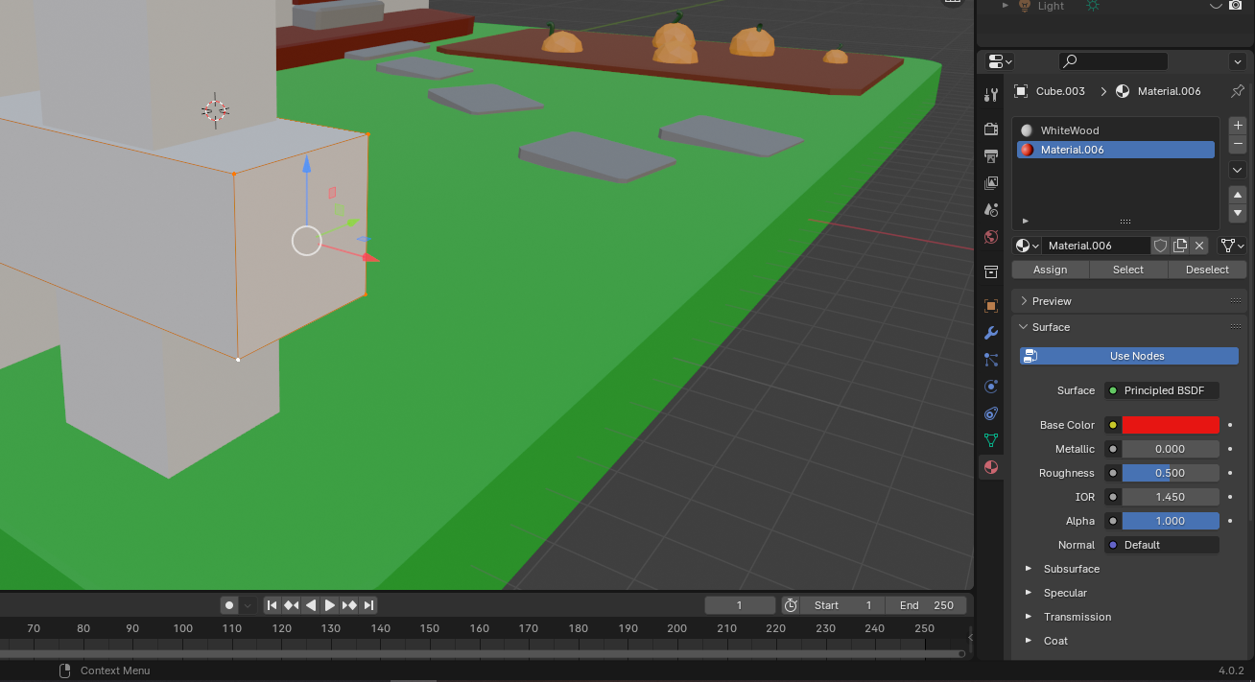
Multiple Materials
Click “+”
Click “New”
Select desired base color
Click “Assign”

Slide 18
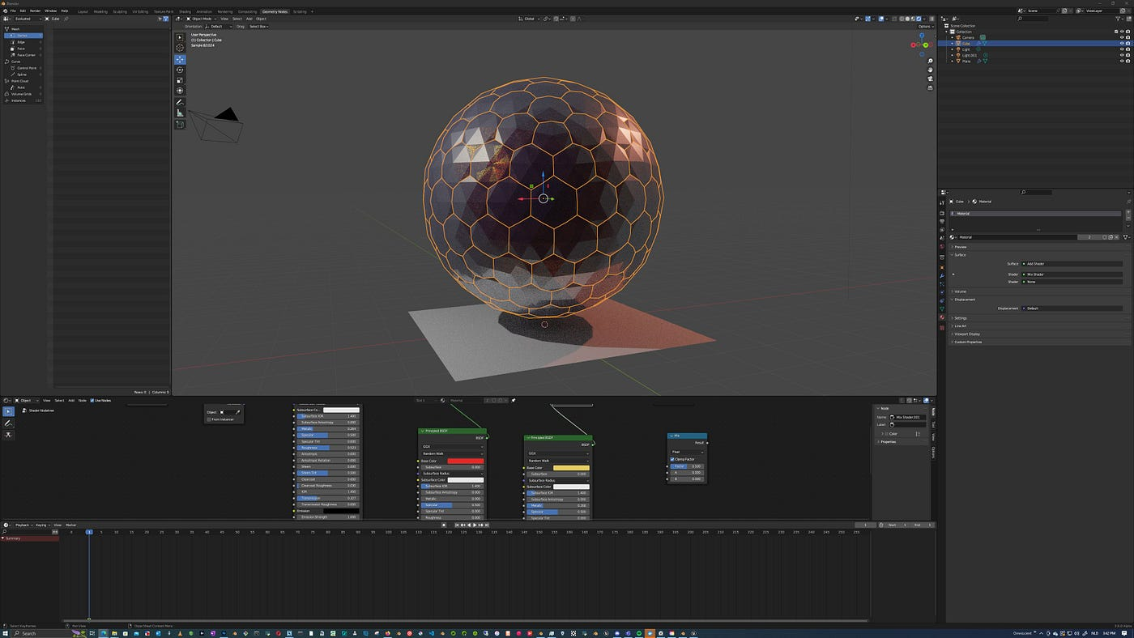
Break Time!

Slide 19
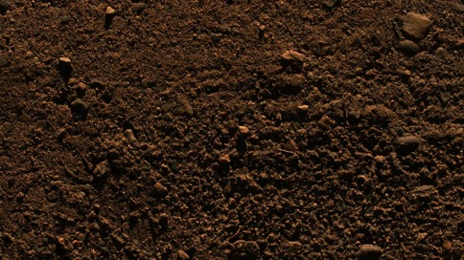
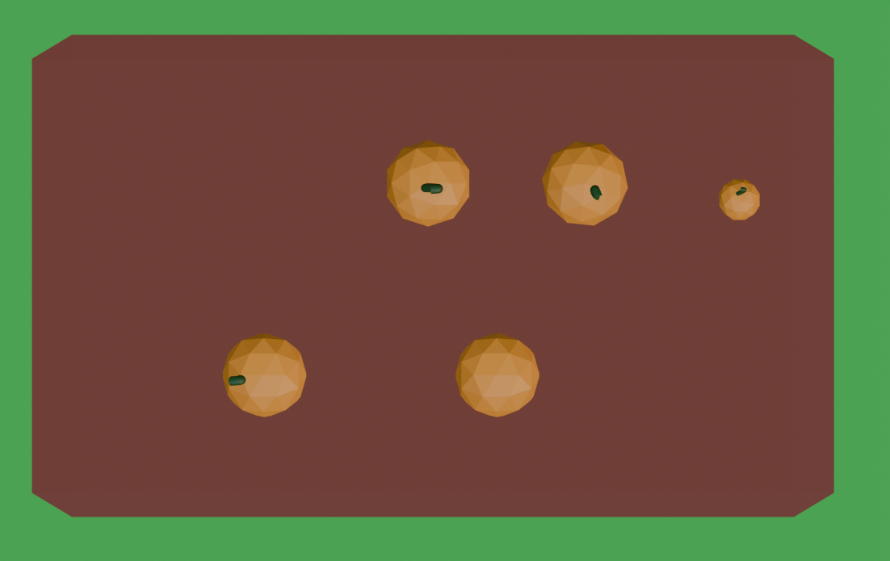
Shader Nodes
Real Dirt
Our Dirt
What if we wanted to make our dirt look more realistic?

Slide 20
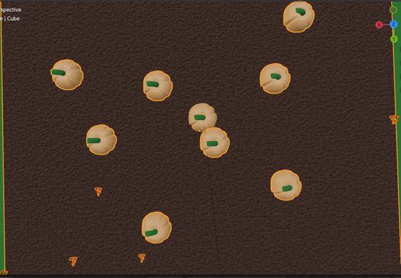
Shader Nodes
With Shader Nodes we can make the dirt more realistic

Slide 21
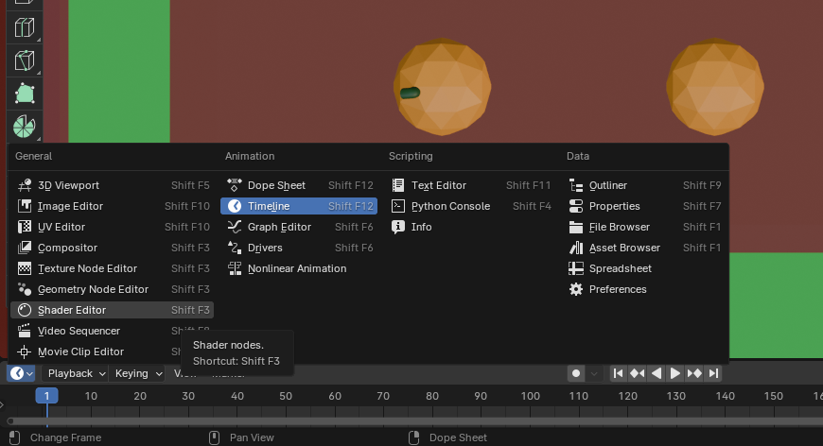
Shader Nodes
Click clock icon to open view menu
Find the “Shader Editor” tab
Open it

Slide 22
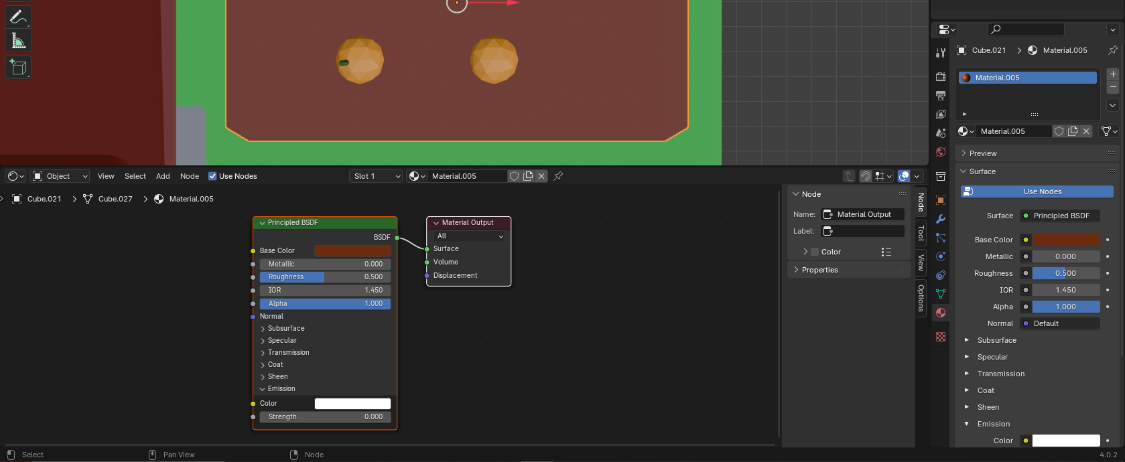
Shader Nodes
These two panels are the same:

Slide 23
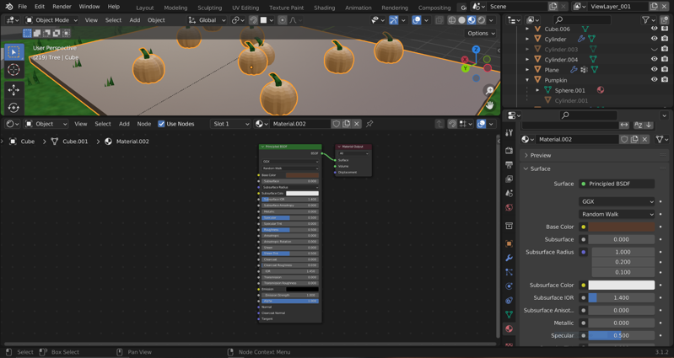
Shader Nodes
These circles represent inputs and outputs

Slide 24
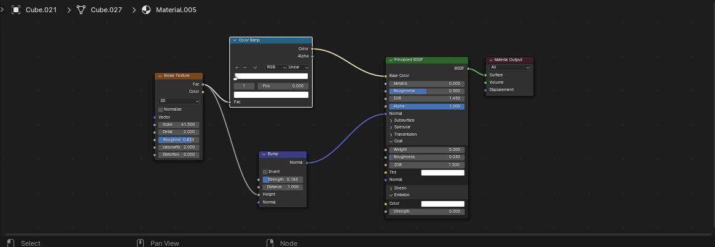
How Do Nodes Work?
The nodes are “read” from left to right

Slide 25
How Do Nodes Work?
Each node represents a modifying operation or function
These circles represent inputs on the left and outputs on the right

Slide 26
Adding Nodes
Shift + A to open Add Node Menu

Slide 27
Practice:
Copy these nodes to make the dirt look more realistic

Slide 28
Without Nodes

Slide 29
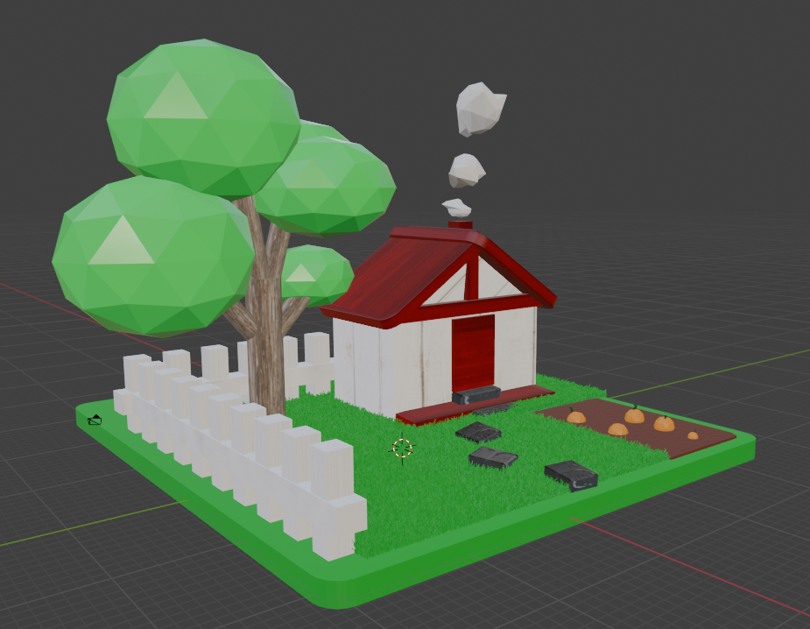
With Nodes
Textures by rawpixel, kues1 on Freepik

Slide 30
Mini Creation
Add materials to all of the objects from session 2
Start with simple materials (colors)
Then try one with the Node Editor

Slide 31
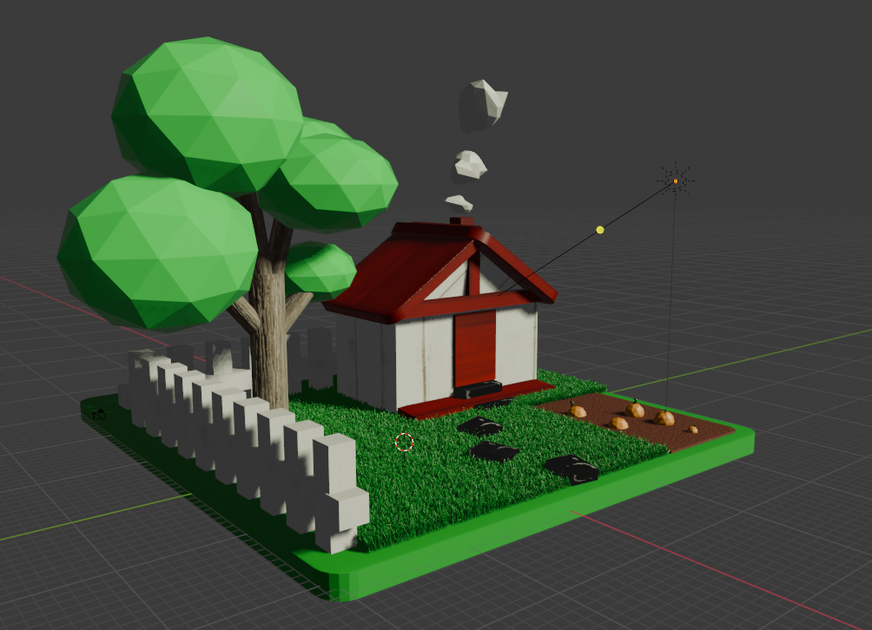
Mini Creation

Slide 32
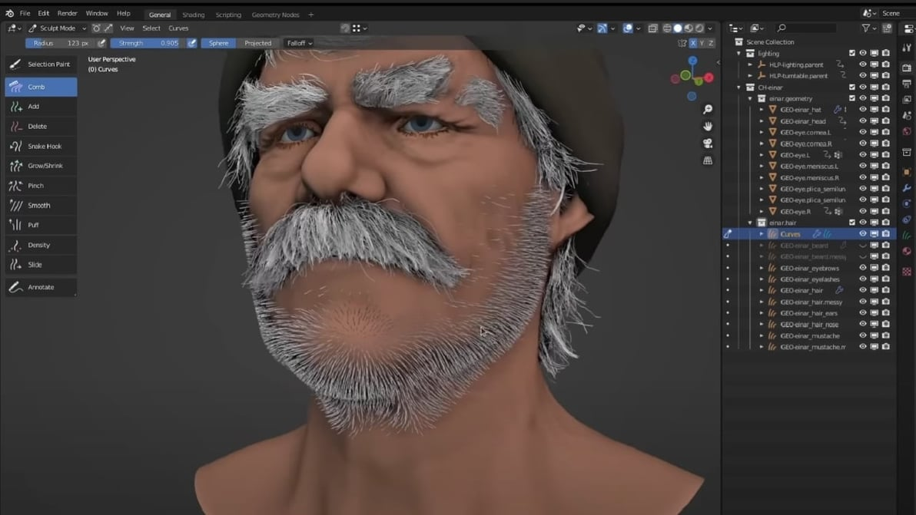
Break Time

Slide 33
Lights and Rendering

Slide 34
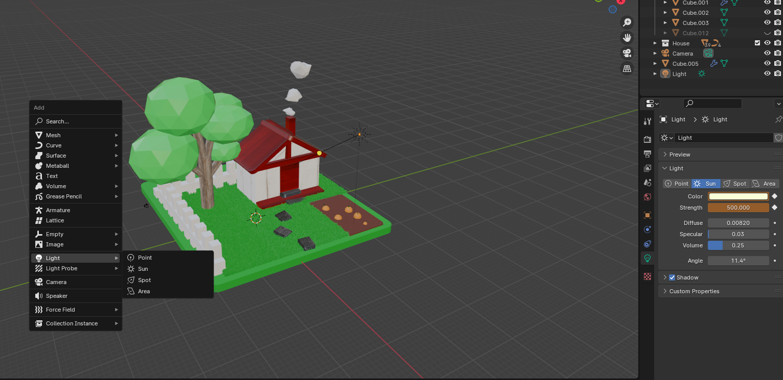
Adding a Light
To add a light to a scene:
Shift + A > Light
There are 4 types
Lights appear in Hierarchy

Slide 35
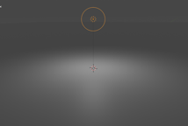
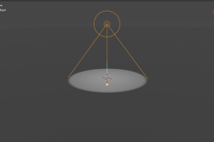
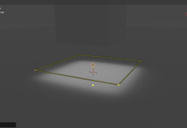
Types of lights
Point
Emits light from all directions
Used for lamps or items that light up
Sun
Emits light with parallel rays, so position does not matter
Used for outdoor/large spaces
Spot
Emits light in a cone shape
Used for “moody” lighting
Area
Emits light in one direction from a square
Used for indoor spaces

Slide 36
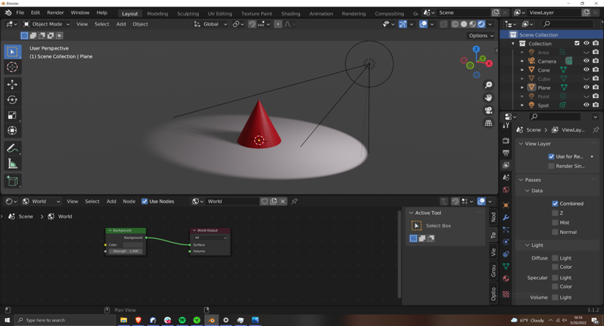
Environment
Every Blender scene has an environment
This Environment has lighting
This is why even with NO LIGHTS objects can still be seen
The Environment can be edited in the “Shader Editor” panel
Select “World” in this drop down menu

Slide 37
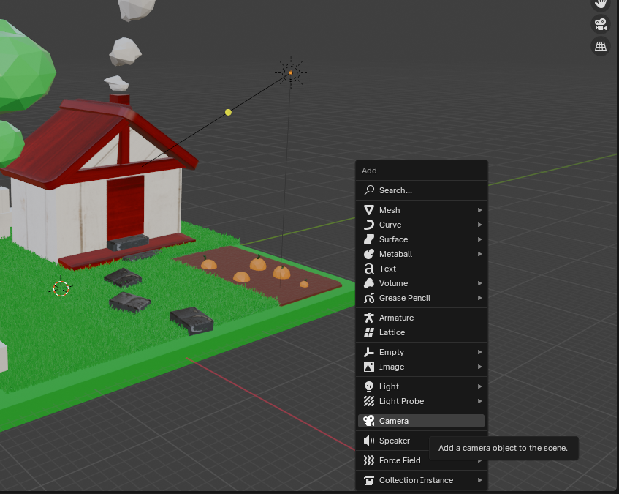
Camera Basics
Cameras are where/what you view your scene: Cameras allow you to frame up your objects
Adding cameras: Shift + A > Camera
Hotkey: Numpad 0 = set view to active camera

Slide 38
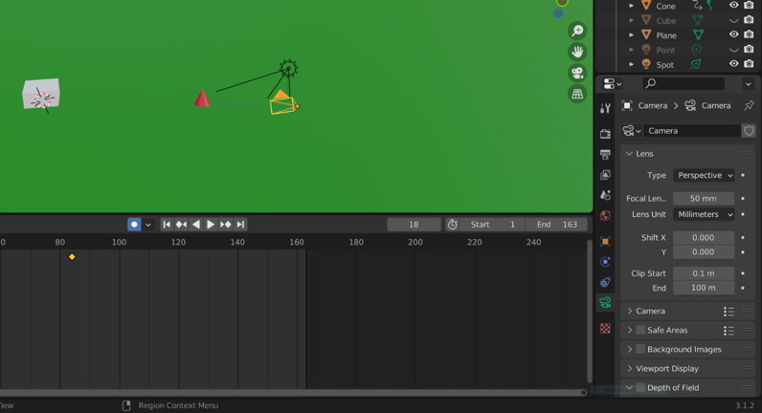
Camera Properties
Camera Constraints:
Camera Properties:

Slide 39
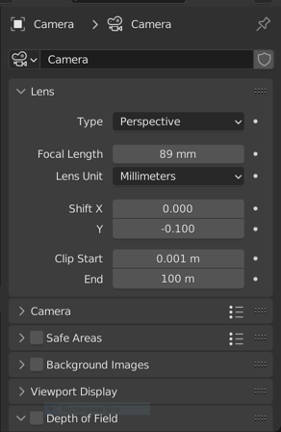
Camera properties
Focal Length
Corresponds to the “Zoom” of the camera
Bigger numbers = tighter shot
Smaller number = wider shot
Clip Start/End
How far can the camera see

Slide 40
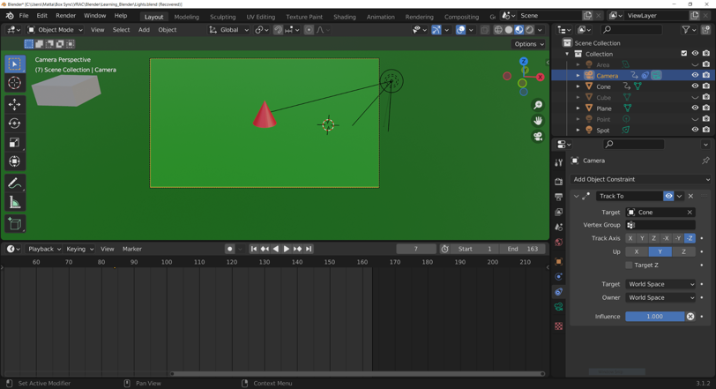
Camera Tracking
What if we wanted to use the camera to follow a moving object?
We could do this manually with key frames, or we can use a constraint.
Enter the constraint menu (looks like a pulley wheel)
“Add Object Constraint” > “Track To”
Use Eyedropper to select object of interest

Slide 41
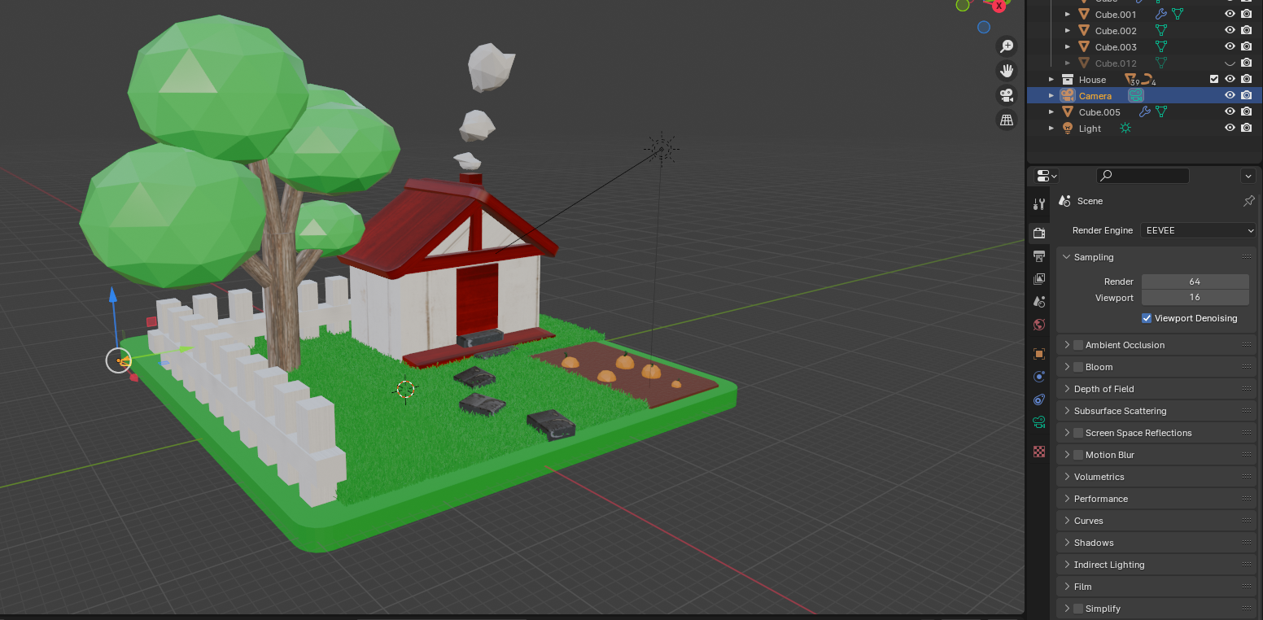
Render Settings
To access render settings select the back of the camera icon:

Slide 42
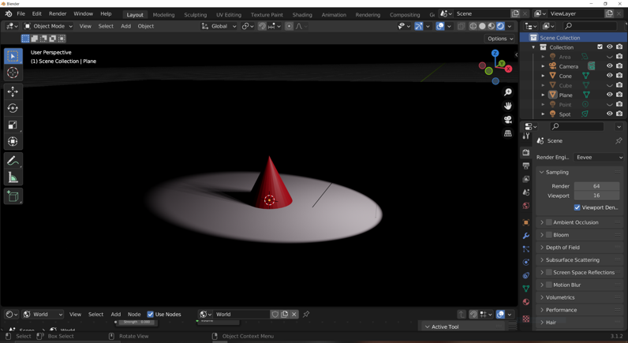
Shadows
In this drop down menu there are options for Eevee, Workbench and Cycles.
We only care about Eevee and Cycles
These options define how our scene handles light/shadows
`

Slide 43
Eevee: Depth Map
Eevee is a faster method.
By creating a Depth Map, Eevee does some simple math to figure out what the shadows should look like.

Slide 44
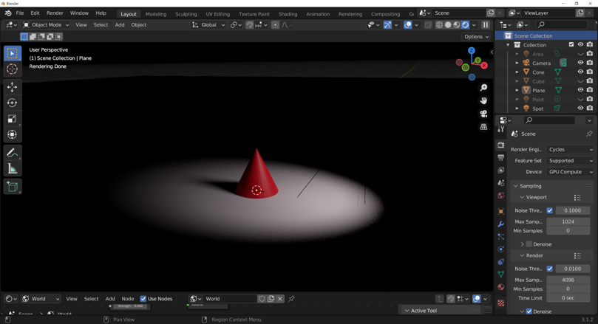
Cycles: Ray Tracing
Cycles is slower, but more accurate.
Cycles looks at the different paths and bounces that a particle would take in the scene.

Slide 45
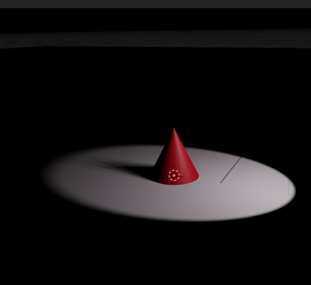
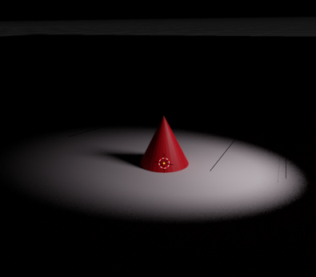
Cycles: Ray Tracing
Eevee
Cycles
Cycles has less aliasing at the top of the cone

Slide 46
Cycles: Ray Tracing
Eevee
Cycles
The shadow drop off is more accurate

Slide 47
Today’s Mini Creation
Apply 1 or more lights in your scene from
Mini Creation 2 and render

Slide 48
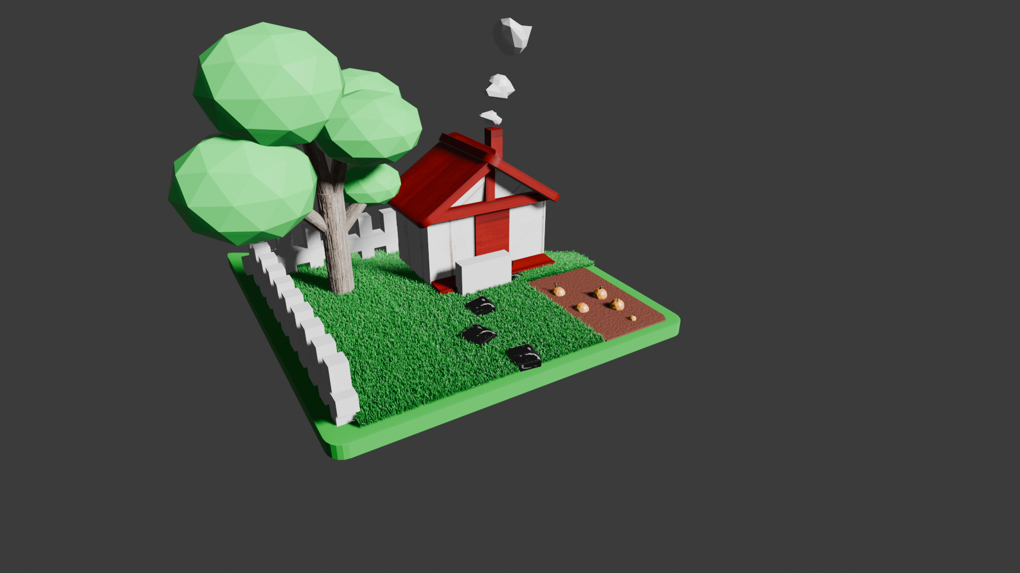
Render

Slide 49
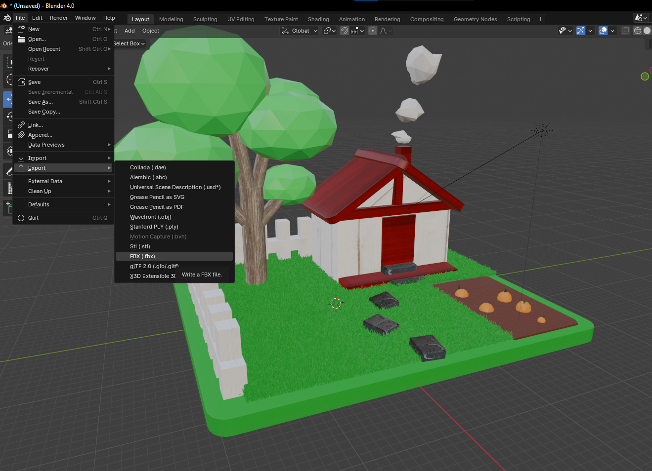
Final Blender Task: Export for Unity
File > Export > FBX

