Slide 1
Craft of Research
Image by storyset on freepik
Week 4: Results and Discussion Section
Instructor: Stephen fieffer
Slides Adapted from Yvonne farah

Slide 2
Outline
Results
Discussion
Broader Impact

Slide 3
Our progress
Image by pch.vector on Freepik
Image by pch.vector on Freepik
Image by Freepik
Image by Storyset on Freepik
Week 1:
What is research?
Week 2:
Problem Statements
Week 3:
Literature Reviews
Week 3-4:
Methods

Slide 4
What’s next…
Image by pikisuperstar on Freepik
Image by vectorjuice on Freepik
Week 4 (we are here!)
Results and Discussion

Slide 5
Results section key objectives
To show progression on specific findings
To communicate the findings and non findings

Slide 6
Before writing the results section
Consider the following questions:
What is the most logical way to present your results?
Do you understand what the results mean beyond statistical significance?
Do your results have a collective broader implication?

Slide 7
Case Study
Social perception in Human AI teams: Warmth and competence predict receptivity to AI teammates
(Watson et al., 2023)
Harris-Watson, A. M., Larson, L. E., Lauharatanahirun, N., DeChurch, L. A., & Contractor, N. S. (2023). Social perception in Human-AI teams: Warmth and competence predict receptivity to AI teammates. Computers in Human Behavior, 145, 107765.

Slide 8
AI technologies are being implemented in a variety of systems in our daily lives. The addition of an AI teammate introduces challenges to the team unique to the implementation of a technological new comer, due to AI being distinct from human counter parts. When team members resist the addition of an AI teammate, team outcomes suffer negatively. This study aims to explore how AI warmth and competence impact receptivity toward AI teammates (Watson et al., 2023).
Week 2:
Problem Statements

Slide 9
Literature review with several sub-themes that set the ground for the study:
AI Teammates as new comers
E.g., The addition of advanced technologies into organizations has been associated with an increase in job insecurity (Hoff & Bashir, 2015)
The addition of an AI teammate is a strong team membership change event (Trainer et al., 2020)
Conceptualizing receptivity to AI teammates
Universal dimensions of agent perception
Week 3:
Literature Reviews

Slide 10
Participants randomly assigned to one of eight possible AI teammate videos
Videos included:
Pepper
IBM Watson
Sophia
TARS
CASE
K-2SO
Week 3-4:
Methods

Slide 11
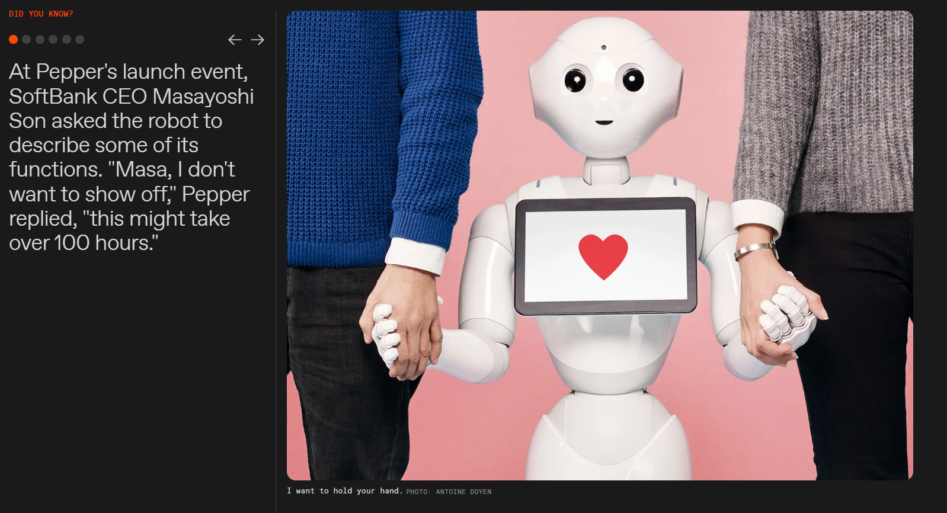
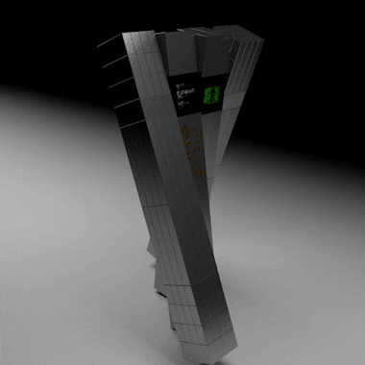
https://robotsguide.com/robots/pepper
https://www.raspberrypi.com/news/go-interstellar-and-build-your-own-replica-tars-robot/
https://www.starwars.com/databank/k-2so-kay-tuesso

Slide 12
Methods set the stage for results by introducing the Measures of the study
Warmth perceptions: participants filled 6 item measures of warmth (friendly, well-intentioned, trustworthy, warm, good-natured, sincere)
Competence perceptions: competent, confident, capable, efficient, intelligent, skillful
Receptivity to AI teammate:
Reflection: adapting team processes
Knowledge utilization: recognition and adoption of AI teammate skills
Psychological acceptance: social attitudes and recognition
Methods also set the stage for results by describing the data analysis approach
ANOVA to evaluate significant differences in warmth and competence between the AI teammates
Multiple regression models (receptivity regressed on warmth and competence)
Week 3-4:
Methods

Slide 13
Report results in a logical order to tell the story
Warmth and competence perceptions
1. Approach the Niche: “We first conducted a one-way ANOVA to evaluate whether there were significant differences in the mean perceived warmth and competence ratings of the AI teammates” (Watson et al., 2023, p.7)
2. Occupying the Niche: “Results revealed significant differences in both the perceived warmth and competence ratings of AI teammates” (Watson et al., 2023, p.7) ; “Pepper was significantly lower in perceived competence than all other AI teammates” (Watson et al., 2023, p.7) ; “Rove was significantly lower in perceived competence than CASE and IBM Watson” (Watson et al., 2023, p.7) ; “Rove and IBM Watson were significantly lower in perceived warmth than K-2SO, Pepper and Vero” (Watson et al., 2023, p.7).
“Results support that both warmth and competence perceptions of AI teammates positively influence all components of receptivity to AI” (Watson et al., 2023, p.7).
Week 4:
Results

Slide 14
Tips for Writing Results Sections
Organize results reporting logically
Follow your methodology/analytic plan/content areas
Should be very stepwise
Include the statistical/numeric results, as well as the interpretation
Tense: Present
Length: Depends on your methods
Number of Sources: Depends on when you’re interpreting the findings

Slide 15
Now, let’s discuss our findings!
Provide extended interpretations
Expand the meaning of the results outside of the study
Indicate how the results add/relate to knowledge in the field
Acknowledge study limitations
Propose future research

Slide 16
Before Writing the Discussion Section
Consider the following questions:
What were the main findings?
What were the interpretations of the main findings?
What surprised you?
What were the limitations in your study? Be realistic.
What are the broader impacts of your findings? How could the findings be used in the real world?

Slide 17
Basic Organization of Discussion Sections
Re-establishing the Territory (Grounding the Discussion)
Framing Principal Findings (Commenting on the Results)
Re-shaping the Territory (Referencing Literature for Support)
Establishing Additional Territory (Expanding Beyond the Study)

Slide 18
Basic Organization: Re-Establishing Territory
(Grounding the Discussion)
Drawing on general background
Drawing on study-specific background
Announcing principal findings
Previewing content
Example: “Results for reflection were relatively consistent, such that perceived warmth and competence showed similar, positive relationships with reflection” (Watson et al., 2023, p.11)

Slide 19
Basic Organization: Framing Principal Findings
(Commenting on the Results)
Accounting for Results
Explicating Results
Relating to Expectations
Addressing Limitations
Example: “Results suggest a much stronger influence of perceived competence than perceived warmth on knowledge utilization. Thus, AI teammates should be designed such as their skills and abilities are clearly apparent and can be integrated to maximize knowledge utilization” (Watson et al., 2023, p.11)

Slide 20
Basic Organization: Reshaping the Territory
(Referencing Literature for Support)
Supporting with Evidence
Countering with Evidence
Example: “Dou et al., 2020 found that people’s expectations for warmth and competence are in part dependent on the intended application of the robot”
(Watson et al., 2023, p.12)

Slide 21
Basic Organization: Establishing Additional Territory
(Expanding Beyond the Study)
Generalizing Results
Stating the Value
Noting Implications
Proposing Directions
Example: “Finally, results highlight the value of integrating research on AI agents in the HCI/HRI literature and adjustment to human newcomers in the teams literature. Most models of human reactions to AI agents do not yet capture the complex social and psychological processes of receptivity to a fully interdependent AI teammate” (Watson et al., 2023, p.12)

Slide 22
Logic Flow of Discussion Section
Recap of key findings
Paragraphs/sections based on main and related findings or by analysis… what do the findings mean? Answer the ‘why’
Limitations
Future directions
Broader impact

Slide 23
Broader Impacts
“[T]he potential to benefit society and contribute to the achievement of specific, desired societal outcomes.”
What are these?

Slide 24
Broader Impacts
Criterion:
Examples:
Why should people outside of research care about what you did?
How does it benefit society?
What positive societal/community outcome did you achieve?
Improved well-being of individuals in society
Increased economic competitiveness
Improved national security
Public scientific literacy

Slide 25
Tips for Writing about Broader Impacts
Built up for justifying your broader impact
Demonstrate creativity or originality
Have a well-organized strategy for accomplishing the goals
Establish qualifications for those responsible for activities to accomplish goals

Slide 26
Basic Guiding Questions
How has your research findings and discussion built up to this point?
What is your primary argument you’ve created?
Why and how will your research benefit society?
What future steps must be taken for society to benefit?

Slide 27
Assignment
Now, it’s your turn to tell a research story!
Pick a journal article that you’ve already read that taught you something new about your research project.
Work on a 3-5 minutes recorded ppt, where you tell the story of the paper based on our course sessions.
Upload to Drive and email link to me (sfieffer@iastate.edu) before end of day Monday 6/23.
Image by pch.vector on Freepik
Image by Freepik
Image by Storyset on Freepik
Image by vectorjuice on Freepik
Image by pikisuperstar on Freepik
Week 2:
Problem Statements
Week 3:
Literature Reviews
Week 3-4:
Methods
Week 4:
Results
Week 5:
Discussion

