Slide 1
Control structures
C++ Lecture 3
Adam Kohl

Slide 2
Motivation
We need our program to perform differently under certain circumstances
We need to repeat parts of our program under certain circumstances

Slide 3
🗣️ Lecture Goals ✅
Today is devoted to programming control structures
Conditionals
Loops
When to use them…

Slide 4
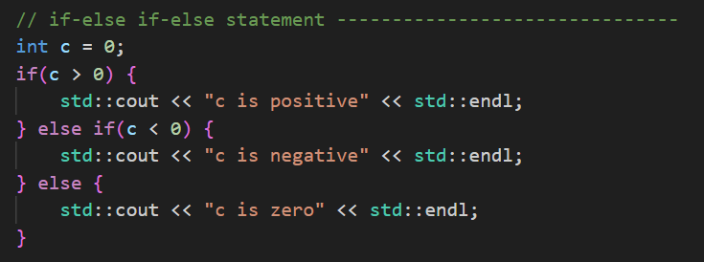
Conditionals (control flow)
if statements
(if the condition is true, execute the block of code)
If-else statements
(if the condition is true, execute the block of code. Otherwise execute the other block)
If-else if-else statements
(check multiple conditions. If all are false, execute the else block)

Slide 5
What’s a Condition?
A condition is any evaluation which results in a Boolean data-type
A Boolean variable
OR
A Boolean expression (using && , ||, >, <, <=, >=, ==,…)

Slide 6
Conditional Examples 💻
Checking single variables in a conditional
Using Boolean expressions in a conditional
if, if-else, if-if else-else
Nested conditionals

Slide 7
🤏 Mini Task ✏️
Go to https://github.com/iastate/VRAC_REU_Programming
Under challenges/ read rollerCoasterCheck 📖
Make a new project and code 👨‍💻

Slide 8
Loops (iterative flow)
Loops allow us to repeat sections of code as long as a condition is met
2 main types of loops
- For loop
- While loop

Slide 9
For Loop Anatomy
Initialization of loop variable run once only before entering the loop
Condition check run every time before entering the loop
Action Run after each iteration of the loop

Slide 10
For Loop
Normally used when we know exactly how many iterations we want
This will print “0 1 2 3 4”

Slide 11
While Loop Anatomy
Condition check run every time before running loop

Slide 12
While loop
Normally used when we don’t know how many iterations we need
This will print “0 1 2 3 4”

Slide 13
Loop Examples 💻
Printing out numbers 1 to 10 (for loop)
Printing out numbers 10 to 1 (for loop)
Making a looping program → when do we quit? (while loop)
Looping through an array (for loop)

Slide 14
🤏 Mini Task ✏️
Go to https://github.com/iastate/VRAC_REU_Programming
Under challenges/ read sevensOnly.md 📖
Make a new project and code 👨‍💻

Slide 15
Questions?

Slide 16
📝 Assignment
Go to https://github.com/iastate/VRAC_REU_Programming
Under challenges/ read guessingGame.md 📖
Make a new project and code 👨‍💻

