Slide 1
Functions & Scope
C++ Lecture 4
Adam Kohl

Slide 2
Motivation
Putting all our code in main is NOT feasible
We need to separate out code instead of putting EVERYTHING in one place (Modular)
We need to make things more organized and easily referenceable (Maintainable)
We need to make scope changes to prevent cluttered memory

Slide 3
🗣️ Lecture Goals ✅
Functions
Program scope
Program stack*
* If we get to it

Slide 4
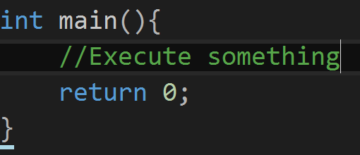
Functions
A function is a group of statements that together perform a task.
You have already come across at least one ⬇️

Slide 5
Anatomy of a Function
Return Value
What will come out of the function
Function Name
Unique identifier
Input parameters
What YOU put in the function
Return Keyword
End of the function!

Slide 6
🫵🏽 Code Etiquette (Functions)
If you repeat code → use functions!
Always use function names that represent what the function does (use verbs!!!!)
Bad 👎
Ok 😐
Great! 🥳

Slide 7
🤏 Mini Task ✏️
Go to https://github.com/iastate/VRAC_REU_Programming
Under challenges/ read customCalculator 📖
Make a new project and code 👨‍💻

Slide 8
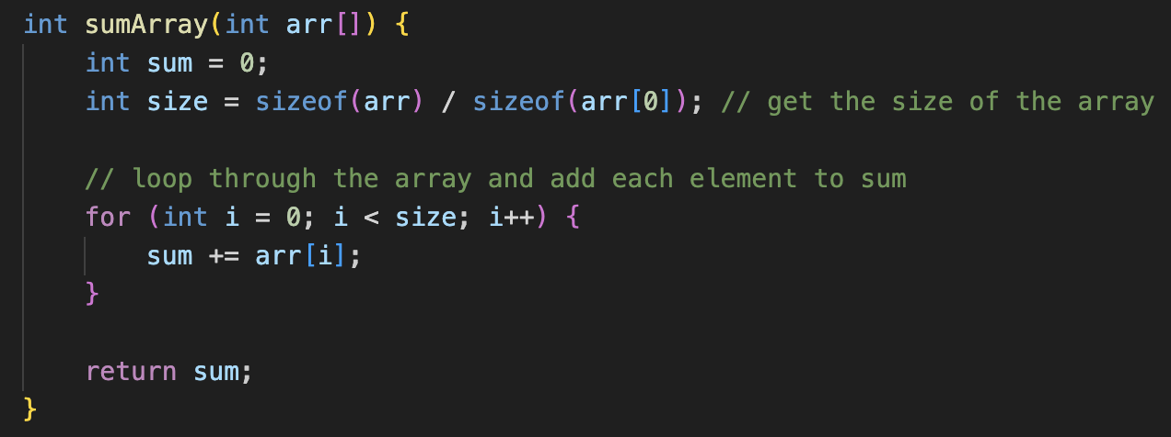
Functions and arrays
Passing an array to a function

Slide 9
Function defaults
Sometimes you want the arguments for your functions to have default values

Slide 10
🤏 Mini Task ✏️
Go to https://github.com/iastate/VRAC_REU_Programming
Under challenges/ read arrayValidation.md 📖
Make a new project and code 👨‍💻

Slide 11
Scope Examples 💻
11
Where you create variables determines their accessibility and lifetime
Local Variables: Variables defined between ‘{’ and ‘}’. They
cannot be accessed outside the braces.
Global Variables: Declared outside all functions and blocks.
They can be accessed anytime during
the lifetime of the program

Slide 12
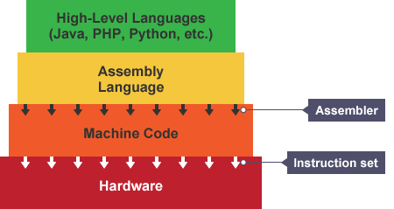
How does any program run?

Slide 13
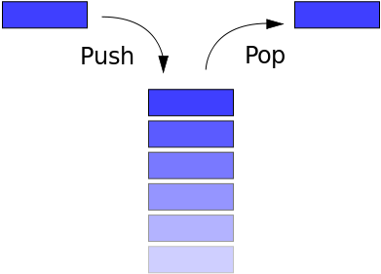
Program Stack
A dynamic structure in memory where variables are stored and accessed during the runtime of your programs.

Slide 14
🤏 Mini Task ✏️
Choose a previous Mini Task or Assignment
Use the debugger to step through the program. Watch how the variables and program stack change.

Slide 15
Questions?

Slide 16
📝 Assignment
Go to https://github.com/iastate/VRAC_REU_Programming
Under challenges/ read arrayValidation2.md 📖
Make a new project and code 👨‍💻

