Slide 1
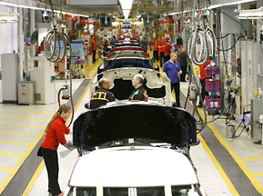
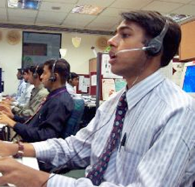

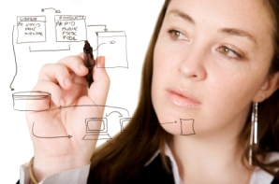
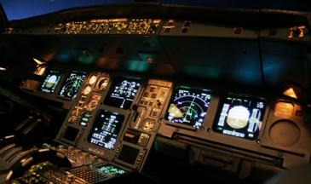
Human Error, GenderMag &
How to Give a Talk (next week)
David Tang
Using slides by Stephen Gilbert & Amanda Newendorp
HCI
Session 3

Slide 2
Human Error
Some slides from Sarah Wiseman, Sandy Gould | University College London

Slide 3
Proportion of system failures based on human error
Instead of on:
Bad design
Maintenance issues
Management issues
90% Air traffic control
85% Cars
70% US nuclear power plants
65% Jet cargo transport
31% Petrochemical plants
19% Petroleum industry

Slide 4
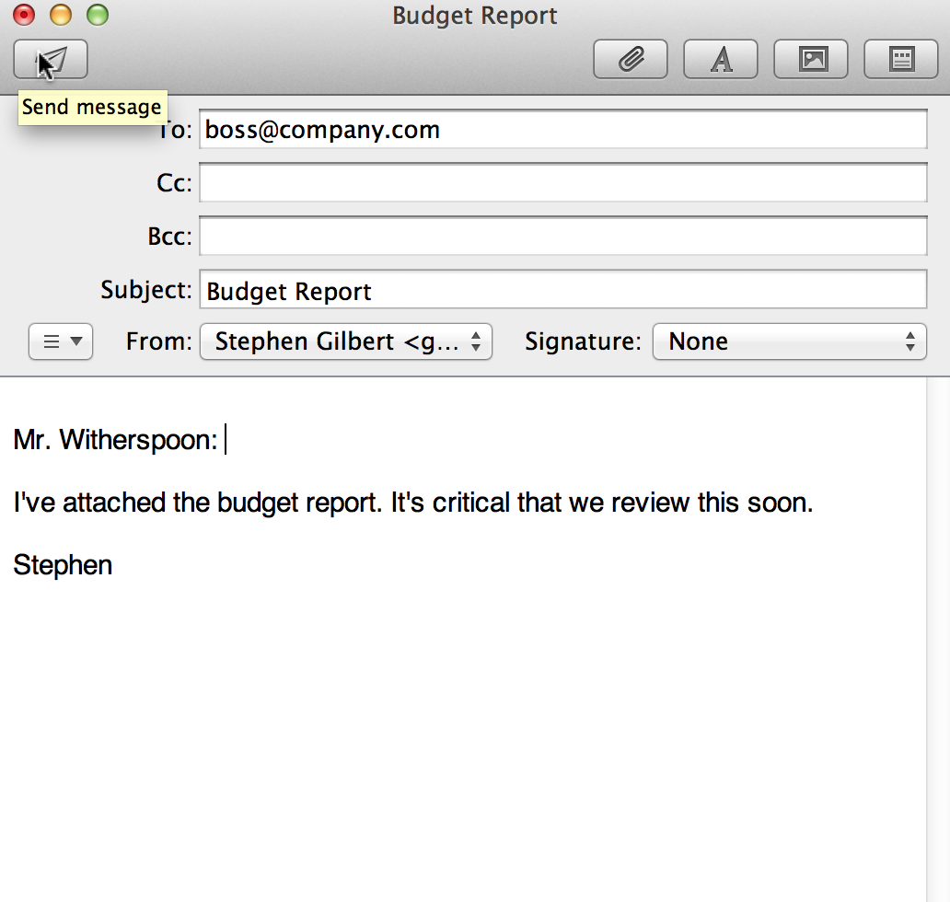
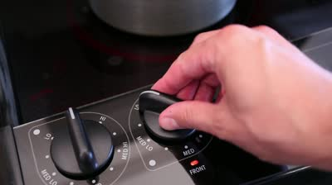
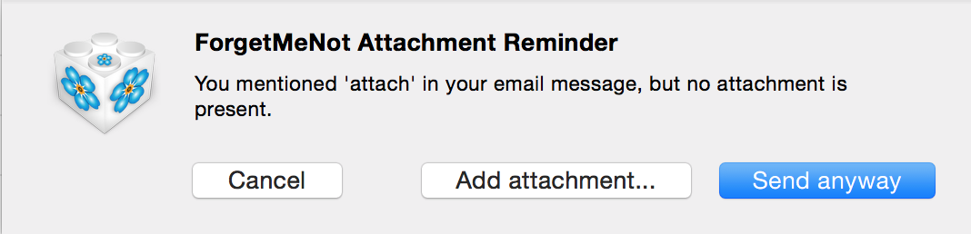
Error: intention is key

Slide 5
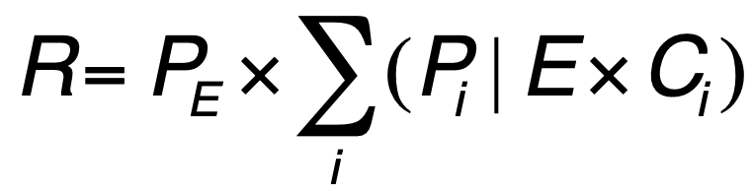
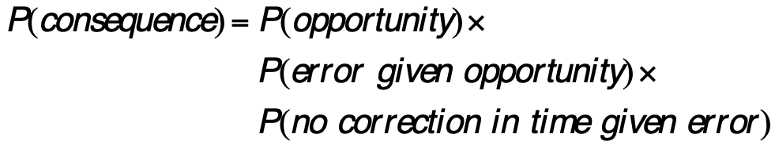
Probabilistic Risk Assessment
Probability of an Event
Probability of consequences given the event
Cost of the consequence
Related to Failure Modes and Effects Analysis (FMEA)

Slide 6
Challenges with probabilistic approach
Getting the probabilities for human perceiving, responding, deciding, etc.
Estimating probabilities of rare or unexpected events.
It assumes many events are independent, but they’re not.
Resilience Engineering

Slide 7
Communication Failure Modes
Newendorp, A. K., Gilbert, S. B., & Dorneich, M. C. (2024). User’s AI Expertise (AIX): Measuring One’s Mental Model of an AI System. Emerging Trends In Networks And Computer Communications (ETNCC), Windhoek, Namibia.

Slide 8


Types of Errors
Human Error
Slips
Mistakes
Right plan.
Wrong execution.
Wrong plan.
Right execution.
I should take my umbrella tomorrow.
(Doh! I forgot!)
The grocery is right next to the gas station. I’ll do shopping first.

Slide 9
Post-Completion Errors
Forgetting the final subgoal of a task because primary goal is reached.
Byrne, M. D., & Bovair, S. (1997). A working memory model of a common procedural error. Cognitive Science, 21, 31-61.
Chung, P. H., & Byrne, M. D. (2008). Cue effectiveness in mitigating postcompletion errors in a routine procedural task. International Journal of Human-Computer Studies, 66(4), 217-232.

Slide 10
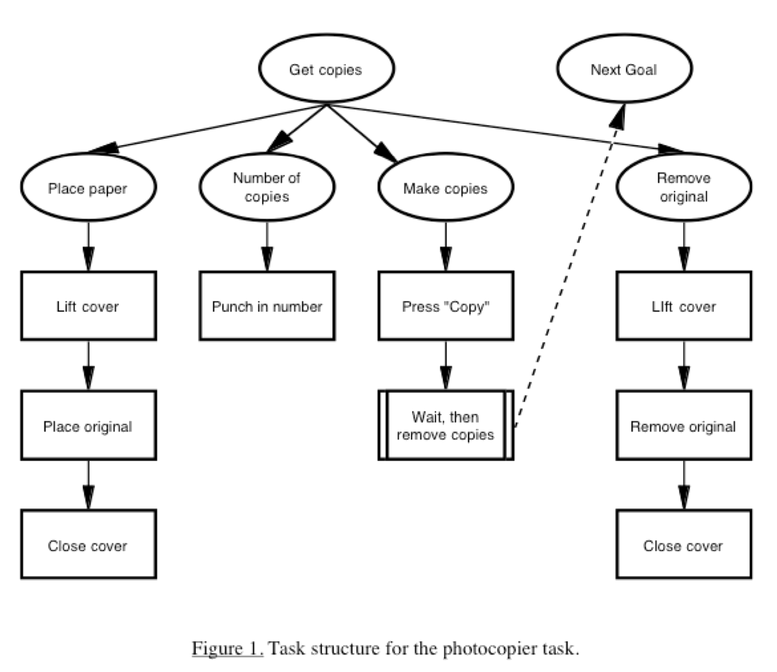

Slide 11
Design Implications
Remove possibility for post-completion errors.
If not feasible…
Provide very strong cues:
Explicit
Timely
Visually salient

Slide 12
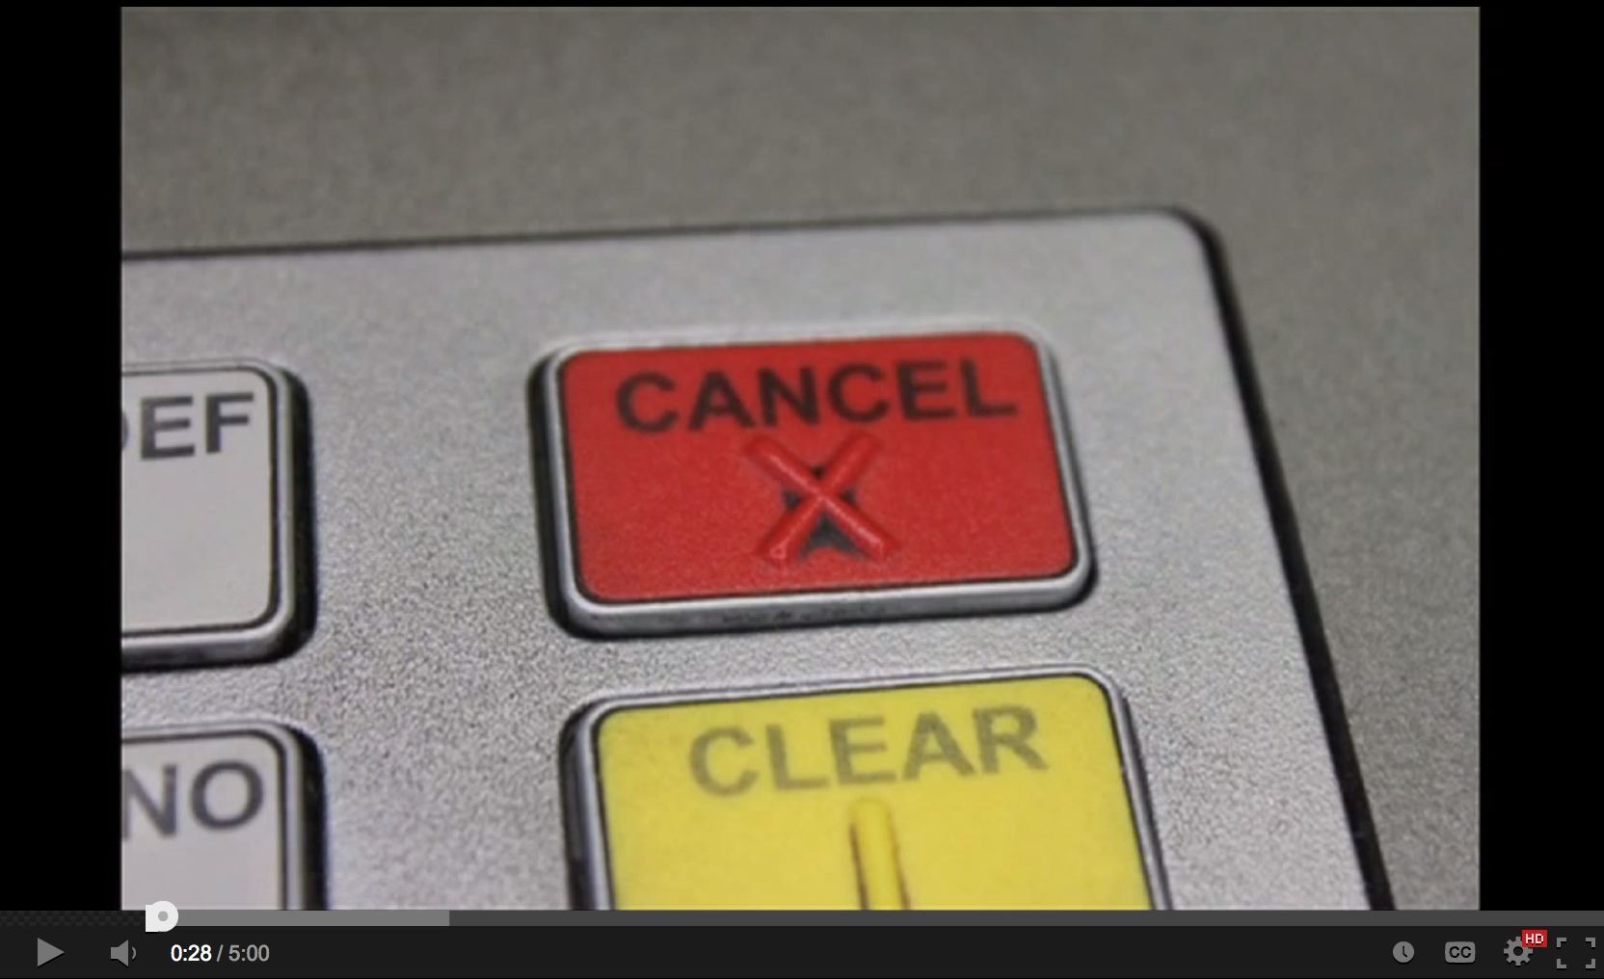
Design Implications 2: Resiliance
Aid recovery
Make actions reversible
Make results of each action noticeable within 150 ms.
Bonnie John on Cancel
http://www.youtube.com/watch?v=gxiA4JTS9P8&t=0m26s

Slide 13

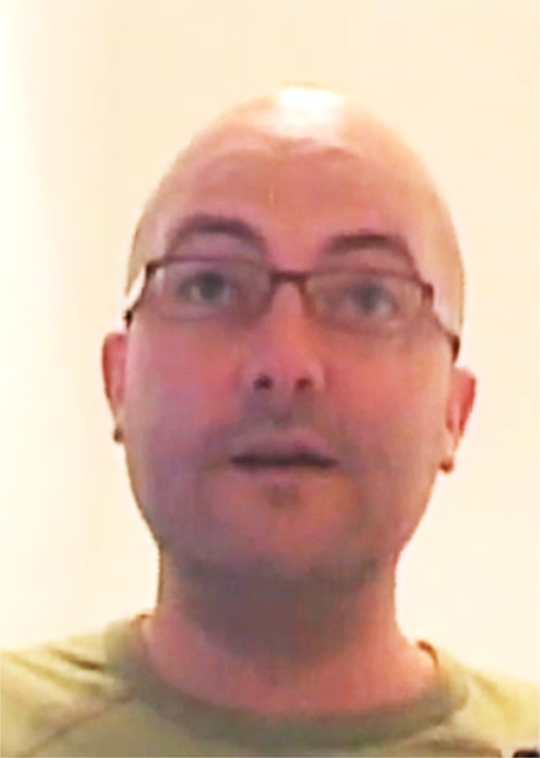
Examples: Name that error
Pizza complaint
http://youtu.be/pkAeNcNJVjA
Chaos buttons, human error and healthcare
Morning 1
http://www.youtube.com/watch?v=ifjDWKMNlIk&t=1m54s
Morning 2
http://www.youtube.com/watch?v=ifjDWKMNlIk&t=3m12s
Dominic Furniss
University College London

Slide 14
Individual Differences
States and traits that make people perceive or perform differently.

Slide 15
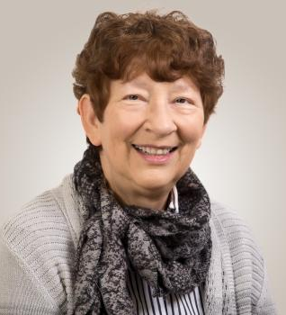
GenderMag:
Could software be sexist?
Dr. Margaret Burnett
GenderMag.org
https://youtu.be/txp4Cl3JGbc

Slide 16
GenderMag Method
What happens if most of the programmers, designers, and managers are men, but half of the users are women?
Can we make more inclusive software without relying on stereotypes?

Slide 17
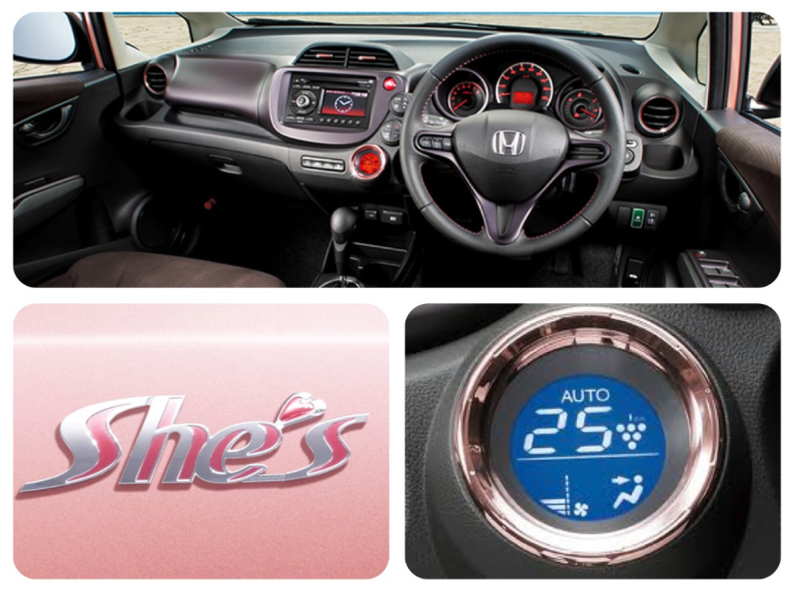

Bad “inclusive” design
Notes:
Shrink it and pink it

Slide 18
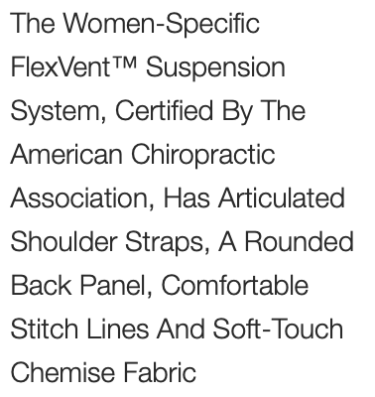
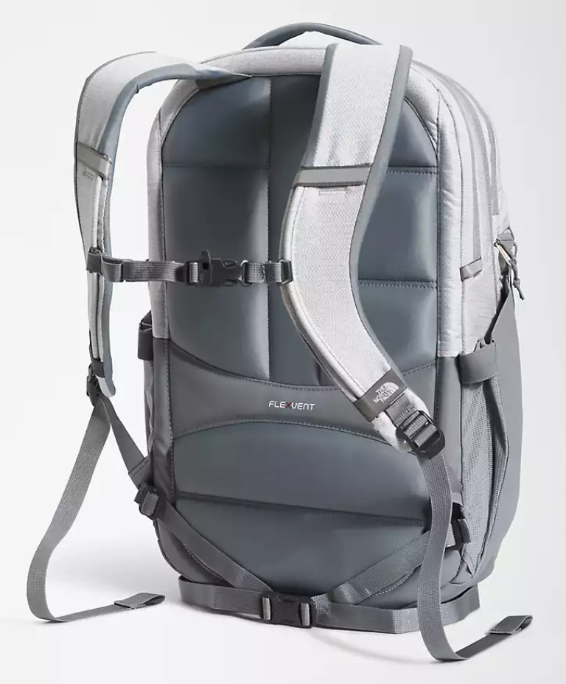
Good inclusive design
Redesigned backpack to fit women better
Can we do the same thing in HCI?

Slide 19
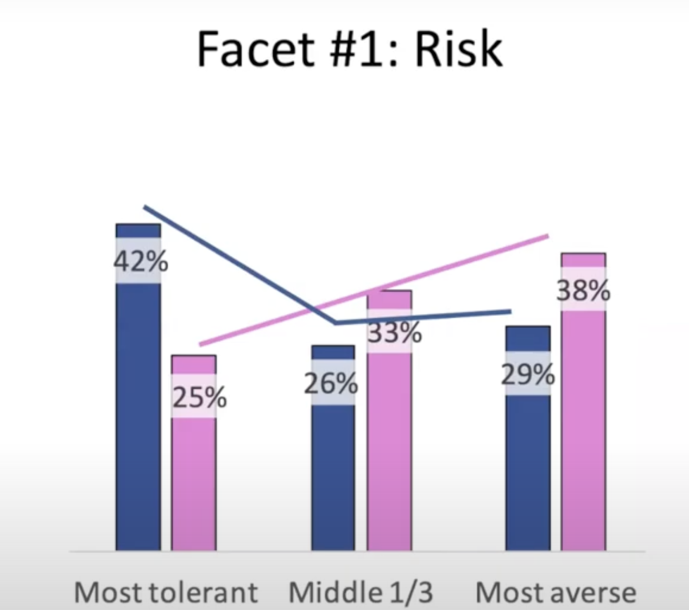
GenderMag cognitive facets
  Risk aversion
  Motivations
  Computer self-efficacy
  Information processing style
  Learning by tinkering vs. process
Gender-based trends for how these facets manifest

Slide 20


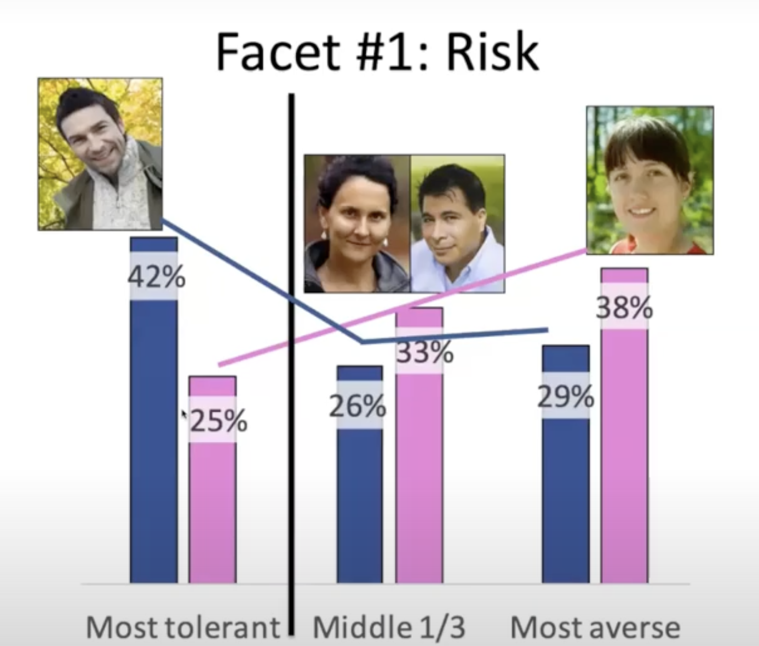

Personas to represent facets
Abi (Abigail/Abishek)
Tim (Timothy/Timara)
Pat (Patrick/Patricia)

Slide 21
Abi persona
Risk-aversion: high
Motivation: uses technology to accomplish the task
Information processing style: comprehensive
Computer self-efficacy: low
Tinkering: avoids it
Abi (Abigail/Abishek)

Slide 22
GenderMag Method
Pick a persona, e.g., Abi
Abi (Abigail/Abishek)

Slide 23
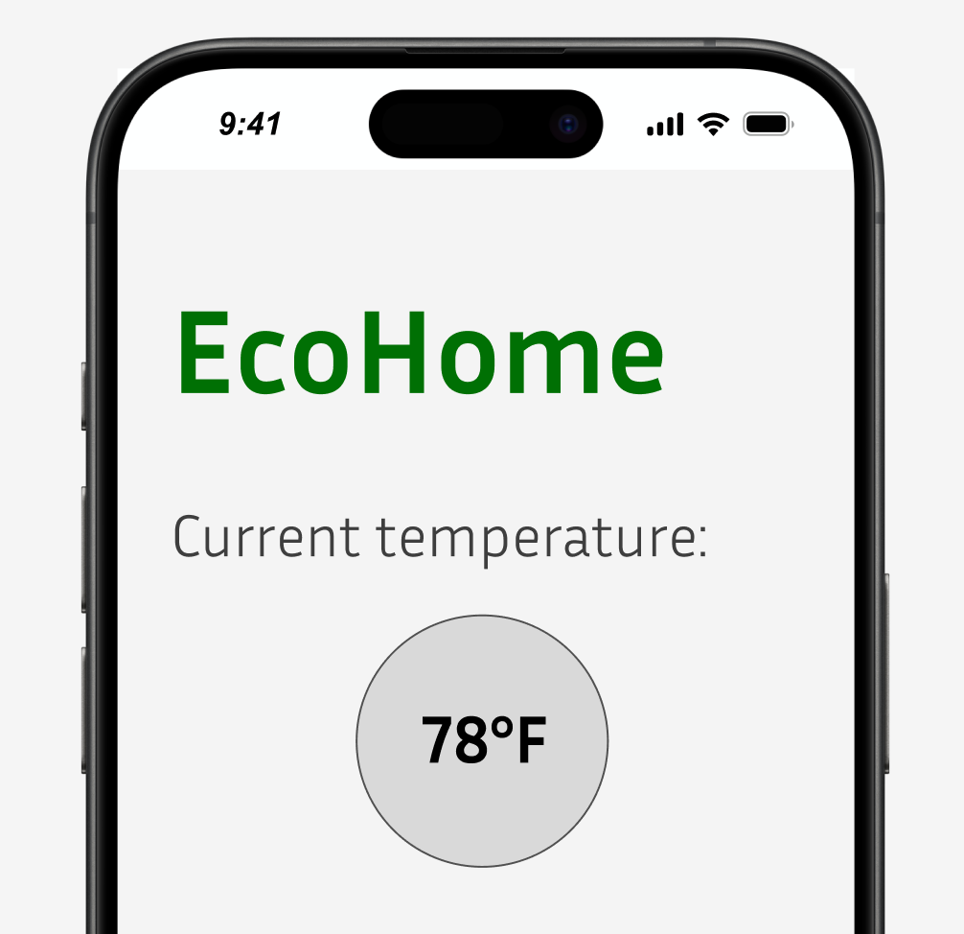
GenderMag Method
Give her a goal
“Use the new EcoHome app to change your thermostat setting to 75°F”

Slide 24
GenderMag Method
Ask developer for subgoal: “What were you hoping Abi would want to do first?”
Abi should go to the page to adjust the temperature.
Will Abi have that subgoal? (yes, no, maybe)

Slide 25
GenderMag Method
Assume Abi has that subgoal. Ask developer what action Abi should take?
Abi should touch the circle that says 78°F to go to the temperature page.
Will Abi take that action? (yes, no, maybe)

Slide 26
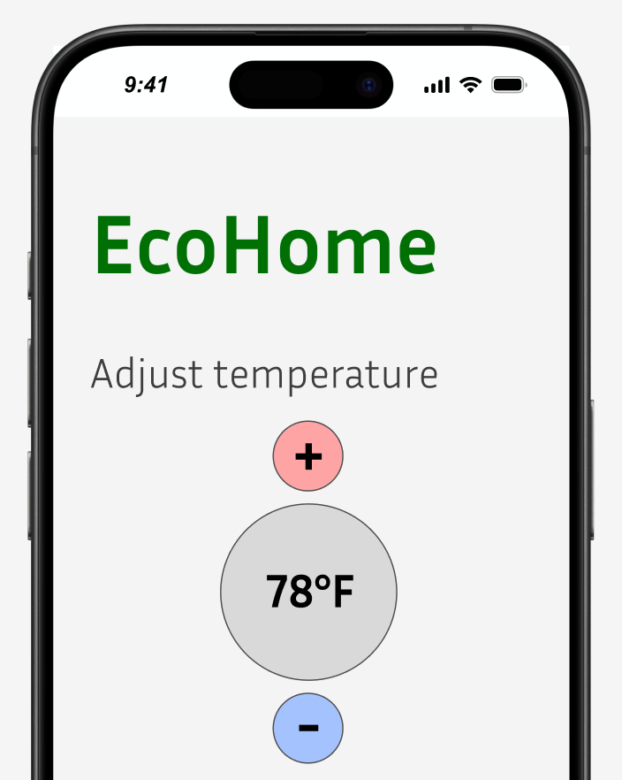
GenderMag Method
If Abi takes the action, will Abi see progress to subgoal? (yes, no, maybe)
If Abi touches the circle that says 78°F, will she know that she’s in the right place to adjust the temperature?

Slide 27
GenderMag Activity
Choose a persona
Give person an overall goal
3. Choose a subgoal for a screen. Will the user have that subgoal?
4. Assume the user has that subgoal. Choose what action should they take. Will the user take that action?
5. Will that action lead user to see progress towards that subgoal?

Slide 28
InclusiveMag and beyond
Same method can be applied to other individual differences
SocioeconomicMag
SeniorMag
ChildrenMag
ADHDMag

Slide 29
GenderMag
Questions?

Slide 30

How to Give a Talk

Slide 31
You’ll be giving a talk…
Video presentation, Demo for app
Group project presentation
In Week 7 to a University of Iowa REU site (next week!):
You talk to them.
You listen to them.

Slide 32
Doesn’t talking come naturally?
No.
It can be scary.
It can be boring, even soporific.

Slide 33
Doesn’t talking come naturally?
No.
It can be scary.
It can be boring, even soporific.
Practice
Technique

Slide 34
What are you trying to tell to your audience?
You’re a passionate analytical authority.
Oh, and by the way…
Your message.

Slide 35
Messages
Please have 1-3 messages to convey.
Each could be said in 30 seconds.
Facebook Participation Increases Isolation Within Rural Communities.
Our method of usability testing using bluetooth is better than existing methods.

Slide 36
Non-Useful Messages
I’m running out of time.
I’m sorry…
I did this, and this, and this, and that.

Slide 37
Typical Talk Outline
What’s the problem? (Hook!)
What have you done about it? (big picture)
How are you different than other people?
What did you do really? (details)
How did you solve the problem?

Slide 38
Sample outline with slide counts
Title/author/affiliation (1 slide)
Motivation and Problem Statement (1-2)
Why should anyone care?
Outline of talk (1)
Suggest you have an innovative solution
Related Work (0-1)
Cover superficially or omit; what have others tried?
Methods / Results / Major Points (4-6)
What did you do? What happened?
Do not superficially cover all details; cover key points well. No big data.
Conclusion (1)
Backup Slides (0-3)

Slide 39
Don’t delay the message
Worse
Better
First, there was the mouse.
Then other interfaces…
I’m working on the iPhone…
My contribution is…
A problem to be solved is…
My contribution is…
Why does this matter?
First there was the mouse…
Build

Slide 40
Tell a story with Signposting
Level of audience interest
What’s the problem?
What’s the goal of this talk?
Where are we headed next?
Background – How does this help me?
Example 1
Are we there yet?
Example 2
Time
Are we there yet?
Example 3
Are we there yet? YES!
Summary
Implications, Next steps, Save the world
Thank you. Questions?

Slide 41
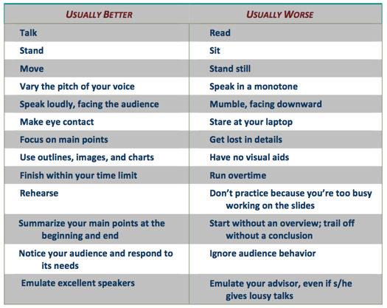
Tips
From
Paul Edwards’ How to Give an Academic Talk
(Valid even though your talk isn't "academic")

Slide 42
Tips for your Voice
Breathe right (from gut, not chest)
When you inhale, your stomach should push out.
puh! tuh! kuh!
Loud and deep
Silence
Repeat phrases
We're going to try it now!

Slide 43
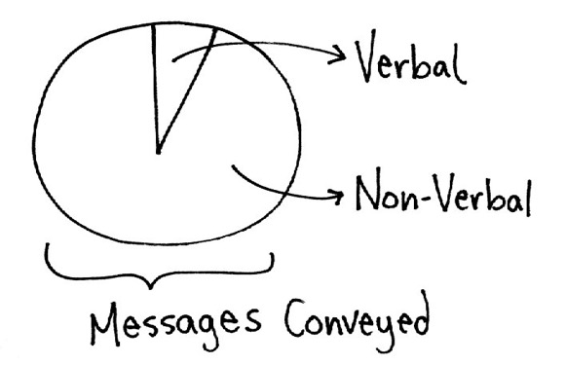
Tips for your Body
Dancing (stand on a plastic bag)
Speed
Where to stand
Eye contact and engagement
Slide inspired by Leslie Potter

Slide 44
Learn from Great Speakers
TED Talks (ted.com)
Ignite talks (https://www.youtube.com/@ignite)
And from bad ones

Slide 45
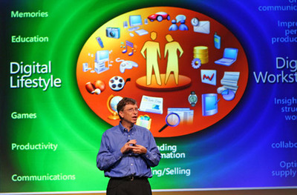
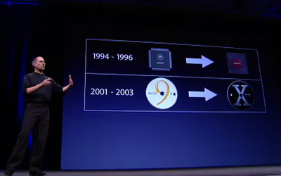
Less is more

Slide 46
Conscious decision
Right now,
Should they look at me or the screen?
Do my words need any visual aid?

Slide 48
Last tips
Use a remote control.
Avoid giving a demo live.
Don’t look at the screen
(your back’s to the audience).
Don’t read your slides.
Do look at someone.

Slide 49
Info for University of Iowa presentation

Slide 50
Outline Logistics
What problem are you addressing? Why is it important?
What have other people done, and how is your approach different?
What are you doing?
What have you learned so far?
What are the challenges you've experienced? What do you wish you knew?
Each team has 15 mins to talk and 5 mins for Q&A.
Each person should speak about 5 mins.

Slide 51
When listening to University of Iowa
If you’re bored, take notes, but not on your phone.
Prepare a question. Every speaker should get at least 2 questions. Post your questions in the chat if you don’t get to speak them.

