Slide 1
Introduction
Adam Kohl

Slide 2
First things first
What are your expectations for this internship?
What do we hope from your internship?
Have fun (in AND out of the lab)
Learn and apply useful technologies in a research setting
Get rid of any fears for graduate school

Slide 3
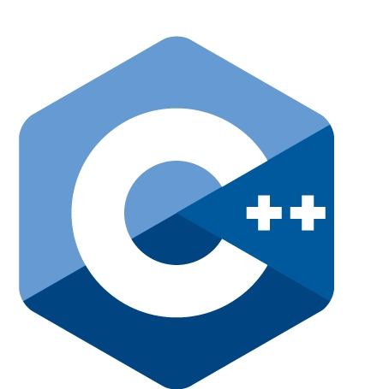
Fundamentals (Week 2 – 4)
Learning & building upon technologies

Slide 4
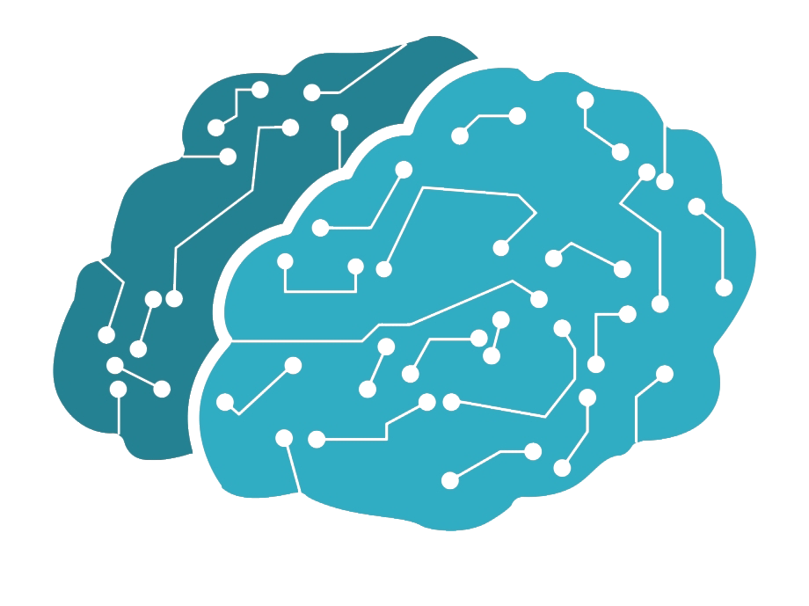
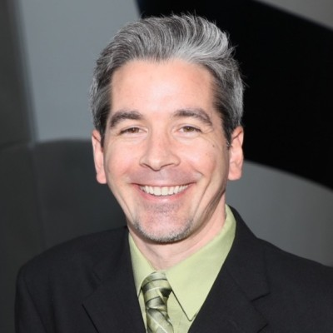
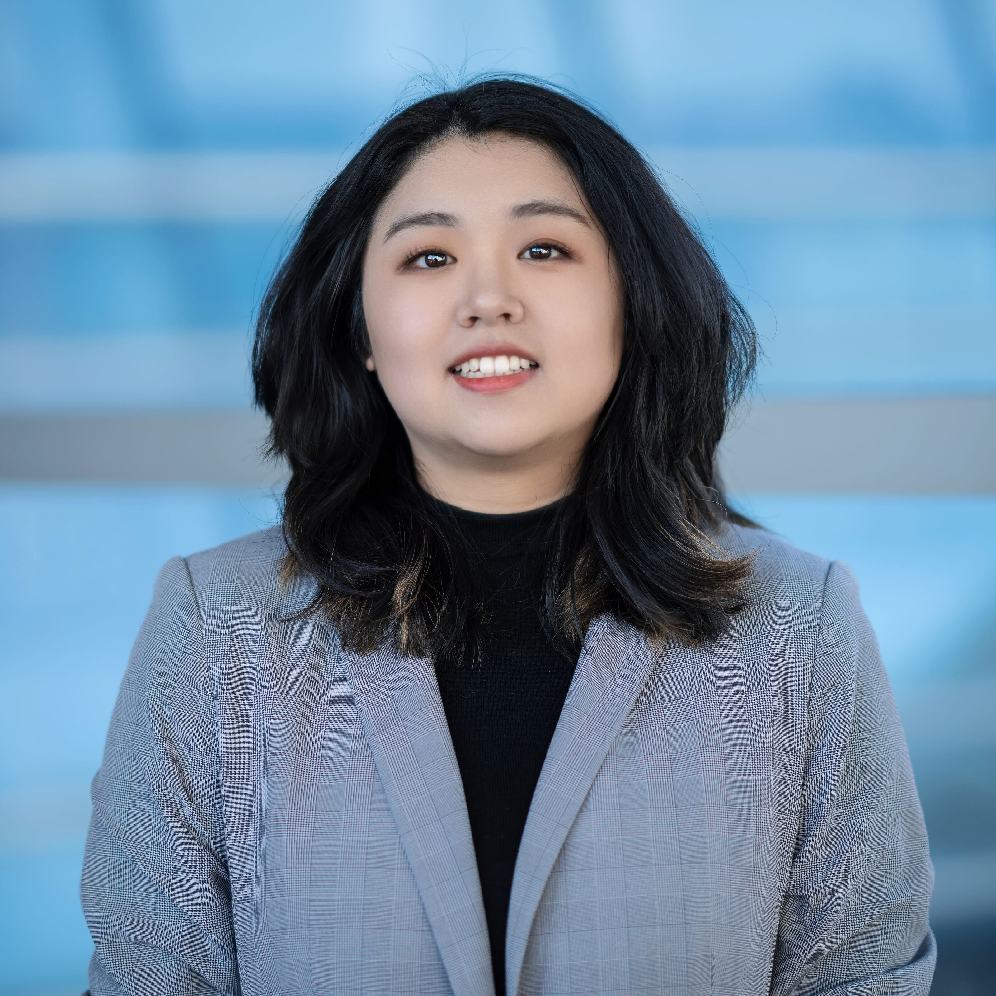
Deeper Dives (Weeks 4 – 5)
Machine learning
Additive Manufacturing
Extended Reality

Slide 5
Major Course Project (MCA) (Weeks 5 – 6)
Project based on everything you’ve learned
Gather ideas along the way
Choose topics for the MCA (within the deeper dive) by June 19th

Slide 6
Calendar

Slide 7
C++ Class Structure
Class time from 9-11am and 2-4pm on Monday, Wednesday, and Friday
Try your best to be 10 minutes early
Class time is used for lectures and worktime (1 hour each)
Daily activities reinforcing concepts
Concepts will build on each other so ask questions early

Slide 8
Motivation (Why C++?)
C++ is a challenging but powerful language
The foundation of more software than you think
Concepts in this class extend to many other languages
C# for Unity especially…

Slide 9
Questions?
Everything is available on the website calendar
SPIRE-EIT 2025 Program Website

