Slide 1
Object Oriented Programming
C++ Lecture 5
Adam Kohl

Slide 2
Motivation
We want to group data and functions together
We want to easily share and reuse specific data and functionality throughout out program
We want to govern access on certain parts of our program to make it good (less errors).

Slide 3
🗣️ Lecture Goals ✅
Classes
Inheritance
Multi-file programs

Slide 4
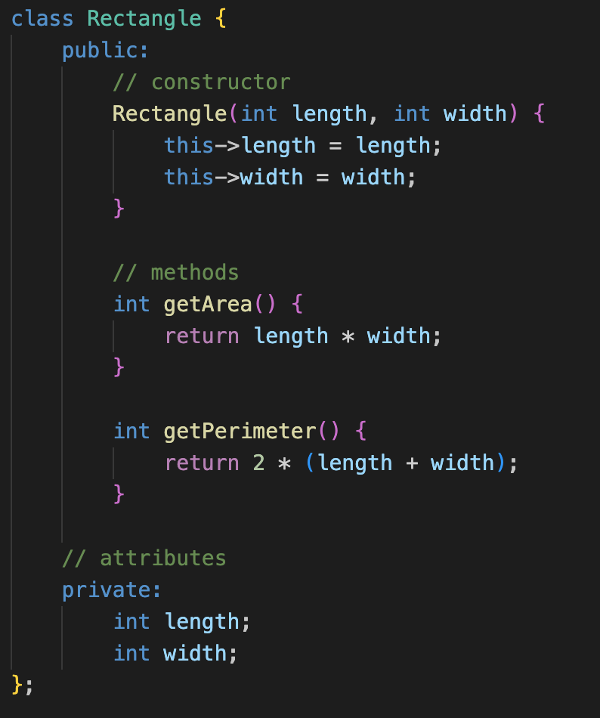
What is a Class?
A class is a definition for a custom data type
The definition is comprised of variables and functions, known as members.

Slide 5
Anatomy of a Class?
Name
Constructor
How we CREATE the object (always same name as class)
Methods
How we USE the object
Access Specifiers
What can we ACCESS
Attributes
What is the class made of

Slide 6
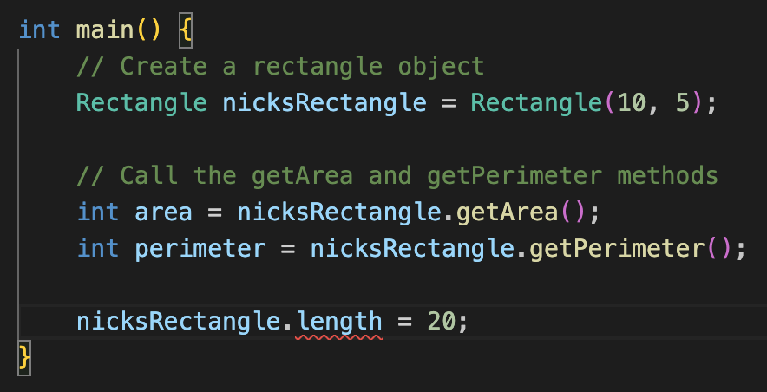
What is an Object?
An object is an instance of our class
Can’t access the length member directly because it is private

Slide 7
Instantiation
We instantiate a class like a normal variable, except this time we use the class constructor
Upon object creation, the constructor is called, and class variables are set.
Instantiate an integer (int type)
Instantiate a class (Rectangle type)

Slide 8
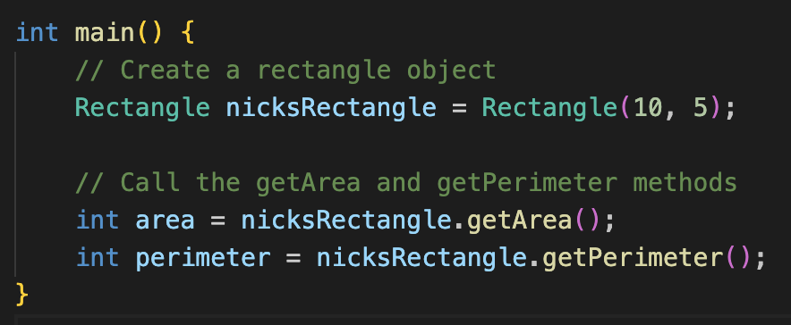
Using the Object
Once the object is made, you can use its public members and utilize the class functionality
Access the public members using the “.” operation

Slide 9
Class Example 💻
Go to https://github.com/iastate/VRAC_REU_Programming
Under challenges/ read modelBankAccount.md 📖
Do modelBankAccount.cpp TOGETHER

Slide 10
🤏 Mini Task ✏️
Go to https://github.com/iastate/VRAC_REU_Programming
Under challenges/ read modelDice.md 📖
Make a new project and code 👨‍💻

Slide 11
Class Inheritance
VracEmployee
Inheritance allows us to pass down attributes and methods from one class to another
It can further organize your system of classes and reduce redundancy of functionality
:Name
:Project
Intern
GradStudent
:labComputer
:cubicle

Slide 12
Class Example
Model the Vrac by creating 3 classes (VracEmployee, Intern, and GradStudent)
Use inheritance to pass down functionality from the base class to the child classes.

Slide 13
Separate Files
As we create more variables, functions, and classes, our file begins to get cluttered and unorganized
We can separate our code into multiple files to avoid this
In C++, these separate files have the .h or .hpp file extension

Slide 14
🤏 Mini Task ✏️
Open your project with the Dice class you created
Make a new file called dice.h
Move your dice class code here
Use #include ”dice.h” in your file with main()

Slide 15
Questions?

