Slide 1
C++ Programming Fundamentals
C++ Lecture 1
Adam Kohl
Dr. Alex Renner, Dr. Eliot Winer

Slide 2
🗣️Lecture Goals✅
Introduction to your integrated development environments (IDE)
The basic building blocks (“Hello World”)
Setting up the IDE
C++ Syntax
Using the “Includes” Statement
Commenting Code
Output to the Command Line
Understanding of IDE’s, C++ Syntax, and Libraries

Slide 3
What is an IDE?
Definition: An Integrated Development Environment (IDE) is a software application that provides comprehensive facilities to computer programmers for software development. An IDE normally consists of a source code editor, build automation tools and a debugger.
Let’s simplify →

Slide 4
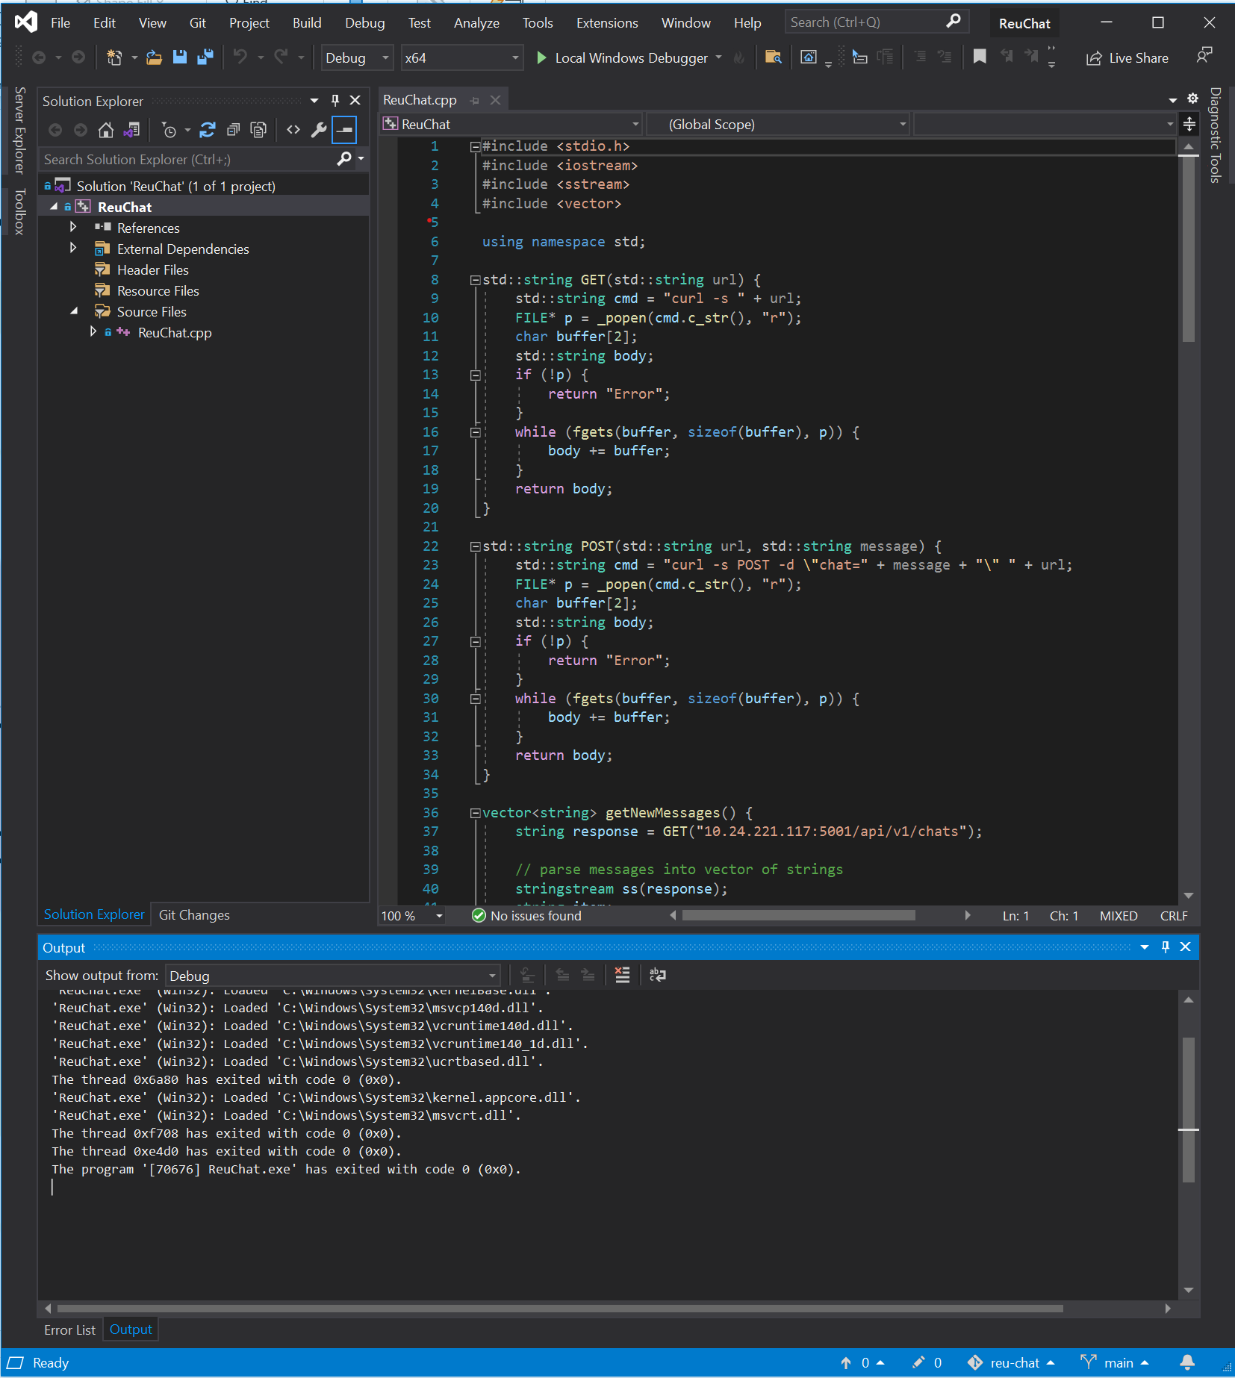
Text Editor vs IDE

Slide 5
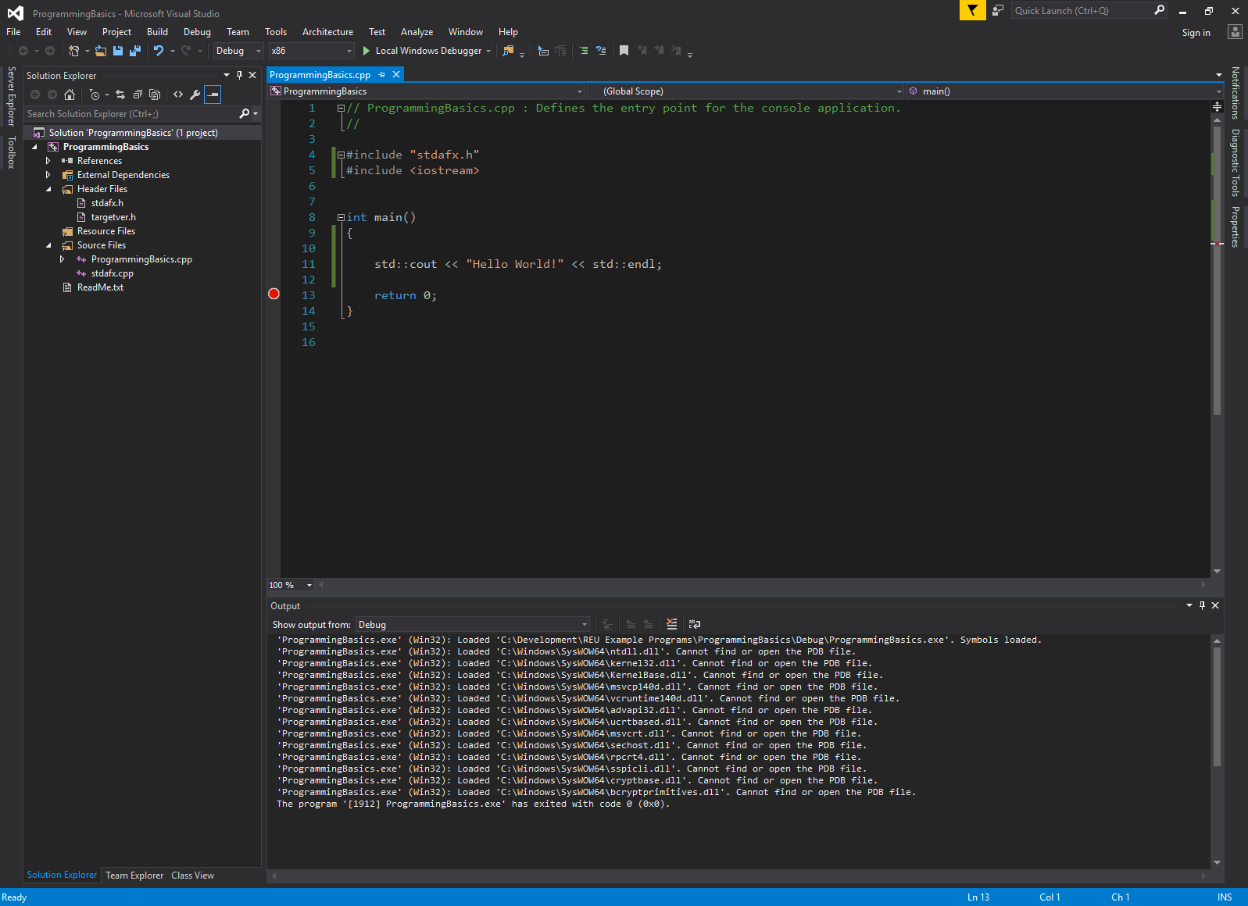
Visual Studio Anatomy
Toolbar
Tools for applying actions to your program
Project Explorer
Same as File Explorer
Editor Window
Where you write code
Console
Build output and debug information

Slide 6
🤏 Mini Task ✏️
Open Visual Studio and and create a new visual C++ Console Application
Run the default file with HelloWorld!

Slide 7
What’s Happening?!
The C++ compiler links the included libraries
The C++ compiler looks for the main() function
Program is executed starting at the first line of main()

Slide 8
Programming Syntax
Letters and symbols must be arranged in a specific way for your program to run
Syntax describes this “language”
Like UK English and American English, many programming languages have the same fundamental structure, but differ slightly

Slide 9
🤏 Syntax Mini Task ✏️
Delete the ‘;’ symbol and run the program.
What happens?

Slide 10
Code Comments
Good programmers comment their code
Comments explain in plain language what a portion of code does
Comments are helpful to yourself and OTHERS when reading code!

Slide 11
Include Statements
There are commonly used functions, objects, and data structures that programmers want to use.
We don’t want to reinvent the wheel every time we program
We include the C++ Standard Library to use pre-written code in our programs.

Slide 12
Include Statements
To specify what features we want, we use #include at the top of our file.
For example, in our Hello World program we used #include <iostream>, giving us access to the cout object, allowing us to print to the console.
Tiny Task: Remove the “#include <iostream>” and see what happens.

Slide 13
Questions?

Slide 14
🤏 Mini Task ✏️
Play around with the Hello World application
Add single line and multiline comments
Have the program print something other than Hello World

