Slide 1
Welcome to SolidWorks
Notes:
https://www.3ds.com/products-services/solidworks/
http://www.hawkridgesys.com/products/

Slide 2
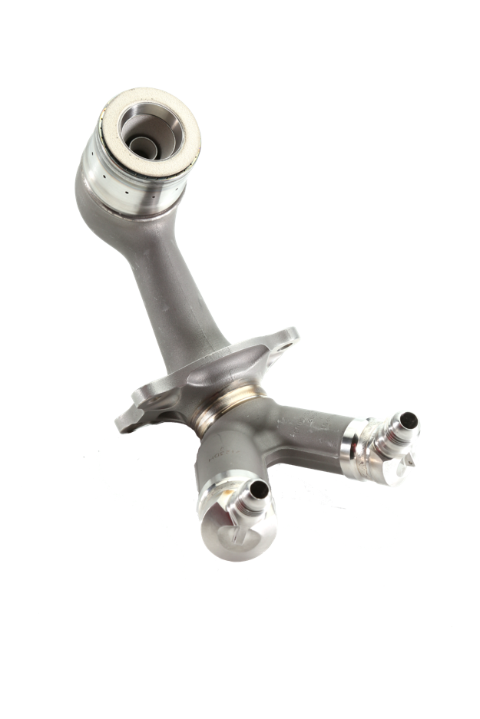
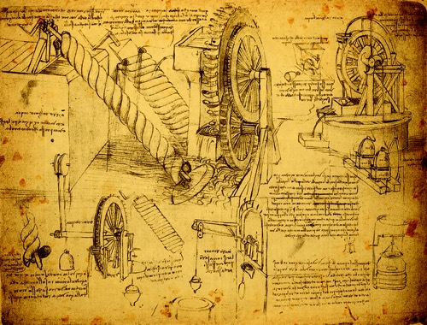
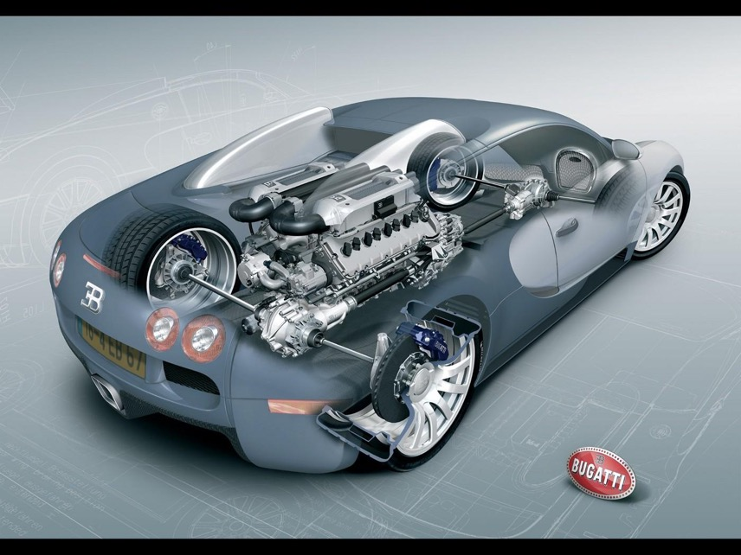
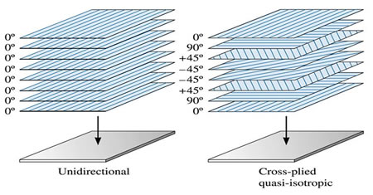
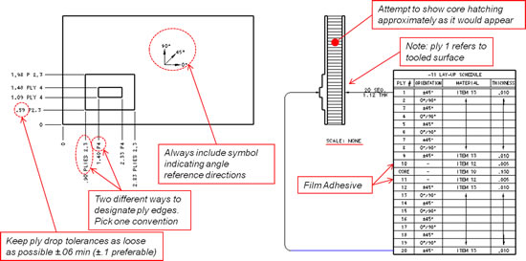
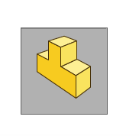
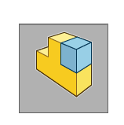
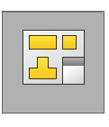
Computer Aided Design (CAD)
Part
Assemblies
Drawings
Notes:
We are using SolidWorks because its interface is easy to use and the instructors are most familiar with this application.
Note that SolidWorks is just one of many other competitors such as Creo, NX, Inventor, CATIA
Note how I did not mention any open source or industrial CAD applications used by artists, designers etc… (e.g., Blender, Maya, Rhino3D, TinkerCAD, Cinema4D
You will learn the differences at the start of this lecture and at the start of Maya lectures
The primary distinction is that “engineering” or “mechanical” CAD and other CAD apps is that the former can be used design, manufacturing, and other analyses
First 2: CAD …where it starts in engineering>>most accurate representations
https://www.ge.com/reports/mind-meld-ge-3d-printing-visionary-joined-forces/
https://www.solidworks.com/feature/topology-study-ideal-geometry-your-design-requirements
https://www.solidworks.com/feature/new-extended-reality-xr-exporter-solidworks-cad

Slide 3
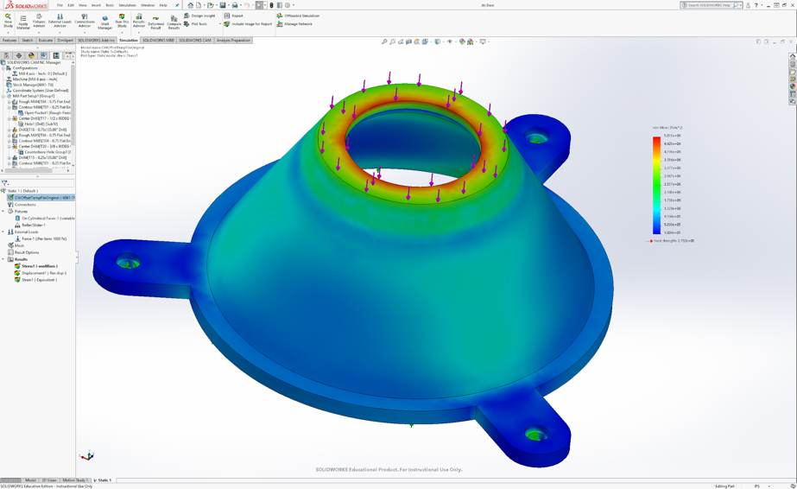
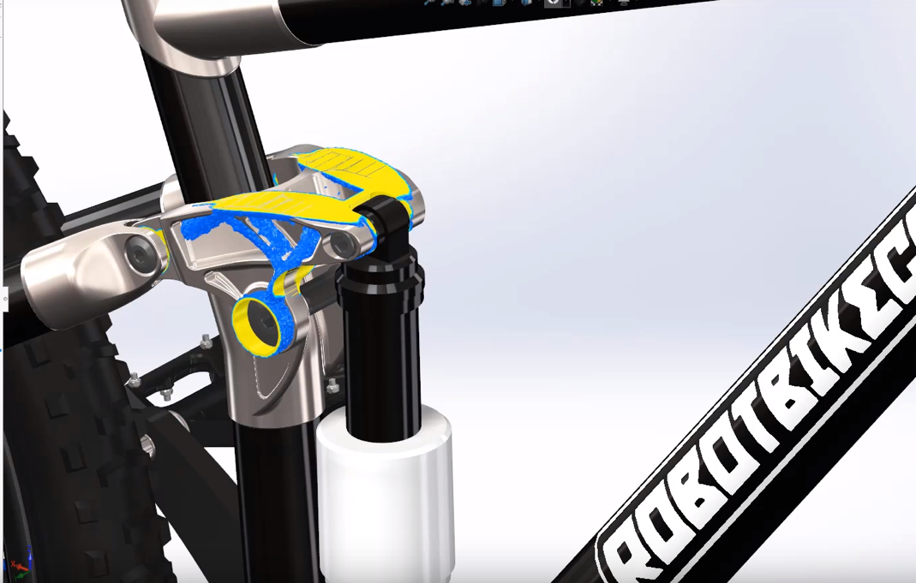
Design Analyses
Finite Element Analysis (FEA)
Topology Optimization
Notes:
https://www.royalcomposites.com/engineering/design/

Slide 4
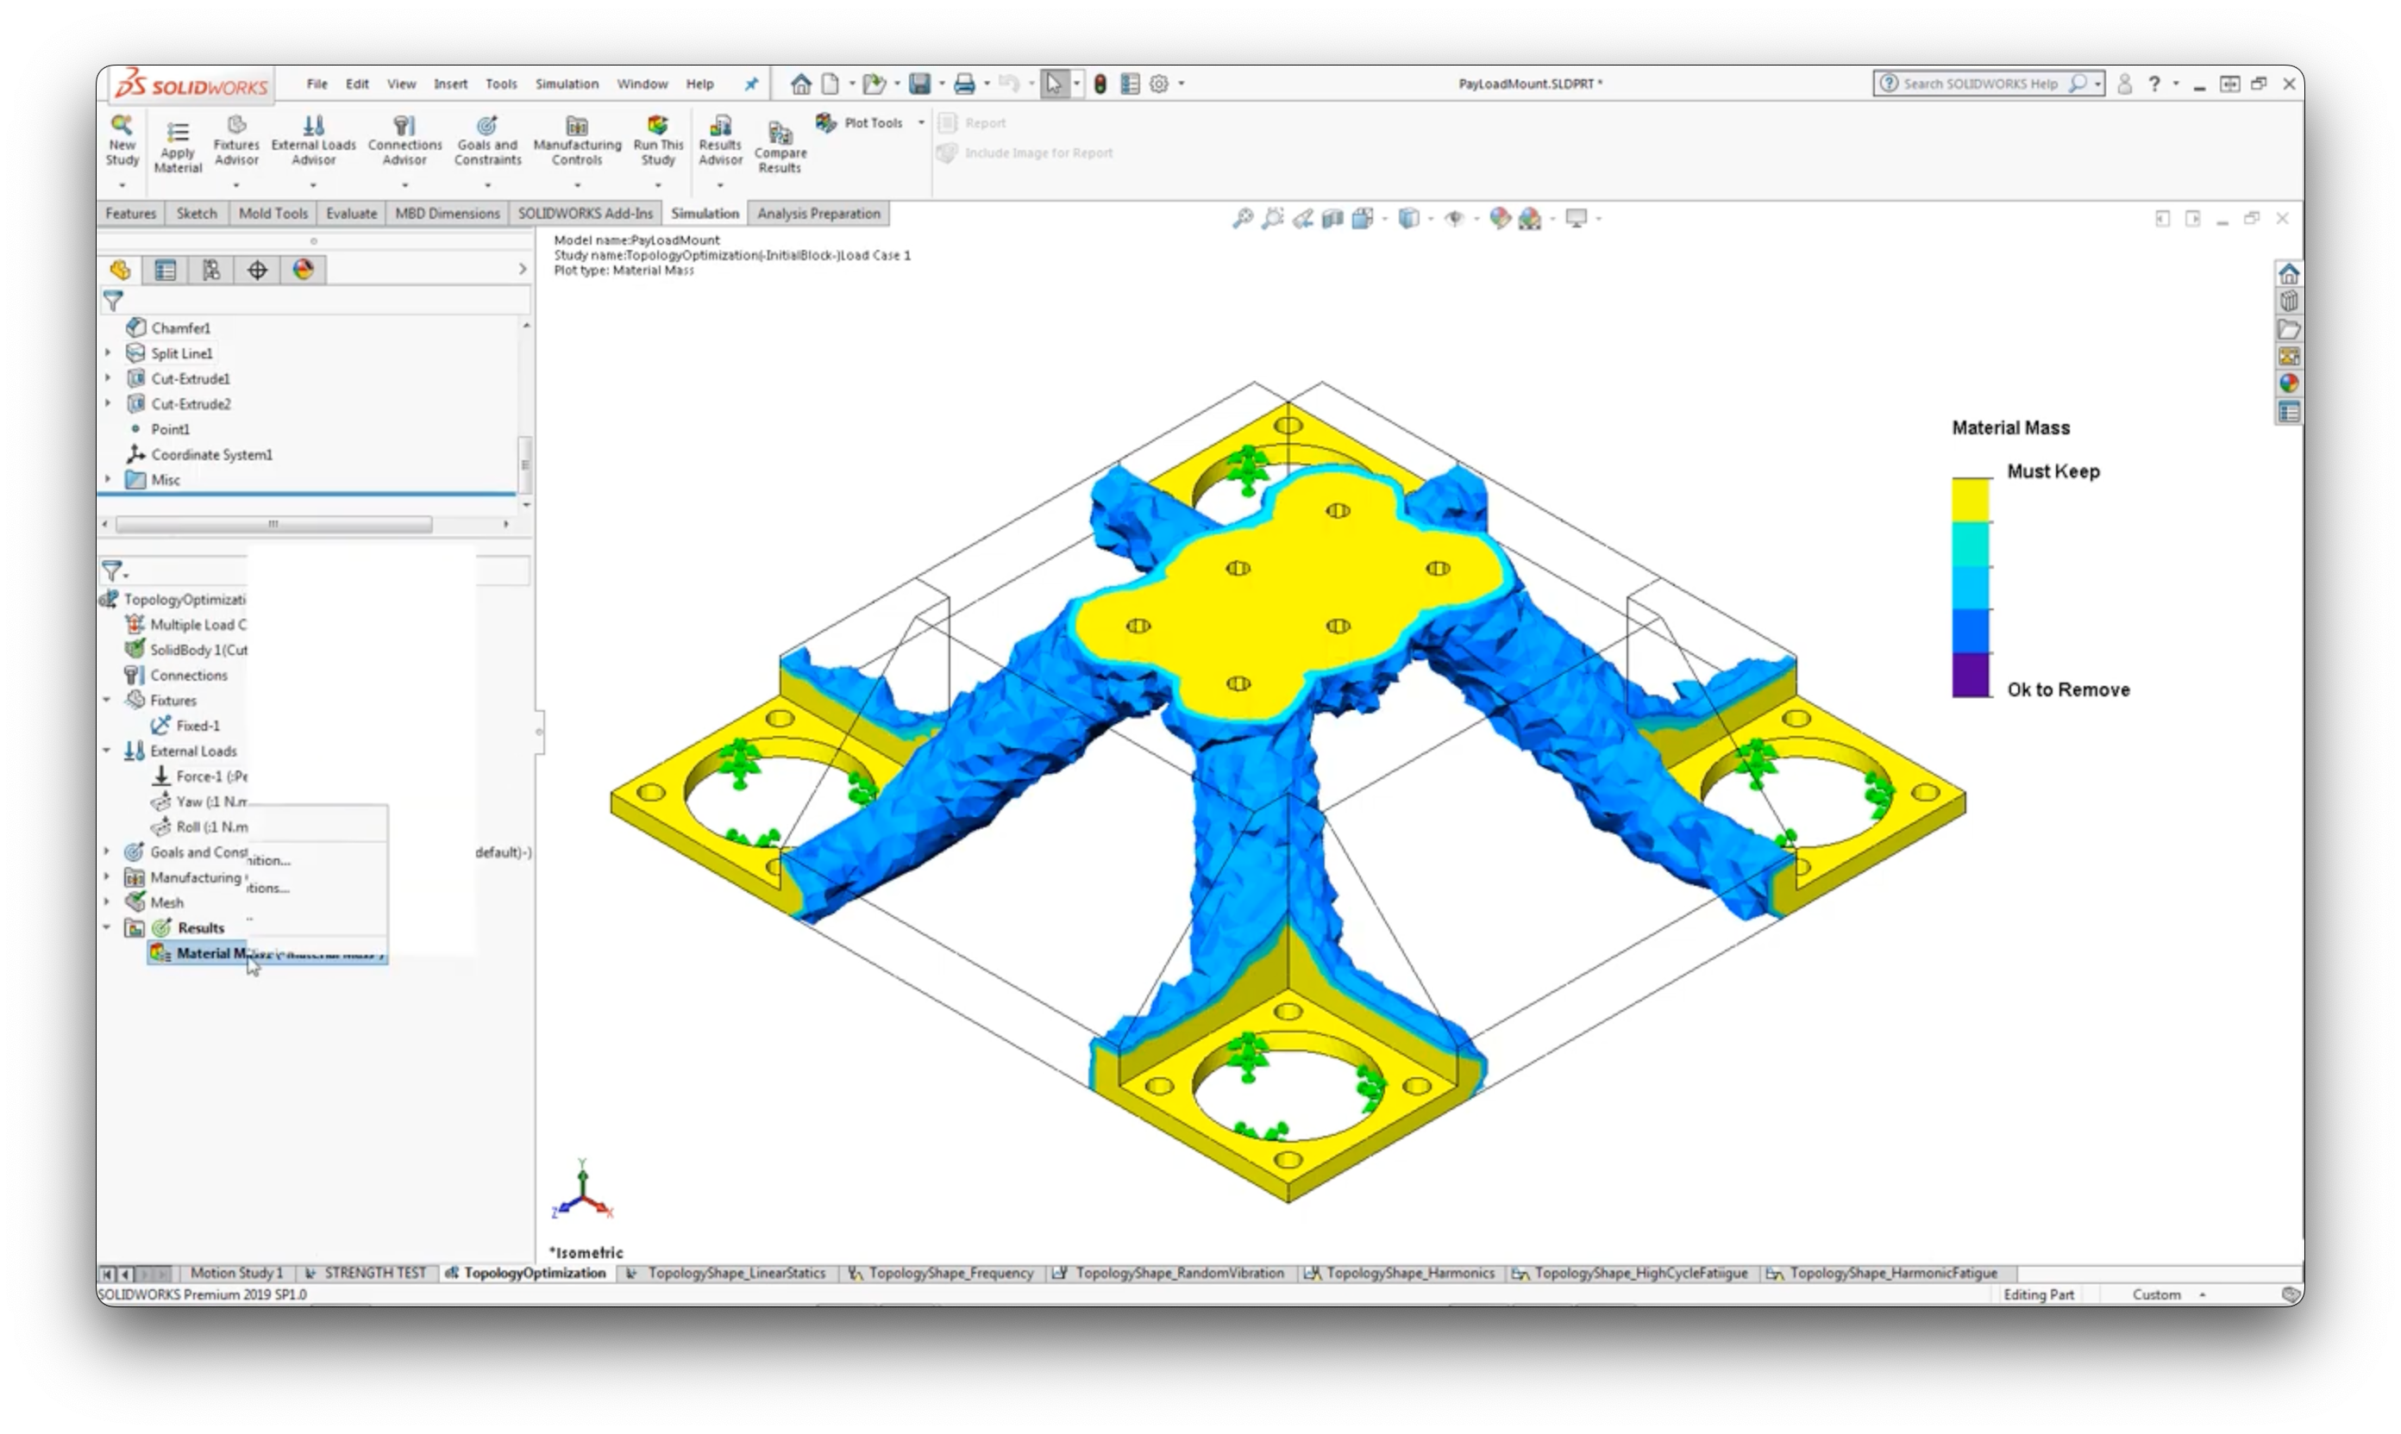
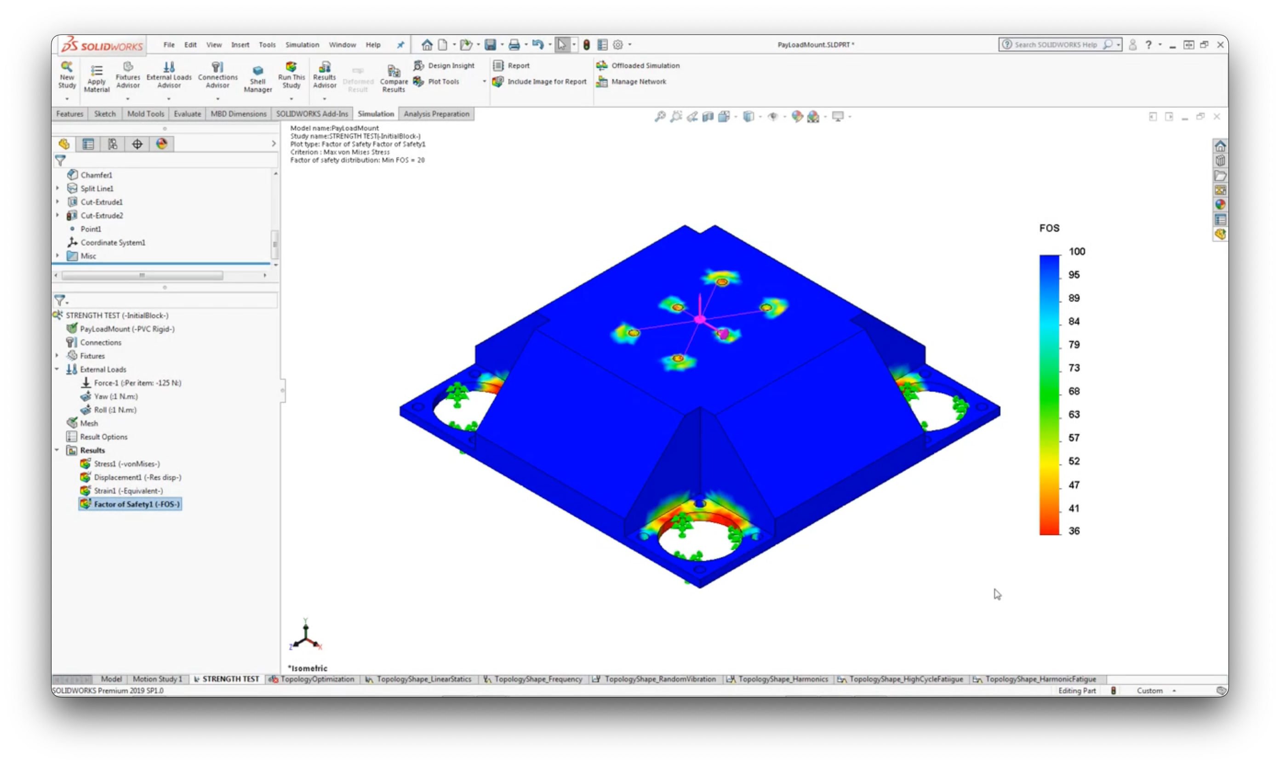
Topology Optimization
Notes:
Parametric Optimization you would design then validate with simulation
Topology optimization huge and complex field
Basic idea is that you do your normal FEA then apply topology optimization to say reduce weight but keep the same strength in the part

Slide 5
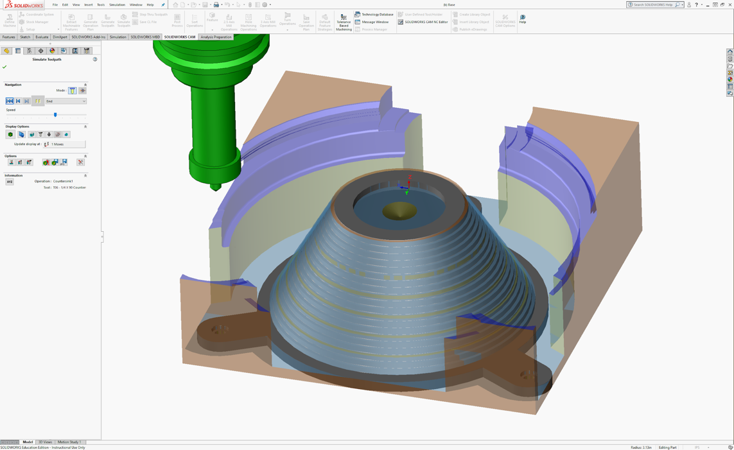
Production Preparation
Computer Aided Manufacturing (CAM) Simulation
CAD to XR (AR/VR/MR/Web)
Notes:
First 2: CAD …where it starts in engineering>>most accurate representations
https://www.solidworks.com/feature/topology-study-ideal-geometry-your-design-requirements
https://www.solidworks.com/feature/new-extended-reality-xr-exporter-solidworks-cad

Slide 6
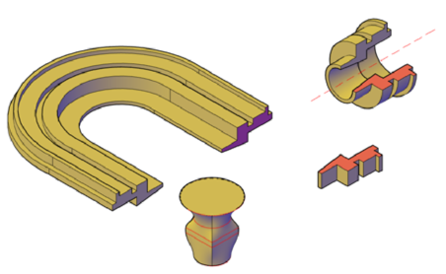
Solid Modeling
Defined by:
Boundary representation (B-rep)
connected surfaces create an inside and outside of the part
Have these properties:
Mass
Volume
Moment of inertia
Notes:
**solid is defined exclusively by the faces…the inside (solid part) and the outside (void)
http://docs.autodesk.com/ACD/2010/ENU/AutoCAD%202010%20User%20Documentation/index.html?url=WS1a9193826455f5ffa23ce210c4a30acaf-68fb.htm,topicNumber=d0e93002

Slide 7
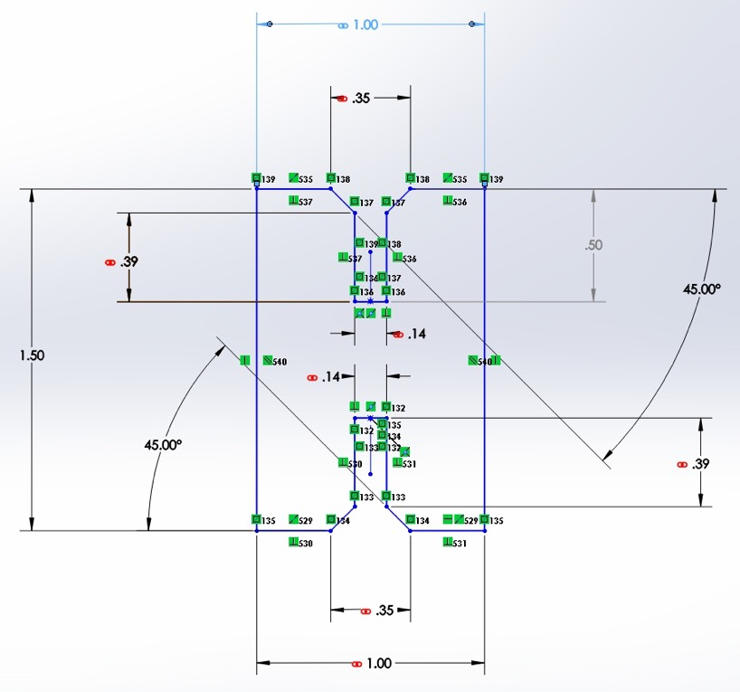
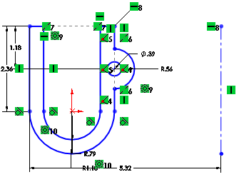
Constraints
Defined as a limitation or restriction
Apply constraints to any geometry drawn in Solidworks (under the discretion of the user)
*Constraints in Solidworks look like this.
Notes:
Don’t think any of your questions are stupid – I’ve been using Solidworks for longer than Spencer has been alive!
But no seriously – my point is that things have become so muscle memory that I definitely don’t even think about how to use the mouse sometimes I just do it – Spencer is probably getting there
My point – we can’t unlearn what we learned to better teach you

Slide 8
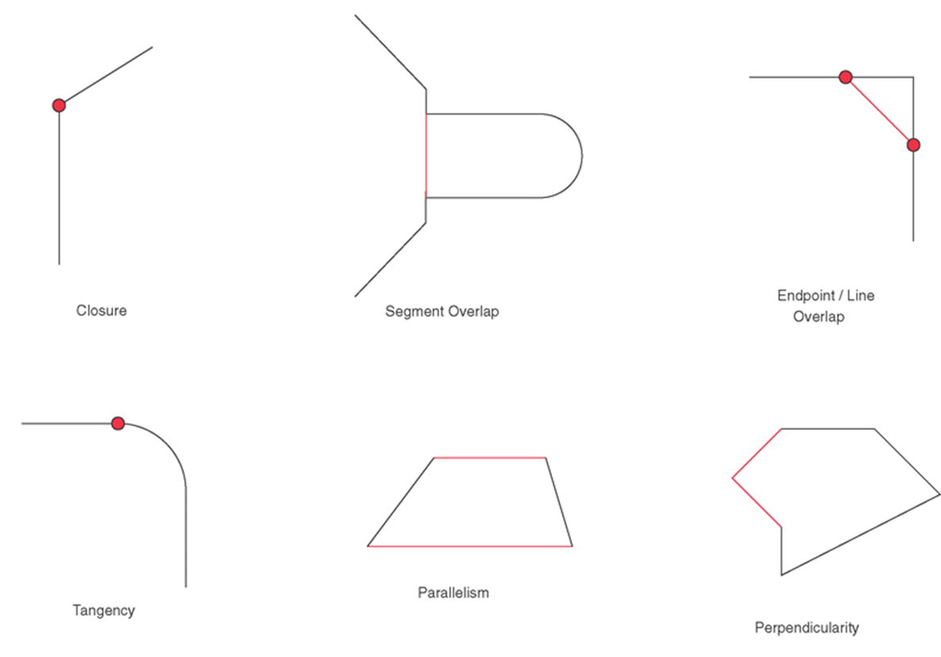
Implicit Constraints
Geometric relationships implied by the way the profile is drawn and interpreted by SolidWorks
Note: SolidWorks only makes closed profiles, so your profiles must have closure.
Notes:
Utilize the constraints tools in Solidworks, so you don’t have to always literally draw lines that are perfectly parallel….Solidworks assumes what you are doing and adjusts the drawing for you.
NOTE: you can choose whether or not you want to go along with Solidworks’s implied constraints………I’ll show you what I mean.
**must have closure, solidworks only makes closed profiles

Slide 9
More Implicit Constraints
Notes:
DO EXAMPLES OF CONSTRAINTS HERE.

Slide 10
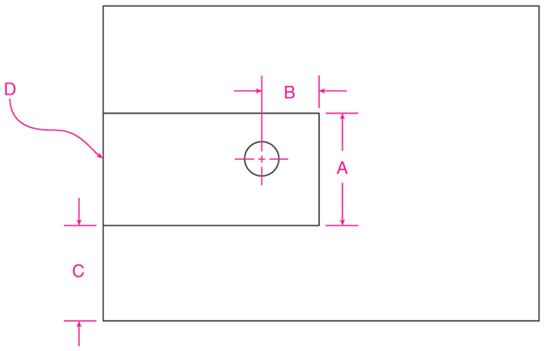
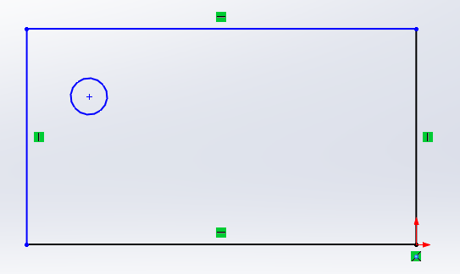
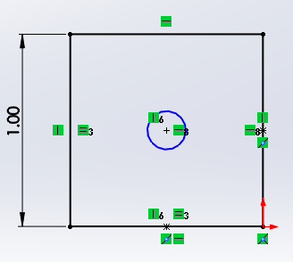
Explicit Constraints
Defined by the operator
Dimensional constraints: assigning a specific length to a line, radius to a circle, etc.
Geometric constraints: specifying the ways in which lines/shapes/features relate to one another
Notes:
Like adding a dimension, the user is telling solidworks that the size of the circles are the same….b/c they dimension each one to be the same
1) DO EXAMPLE OF SMART DIMENSION.
2) DO BOTTOM EXAMPLE.
https://eedcourses.engineering.osu.edu/sites/eedcourses.engineering.osu.edu/files/uploads/1186/SolidWorks/SW03/Geometric_Constraint_Modeling_Lecture.pdf

Slide 11
Show and tell
MMB scroll:
zoom
LMB: select
MMB click/hold:
rotate part
MMB click/hold +
Control: pan
RMB: change view
MMB click/hold +
Shift: precise zoom
Notes:
Don’t think any of your questions are stupid – I’ve been using Solidworks for longer than Spencer has been alive!
But no seriously – my point is that things have become so muscle memory that I definitely don’t even think about how to use the mouse sometimes I just do it – Spencer is probably getting there
My point – we can’t unlearn what we learned to better teach you
Fixed constraint shouldn’t be there wish SolidWorks would remove it
Normal to for sketches (click the button, but also control 8)
Will help make your sketches fully defined
Go over all mouse functionality
Practice how to zoom in and out – see how if on one side it zooms in and at different than if on the other side of the part
If you lose the part – here’s how to zoom to fit
At least have every practice this while I show them how to do a basic sketch
Have Spencer check that everyone can use the mouse
Once you get used to the ways to click – the activities at the end will be much easier – it just takes some getting used to

Slide 12
Levels of Constraint
Fully constrained
Every element has been completely dimensioned/specified
Underconstrained
Not all elements are dimensioned/specified (leaves interpretation up to Solidworks)
Overconstrained
Adding a new constraint would conflict with existing constraints (Solidworks won’t let another dimension be added)
Notes:
FULLY CONSTRAINED EXAMPLE.
UNDERCONSTRAINED EXAMPLE.

Slide 13
Example of an Overconstrained Sketch
Center point of line
Driven Dimension: is driven by the model *Changing the model changes this driven dimension value
Driving Dimension: drives the model *Changing this driving dimension changes the model
Notes:
**show this live in solidworks

Slide 15
One of the basic steps…Extrusion
Linear Extrusion: starts with closed polygon (profile) drawn on a plane, and then swept along a defined path for a defined length
Notes:
**Show extrusion in Solidworks
**Show coordinate systems from last slide
**Show a cut

Slide 16
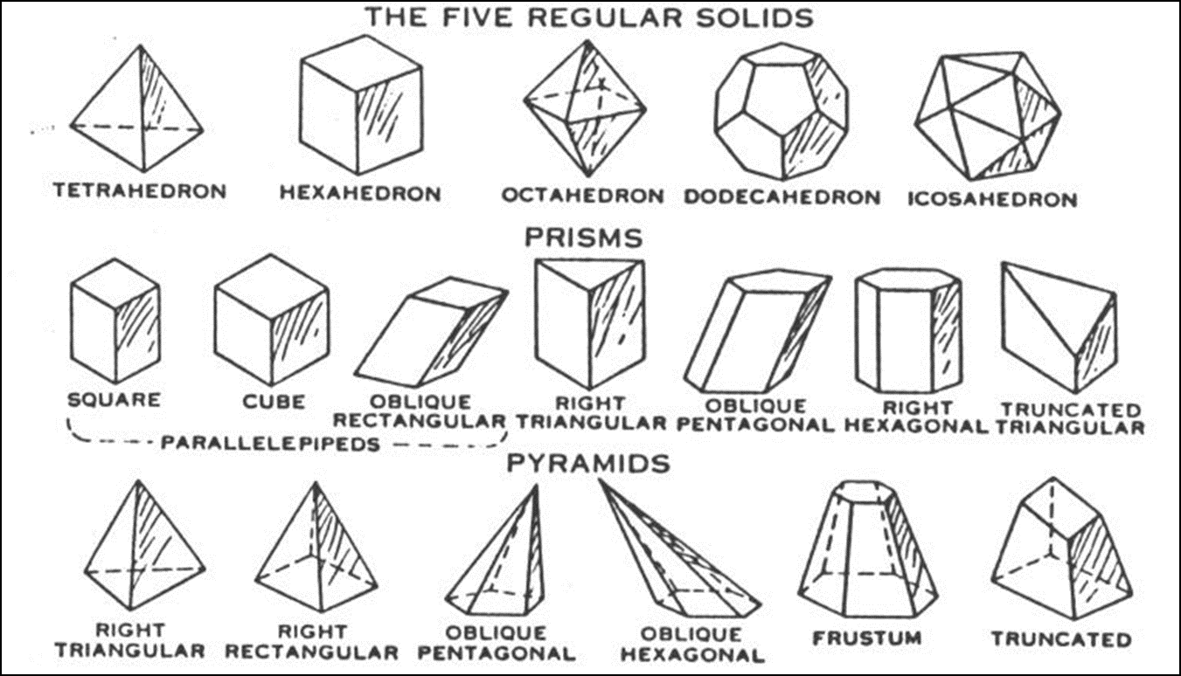
Extruding a primitive shape allows you to make some of these 3D objects…

Slide 17
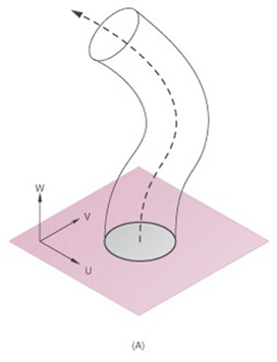
Path-based Extrusion
Sweep: create a profile and define its path to be extruded along
Notes:
DO SWEPT PATH EXAMPLE FOR THEM AND HAVE THEM MESS AROUND.

Slide 18
Revolute Extrusions
Start with a drawn profile and define an axis of rotation about which the profile is rotated for a defined angle.
Notes:
DO REVOLVED EXTRUSION AND HAVE THEM MESS AROUND.

Slide 19
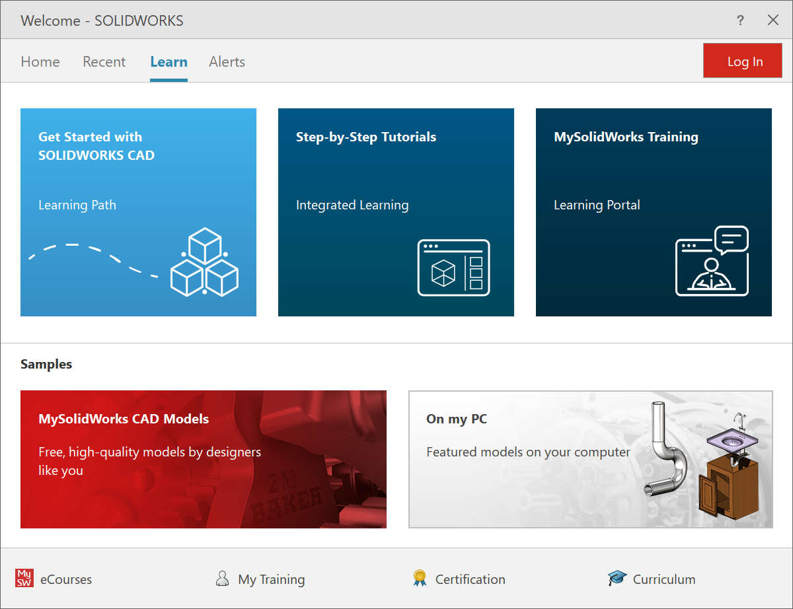
Activity
Use Step-by-Step Tutorials from SolidWorks
Goal is getting used to the interface
You’ll access tutorials for two parts as seen on the next slides
We’ll be walking around ready to help answer questions and helping complete the parts.
Notes:
May be frustrating at first but be patient, the tutorials take you through operation one small step at a time

Slide 20
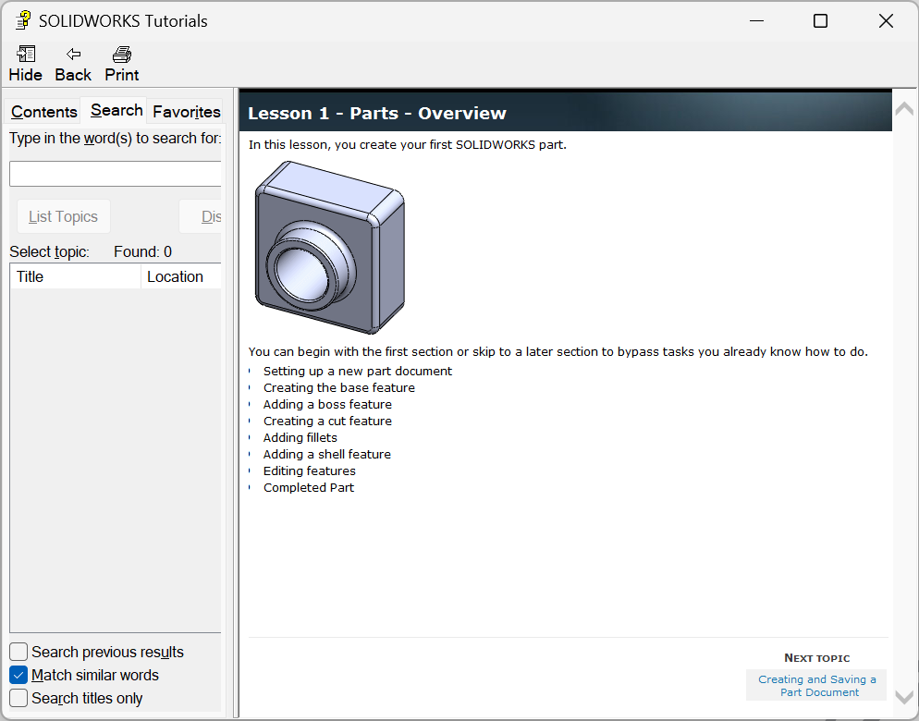
Activity
Extrusions, cuts, fillets, shell
Select ”Getting Started” tab
Then choose ”Lesson 1: Parts”
Click “Next Topic” in the bottom right to progress through the lesson
When done with this part do the next…
Notes:
You’ll be making the part shown in the picture on the right
The tutorial will walk you through each step, and show you where the buttons are in the interface
But don’t hesitate to ask questions along the way – no tutorial is perfect – but these are the best we have found – Eliot uses them when he teaches a course that uses this software application.
The tutorial window should show up in a window right next to the SolidWorks window

Slide 21
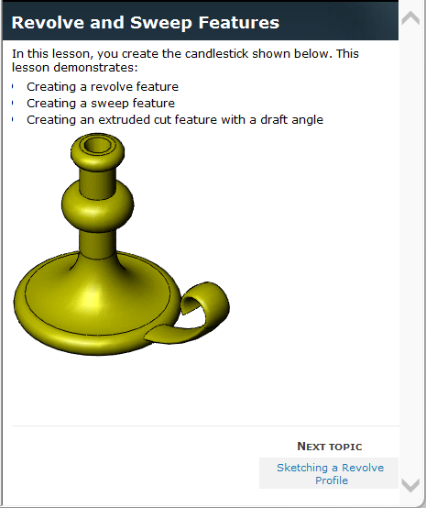
Activity
Select ”Basic Techniques” tab
Then choose ” Revolves and Sweeps”
You may not get done with this part during class time
Try to finish as much of it as possible before the afternoon class session
You’ll need these skills to make the next parts
Notes:
You’ll be making the part shown in the picture on the right
The tutorial will walk you through each step, and show you where the buttons are in the interface
But don’t hesitate to ask questions along the way – no tutorial is perfect – but these are the best we have found – Eliot uses them when he teaches a course that uses this software application.
The tutorial window should show up in a window right next to the SolidWorks window

