Slide 1
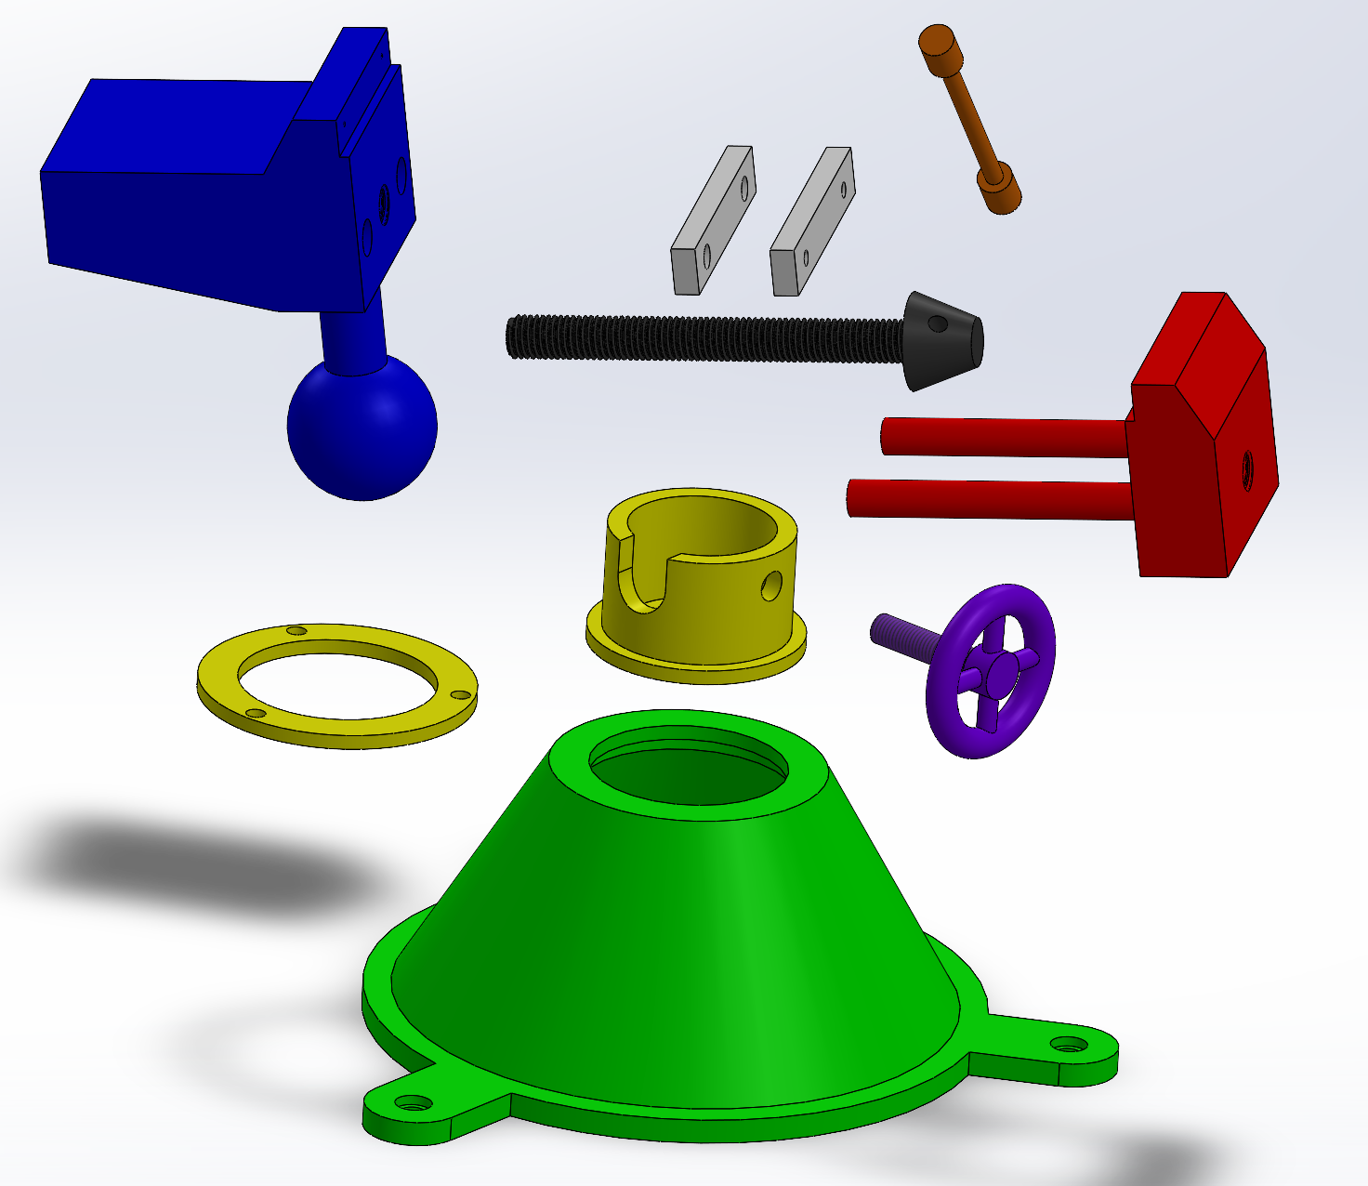
Advanced Modeling in Solidworks

Slide 2
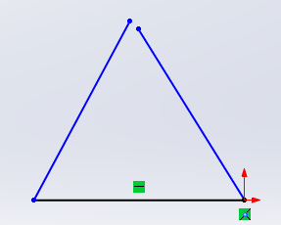
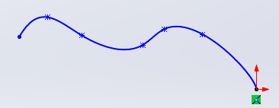
Refresher:
Do these sketches create 3D features in Solidworks?
Notes:
Remember: Maya can create surfaces based on a line/edge, but Solidworks CAN’T.
***The sketches in Solidworks need to be CLOSED in order to make a 3-dimensional feature.

Slide 3
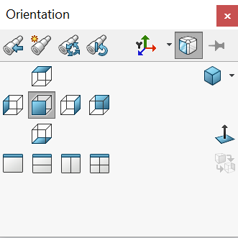
Helpful SolidWorks tools
Normal To is your friend when sketching
Reference Geometry>Axis
Linear Pattern>Linear Pattern or Circular Pattern
Hold down the center button of your mouse to rotate your part
Press Space Bar on keyboard to get this
        Allows you to easily orient the part being modeled

Slide 4
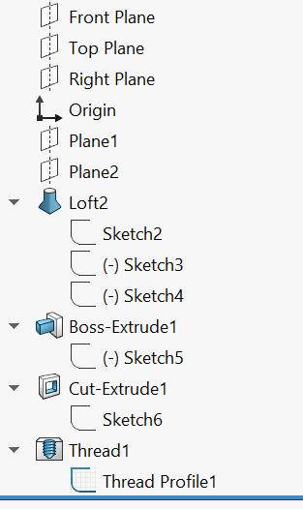
Constraint-based Modeling
Collection of features
  Ex: Extrude, Extruded cut, Revolve, Fillet/Round, Chamfer, Sweep, Loft, etc.
Parts Tree
  Pay attention to the parent/child relationship between a feature and it’s sketch

Slide 5
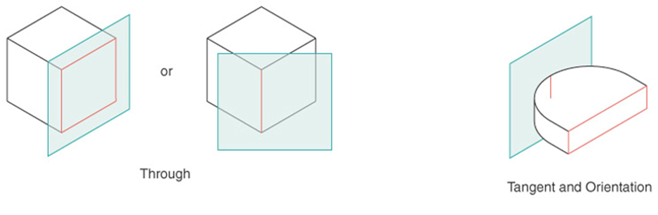
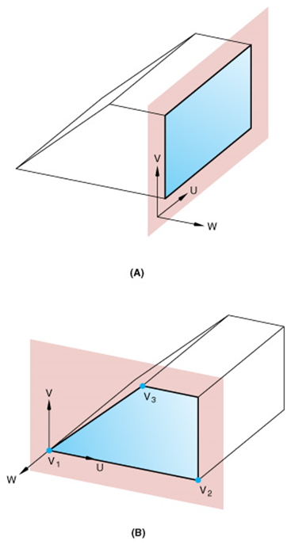
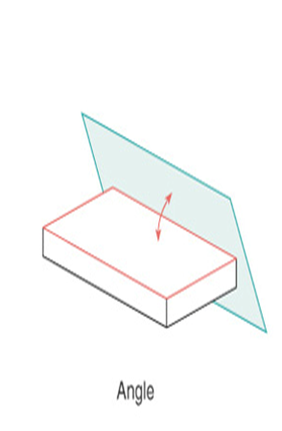
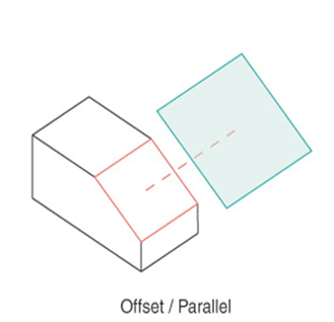
Sketch Planes
Canvas for drawing the construction geometry of a part (profile, construction lines, etc.)
Notes:
*add a workplane to any part and you can create geometry off of that plane
*you have the freedom to choose where the plane is located and its relation to the rest of the part
SHOW THEM HOW TO DO WORKPLANES.
INSERT A WORKPLANE YOURSELF.
TRY ONE AT 45 DEGREES.
TRY ONE THAT IS 2 INCHES AWAY FROM THE OBJECT SURFACE.

Slide 6
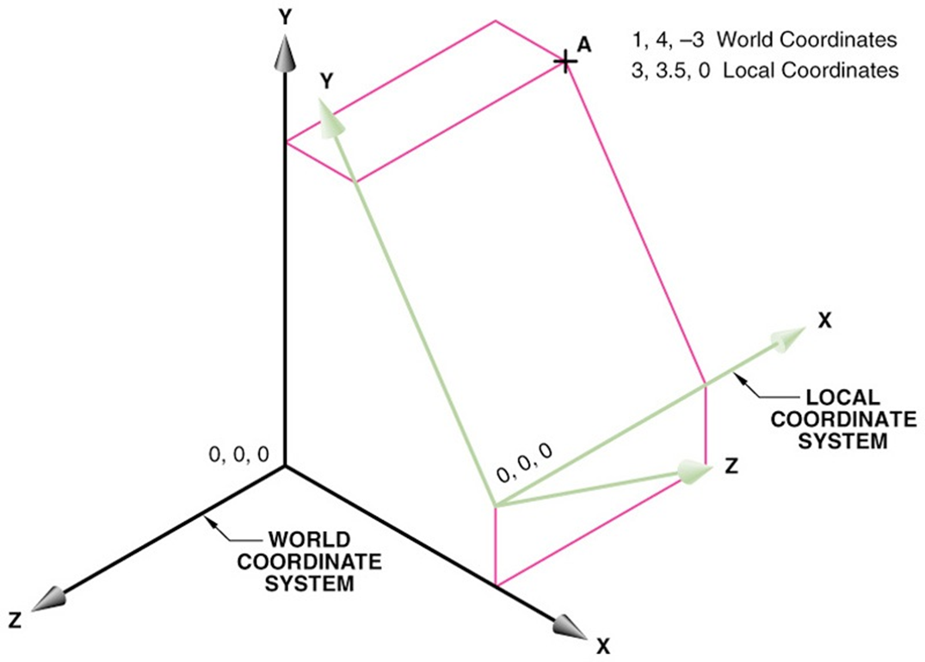
Coordinate Systems
Local Coordinate Systems make geometry creation easier.
Origin for LCS can be anywhere on model
Notes:
MAKE THIS SHAPE AND MAKE SOME REFERENCE GEOMETRY OFF OF IT AT VARIOUS COORDINATE SYSTEMS.

Slide 7
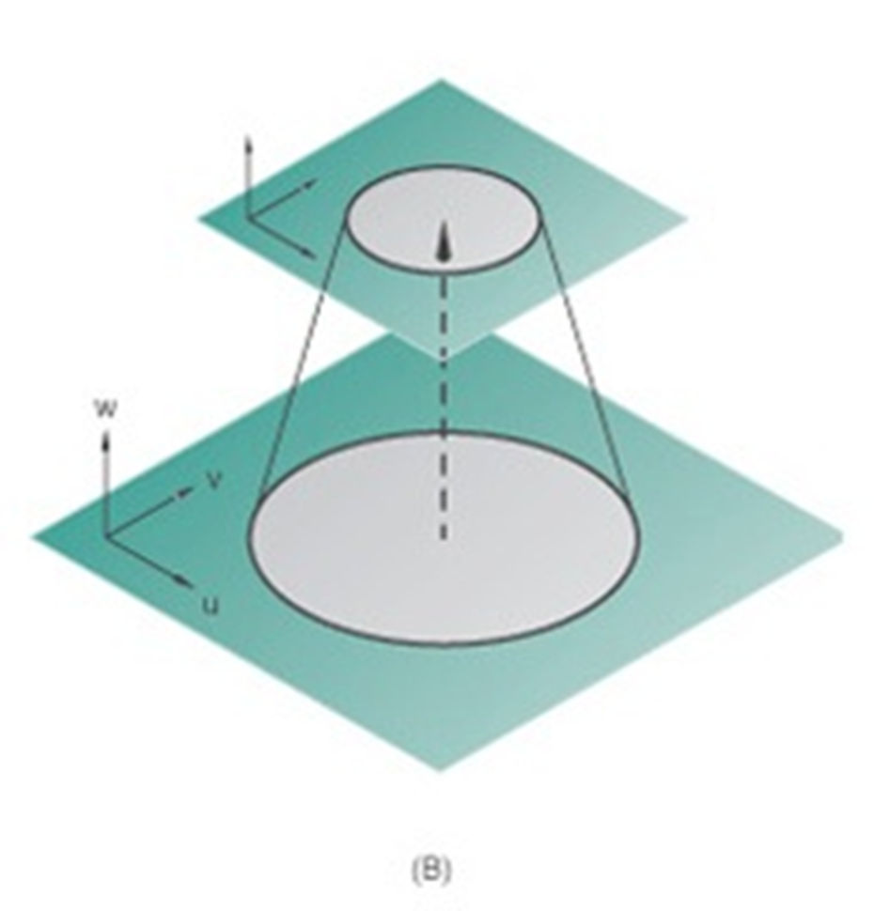
Blend Extrusion
Loft: create a profile on the base plane, define the second plane (with a second profile) to which the initial profile will be extruded to
Notes:
DO THIS IN SOLIDWORKS.
TRY DOING SOMETHING SIMILAR TO THIS IN SOLIDWORKS, CREATING A LOFTED EXTRUSION.

Slide 8
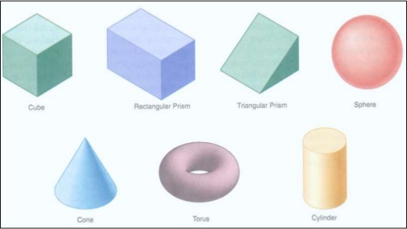
Solid Primitives
Almost every object can be decomposed into its most fundamental, 3-dimensional geometries
Solidworks can only create a limited set of 3D objects
Combine these to make a complex object!
Notes:
http://www.slideshare.net/Nareek/solid-modelling-cg

Slide 9
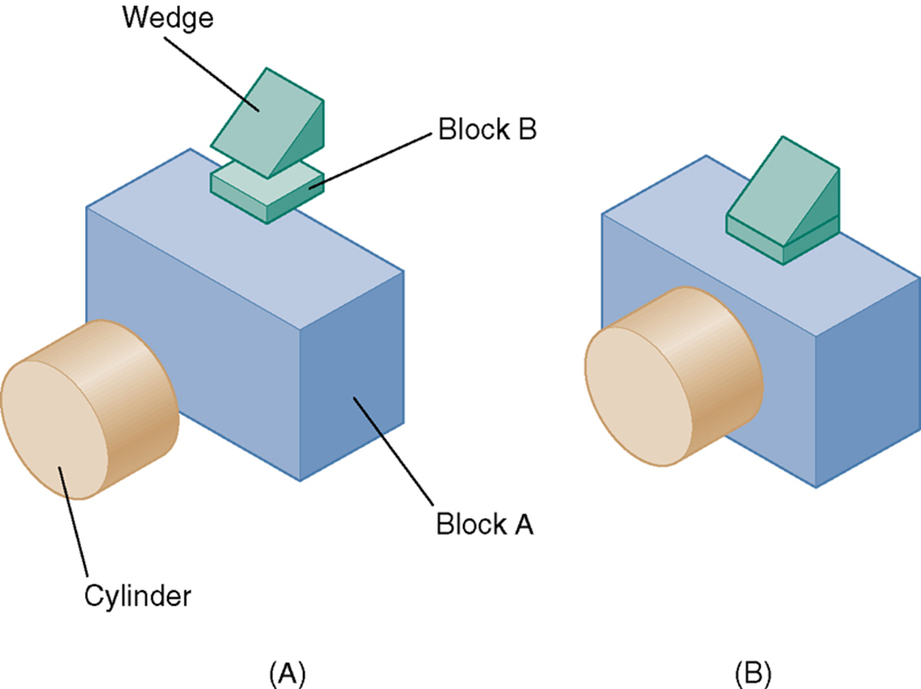
Make this part…
Notes:
Model this as an activity

Slide 10
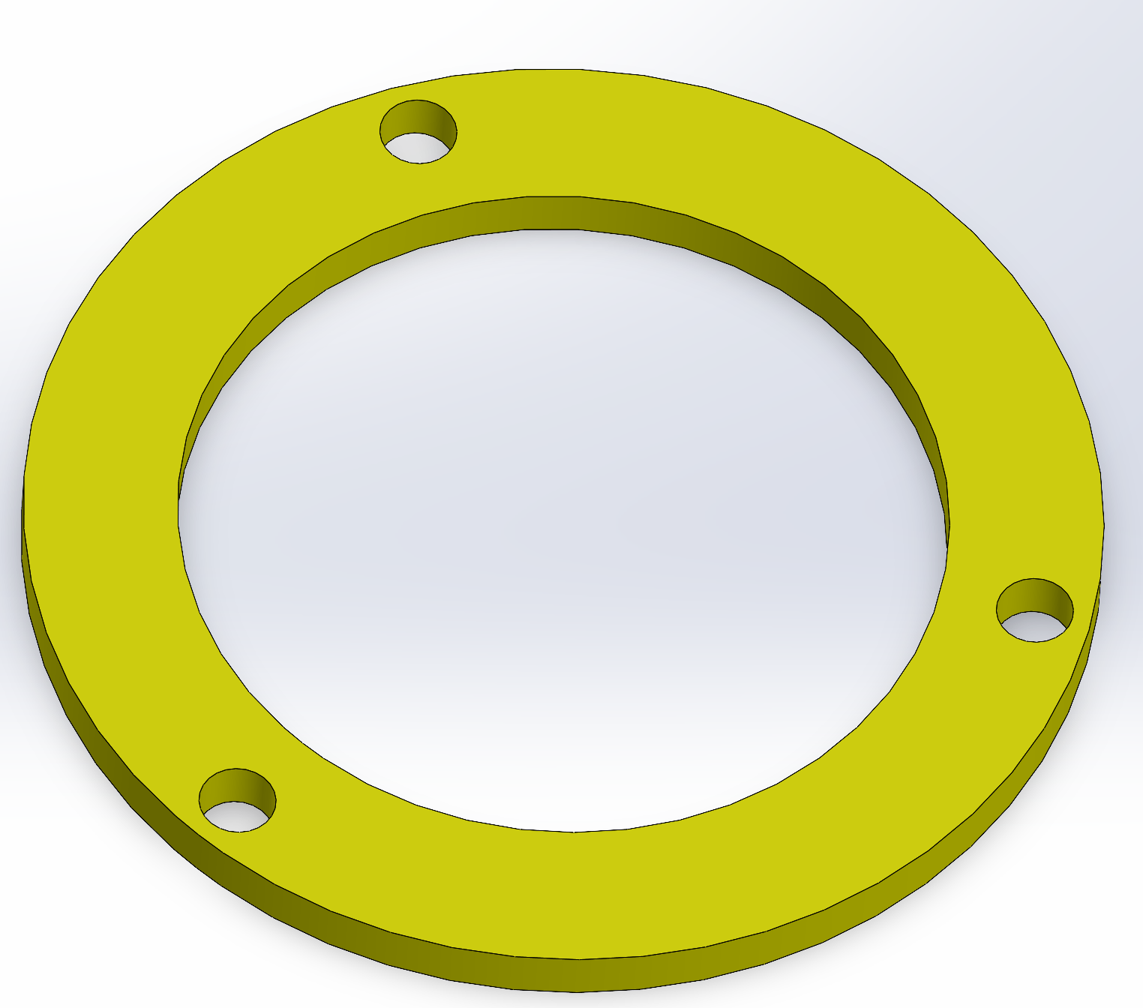
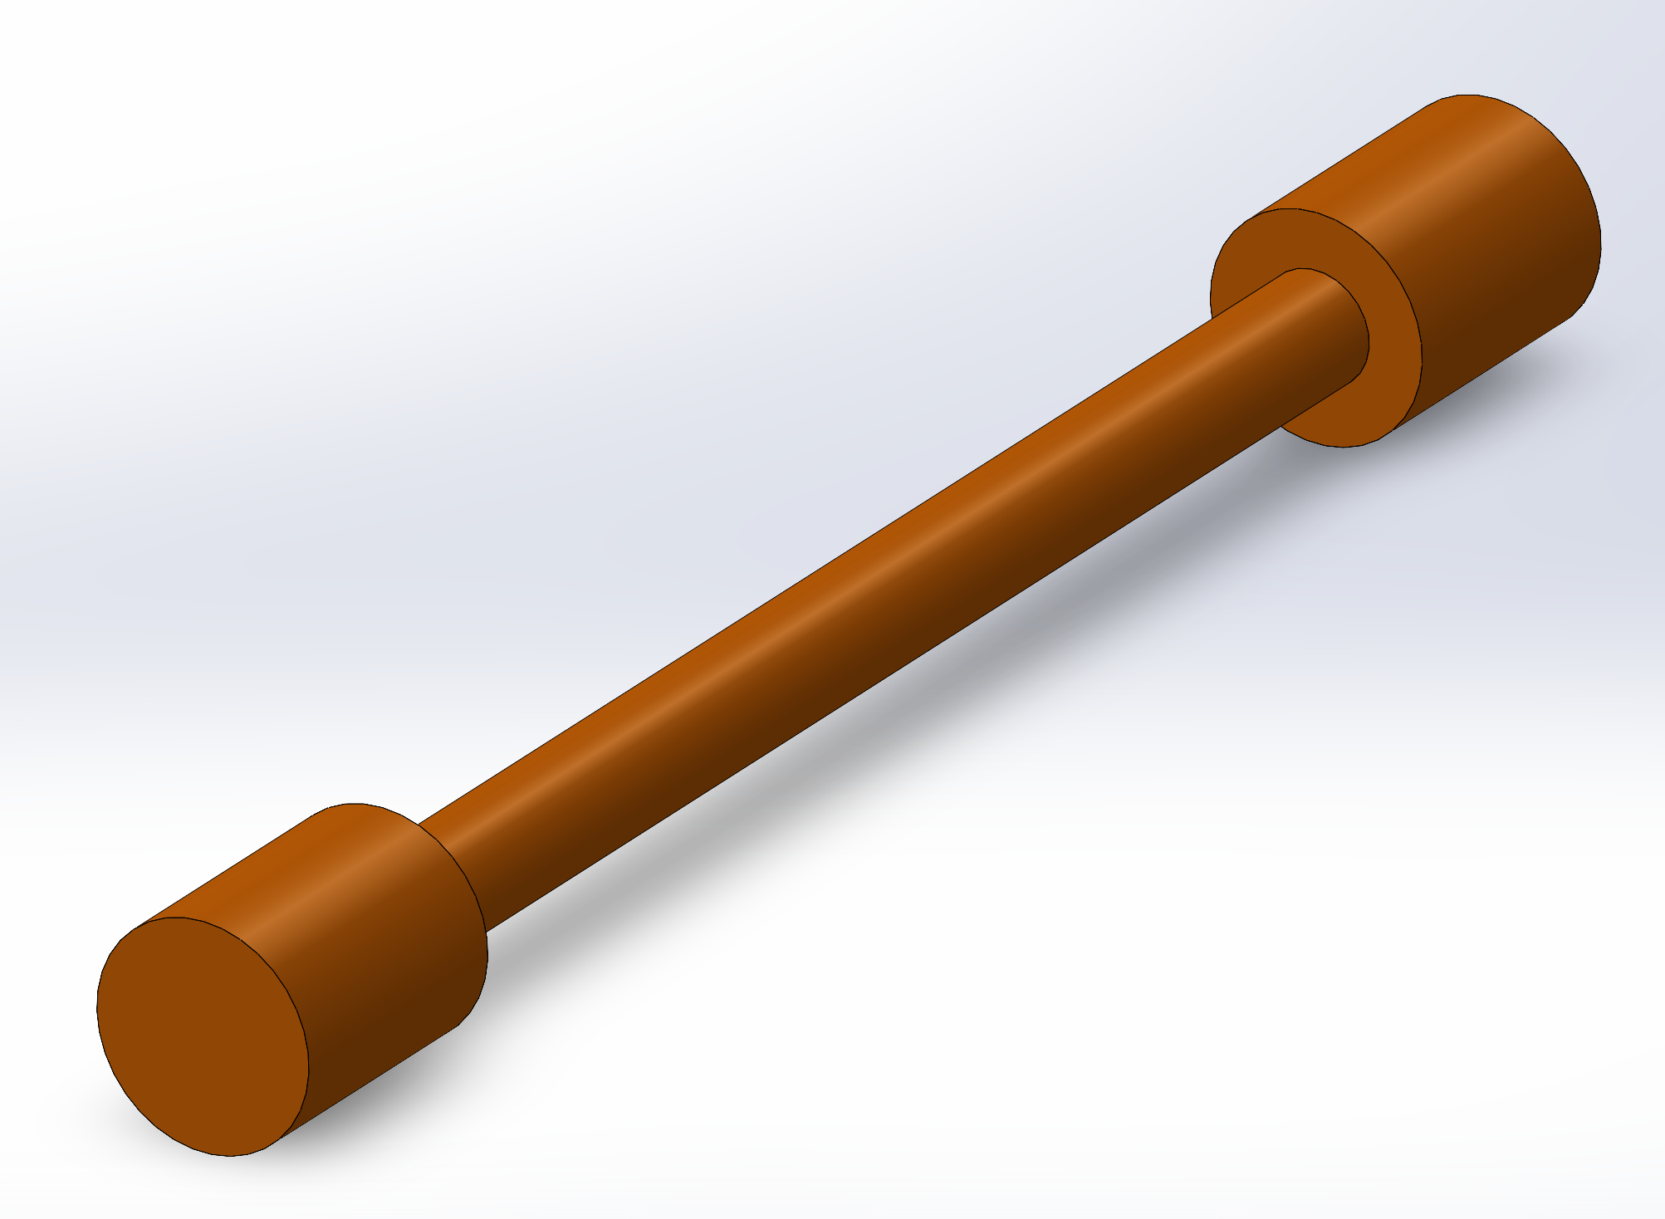
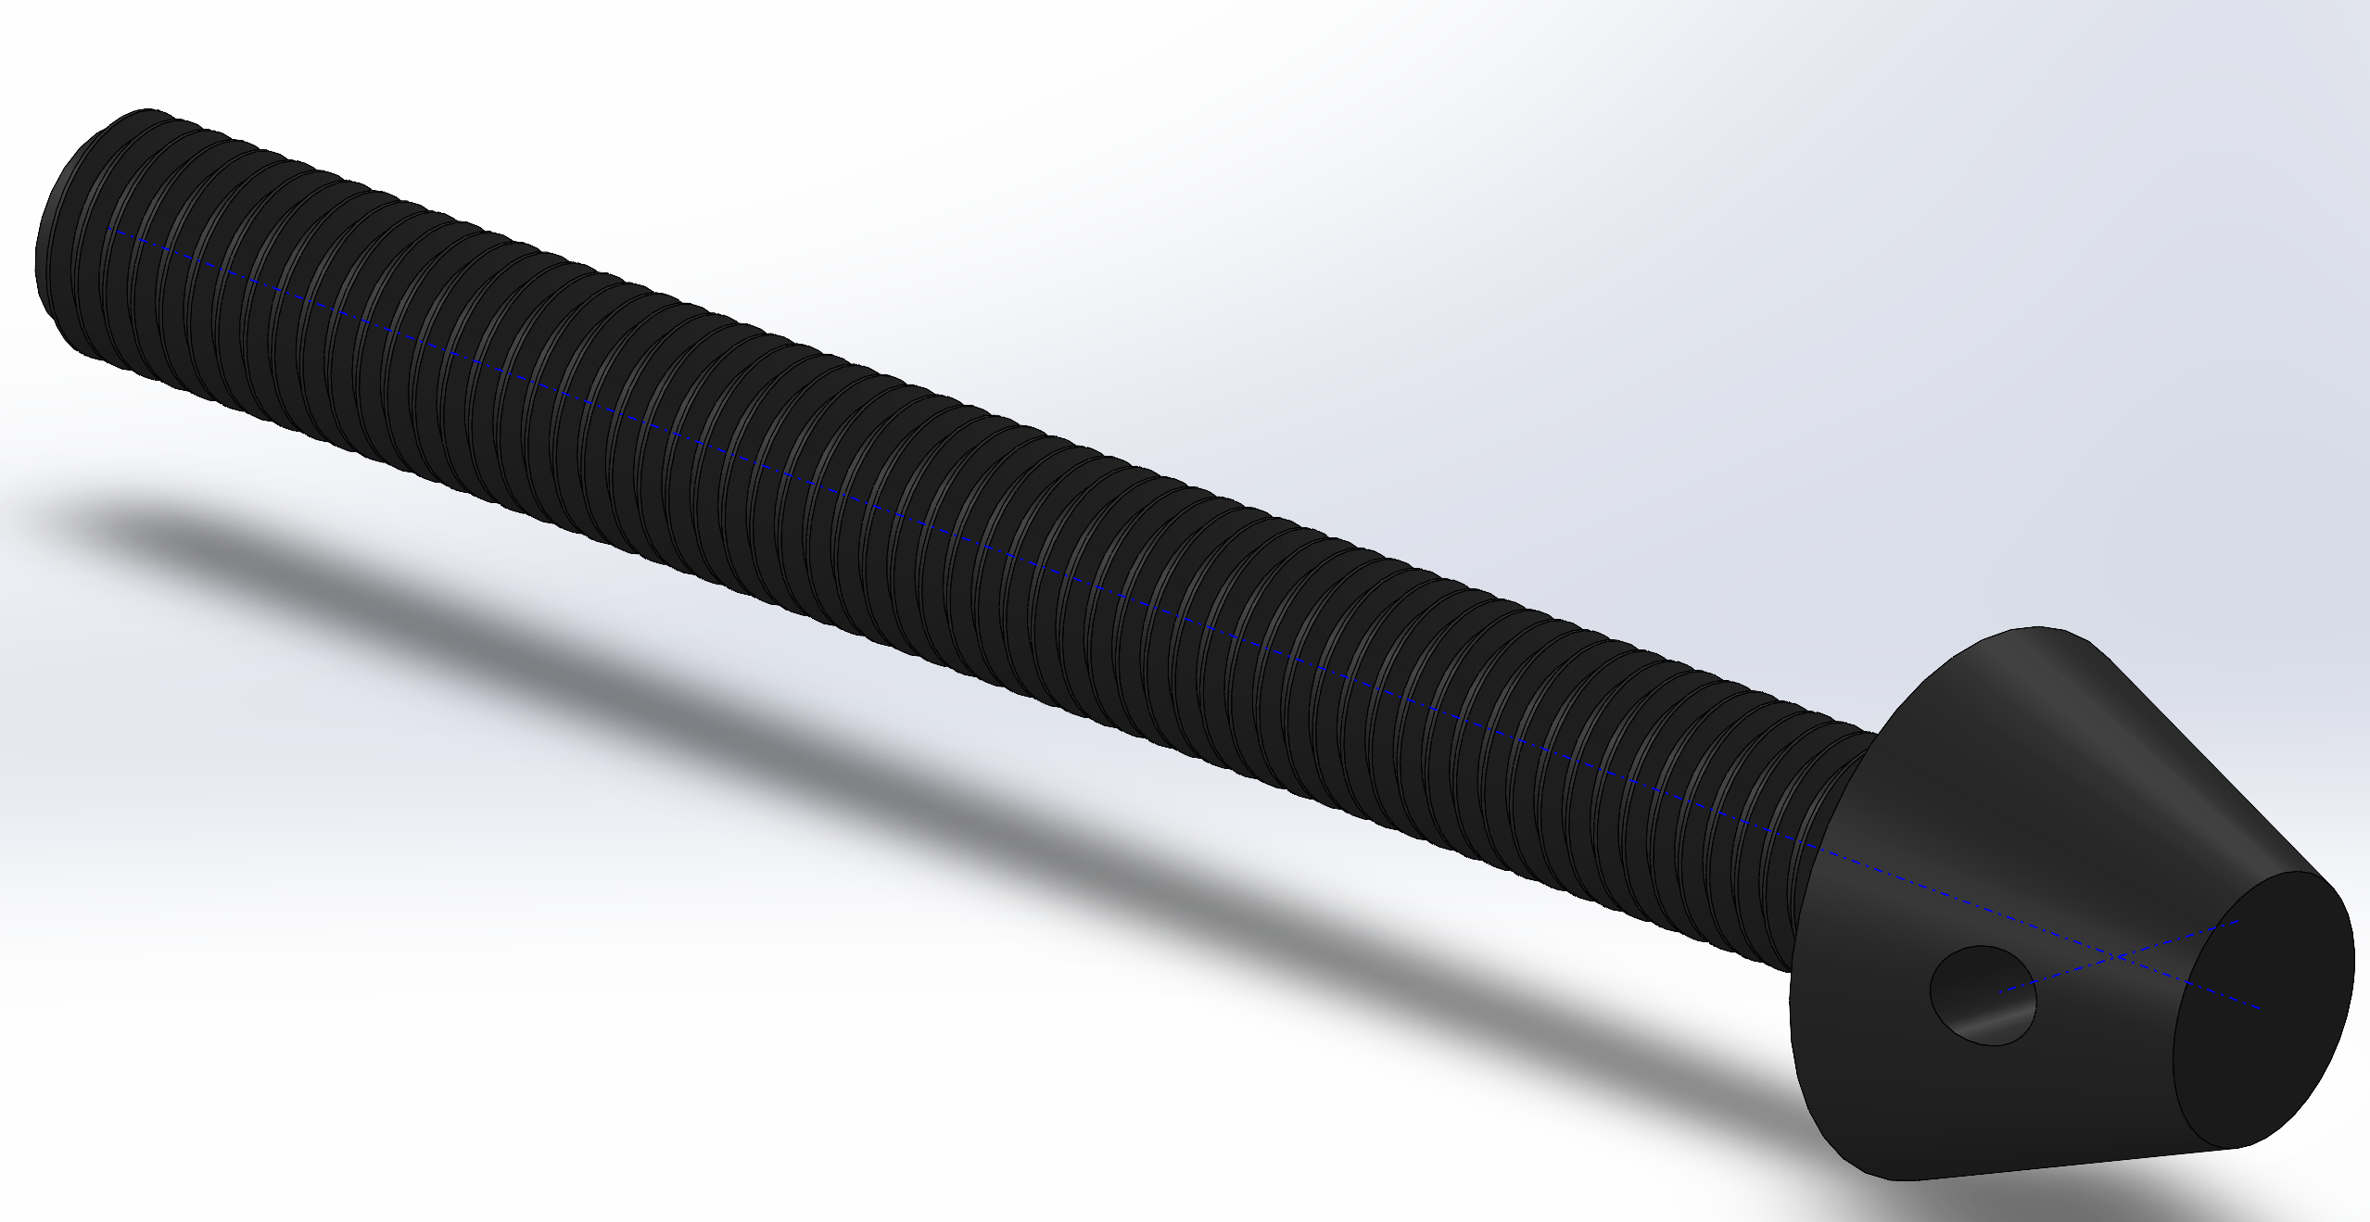
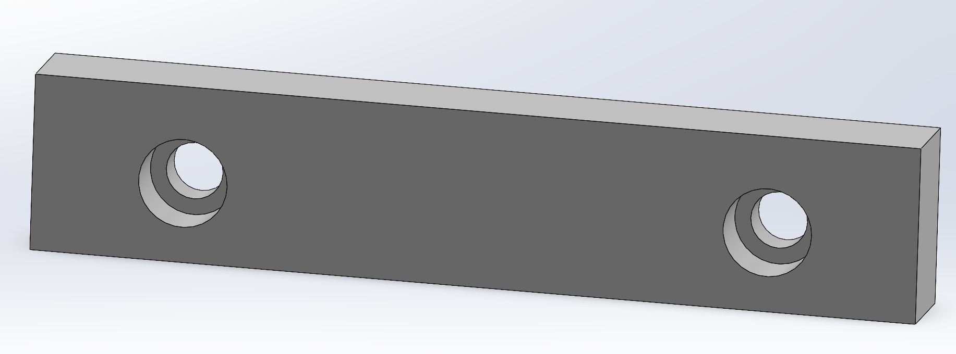
What are the fundamental 3D geometries of these parts?
Notes:
GIVE ME SOME IDEAS ON HOW YOU MIGHT MAKE THIS PART.

Slide 11
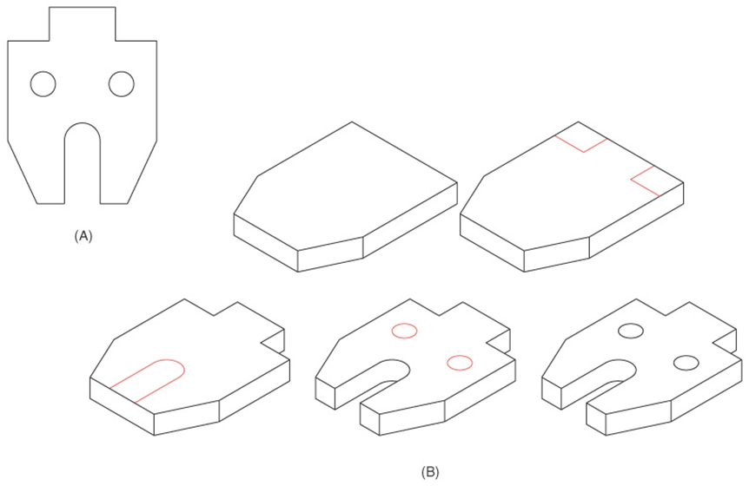
Feature Definition
The order in which a part’s features are added to it is important!
Look for major features first.
Notes:
***Rather than outlining this whole shape and extruding it, start with the general hexagonal extrusion and cut parts off of it.
*Like I said, there are many ways to do the exact same thing, but with practice you will find ways to model parts that is quick and efficient because you know what features to model first.

Slide 12
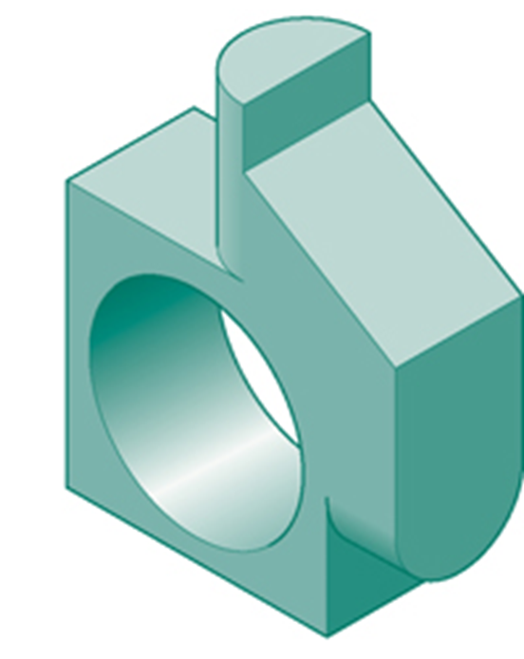
How would you model this part?

Slide 13
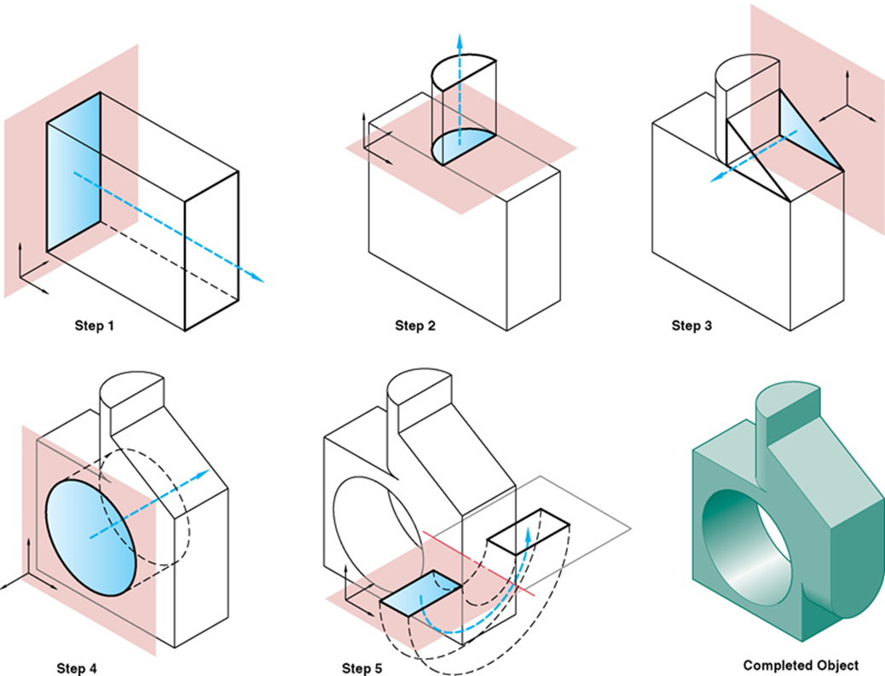

Slide 14
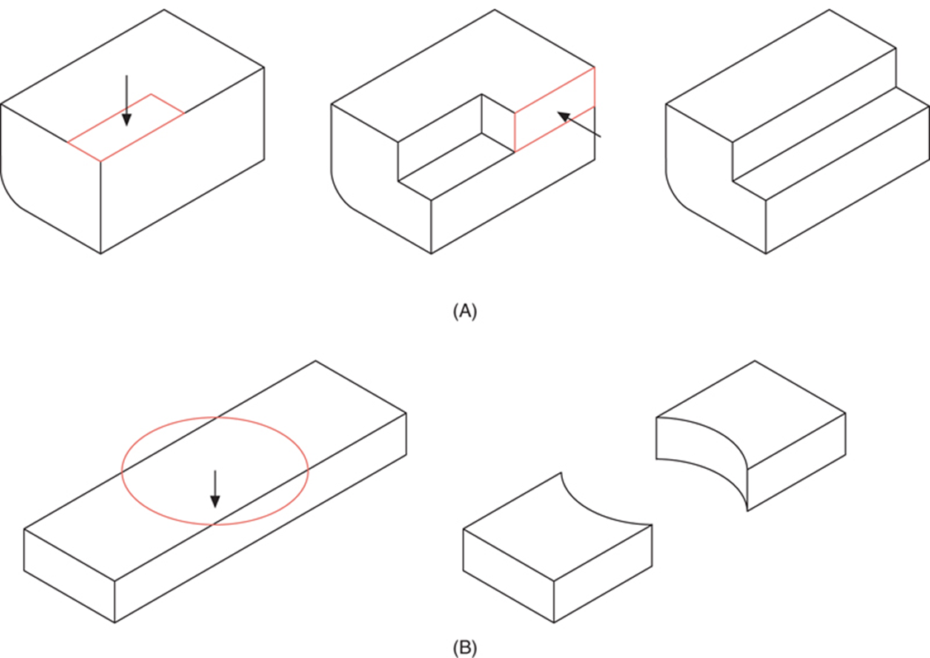
Feature Definition- How not to do it
Too many steps!
Don’t make two parts from one!
Notes:
***Something to help your modeling: Model a part in as few features as possible….only do what is absolutely necessary…..here’s an example of what I mean.
***Other note from this slide: Make only one part at a time….example B) shows the transition from one part to two completely separate parts….THIS IS NOT GOOD.
-if you want to put two parts together, do so in an assembly, not within one part file.

Slide 15
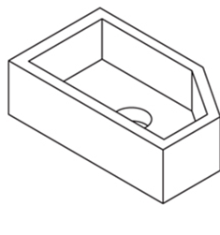
Try this…
Model this hollowed out, angled, box with a hole in it.

Slide 16
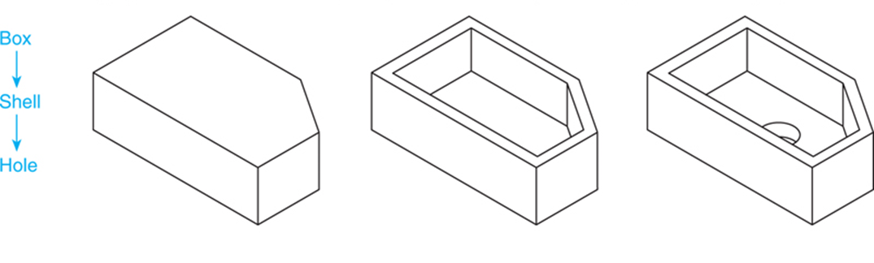
It looks something like…

Slide 17
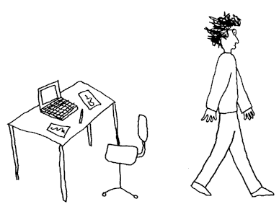
Break Time…get up and move!

Slide 18
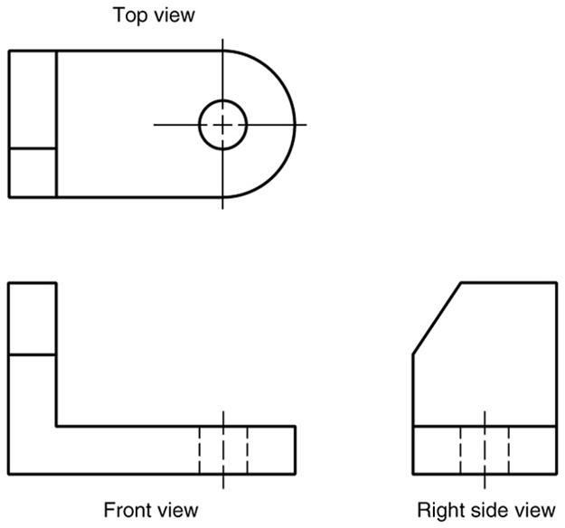
Multiview Drawings
2-Dimensional
Generally, three parallel projections (principle) are used.
Notes:
*Rather than seeing the three dimensional final product that needs to be modeled, you will be given multiview drawings from which you need to model the part.

Slide 19
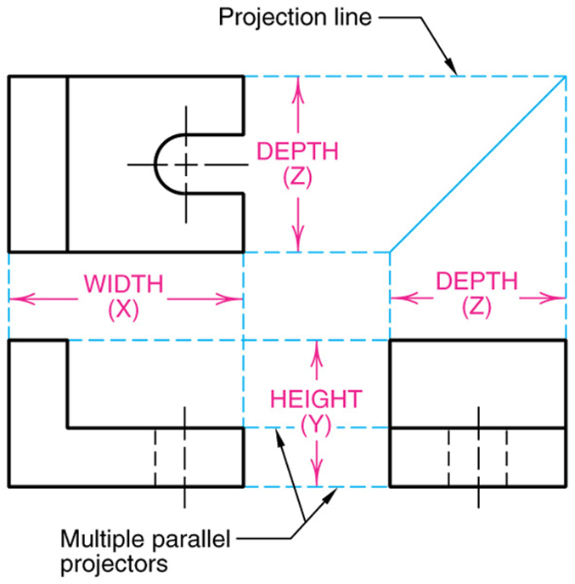
Adjacent Views
Note: all necessary information to model a part is given in its technical drawing.
*Do the math to find the dimension of a feature that is not directly given to you.
Notes:
When you see a drawing, know that these dimensions relate and are the same.
**All of the information that you need to model a part should be on that part drawing that you are given…..if a dimension is not directly given to you, that means that you can do the math to figure it our yourself based on the information you are already given.

Slide 20
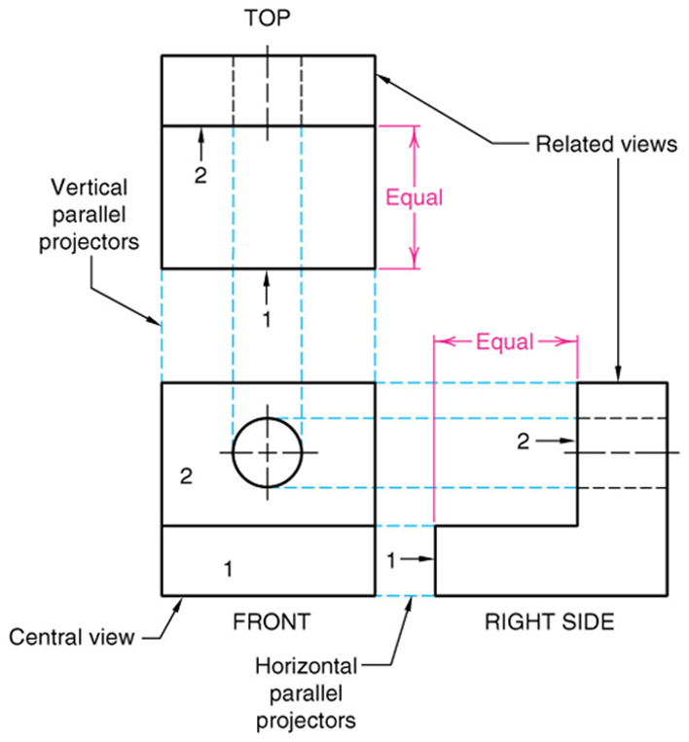
Take a closer look…
Orthographic Projection Rule 1: Every point or feature in one view must be aligned on a parallel projector in any adjacent view.
    Note the projection lines located on the right and top views that represent the hole on the front view.
Notes:
Take a look at the hole seen on the front view…when looking at the part from the right side, you wouldn’t be able to see the hole, but the dotted projection lines allow the viewer to be able to know that the hole is in fact there.

Slide 21
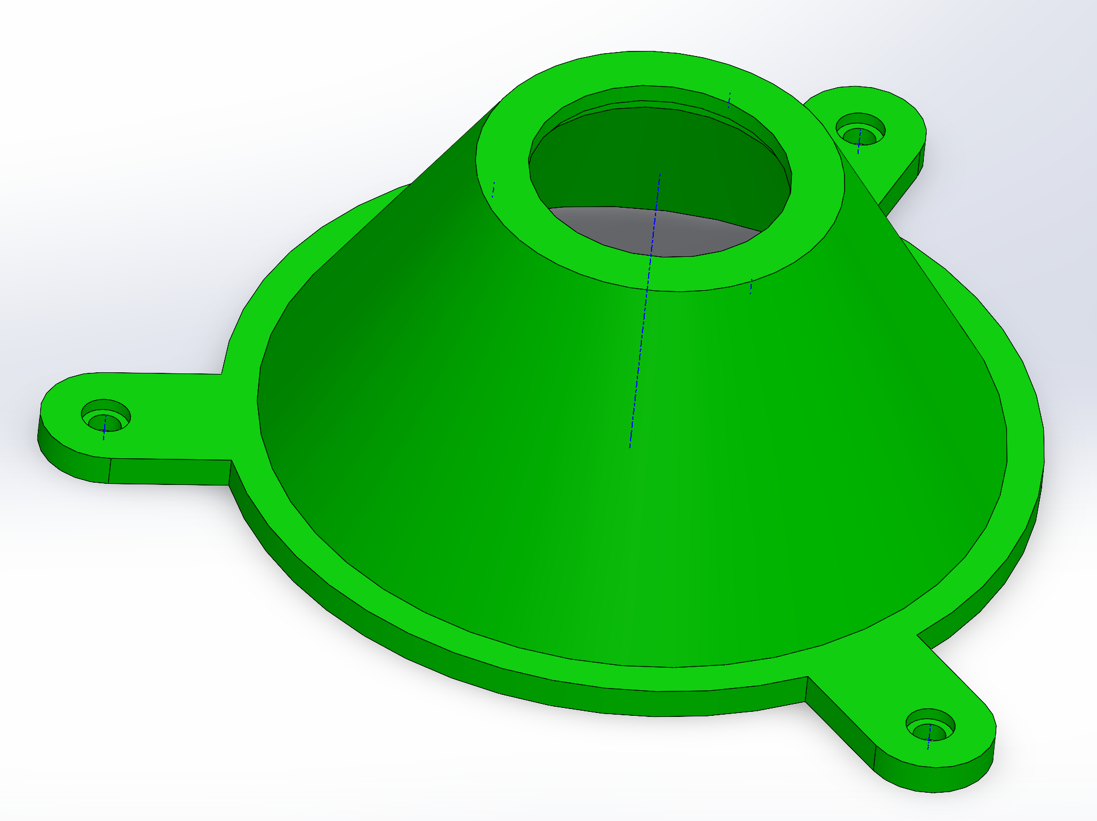
What are the fundamental 3D geometries of this part?
Notes:
GIVE ME SOME IDEAS ON HOW YOU MIGHT MAKE THIS PART.

Slide 22
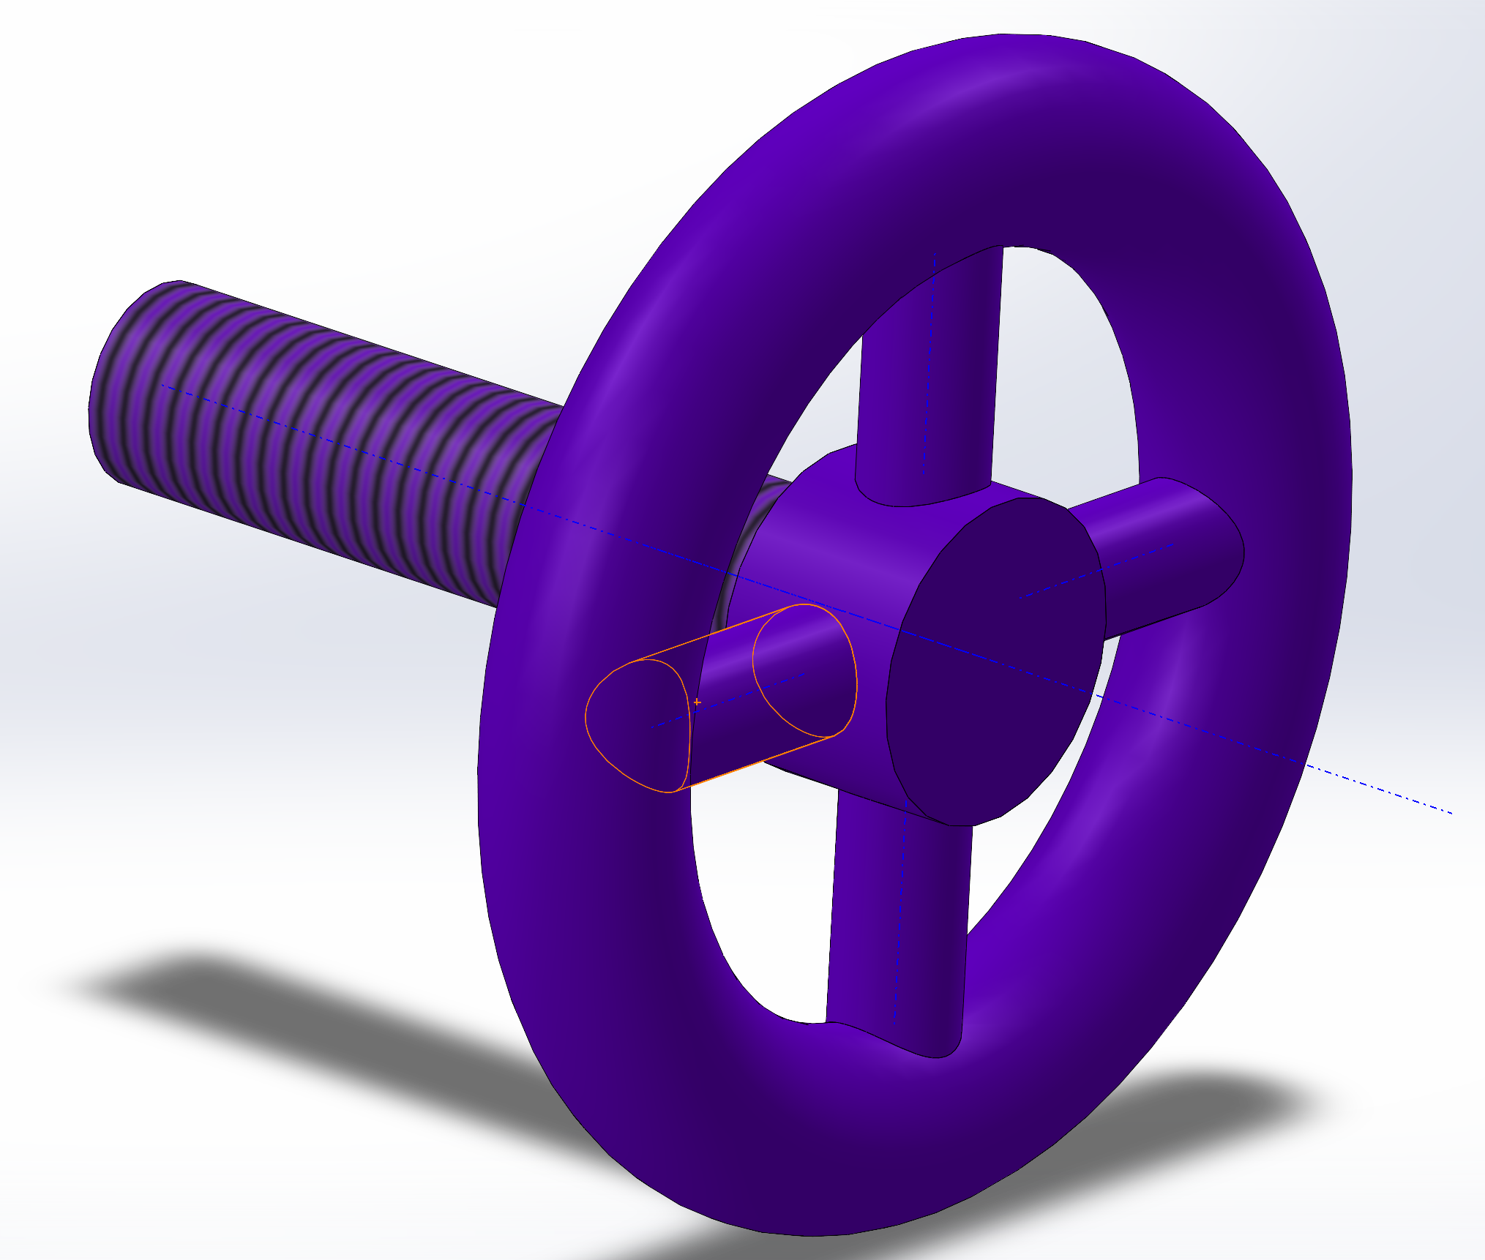
What are the fundamental 3D geometries of this part?
Notes:
GIVE ME SOME IDEAS ON HOW YOU MIGHT MAKE THIS PART.

Slide 23
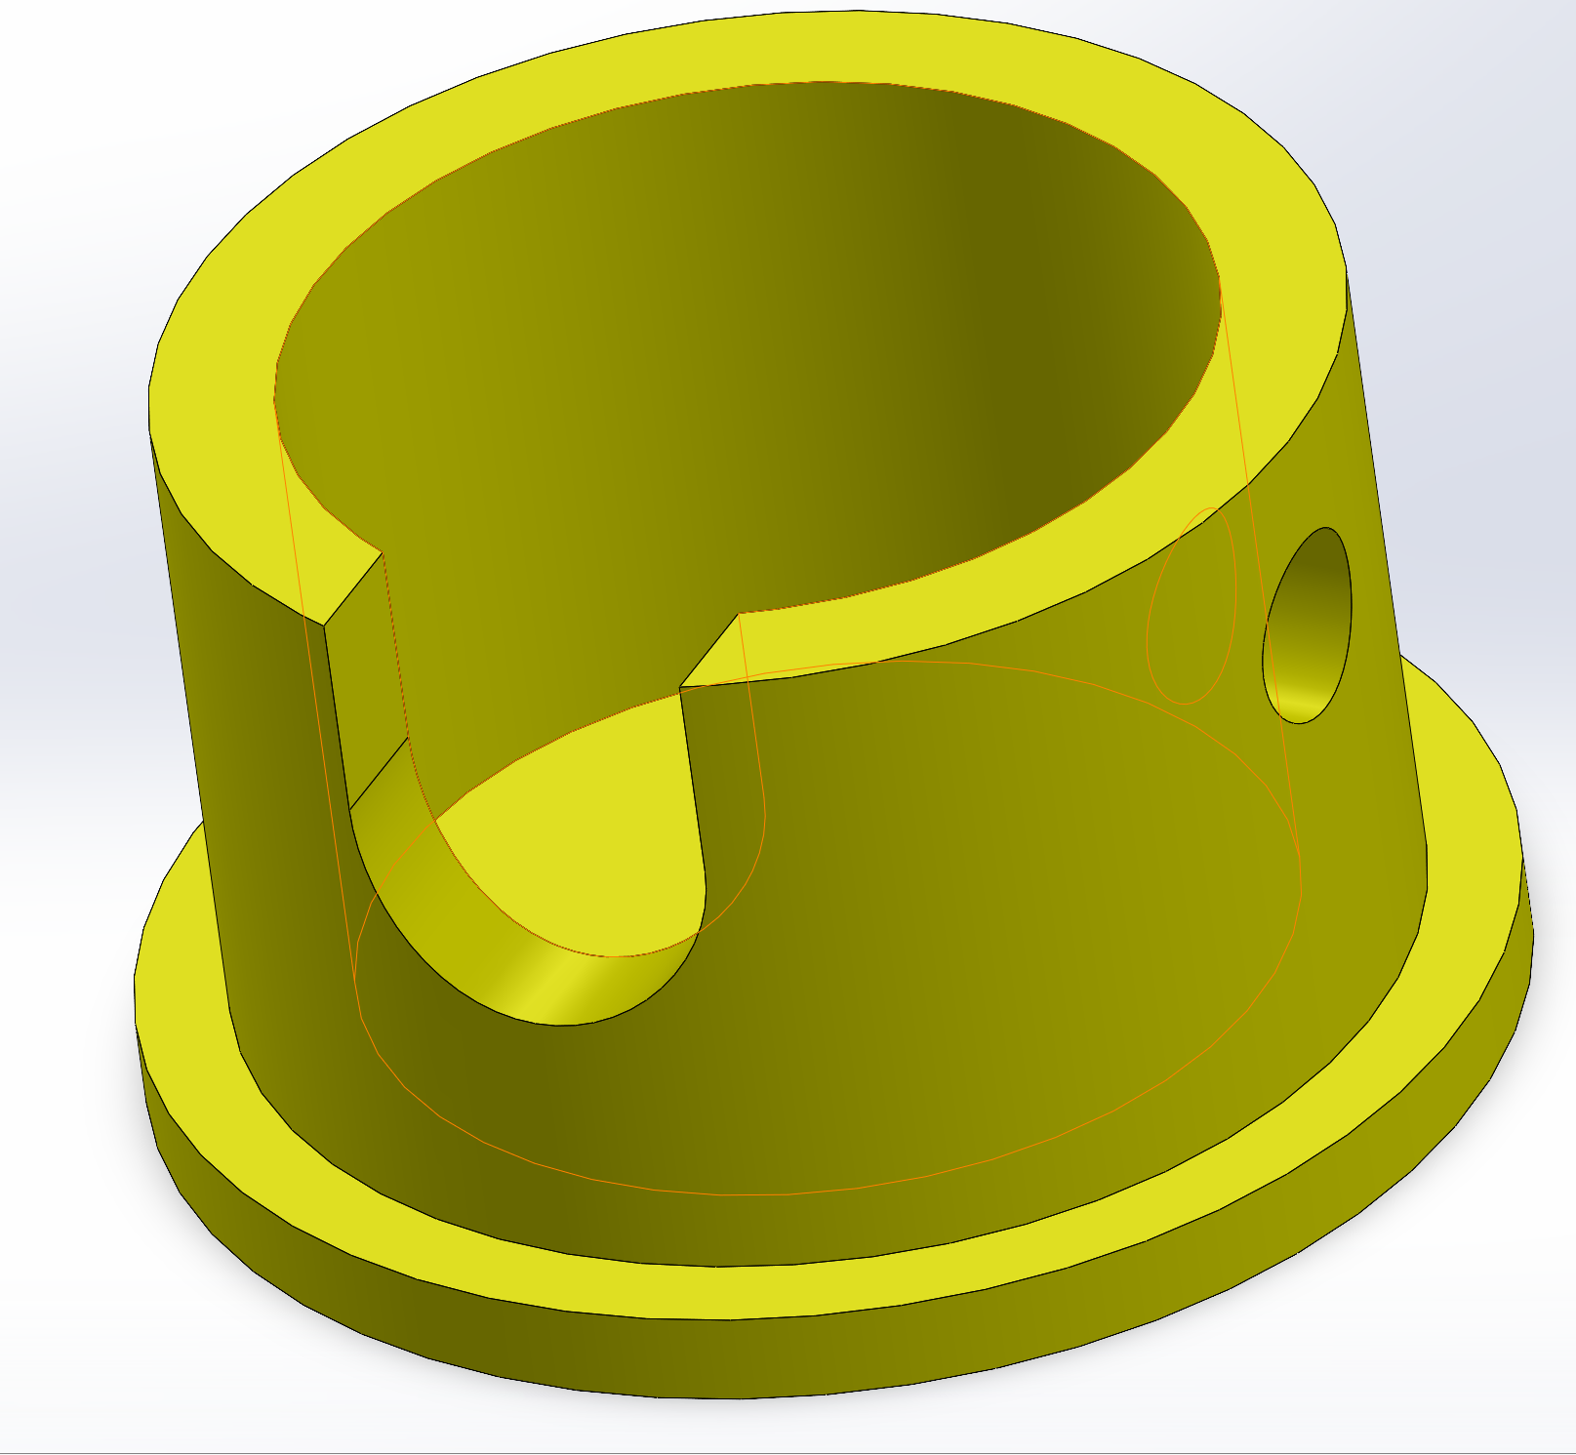
What are the fundamental 3D geometries of this part?
Notes:
GIVE ME SOME IDEAS ON HOW YOU MIGHT MAKE THIS PART.

Slide 24
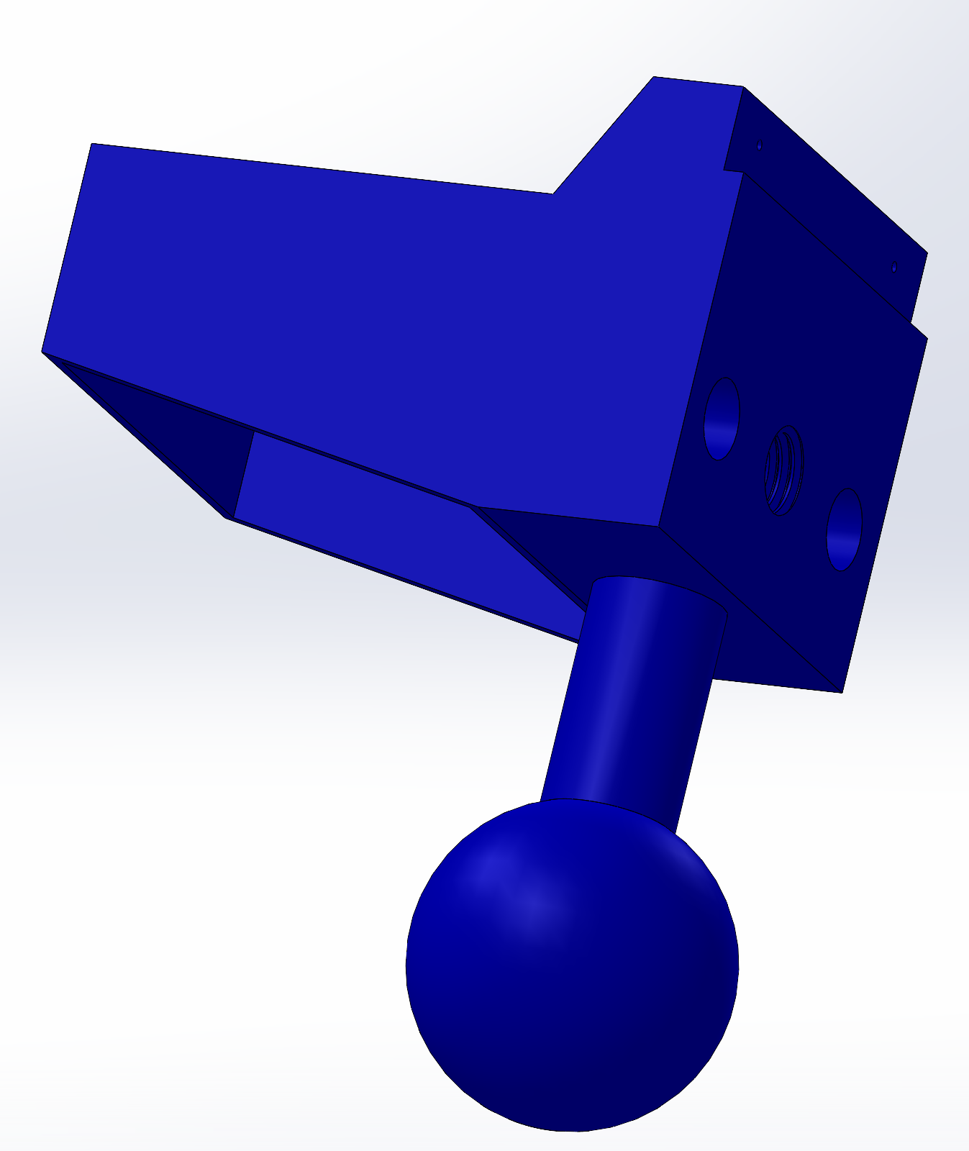
What are the fundamental 3D geometries of this part?
Notes:
GIVE ME SOME IDEAS ON HOW YOU MIGHT MAKE THIS PART.

Slide 25
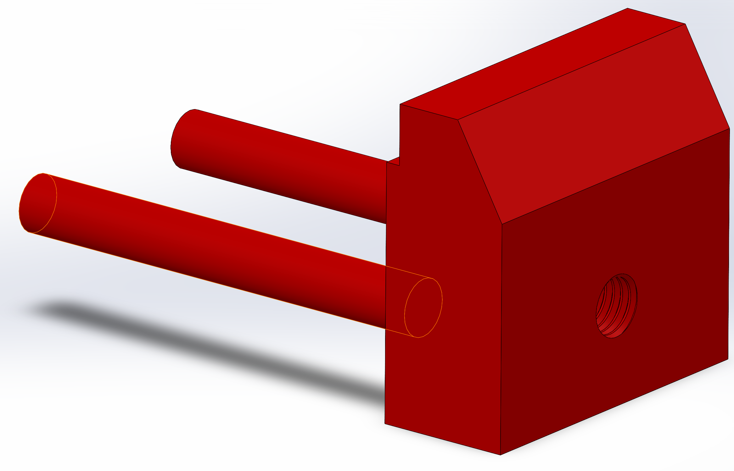
What are the fundamental 3D geometries of this part?
Notes:
GIVE ME SOME IDEAS ON HOW YOU MIGHT MAKE THIS PART.

Slide 26
Activity
Only provided PDFs of the drawing files
Use what you’ve learned about decomposing parts into primitive shapes and technical drawings
Model the (1) Base, (2) Casing, (3) Head, (4) Grip, (5) Jaw, (6) Shaft, (7) Plate, (8) Pin (all measurements are in inches)
Note: Think about the part’s main features and how to best model them. In what order should you model these features?

