Slide 1
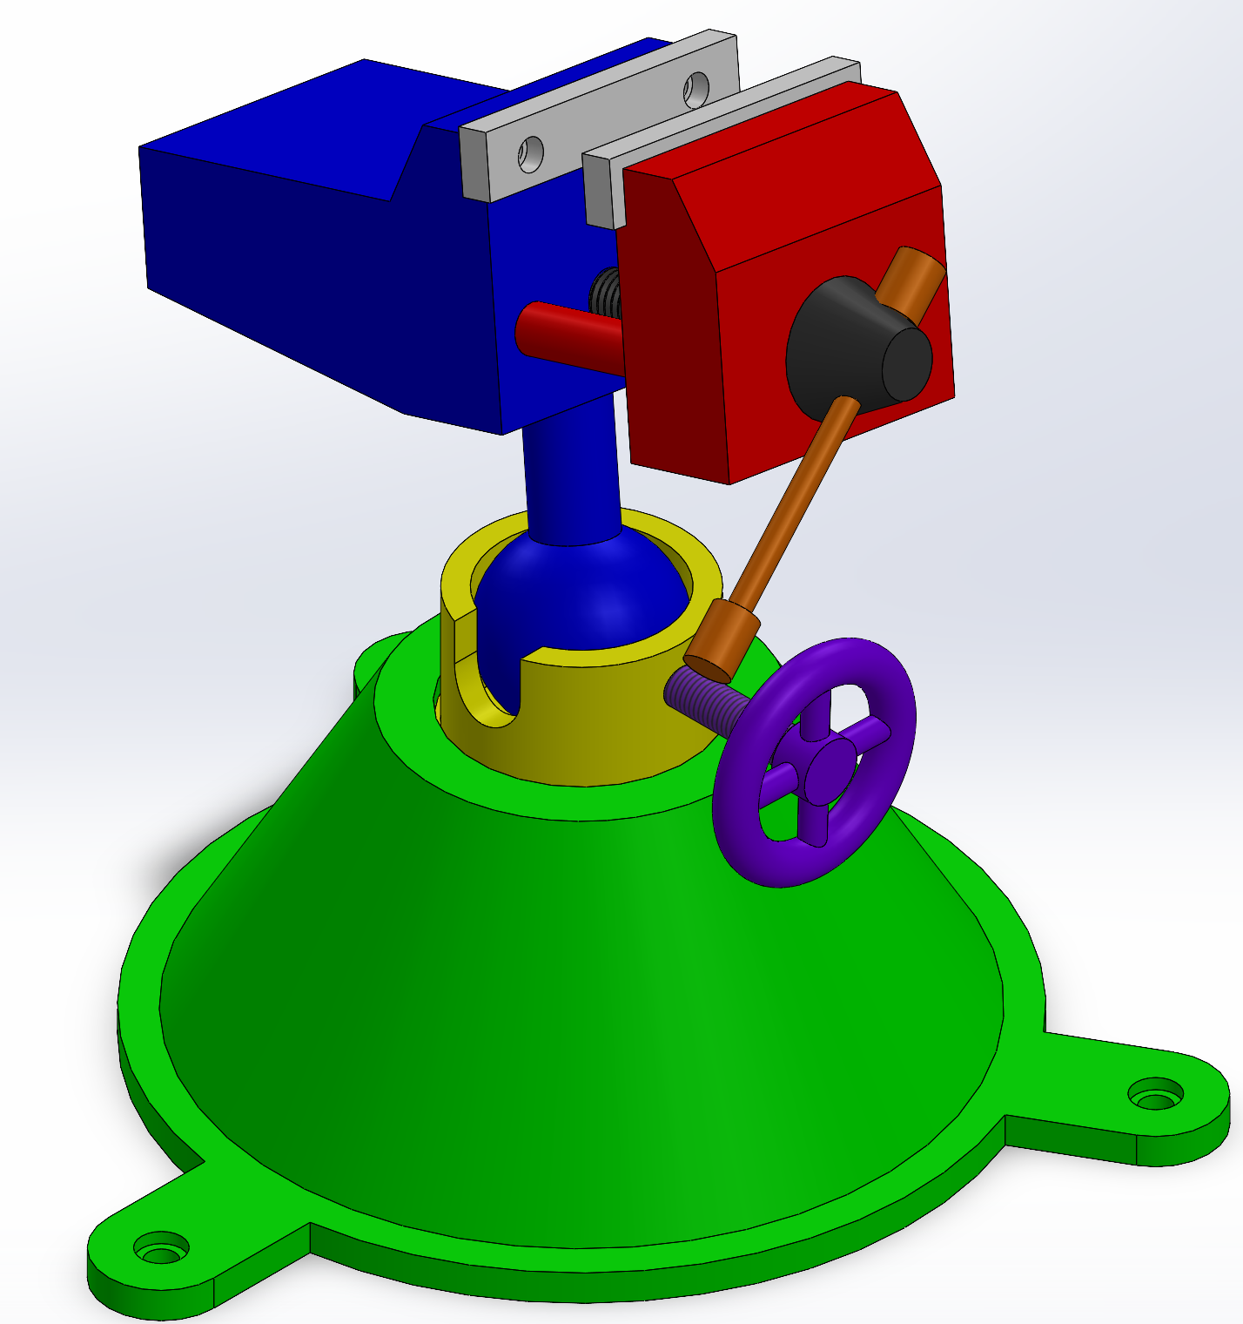
Assembly in SolidWorks

Slide 2
Design for Manufacturing
Tolerances
Manifold vs Non-manifold
Part Influence on Assembly
Assembly Steps

Slide 3
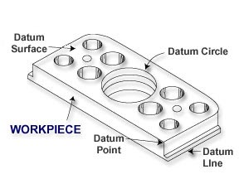
Geometric Dimensioning and Tolerancing
Tolerances in a design tell the inspector how much variance or imperfection is allowable before the part must be considered unfit for use.
Tolerance is the difference between the maximum and minimum limits on the dimensions of the part.
Since parts are never perfect, a datum feature is used during inspection, to substitute for the perfect datum of the drawing.
Datum features are simply referred to as datums

Slide 4
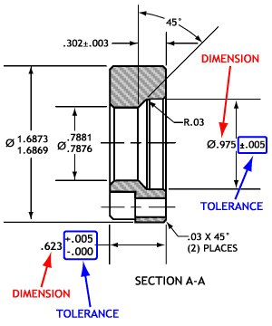
Plus / Minus Tolerancing
When the part is produced in a manufacturing process, there will be errors.
Even though most errors are undetectable to our eye, the variations can be picked up using precise measurements such as a CMM.

Slide 5
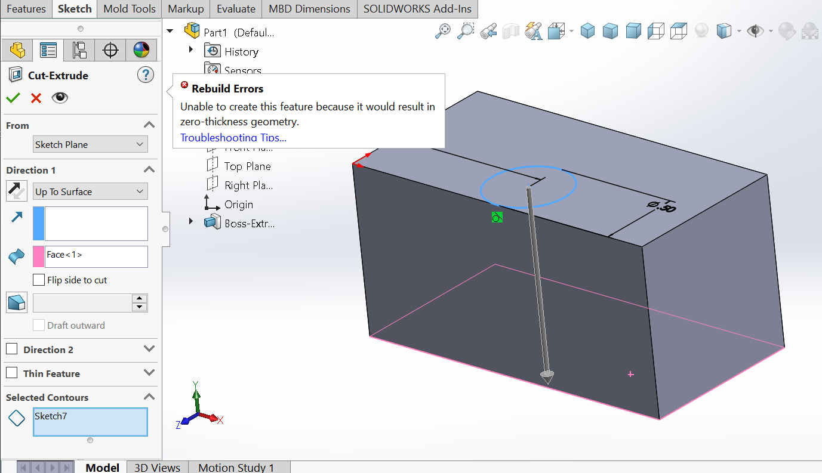
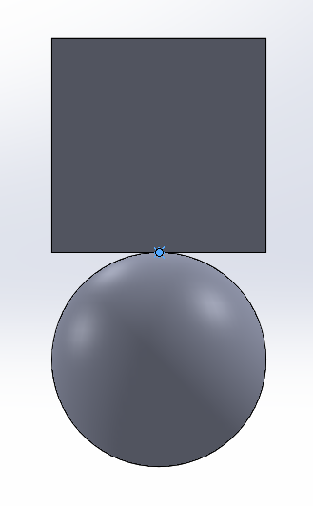
Manifold vs. Non-Manifold
Think of it as “Manufacturable” vs “Non-Manufacturable”
Can this part be manufactured?

Slide 6
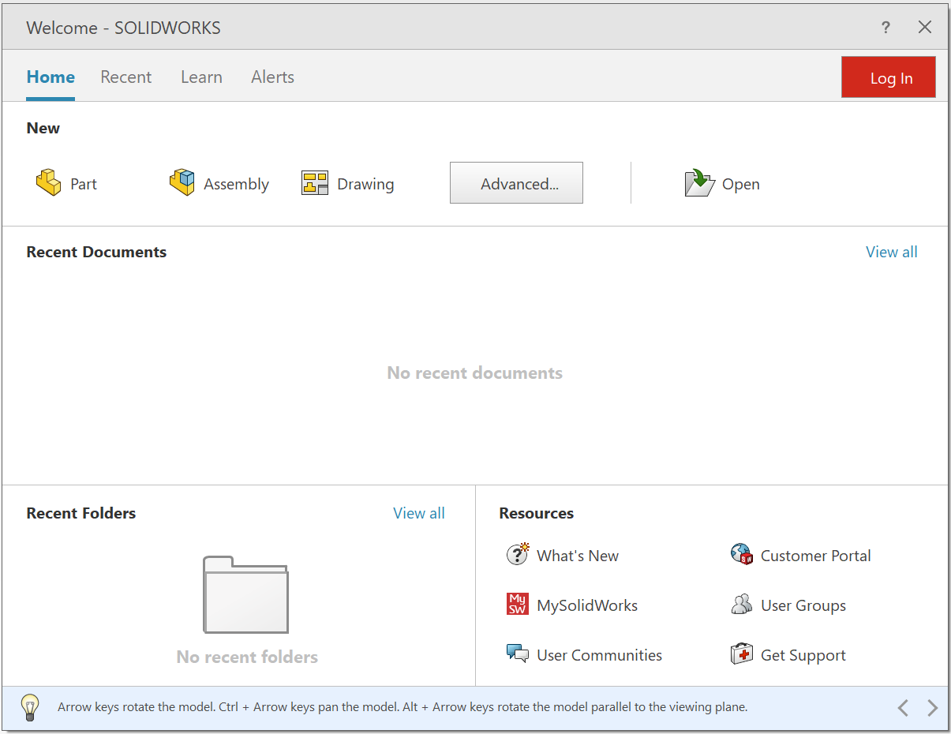
Creating an Assembly

Slide 7
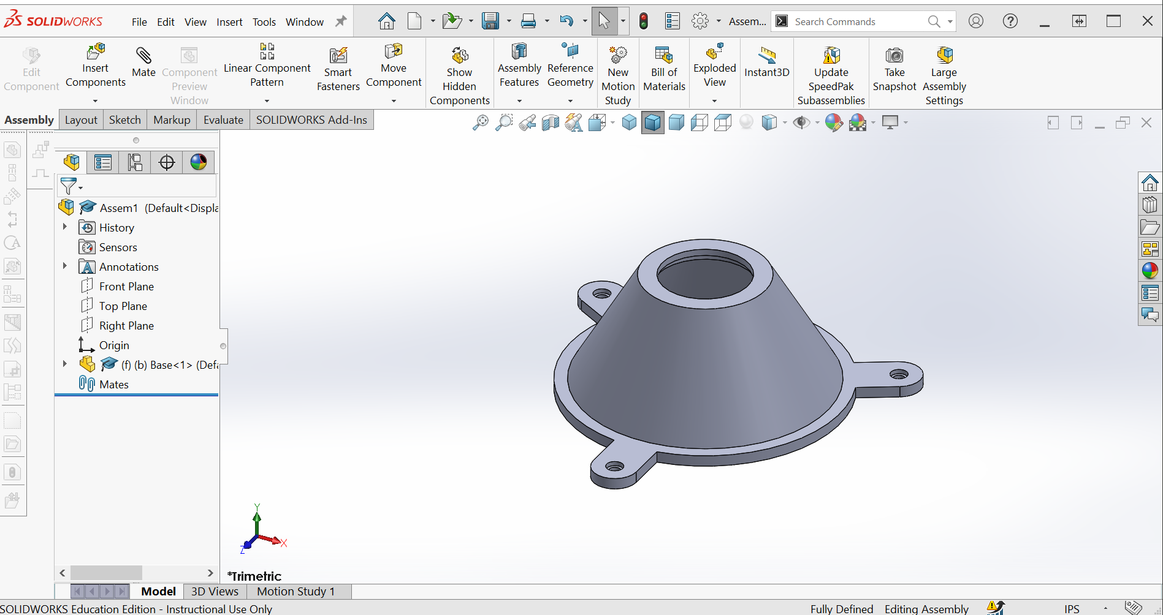
Inserting Parts
Click “Browse if parts do not show in dialog box

Slide 8
The Assembly Tree
The design tree stores all information regarding the parts, mates, materials, and history of the assembly
Very useful for manipulating parts

Slide 9
Move Component

Slide 10
Activity
Complete the Lesson 2: Assemblies tutorial
Assemble the Vise
If your parts do not fit correctly, use the parts that are shared with you to make the assembly

Slide 11
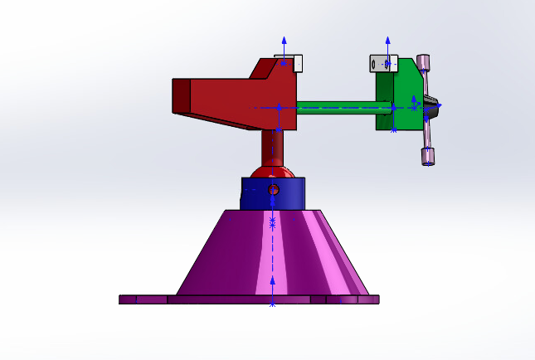
Vice Assembly

