Slide 1
Interdisciplinary Research REU Intro to HCI, Lecture 5
Amanda Newendorp, with content from Stephen Gilbert

Slide 2
A couple scenarios:

Slide 3
Planning a vacation to Paris
Here’s a spreadsheet with an hourly itinerary for our trip to Paris.
The top attractions are the Eifel Tower and the Louvre. Let’s prioritize those!
Ugh, not a schedule. Vacations are about being spontaneous!
Which approach is best?

Slide 4
More generically…
But Dr. Smith says we should always start by…
In my computer science classes, we’re supposed to do this…
I get straight As, and I don’t do either of those things.
Which approach is best?

Slide 5
Sound familiar?

Slide 6
An alternate version:

Slide 7
Planning a vacation to Paris
The Louvre is closed on Monday and Tuesday, so let’s go to the Eifel Tower on Monday and play it by ear on Tuesday.
The must-see attractions are the Eifel Tower and the Louvre. When are they open?
We need time to be spontaneous and do whatever looks fun!
Using each other’s strengths

Slide 8
More generically…
But Dr. Smith says we should always start by…
In my computer science classes, we’re supposed to do this…
I get straight As, and I don’t do either of those things.
Okay. How about we figure where we agree and disagree, then we’ll make a list of questions for the professor.
Using each other’s strengths

Slide 9
Sound familiar?

Slide 10
What is interdisciplinary research (IDR)?
Interdisciplinary research is a mode of research by teams or individuals that integrates information, data, techniques, tools, perspectives, concepts, and/or theories from two or more disciplines or bodies of specialized knowledge to advance fundamental understanding or to solve problems whose solutions are beyond the scope of a single discipline or area of research practice.
NAS, 2004

Slide 11
Why is IDR important?
Notes:
(Discussion)

Slide 12
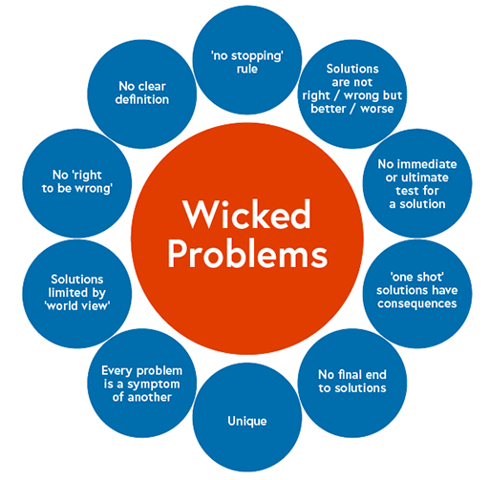
Wicked problems
https://www.youtube.com/watch?v=ZwABiQBmuLA
Political instability
Poverty
Sustainability
Climate change
Inequality
Food security
Antibiotic resistance
Access to healthcare and education
https://www.open.edu/openlearn/money-business/people-organisation-matters/hybrid-working-organisational-development/content-section-2.2

Slide 13
Activity #1
Your group has been asked to select a team of experts to tackle an emerging concern related to AI ethics.
In your groups, choose one of the two problems on the next slide.
What types of experts might you recruit to work on this problem?
If you could only choose three experts, who would you choose?

Slide 14
Activity #1
In your groups, choose one of the two problems.
What types of experts might you recruit to work on this problem?
If you could only choose three experts, who would you choose?
Problem #1:
The use of AI in autonomous decision-making, such as in self-driving cars and medical diagnostics, raises ethical questions about the accountability and reliability of these systems, especially in critical situations where human lives are at stake.
Problem #2:
There are concerns that biased algorithms perpetuate systematic discrimination against marginalized groups, leading to unfair outcomes in areas such as hiring and criminal justice.

Slide 15
What makes IDR difficult?
Notes:
(Discussion)

Slide 16
What makes IDR difficult?
Differences in research methods

Slide 17
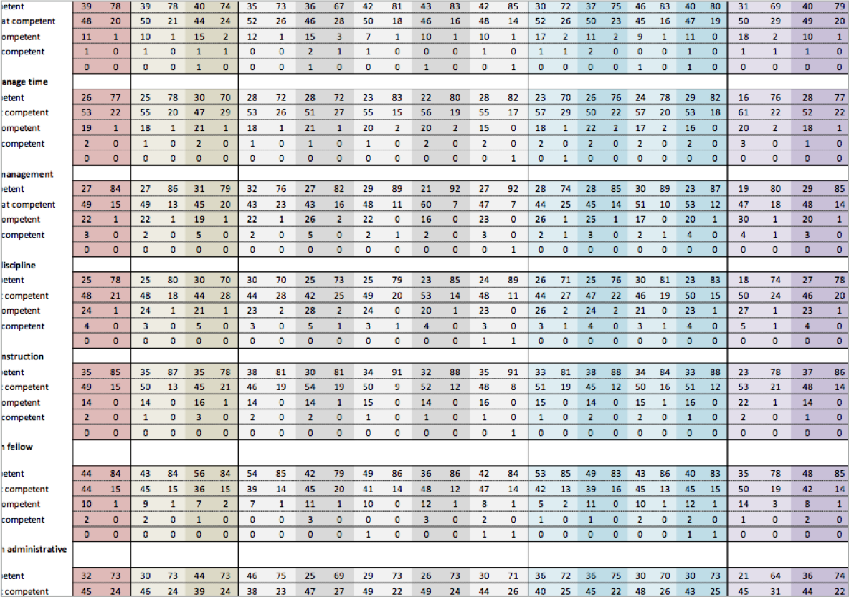
If your research question is…
“Why are most U.S. elementary teachers female?”
Which data are more important?
24 personal journals from teachers
Statistics on teacher hiring
Difference in research methods
Strober, 2011
Notes:
Add pop up

Slide 18
What makes IDR difficult?
Differences in research methods
Differences in knowledge, skills, and priorities

Slide 19
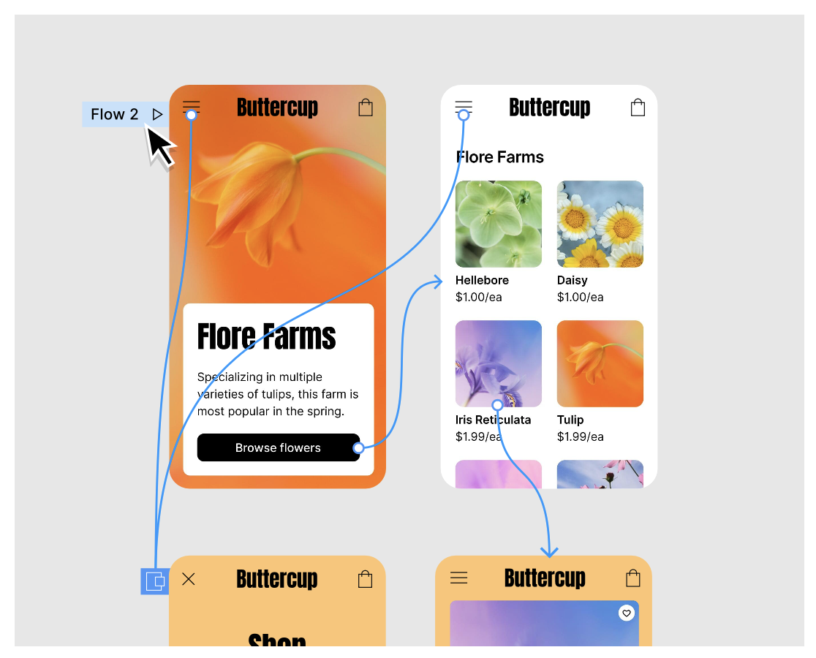
Prototype fidelity
https://www.figma.com/prototyping/

Slide 20
Prototype fidelity
UX designer: “I made a prototype with Figma; now I can have some people click through the interface and give me feedback”
Non-technical manager: “Whoa. You already built the app? How did we get this far without any testing?”
Engineer: “Yeah, this looks nice, but I can’t program it to X, Y, or Z because of technical constraints.”
https://www.figma.com/prototyping/

Slide 21
Prototype fidelity
UX designer: “I made a prototype with Figma; now I can have some people click through the interface and give me feedback”
Difference in knowledge, skills, and priorities
Non-technical manager: “Whoa. You already built the app? How did we get this far without any testing?”
Engineer: “Yeah, this looks nice, but I can’t program it to X, Y, or Z because of technical constraints.”
https://www.figma.com/prototyping/

Slide 22
What makes IDR difficult?
Differences in research methods
Differences in knowledge, skills, and priorities
Differences in language

Slide 23
Differences in language
It’s a Kalman Filter
It’s a dynamic Bayesian network
Engineer
Statistician
“Unfortunately, much of the published literature on KF is in the engineering journals…and uses a language, notation, and style that is alien to statisticians.”
Meinhold & Singpurwalla (1983)

Slide 24
What makes IDR difficult?
Differences in research methods
Differences in knowledge, skills, and priorities
Differences in language
Differences in culture

Slide 25
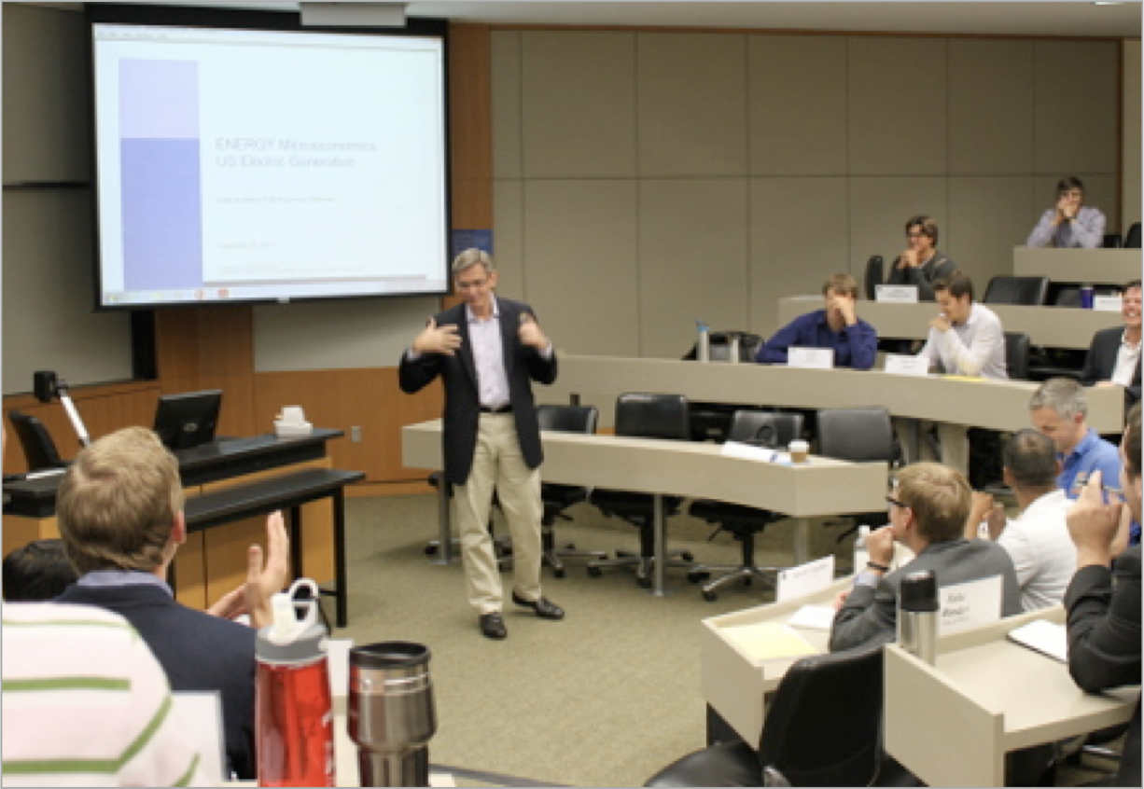
Differences in Culture
Sociolinguistic rules within communities
Is it okay to interrupt?
How do you arrange speaking turns?
What do you say outright vs. subtly?
How do you question people?
Do you present with slides?

Slide 26
What makes IDR difficult?
Differences in research methods
Differences in knowledge, skills, and priorities
Differences in language
Differences in culture
Coordinating with each other

Slide 27
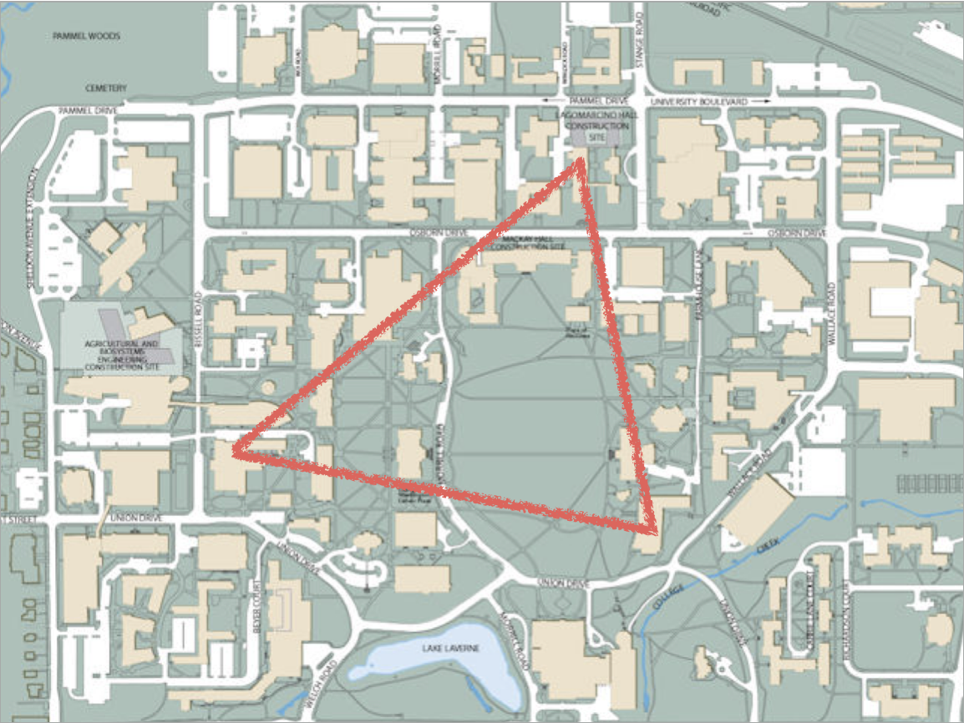
Coordinating with each other

Slide 28
What makes IDR difficult?
Differences in research methods
Differences in knowledge, skills, and priorities
Differences in language
Differences in culture
Coordinating with each other
Dividing up the money

Slide 29
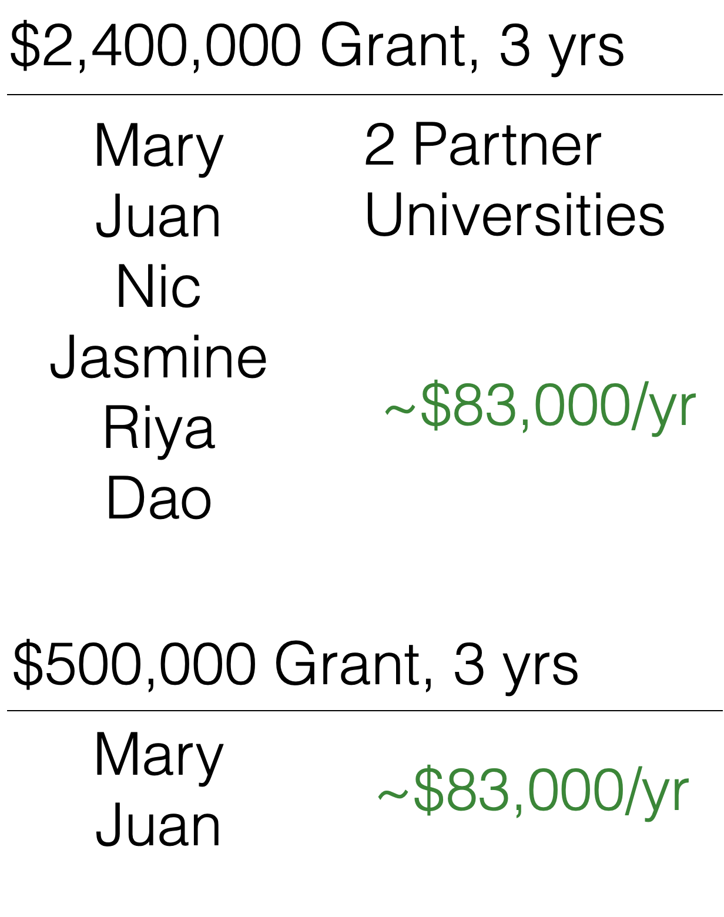
Dividing up the money

Slide 30
What makes IDR difficult?
Differences in research methods
Differences in knowledge, skills, and priorities
Differences in language
Differences in culture
Coordinating with each other
Dividing up the money
Difficulty publishing

Slide 31
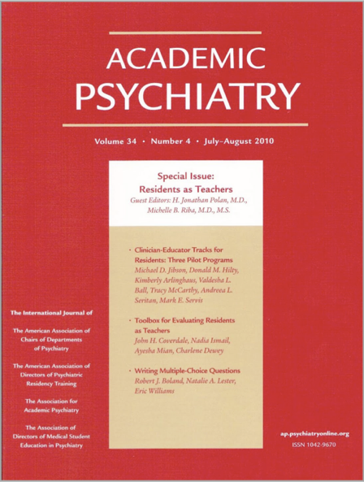
Difficulty publishing
Interdisciplinary journals
Discipline-specific journals

Slide 32
What makes IDR difficult?
Differences in research methods
Differences in knowledge, skills, and priorities
Differences in language
Differences in culture
Coordinating with each other
Dividing up the money
Difficulty publishing
More complex tenure case

Slide 33
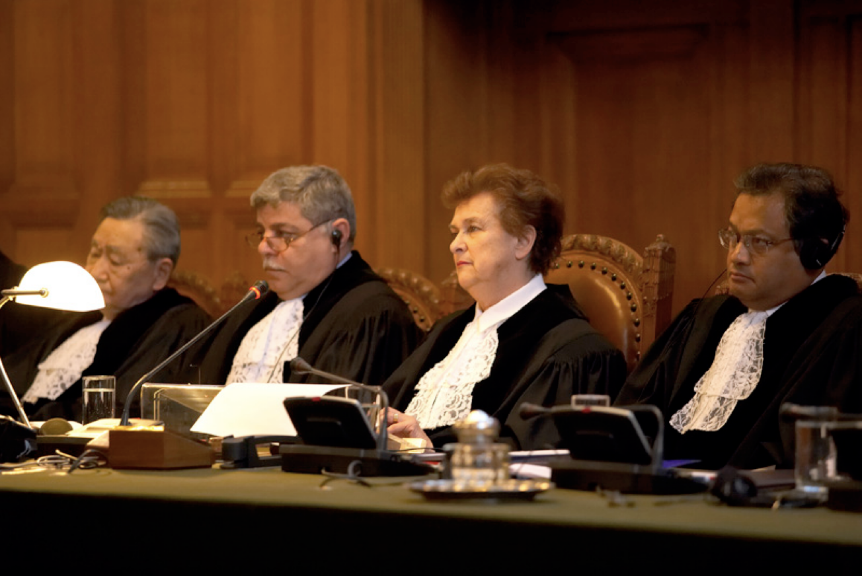
More complex tenure case
“They published where?”
“She got letters from where?”
“He worked with who?”

Slide 34
What makes IDR great?

Slide 35
What makes IDR great?
Differences in research methods
Differences in knowledge, skills, and priorities
Differences in language
Differences in culture
Coordinating with each other
Dividing up the money
Difficulty publishing
More complex tenure case
Also a benefit!
Notes:
add timing

Slide 36
How many disciplines do you think are part of the HCI program at ISU?
Notes:
(Discussion)

Slide 37
Around VRAC
>25*
Mechanical Engineering, Education, Interior Design, Computer Science, Psychology, Journalism, Graphic Design, Earth Atmosphere and Climate, and more
*As of 2024 VRAC faculty directory: https://www.vrac.iastate.edu/directory/?wpv-classification=faculty

Slide 38
Interdisciplinary Programs at Iowa State
Human Computer Interaction, but also:
21 departments (and counting)
https://www.grad-college.iastate.edu/academics/programs/apprograms.php
Notes:
rearrange - put VRAC slide first
add count

Slide 39
Activity #2
Discuss your summer REU project
How many different disciplines are represented in your team?
Can you remember a time when your different backgrounds led to a disagreement? How did you handle it?
Can you remember a time when your different backgrounds helped your team be successful?
Notes:
(skipped this activity)

Slide 40
Activity #3
You’ve been assigned to provide a preliminary report about the effects of social media on teenagers’ mental health, but you have limited time and resources. You must pick two of the following data sets.
Which would you choose? Why?
2022 teen social media use and mental heath statistics
2023 teen interview transcripts about social media
2021 social media detox clinical trial results
2020 teen diary entries on their social media usage and emotional state
2018 comprehensive report about social media and mental health

Slide 41
Activity #3
Meet with your group and share each of your top two choices. Then decide as a group which two are most important.
2022 teen social media use and mental heath statistics
2023 teen interview transcripts about social media
2021 social media detox clinical trial results
2020 teen diary entries on their social media usage and emotional state
2018 comprehensive report about social media and mental health

Slide 42
What makes a good interdisciplinary researcher?
Lyall et al., 2011
Flexibility, adaptivity, creativity
Curiosity about other disciplines
Good communication & listening skills
Willingness to tolerate ambiguity
Ability to bridge theory & practice
Good team-worker
Willingness to admit limitations of your disciplinary knowledge

Slide 43
Assignment
You might already have a multidisciplinary background!
Think about three different disciplines you’ve studied or that you’re interested in. Then form a research question that involves all three of these areas of interest.
Example Disciplines: Mechanical engineering, design, education
RQ: Is Diagram A or Diagram B more effective for helping people learn how to use the new gadget I designed?

